Slide 1
EMPLOYEE ATTRITION PREDICTION PROJECT
MCA – Section(11)
Project ID – MCA-1133
Project Guide – Mr. Sarvesh Sarwankar
Students
Arjun Dev Vashishtha,
Anubhav Gaur,
Kartik Kumawat

Slide 2
Introduction
Employee attrition refers to the turnover or departure of employees from an organization. Predicting employee attrition is crucial because it helps HR departments reduce turnover costs, plan retention strategies, and improve workforce management. In this project, we will predict whether an employee will leave or stay in the company based on factors like age, job satisfaction, work-life balance, monthly income, and more.

Slide 3
Problem Statement
Employee attrition is a challenge for many companies. High attrition rates can be costly, as they involve recruitment, training, and knowledge loss. The problem we are addressing is to predict employee attrition before it happens, allowing HR teams to focus their retention efforts on employees at risk of leaving. By identifying key factors contributing to attrition, HR can take preventive actions to retain valuable talent.

Slide 4
Project Objective
The primary objective of this project is to develop a machine learning model that predicts if an employee will leave or stay with the company.
Key features used to make predictions include:
Job satisfaction
Monthly income
Years at the company
Work-life balance
Age and more.

Slide 5
Dataset Overview
Data Source: IBM HR Kaggle Dataset The dataset includes information about employees from a company, with details such as:
Attributes: Age, Job Satisfaction, Monthly Income, Years at the Company, Work-Life Balance, etc.
Number of Records: The dataset contains 1,470 employee records.
Data Types: Both categorical (e.g., department, job role) and numerical features (e.g., age, income) are included.

Slide 6
Data Preprocessing
Data preprocessing is an essential step to clean and prepare data for analysis. Steps taken:
Cleaning: Removed any duplicates and handled missing values using mean imputation for numerical features and mode imputation for categorical features.
Encoding: Converted categorical features (e.g., gender, department) into numerical values using one-hot encoding.
Scaling: Normalized numerical features (e.g., monthly income, years at the company) to have a standard scale using Min-Max scaling.
Feature Engineering: Created new features like "Tenure" based on the employee's years at the company.

Slide 7
Model Selection
We tested various machine learning algorithms to predict employee attrition:
Logistic Regression: A simple and interpretable model for binary classification.
Random Forest: A robust model that provides feature importance and handles non-linear relationships well.
Support Vector Machine (SVM): A powerful model for classification, especially in high-dimensional spaces.
We selected Random Forest based on its performance in capturing complex patterns and its high accuracy.

Slide 8
Model Training and Testing
The dataset was split into training (80%) and testing (20%) sets. The model was trained using the training set, and predictions were made on the testing set. Libraries and tools used:
Python (Scikit-learn)
Jupyter Notebook for coding and visualization
Random Forest Classifier for the prediction model

Slide 9
Challenges
Challenges faced during the project:
Imbalanced Data: The dataset had more employees who stayed than those who left, which required using techniques like oversampling (SMOTE).
Handling Missing Data: Missing values in some features were imputed using mean and mode techniques, but this might affect the model's performance.
Overfitting: The model was prone to overfitting, so we used cross-validation to ensure it generalized well.

Slide 10
UI Design with Streamlit
Overview: A user-friendly interface built with Streamlit allows HR teams to input employee data and get real-time attrition predictions.
Features:
Input Fields: Users enter details like age, job satisfaction, income, and years at the company.
Prediction: The model predicts if attrition is likely (Yes/No).

Slide 11
Real-time Prediction: Instant results after data entry.
Streamlit Code: The app integrates the trained model with interactive widgets for easy user input and fast predictions.

Slide 12
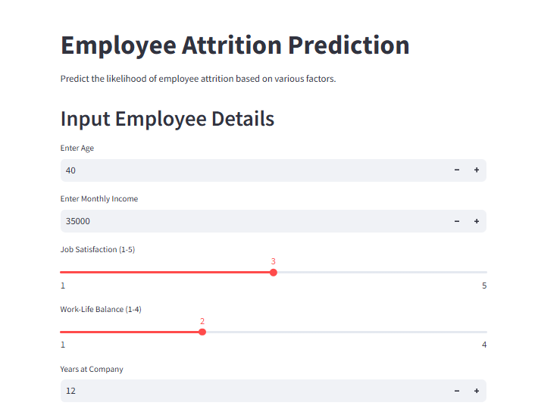
OUTPUT SCREENSHOTS
Output 1 :

Slide 13
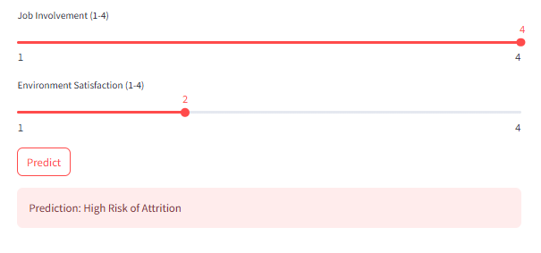

Slide 14
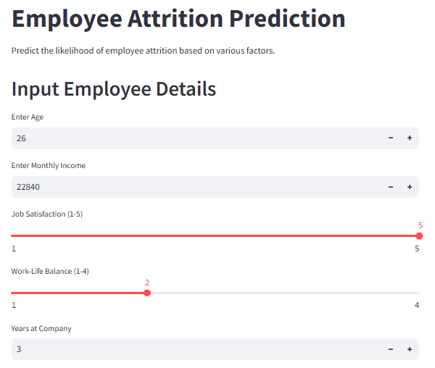
Output 2 :

Slide 15
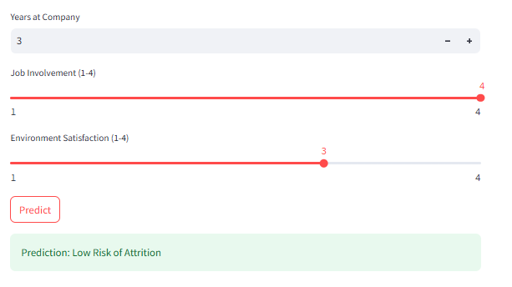

Slide 16
Conclusion
In this project, we successfully built a model to predict employee attrition using the IBM HR Kaggle dataset. By analyzing key features like job satisfaction, income, and work-life balance, we were able to provide actionable insights for HR teams to retain employees. The model achieved high accuracy and can serve as a valuable tool in workforce management

Slide 17
References
IBM HR Kaggle Dataset: https://www.kaggle.com/datasets
Scikit-learn Documentation: https://scikit-learn.org
Jupyter Notebook Documentation: https://jupyter.org

Slide 18
THANK YOU

