Slide 1


Slide 2
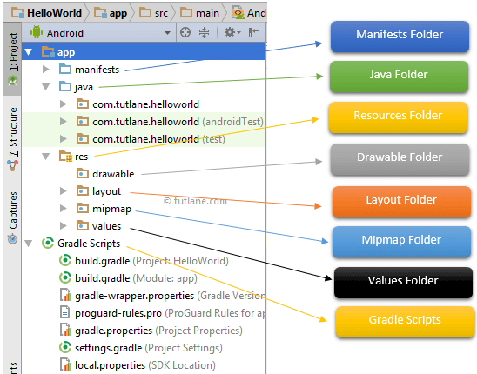
Android App / Project Folder Structure
The Android project structure on the disk might be differs from the above representation. To see the actual file structure of the project, select Project from the Project dropdown instead of Android.

Slide 3
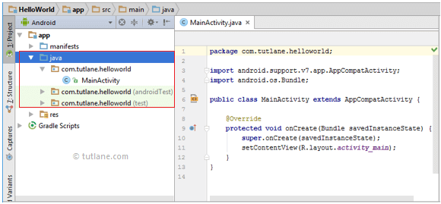
by default the class file MainActivity.java will create automatically under the package name “com.tutlane.helloworld” like as shown below.

Slide 4
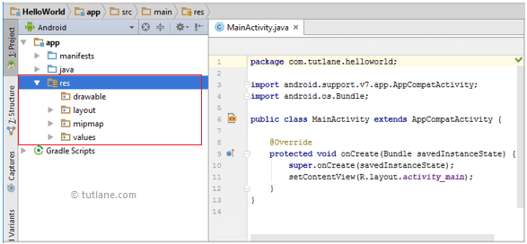
res (Resources) Folder

Slide 5
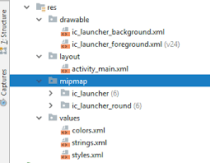
Drawable Folder (res/drawable)
It will contain the different types of images as per the requirement of application. It’s a best practice to add all the images in a drawable folder other than app/launcher icons for the application development.

Slide 6
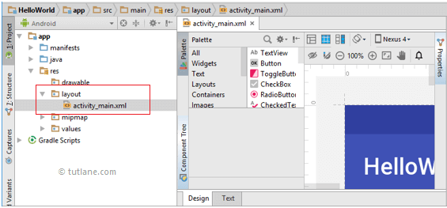
Layout Folder (res/layout)
This folder will contain all XML layout files which we used to define the user interface of our application. Following is the structure of the layout folder in the android application.

Slide 7
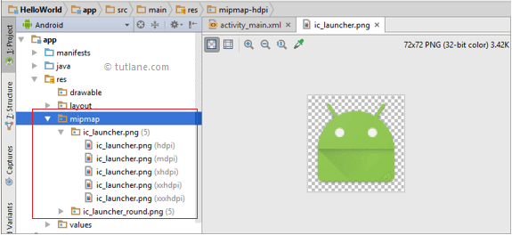
Mipmap Folder (res/mipmap)
This folder will contain app / launcher icons that are used to show on the home screen. It will contain different density type of icons.

Slide 8
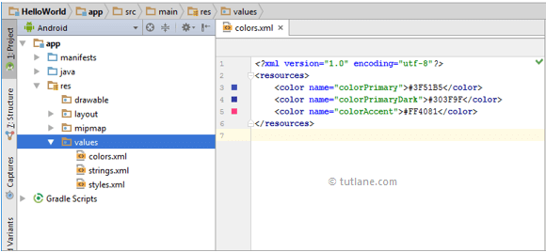
Values Folder (res/values)
This folder will contain various XML files, such as strings, colors, style definitions and a static array of strings or integers. Following is the structure of the values folder in android application.

Slide 9
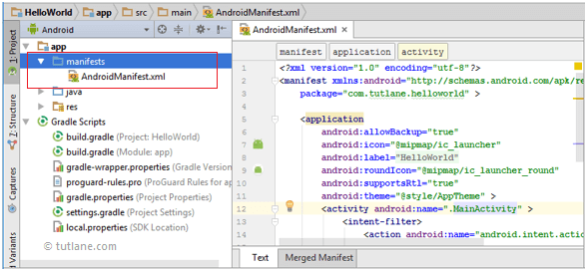
Manifests Folder This manifest file will contain information about our application such as android version, access permissions, metadata, etc.

Slide 10
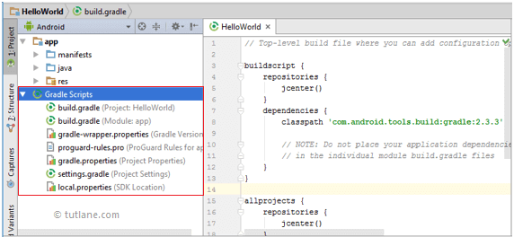
Gradle Scripts means automated build system and by using this we can define a build configuration that applies to all modules in our application.

Slide 11
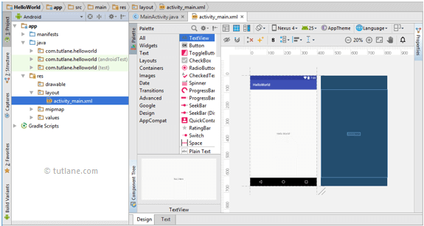
Android Layout File (activity_main.xml)

Slide 12
Android Layout File (activity_main.xml)
<?xml version="1.0" encoding="utf-8"?> <android.support.constraint.ConstraintLayout xmlns:android="http://schemas.android.com/apk/res/android" xmlns:app="http://schemas.android.com/apk/res-auto" xmlns:tools="http://schemas.android.com/tools" android:layout_width="match_parent" android:layout_height="match_parent" tools:context="com.tutlane.helloworld.MainActivity"> <TextView android:layout_width="wrap_content" android:layout_height="wrap_content" android:text="Hello World!" app:layout_constraintBottom_toBottomOf="parent" app:layout_constraintLeft_toLeftOf="parent" app:layout_constraintRight_toRightOf="parent" app:layout_constraintTop_toTopOf="parent" />
</android.support.constraint.ConstraintLayout>

Slide 13
Android Main Activity File (MainActivity.java)
The main activity file in the android application is MainActivity.java and it will exist in the java folder.
package com.tutlane.helloworld; import android.support.v7.app.AppCompatActivity; import android.os.Bundle; public class MainActivity extends AppCompatActivity { @Override protected void onCreate(Bundle savedInstanceState) { super.onCreate(savedInstanceState); setContentView(R.layout.activity_main); } }

Slide 14
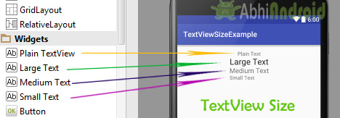
TextView displays text to the user and optionally allows them to edit it programmatically. TextView is a complete text editor, however basic class is configured to not allow editing but we can edit it.

Slide 15
<TextView android:id="@+id/simpleTextView" android:layout_width="wrap_content" android:layout_height="wrap_content" android:text="AbhiAndroid" />
TextView code in XML:
TextView code in JAVA:
TextView textView = (TextView) findViewById(R.id.textView);
textView.setText("AbhiAndroid"); //set text for text view

Slide 16
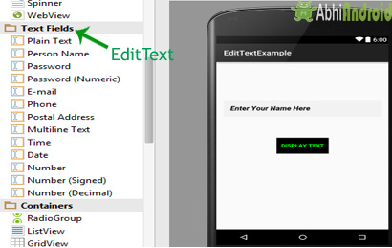
EditText is a standard entry widget in android apps. It is an overlay over TextView that configures itself to be editable.

Slide 17
EditText is a subclass of TextView with text editing operations. We often use EditText in our applications in order to provide an input or text field, especially in forms.
Important Note: An EditText is simply a thin extension of a TextView. An EditText inherits all the properties of a TextView.

Slide 18
EditText code in XML:
<EditText android:id="@+id/ET"
android:layout_height="wrap_content"
android:layout_width="match_parent"/>
EditText code in JAVA:
EditText simpleEditText=(EditText) findViewById(R.id.ET);
String editTextValue=simpleEditText.getText().toString();

Slide 19
CheckBox is a type of two state button either unchecked or checked in Android. Or you can say it is a type of on/off switch that can be toggled by the users. You should use checkbox when presenting a group of selectable options to users that are not mutually exclusive. CompoundButton is the parent class of CheckBox class.

Slide 20
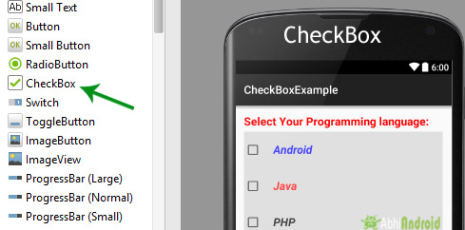

Slide 21
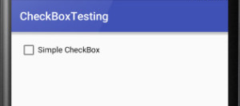
CheckBOX code in XML:
<CheckBox android:id="@+id/simpleCheckBox“
android:layout_width="wrap_content"
android:layout_height="wrap_content"
android:text="Simple CheckBox" />

Slide 22

CheckBOX code in XML:
<CheckBox android:id="@+id/simpleCheckBox“
android:layout_width="wrap_content"
android:layout_height="wrap_content"
android:text="Simple CheckBox"
android:checked="true"/>

Slide 23
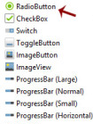
RadioButton are mainly used together in a RadioGroup. In RadioGroup checking the one radio button out of several radio button added in it will automatically unchecked all the others. It means at one time we can checked only one radio button from a group of radio buttons which belong to same radio group.

Slide 24
<RadioGroup
android:layout_width="wrap_content"
android:layout_height="wrap_content">
<RadioButton
android:id="@+id/simpleRadioButton"
android:layout_width="wrap_content"
android:layout_height="wrap_content"/>
<RadioButton
android:id="@+id/simpleRadioButton1"
android:layout_width="wrap_content"
android:layout_height="wrap_content"/>
</RadioGroup>

Slide 25
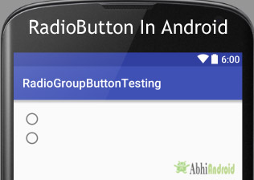

Slide 26
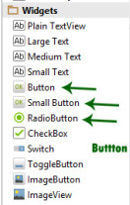
Button represents a push button. A Push buttons can be clicked, or pressed by the user to perform an action. There are different types of buttons used in android such as CompoundButton, ToggleButton, RadioButton.

Slide 27
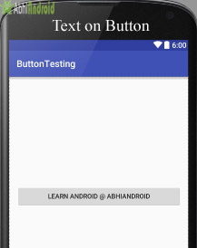
<Button
android:id="@+id/simpleButton"
android:layout_width="fill_parent"
android:layout_height="wrap_content"
android:layout_centerInParent="true"
android:text="Learn Android @ AbhiAndroid"/>

Slide 29
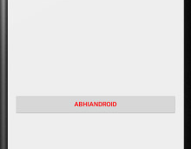
Button button = (Button) findViewById(R.id.simpleButton);
button.setText("ABHIANDROID");
//set the text on button

