Slide 1
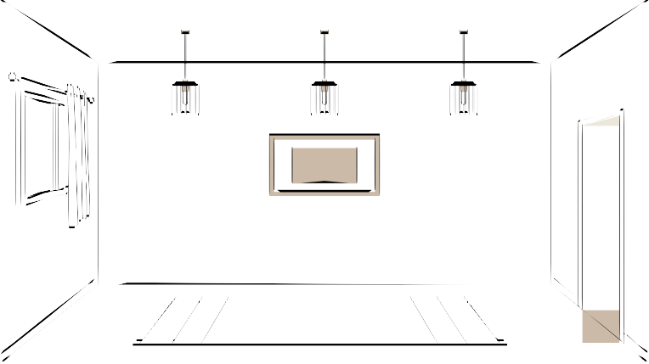
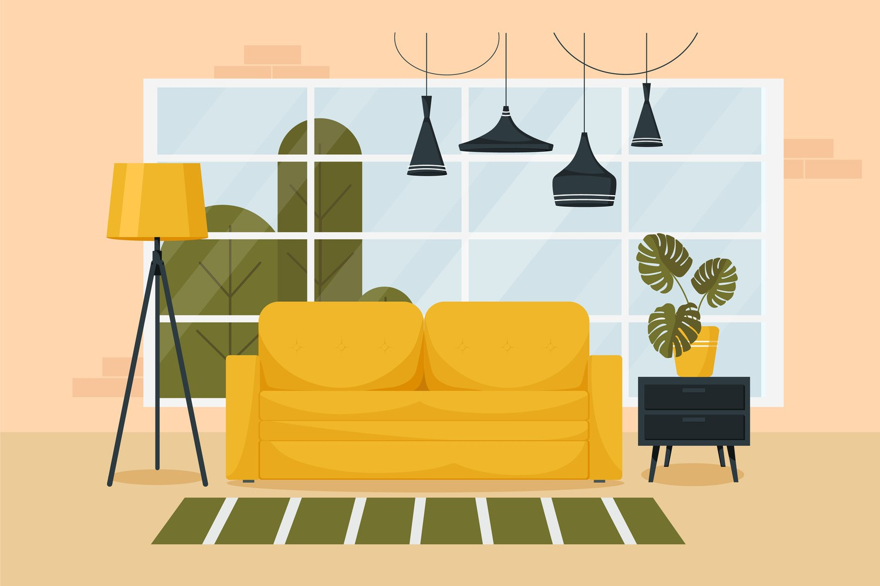



HTML
CSS
JS
Structure/layout
Style
Logic

Slide 2
CSS
Cascading Style Sheet
It is a language that is used to styling document.

Slide 3



Basic Syntax
Selector
h1 {
color: red;
}
Property
Value
semicolon shows that one property has ended & it is important to put this even though it won't incurr error

Slide 4

Including Style
Inline
<h1 style="color: red"> Apna College </h1>
<style> tag
<style>
h1 {
color : red;
}
</style>
Writing style directly inline on each element
Style is added using the <style> element in the same document

Slide 5

Including Style
External Stylesheet
<link rel="stylesheet" href="styles.css">
Writing CSS in a separate document
& linking it with HTML file

Slide 6
Color Property
Used to set the color of foreground
color: red;
color: pink;
color: blue;
color: green;

Slide 7
Background Color Property
to set the color of background
background-color: green;
background-color: red;
background-color: blue;

Slide 8
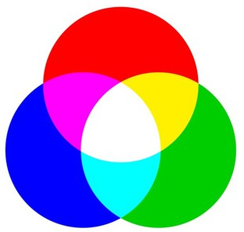
Color Systems
RGB
color: rgb(255, 0, 0);
color: rgb(0, 255, 0);

Slide 9
Color Systems
Hex (Hexadecimal)
color: #ff0000;
color: #00ff00;

Slide 10
Selectors
Universal Selector
* { }
Class Selector
.myClass { }
h1 { }
Id Selector
#myId { }
Element Selector

Slide 11
Text Properties
text-align : left / right /center

Slide 12
Text Properties
text-decoration
text-decoration : underline /
line-through /
overline dotted red;

Slide 13
Text Properties
font-weight : normal / bold /
bolder / lighter
font-weight : 100-900

Slide 14
Text Properties
font-family
font-family : arial, roboto;
font-family : arial

Slide 15
Units in CSS
Absolute
pixels (px)
96px = 1 inch
font-size: 2px;

Slide 16
Text Properties
line-height
line-height : 2px
line-height : 3
line-height : normal

Slide 17
Text Properties
text-tranform : uppercase / lowercase/ capitalize / none

Slide 18
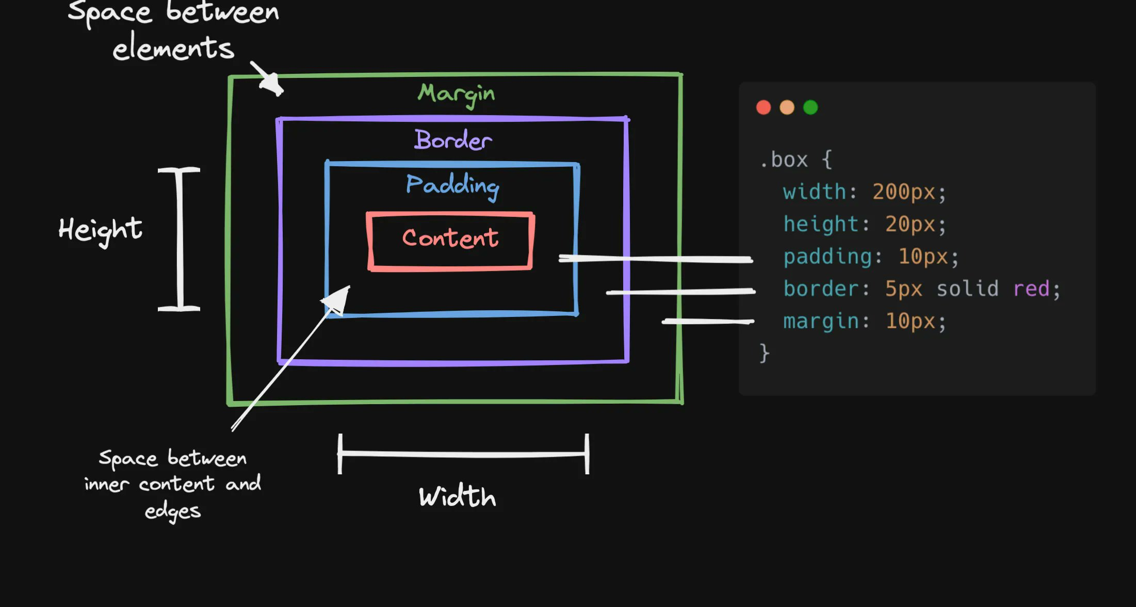

Box Model in CSS
Height
Width Border Padding Margin

Slide 19
Height By default, it sets the content area height of the element
div {
height: 50px;
}

Slide 20
Width By default, it sets the content area width of the element
width: 50px;
div {
}

Slide 21
Border Used to set an element's border
border-width : 2px;
border-style : solid/dotted/dashed
border-color : green;

Slide 22
Border
Shorthand
border : 2px solid black

Slide 23
Border Used to round the corners of an element's outer border edge
border-radius : 10px;
border-radius : 50 % ;

Slide 24
Padding
padding-left
padding-right
content
padding-top
padding-bottom
Padding

Slide 25
Padding
Shorthand
padding: 50px;
padding: 1px 2px 3px 4px;
top | right | bottom | left -> clockwise

Slide 26
Margin
margin-right
margin-left
content
Margin
content
margin-top
margin-bottom

Slide 27
Margin
Shorthand
margin: 50px;
margin: 1px 2px 3px 4px;
top | right | bottom | left -> clockwise

Slide 28
Display Property
display: inline / block / inline-block / none
inline - Takes only the space required by the element. (no margin/ padding)
block - Takes full space available in width
inline-block - Similar to inline but we can set margin & padding.
none - To remove element from document flow.

Slide 29
Visibility
visibility: hidden;
Note : When visibility is set to none, space for the element is reserved.
But for display set to none, no space
is reserved or blocked for the element.

Slide 30
Alpha Channel
opacity (0 to 1)
RGBA
color: rgba(255, 0, 0, 0.5);
color: rgba(255, 0, 0, 1);

Slide 31
Units in CSS
Relative
%
em
rem
more like vh, vw etc

Slide 32
Percentage (%)
It is often used to define a size as relative to an element's parent object.
width : 33% ;
margin-left : 50% ;

Slide 33
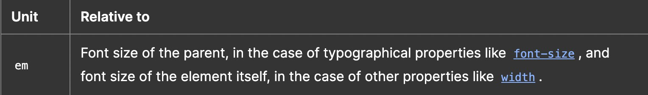
Em
font size of child will be half of parent for 0.5em
for padding & margin it's relative to same element's font size
show both on same par & div make a button with border & font-size
then change its border radius from pixel to ems to set a constant shape

Slide 34
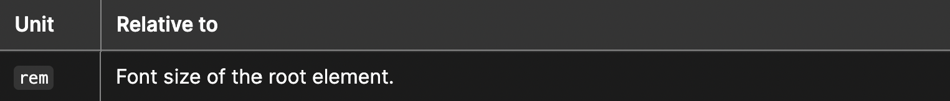
Rem (Root Em)
font size of child will be half of parent for 0.5em
for padding & margin it's relative to same element's font size
show both on same par & div make a button with border & font-size
then change its border radius from pixel to ems to set a constant shape

Slide 35
Others
vh: relative to 1% viewport height
vw : relative to 1% viewport width

Slide 36
Position
The position CSS property sets how an element is positioned in a document.
position : static / relative / absolute / fixed

Slide 37
Position
static - default position (The top, right, bottom, left, and z-index properties have no effect)
relative - element is relative to it self. ( T h e t o p , right, bottom, left, and z-index will work) absolute - positioned relative to its closest ancestor. (removed from the flow)
fixed - positioned relative to browser. (removed from flow)
sticky - positioned based on user's scroll position

Slide 38
z-index
It decides the stack level of elements
Overlapping elements with a larger z-index cover those with a smaller one.
z-index : auto (0)
z-index : 1 / 2 / ...
z-index : -1 / -2 / ...

Slide 39
Background Image
Used to set an image as background
background-image : url(“link or address of image”);

Slide 40
Background Size
background-size : cover / contain / auto

