Slide 1



Slide 2
^{AGENDA}
FIREBASE?
REALTIME DATABASE
CLOUD FUNCTIONS
HELLO FUNCTIONS
WELCOME NEW USERS WITH CLOUD FUNCTION

Slide 3
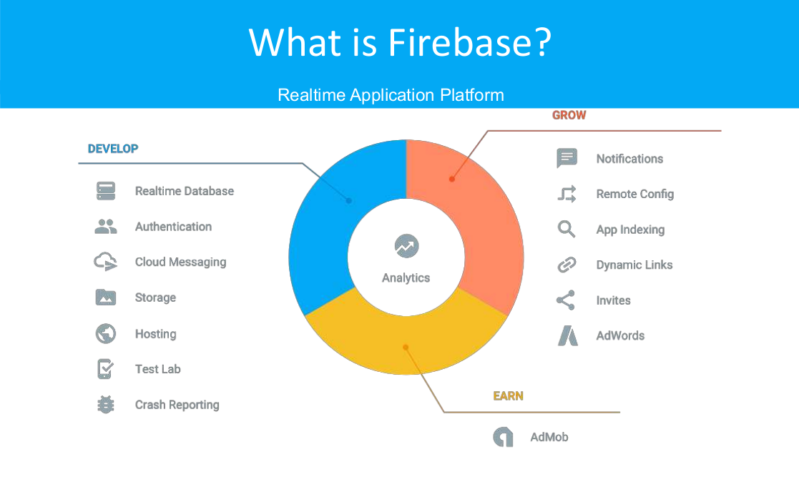

Slide 4
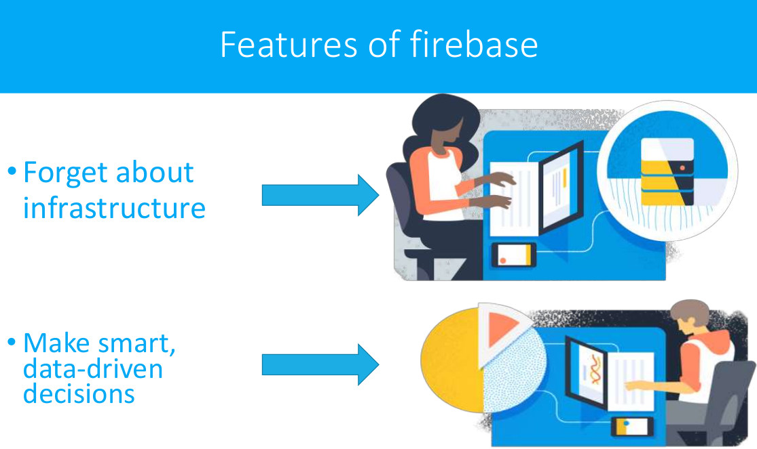

Slide 5
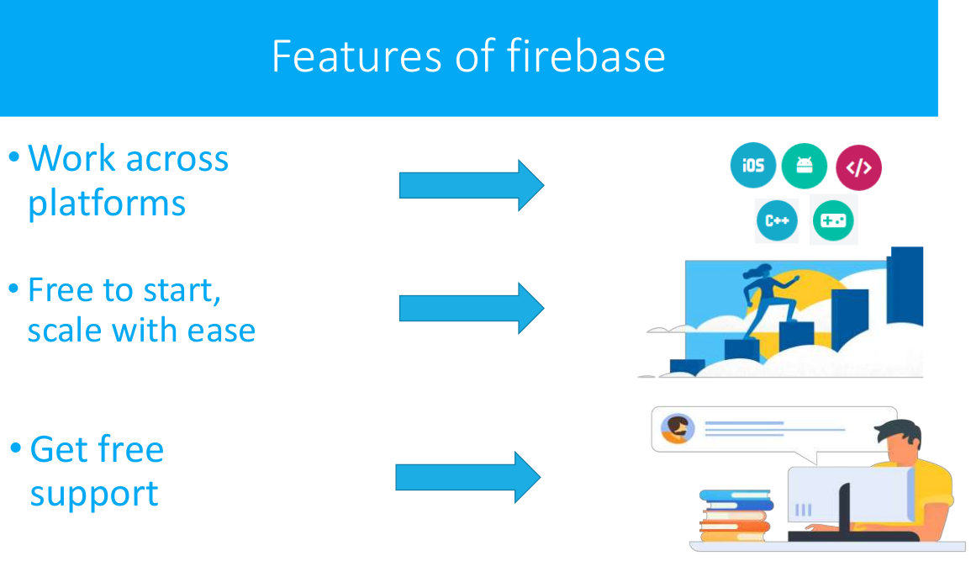

Slide 6
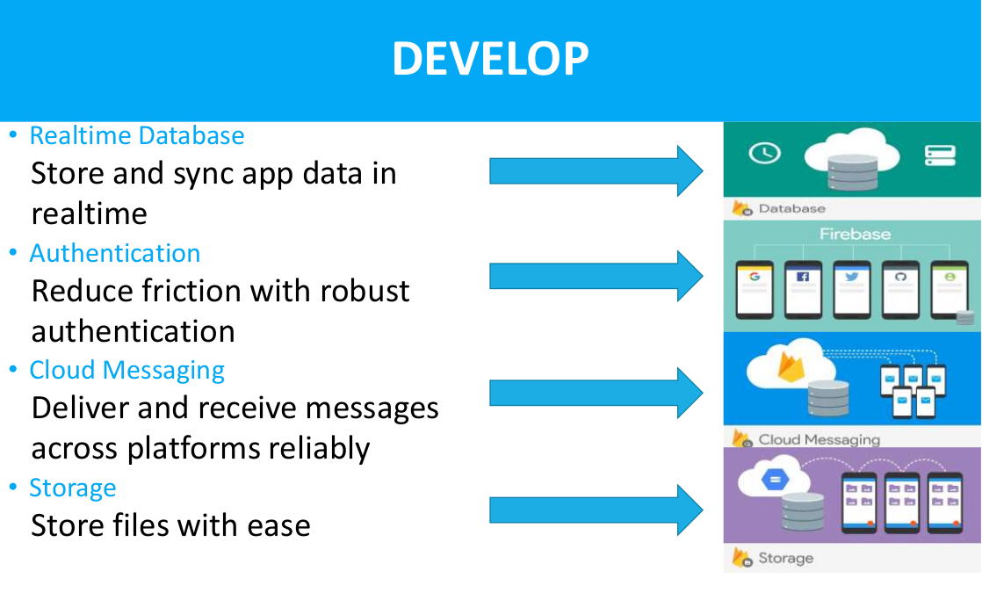

Slide 7
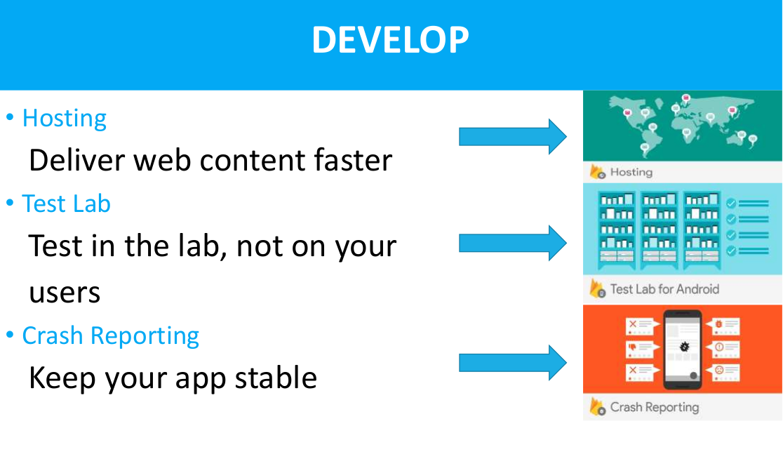

Slide 8
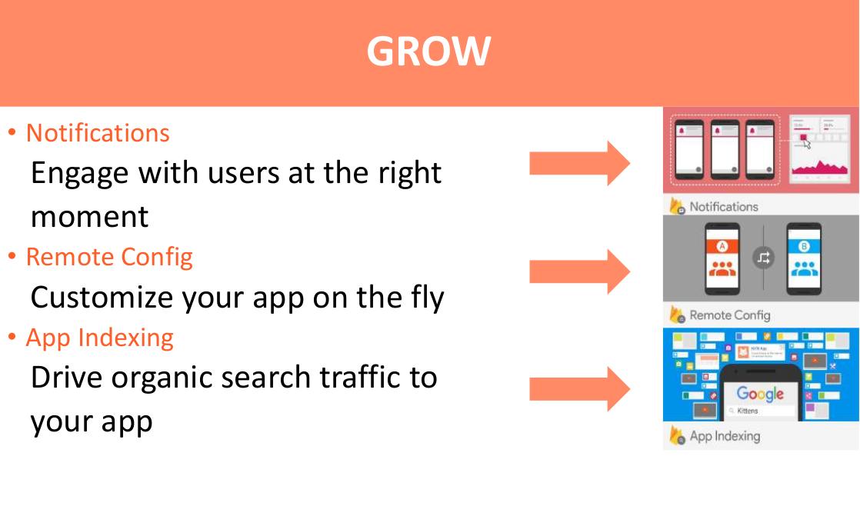

Slide 9
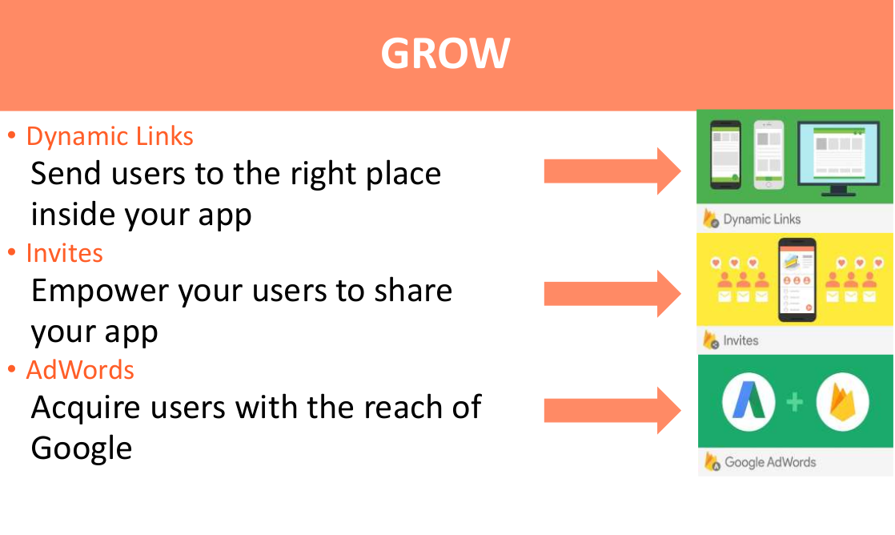

Slide 10
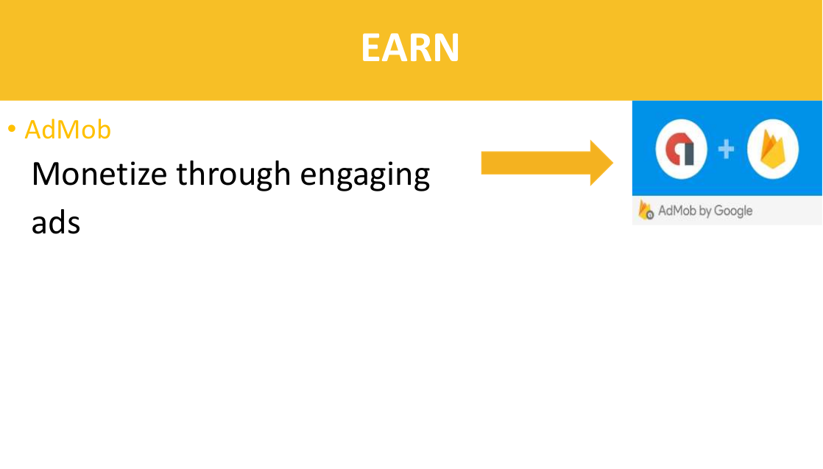

Slide 11
REALTIME DATABSE
SQL VS NON-SQL
TABLE vs XML vs JSON
HOW IS IT REALTIME?
Let's see the next slide

Slide 12
CLOUD FUNCTIONS
JAVASCRIPT vs TYPESCRIPT
PROMISES
ASYNC/AWAIT

Slide 13
PRACTICAL TIME!
HELLO WORLD FUNCTION
Prerequisits:
NPM: npm --version
Node JS 8+: node --version
Firebase CLI : firebase --version
npm install -g firebase-tools

Slide 14
STEPS
Step 1: Create a Firebase Project
Step 2: Create Directory
Step 3: Login to Firebase
firebase login
Step 4: Initialize the Project
firebase init
follow the instructions
Step 5: Get the Latest Versions
npm install firebase-admin@latest firebase-funtions@latest
firebase deploy

Slide 15
WELCOME OUR USER
Step 1: Some background of our Project
Step 2: Clone the Repository
git clone https://github.com/honeycoder96/AOG-Start
Step 3: Setup Firebase Project in Console
authentication and cloud database
Step 4: Firebase Login
firebase login
Step 4: Connect the Project with Console
firebase use --add
Step 5: Let's Deploy the current Project
firebase deploy --except functions
send some messages

Slide 16
Step 6: Install the Dependency
npm install
Step 7: Import the Cloud Function and Firebase Admin Module(index.js)
Step 8: Lets Understand the schema of Database
Step 9: Let's Code our Function
Step 10: Deploy the function and Test
firebase deploy --only functions

Slide 17
CONCLUSION
?
THANK YOU

