Slide 1
FLIPKART GRIDLOCK 2.0 · THEME 3 · TEAM ROCKET
SENTINEL-BLR
Evidence-Quality Automated Traffic Enforcement
Every traffic-AI system asks one question: was a violation detected?
We built one that asks a second: is the evidence good enough to fine someone?
ERS · a single 0–100 reliability score on every detection
Notes:
0:00–0:18 OPENING (both on camera). A: "We're Team Rocket." Every traffic-AI asks: was a violation detected? B: "We ask a second question no deployed Indian system asks — is the evidence good enough to fine someone?"

Slide 2
THE PROBLEM
26,000
ON THE RECORD — BENGALURU, 2024
Bengaluru Traffic Police confirmed their AI still cannot detect wrong-side driving — those cases are registered “by a manual process.”
wrong challans — Hyderabad, 2025
Their violation detector and their plate reader silently drifted out of sync. Fines went to the wrong vehicles — some to cars in a completely different part of the city.
Detecting violations is already solved. Knowing which detections are reliable enough to enforce on is not.
Notes:
0:18–0:52 THE PROBLEM (A). 26,000 wrong challans in Hyderabad last year — detector and plate-reader drifted out of sync. Bengaluru's own police say their AI still can't do wrong-side driving. Detecting isn't the gap; trusting a detection is.

Slide 3
THE CORE IDEA · EVIDENCE RELIABILITY SCORE
One number decides what happens to every detection
ERS = 0.30 C_{det} + 0.25 C_{ocr} + 0.20 R_{cons} + 0.15 H_{cal} + 0.10 Q_{pre}
detection · plate read · multi-frame agreement · calibration · image quality
ERS ≥ 85
60 – 84
< 60
AUTO-FINE
HUMAN REVIEW
DISCARD
clear day, clean plate → 93
light rain, partial plate → 75
heavy rain, mud → 47 · no record
Weak evidence structurally cannot become a fine.
Notes:
0:52–1:33 THE ERS (A). Every detection gets one number 0–100. Five inputs. It routes itself: 85+ auto-fine, 60–84 human review, under 60 discard. Clear day 93 → fine. Heavy rain, mud 47 → discarded. Weak evidence cannot become a fine.

Slide 4
THE PIPELINE
A standard spine — and the four layers that are ours
AUTO-FINE
Camera Feed
Preprocess
Detection
Violation Engine
ERS Gate ★
HUMAN REVIEW
RTSP / ONVIF
CLAHE · Retinex
YOLOv10 · ATS
7 categories
0–100 reliability
DISCARD
Auto-Cal ★
OCR Fusion ★
YAML Policy ★
re-aligns drift every 15 min
5-frame plate recovery
rules change in <1 min
★ our contribution Everything else is a standard YOLO + OCR build.
Notes:
1:33–2:42 SYSTEM + WHAT'S OURS (B). Standard pipeline underneath. These four are ours: calibration heartbeat (re-aligns a drifting camera every 15 min without stopping enforcement), 5-frame OCR fusion (recovers a plate from mud/rain), YAML policy engine (police change a rule in <1 min, no engineer), and the ERS gate on top. Triple riding can NEVER auto-fine — a human always signs off. We'd rather miss a violation than wrongly accuse someone.

Slide 5
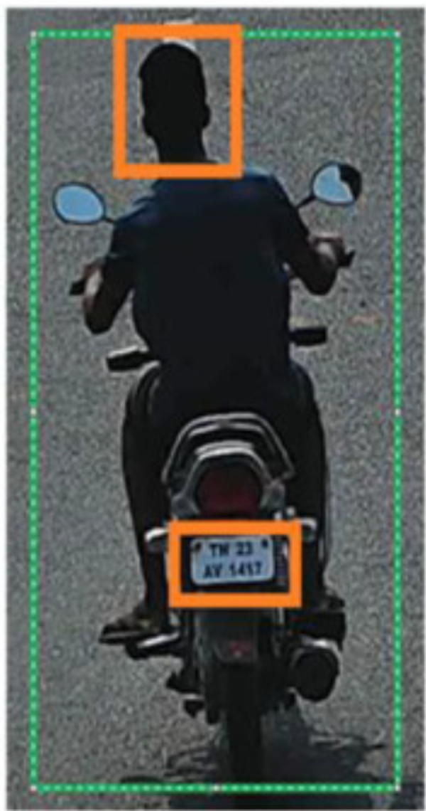
WHAT THE OFFICER ACTUALLY RECEIVES
One packet. One score. One decision.
Detection conf.
91%
ERS
91
OCR conf.
94%
Frame consensus
5 / 5
Calibration
HEALTHY
/ 100
SHA-256
3fa2…c91b (tamper-evident)
AUTO-FINE
Annotated frame + GradCAM overlay
§129 helmet · legally defensible without human review
KA 05 MN 4821 · 2-wheeler · Helmet non-compliance
Notes:
2:42–3:10 DEPLOYMENT (B then A). One packet, one score, one decision — this is what an officer sees. It starts at 10 junctions pulled from real violation data, each next phase a measured gate not a calendar date. Runs on Bengaluru's existing CCTV plus a small edge box per junction — phase one is lakhs, not crores. Grounded in real MV Act sections and the new DPDP Act.

Slide 6
TRUST ARCHITECTURE · HOW WE EARN THE RIGHT TO AUTO-FINE
We don't issue a single auto-fine until the data earns it.
SHADOW MODE FIRST
≤1% WRONGFUL-FINE GUARANTEE
CITIZEN EVIDENCE PORTAL
Full pipeline live. Zero fines issued.
Officers adjudicate normally. Their decisions become the ground truth that calibrates the system.
99% precision gate on held-out officer labels before any auto-fine goes live.
No junction advances to Stage 1 until it clears
Conformal risk control
A distribution-free statistical method sets the auto-fine threshold from shadow-mode labels — not from us.
Provably ≤1% wrongful-fine rate at 95% confidence. Per violation type.
Threshold set by data. Re-validated on drift.
Every challan has a QR code.
Owners see the annotated frame, ERS sub-scores, and GradCAM overlay — the same view the officer saw.
Disputes provisionally stay the fine. Overturns feed directly into recalibration.
Citizens fix errors. The system gets harder to fool.
Hyderabad went live on unvalidated thresholds.
We don't.

Slide 7
DEPLOYMENT PATH · 10 JUNCTIONS TO CITY-WIDE
Three phases. Each gated by measurable criteria, not timelines.
PHASE 1
PHASE 2
PHASE 3
10 high-urgency junctions
Top 10 by enforcement load from Police Violations Dataset. Real rows — auditable, not guessed.
Gate: mAP ≥ 0.85 + auto-fine precision ≥ 99%
Stage 0 shadow → Stage 1 live
50 junctions
Selected by live Sentinel-BLR urgency scores, not manual survey.
Gate: synthetic priors fully replaced by local field data
within 30 days of Phase 1
City-wide rollout
Multi-angle coverage recommended by Layer 9 analytics, not manual deployment decisions.
Gate: infrastructure cost grows linearly or sub-linearly
Same architecture — no rebuild
Hardware cost (Phase 1, 10 junctions): low lakhs.
Jetson Orin NX ~₹50–80K/unit. Sits on top of BTP's existing CCTV feeds — no camera replacement. Not a multi-crore infrastructure commitment.

Slide 8
Most systems decide whether to fine.
Ours decides whether it should — and it knows when it's wrong.
SENTINEL-BLR Team Rocket · Flipkart Gridlock 2.0
Notes:
3:10–3:25 CLOSE (both). B: "Most systems decide whether to fine." A: "Ours decides whether it should — and it knows when it's wrong." Both: "Sentinel-BLR. Thank you."

