Slide 1
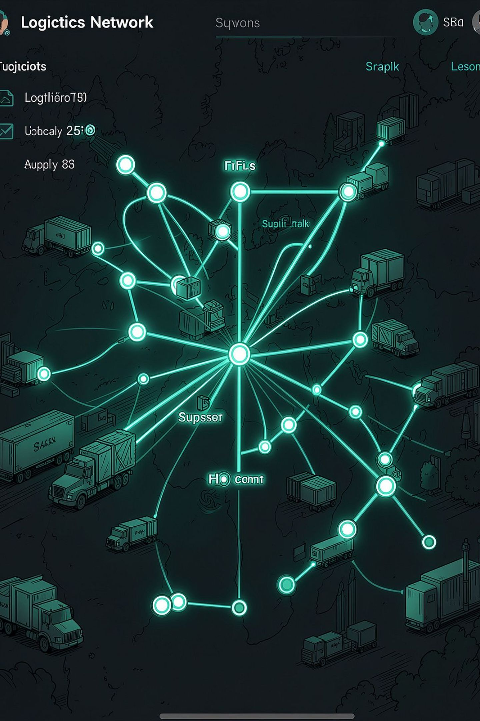
THREATNEXUS · IBM BOB AI INNOVATION HACKATHON 2026 · TRACK: AI
FLEETIQ
AI-Powered Supply Chain Disruption & Fleet Utilisation Assistant
Detect. Predict. Optimise. Act.
Team: Krisha Prajapati (Team Lead) · Diya Joshi · Dhruvi Raval · Shrey Raval

Slide 2
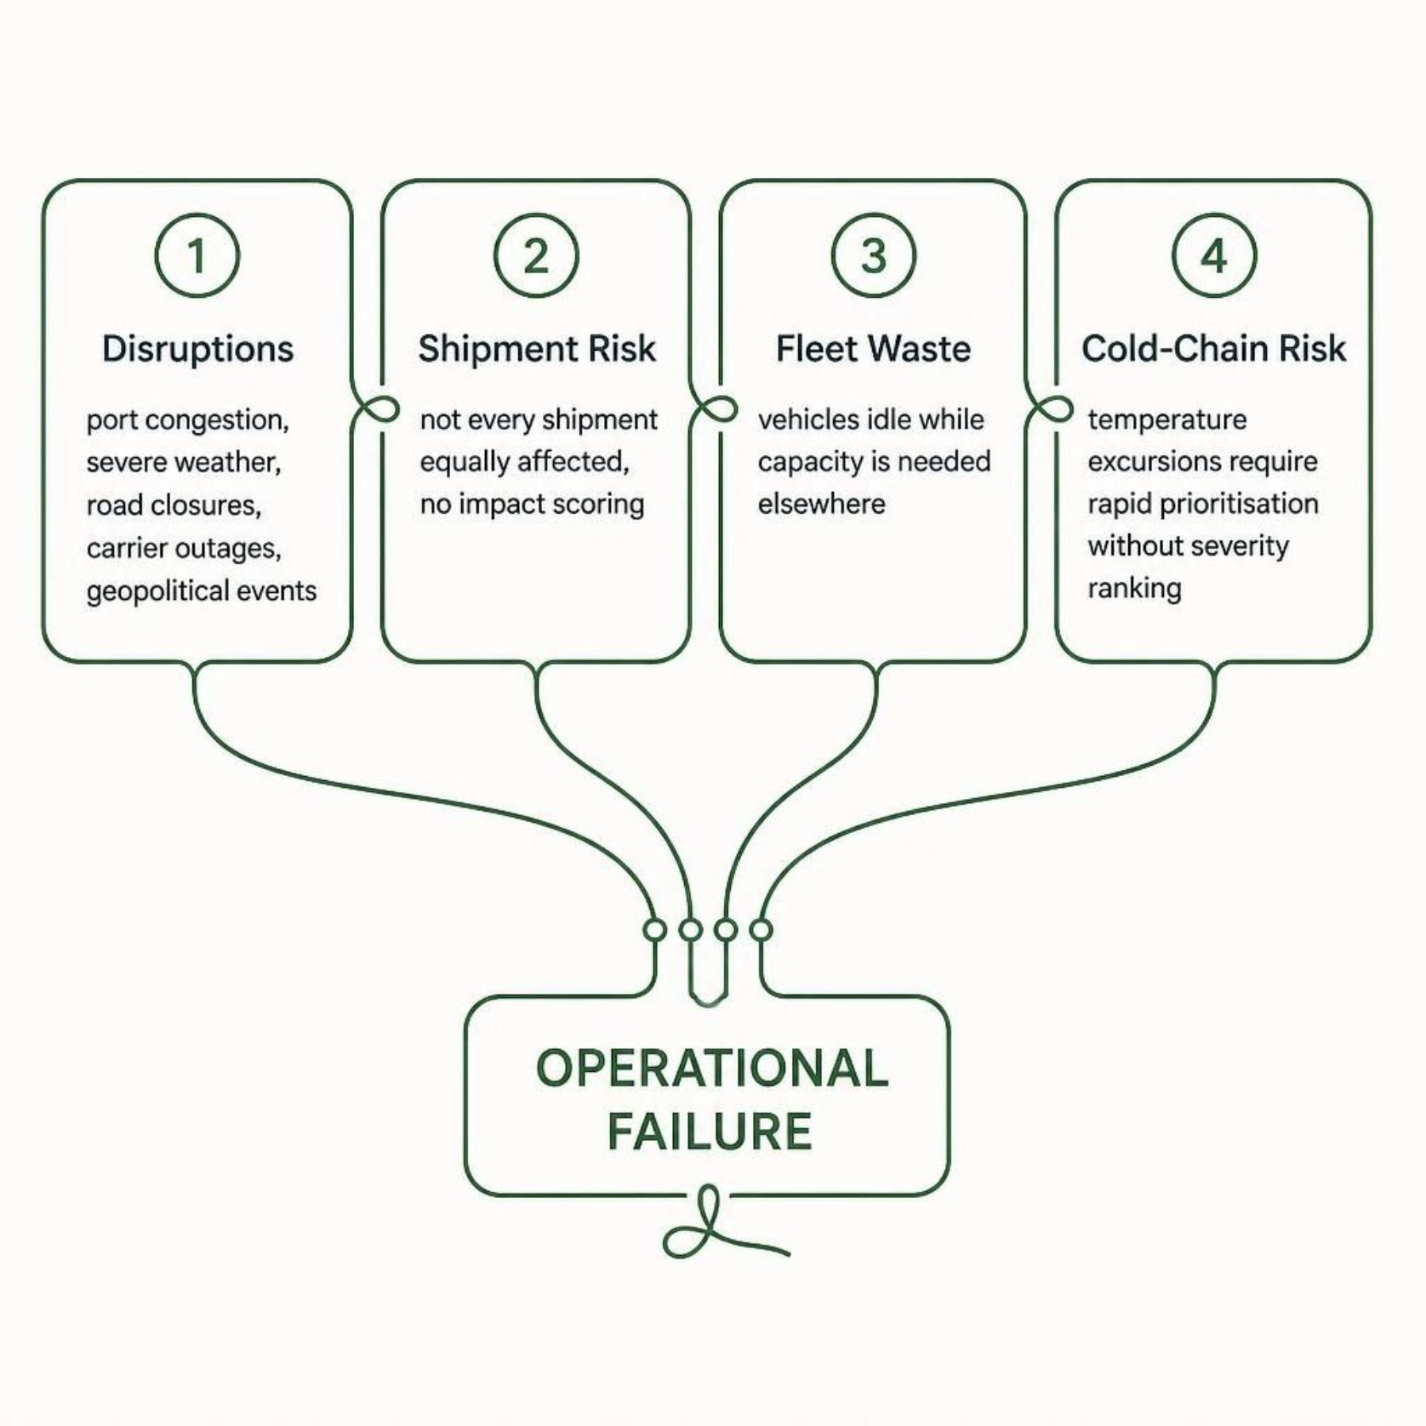
Supply Chains Are Disrupted From Multiple Directions
Operations teams face cascading disruption signals — but lack a unified way to prioritise and act.
The Core Challenge
The challenge is not only collecting operational data — it is turning fragmented signals into prioritised action.
Without a unified intelligence layer, disruptions cascade unchecked across shipments, fleet, and cold-chain operations.

Slide 3

Introducing FLEETIQ
One unified operational intelligence layer — from raw disruption signals to actionable decisions.
Risk & Recommendations
FLEETIQ Intelligence
Operational Events
L2-1 · Shipment Impact
L2-2 · Route & Carrier
Prioritise affected shipments by severity
Recommend alternatives with trade-offs
L2-3 · Fleet Redeployment
L2-4 · Cold-Chain Ranking
Score idle vehicles for redeployment
Rank temperature excursions by severity
One platform. Four operational decisions.

Slide 4

From Operational Data to Action
FLEETIQ's pipeline transforms raw operational data into prioritised, explainable decisions — with IBM Granite providing the final AI briefing layer.
Operational Data
SQLite Database
Collect raw telemetry and logs for processing.
Store and index operational records efficiently.
Intelligence Engines
Risk & Recommendation
Run five deterministic models to score events.
Generate prioritised, explainable operational scores.
The deterministic intelligence layer calculates operational scores first. IBM Granite then transforms those results into a concise, understandable operational briefing.

Slide 5
Five Intelligence Engines. One Operational View.
Disruption Detection
1
Severity + geography + temporal relevance
Output: Disruption detection
Impact Analyzer
2
Severity + proximity + cargo sensitivity + shipment value
Output: Impact score
Route Recommender
3
Alternate route · Alternate carrier · Hold & wait — with delay and cost trade-offs
Output: Recommendation
Fleet Optimizer
4
Haversine distance + capacity compatibility + vehicle-type suitability
Output: Redeployment score
Cold-Chain Ranker
5
Temperature deviation + excursion duration + cargo sensitivity
Output: Severity ranking

Slide 6
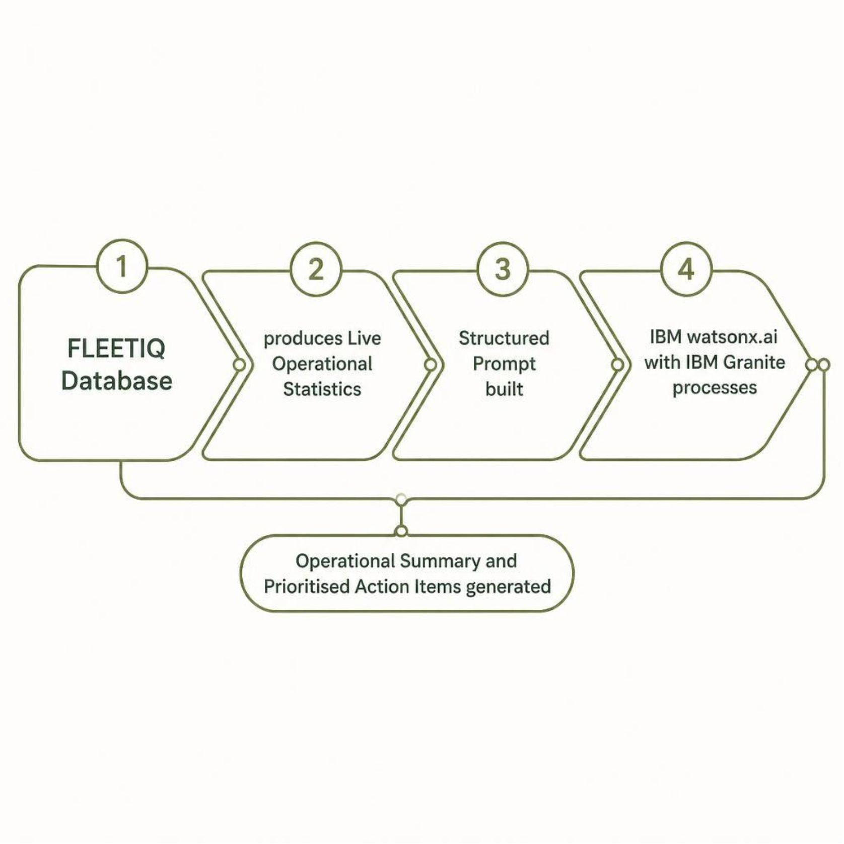

IBM Granite Turns Operational Signals Into an AI Briefing
Architectural Principle
AI explains the situation. Business logic determines the underlying operational scores.
Configurable Granite model via watsonx.ai
Graceful fallback when credentials unavailable
AI summary generated entirely from application data
IBM Bob + MCP planned for natural-language queries
IBM Granite receives structured operational statistics — it does not calculate scores or make autonomous decisions.

Slide 7
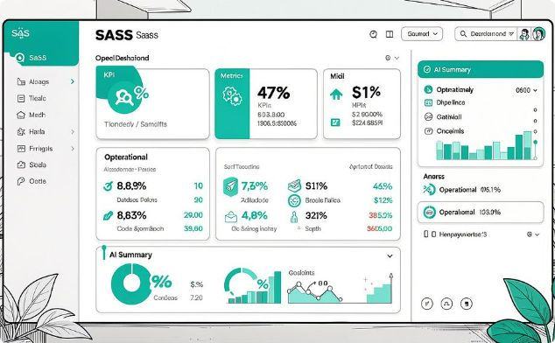
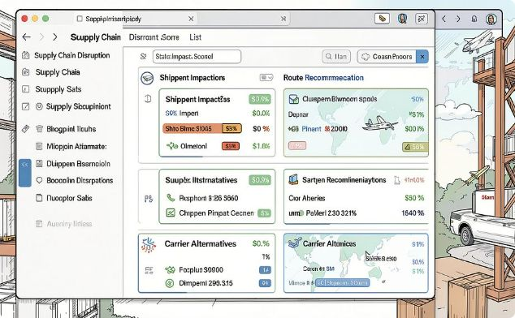
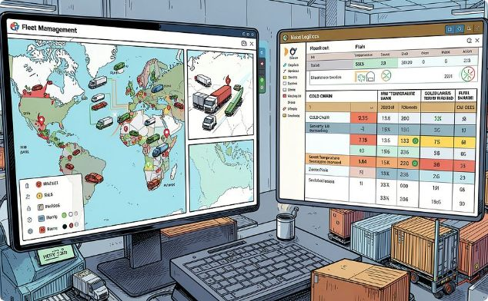
Three Pages Cover the Complete L2 Problem
Dashboard · /
Disruptions & Shipments · /disruptions
Fleet & Cold Chain · /fleet-coldchain
Operational KPIs · Active disruptions · At-risk shipments · Idle fleet · Cold-chain status · AI summary
L2-1 · L2-2
Affected shipments · Impact scores · Route recommendations · Carrier alternatives
L2-3 · L2-4
Idle fleet redeployment scores · Temperature excursions · Severity ranking

Slide 8
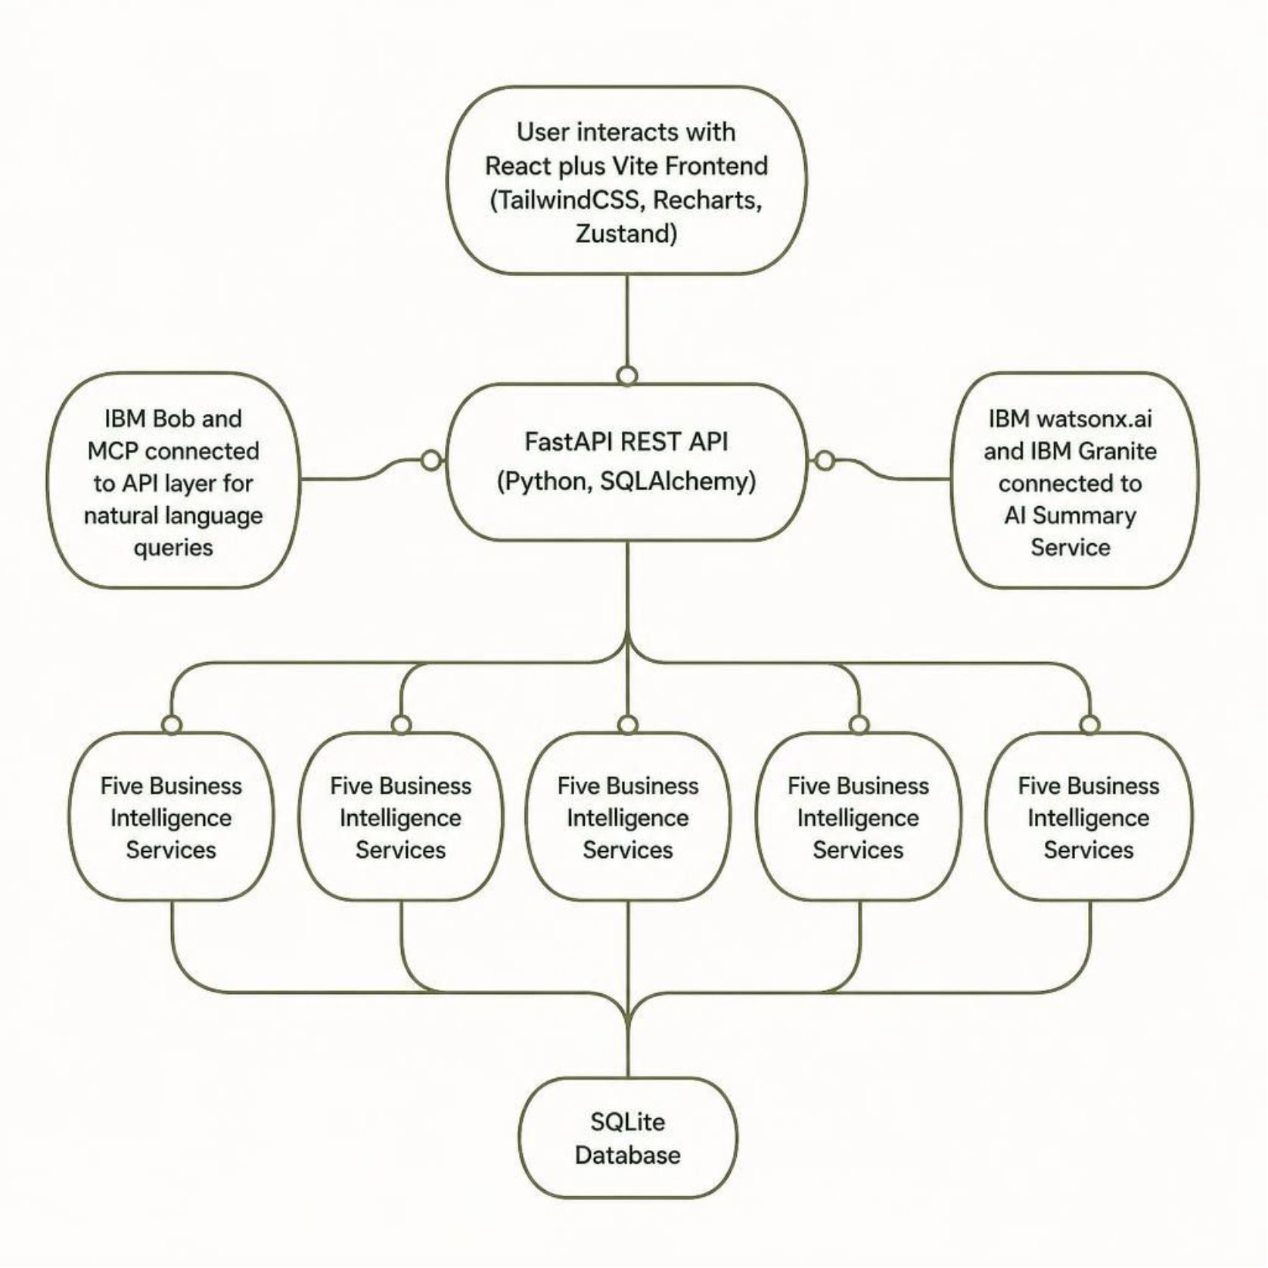
FLEETIQ Technical Architecture
Technology Stack
Frontend
Backend
React · Vite · TailwindCSS · Recharts · Zustand
Python · FastAPI · SQLAlchemy
AI
Integration
IBM watsonx.ai · IBM Granite
IBM Bob · MCP
Testing
pytest · GitHub Actions

Slide 9
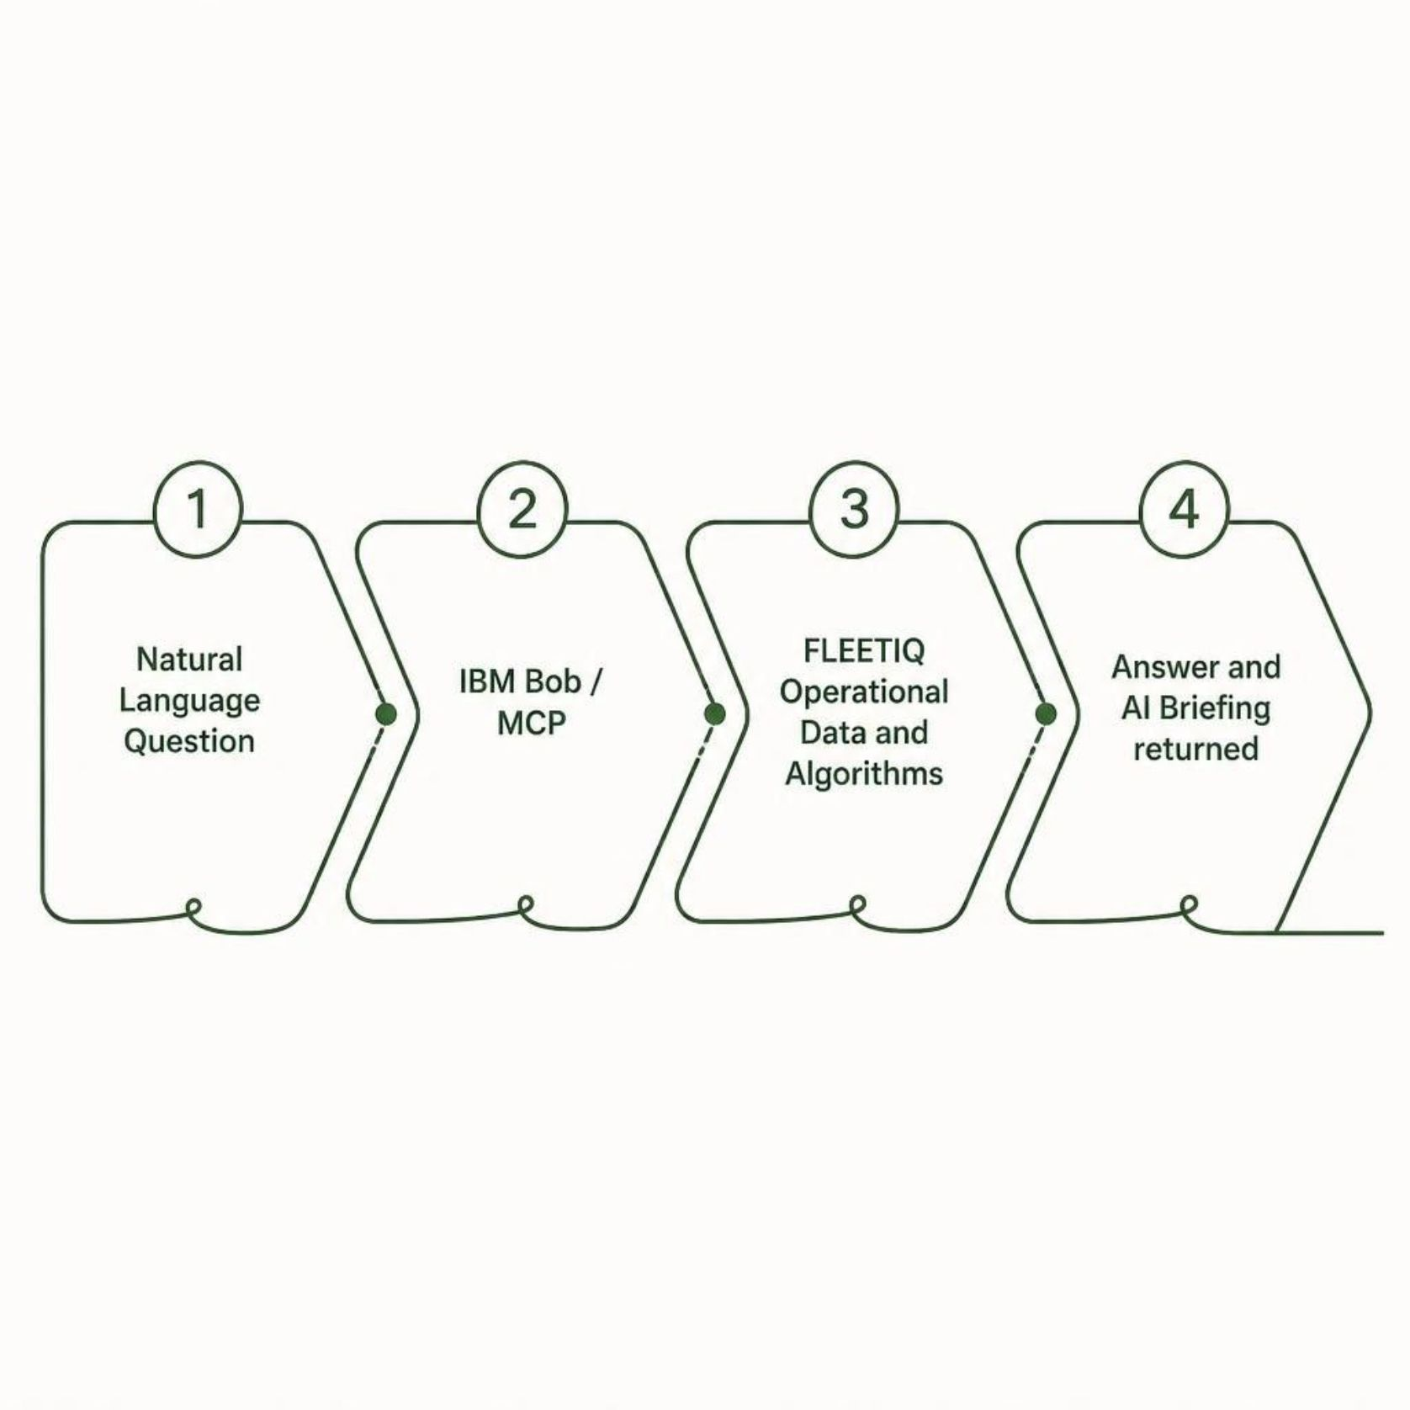


Ask FLEETIQ What Matters Most
Conceptual Query Flow
IBM Bob + MCP Natural-Language Interface
"Which shipments are most at risk?"
"Which fleet vehicles are idle and suitable for redeployment?"
"Which cold-chain incidents require immediate attention?"
"Generate an operational summary."
Demo Journey
Dashboard → Disruption → Shipment → Recommendation → Fleet → Cold Chain → AI Summary

Slide 10
From Disruption Data to Operational Decisions
Faster Prioritisation
Better Fleet Utilisation
Reduced Operational Risk
Identify high-impact shipments and critical incidents
Find idle vehicles suitable for redeployment
Prioritise disruption and cold-chain incidents systematically
Explainable Intelligence
AI-Assisted Operations
Transparent scoring based on operational factors
IBM Granite converts complex data into a concise briefing
Future Scope
Current Status
Real-time GPS and fleet telemetry
Live weather and port feeds
Predictive disruption forecasting
Advanced ML-based forecasting
Automated alerts
Production cloud deployment
Historical trend analytics
Backend foundation and business-logic phases implemented and tested.
FastAPI backend + SQLAlchemy + SQLite
5 business intelligence services
IBM watsonx.ai + Granite integration
Deterministic seeded demo data
146 passing backend tests
FLEETIQ — "Detect disruption. Protect shipments. Optimise fleet. Act faster."
ThreatNexus · IBM BoB AI Innovation Hackathon 2026

