Slide 1
D1 • DEFENSE & AEROSPACE
MISSIONGUARD
AI
MISSION READINESS
Explainable Mission Readiness
& Predictive Maintenance Copilot
78%
CAUTION
DATA → INSIGHT → READINESS → ACTION
TOP RISK
SERVICE
180 days
Vibration
Team: CODESTORM
Prototype • Synthetic demonstration data
CODESTORM • MISSIONGUARD AI
01

Slide 2
The problem
Mission readiness is not just a maintenance schedule.
Today's monitoring gap
THE DECISION
Is this asset ready
for the next mission?
▸ Scheduled servicing can miss condition-based warning signs.
▸ HUMS / sensor signals may be underutilized.
▸ Service records add context but are hard to synthesize quickly.
▸ A single risk score does not explain where the problem is.
▸ Teams need a clear priority before the next mission window.
The answer is often buried across sensor signals, service history and usage.
READINESS
RISK
ACTION
Core challenge: transform data into an understandable, actionable readiness assessment.
CODESTORM • MISSIONGUARD AI
02

Slide 3
Our solution
MissionGuard turns scattered health signals into one explainable decision.
SENSOR
DATA
HEALTH
ANALYSIS
READINESS
RISK +
WHY?
ACTION
WHAT is wrong?
WHY is it risky?
WHAT should be prioritized?
DATA
→
INSIGHT
→
EXPLANATION
→
ACTION
→
MISSION DECISION
CODESTORM • MISSIONGUARD AI
03

Slide 4
How it works
A transparent pipeline from asset data to readiness.
SENSOR DATA
HEALTH
ANALYSIS
READINESS
ENGINE
RISK +
EXPLANATION
MAINTENANCE
COPILOT
SERVICE RECORDS
OUTPUT
READY
CAUTION
NOT READY
• sensor health • component risk • reasons • prioritized recommendations
CODESTORM • MISSIONGUARD AI
04

Slide 5
Five core capabilities
Designed around the questions an operator actually needs answered.
01
02
03
Mission Readiness
Sensor Health
Component Risk
A simple overall readiness status built from multiple health indicators.
Highlights abnormal vibration, temperature, pressure and usage signals.
Surfaces the monitored component/system associated with the highest risk.
04
05
Explainable WHY
Maintenance Copilot
Traces the assessment back to the indicators driving concern.
Converts detected risks into a prioritized decision-support action plan.
WHAT → WHY → ACTION
CODESTORM • MISSIONGUARD AI
05

Slide 6
System architecture
Lightweight prototype architecture with clear separation of concerns.
USER
MISSIONGUARD UI
HTML / CSS / JS
FLASK API
SYNTHETIC
SENSOR DATA
SERVICE /
MAINTENANCE
HEALTH ANALYSIS
READINESS ENGINE
RISK +
EXPLAINABILITY
MAINTENANCE
COPILOT
FINAL READINESS
DECISION
The architecture keeps the decision path auditable: data → analysis → explanation → recommendation.
CODESTORM • MISSIONGUARD AI
06

Slide 7
IBM Bob in the development lifecycle
Bob is positioned as a core development component—not just a code generator.
PLAN
IMPLEMENT
DEBUG
REVIEW
TEST
DOCUMENT
Project & architecture planning
Code implementation
Debugging and refactoring
Code review
Test creation
Documentation + workflow improvement
Evidence matters: maintain the required Bob task-session evidence for judging.
CODESTORM • MISSIONGUARD AI
07

Slide 8
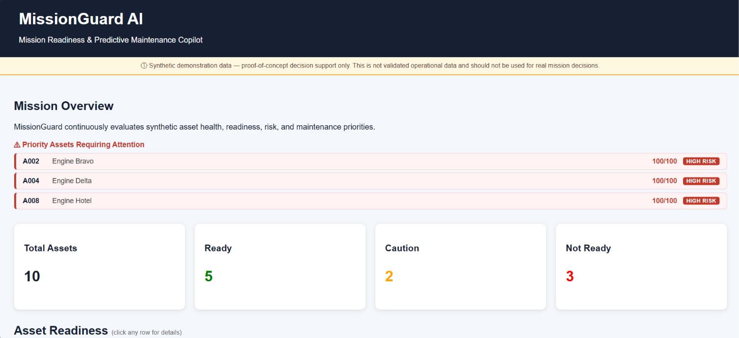
Working prototype: Mission Overview
Actual running application — synthetic demonstration data, as shown in the prototype.
LIVE APPLICATION EVIDENCE
CODESTORM • MISSIONGUARD AI
08

Slide 9
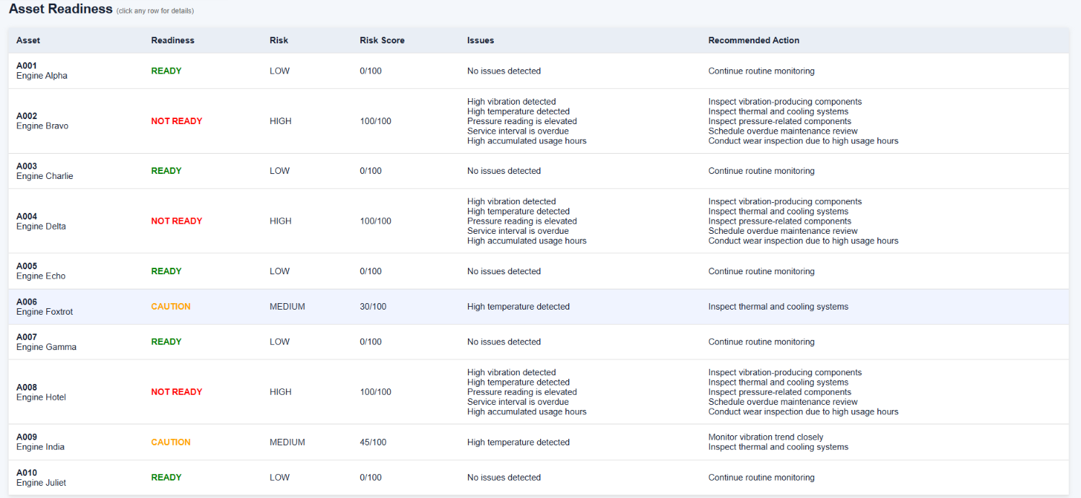
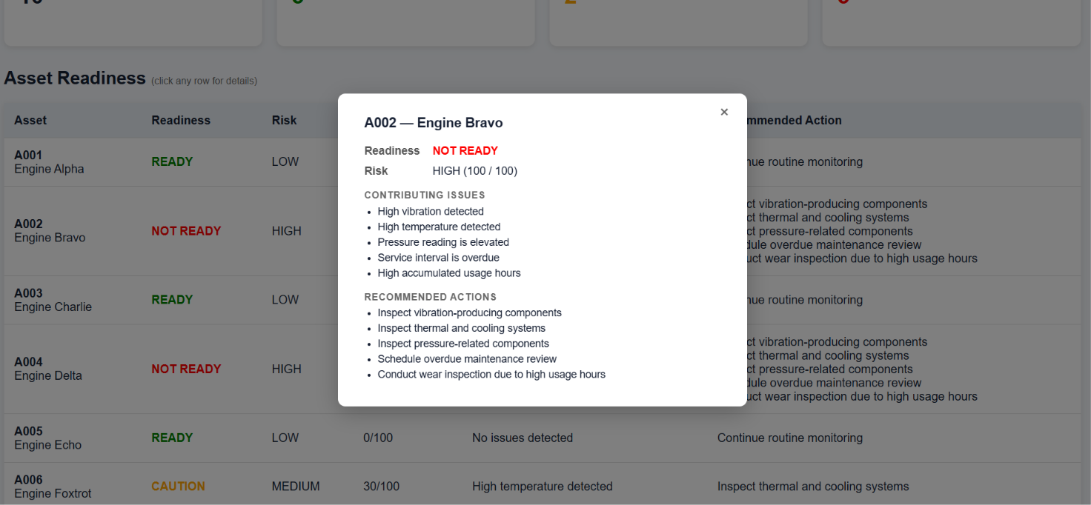
Working prototype: Explainable asset decision
One asset → readiness → contributing issues → recommended maintenance action.
ASSET READINESS
WHY + ACTION
A002 — Engine Bravo
NOT READY
HIGH RISK • 100 / 100
Why: vibration + temperature + pressure + overdue service + accumulated usage
CODESTORM • MISSIONGUARD AI
09

Slide 10
Why MissionGuard stands out
The differentiator is not another dashboard—it is the decision chain.
TRADITIONAL MONITORING
MISSIONGUARD
SENSOR + SERVICE DATA
SENSOR DATA
WHAT? • READINESS / RISK
NUMBERS
WHY? • EXPLANATION
HUMAN INTERPRETATION
ACTION? • PRIORITY
Readiness + component risk + explainability + action
CODESTORM • MISSIONGUARD AI
10

Slide 11
Trust, limits & future scope
Credibility is part of the product.
PROTOTYPE GUARDRAILS
FUTURE SCOPE
▸ Synthetic demonstration data only.
▸ Sensor thresholds are prototype assumptions.
▸ Real deployment needs validated historical datasets.
▸ Failure predictions require validation against actual outcomes.
▸ Recommendations are decision-support suggestions.
▸ Production requires security, monitoring, domain validation and expert review.
▸ Not a replacement for qualified maintenance or operational decision-makers.
BETTER AI
Validated predictive models • anomaly detection • RUL
BETTER DATA
Historical datasets • real-time streams • more indicators
BETTER COPILOT
Natural-language Q&A • what-if analysis • history summaries
ENTERPRISE
Authentication • RBAC • audit logs • alerts • integrations
No unsupported accuracy claims. No unimplemented IBM services.
CODESTORM • MISSIONGUARD AI
11

Slide 12
MISSIONGUARD AI
A clearer path from asset health to mission readiness.
DATA
→
INSIGHT
→
READINESS
→
ACTION
MissionGuard transforms sensor and maintenance data into an explainable mission-readiness assessment, component-level failure-risk insight, and prioritized maintenance plan.
TEAM CODESTORM
Thank you
CODESTORM • MISSIONGUARD AI
12

