Slide 1
Deep Dive Cryptography
November 2018
Kris Hardy
rhardy9@cnm.edu

Slide 2
What We’ll Learn
Intro to Cryptography Concepts
Hashing
Password-based Key Deriviation
Private-Key (Symmetric) Encryption
Public-Key (Assymetric) Encryption

Slide 3
Requirements for a Secure System
CIA Triad
Confidentiality
Integrity
Confidentiality – Is the data/system private?
Integrity – Is the data/system correct?
Availability – Is the data/system available?
Availability

Slide 4
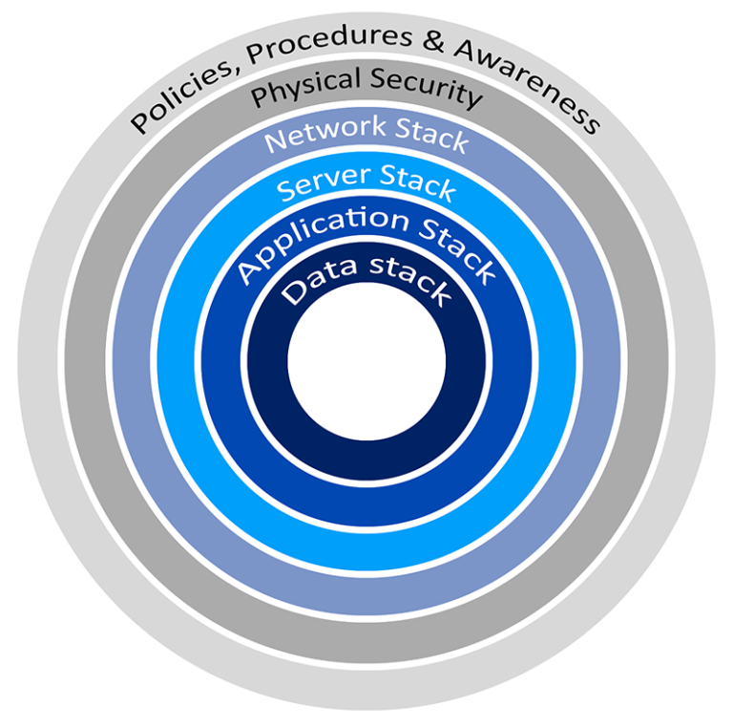
Defense in Depth
(ie the Onion Model)
No system is perfect, so security needs to be considered at each layer
Data has to flow through various security layers
Different controls will be used at different layers

Slide 5
Defense in Depth Examples
Policy, Procedures & Awareness – Employee and user training, incidence response plans, etc.
Physical Security – Locked facilities, badges, etc.
Network Stack – Firewalls, VPNs, IDS/IPS
Server Stack – OS, system firmware updates, secure configuration
Application Stack – Input sanitization, User authentication
Data Stack – Encryption, Backups

Slide 6
Cryptography
The science of encrypting information to hide it from others
Cipher (aka cryptographic algorithm) – The method used to encrypt, decrypt or authenticate the information
Ciphers are hard to design correctly and hard to implement bug-free
NEVER ROLL YOUR OWN CRYPTO! Use proven and expert-reviewed libraries, random number generators, etc.

Slide 7
When to apply cryptography
Data-at-rest – Data is stored somewhere (hard drive, database, etc.) and is not being actively used and is not in RAM.
Data-in-transit – Data is being moved between systems, usually over a network.
Data-in-use – Data is being actively used, often in RAM.

Slide 8
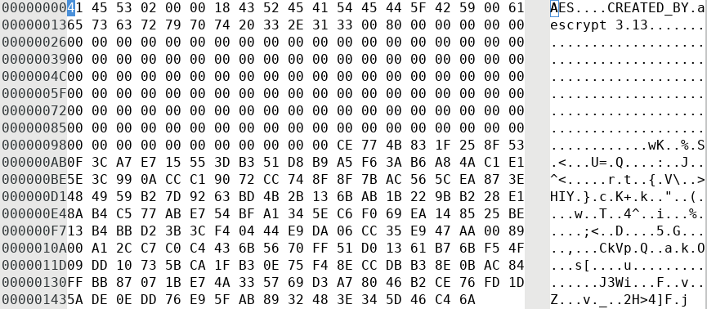
Quick Example: Symmetric Encryption
passwords.txt.aes (shown in a hex editor)
Encrypt
Cipher: aes128
Key: MySecret
passwords.txt
Username: khardy
Password: IL0v3Cryp40
passwords.txt.aes
Decrypt
Cipher: aes128
Key: MySecret
passwords.txt
Username: khardy
Password: IL0v3Cryp40

Slide 9
Hashing
hash(“sha256”, “mypassword”) => 89e01536ac207279409d4de1e5253e01f4a1769e696db0d6062ca9b8f56767c8
A function which performs one-way encryption, but not decryption.
Useful for situations where you don’t want or need the plaintext, but need to know if something is different.
Examples:
  Signatures
  Storing passwords (you don’t want the password, but need to know if it is correct)
  Verify that a file’s contents haven’t changed

Slide 10
Hashing Algorithms
MD5 – Message Digest. Obsolete.
SHA-1 – Secure Hash Algorithm. Vulnerable to collisions, obsolete.
SHA-2 – Includes SHA-224, SHA-256, SHA-384, SHA-512. Creates a hash of the named bit-length. (SHA-512 creates 512-bit hashes)
SHA-3 – New. Named in 2012 by NIST.
HMAC – Hashed Message Authentication Code. Hash-based system to detect message tampering using a Message Authentication Code (MAC).

Slide 11
Hashing Algorithms
RIPEMD – RACE Integrity Primitives Evaluation Message Digest. 128-bit version is vulnerable.
RIPEMD-160 – Strengthened RIPEMD algorithm that creates a 160-bit hash. RIPEMD-256 and RIPEMD-320 are available, but don’t significantly increase the hash strength.

Slide 12
Hashing in PHP
hash() - Hashes a value
hash_equals() - Compares a two hashes in a way to avoid timing attacks
hash_algos() - Lists available algorithms

Slide 13
Key Stretching
A feature of some cryptographic algorithms that derive strong keys from weaker passwords.
Example: Password-based Key Derivation Functions (PBKDF)
  Runs repetitive hashing on a password to create a repeatable, high-entropy key
  Common Algorithms: PBKDF2, Argon2

Slide 14
Key Stretching Algorithms
BCRYPT – Derives keys using the Blowfish cipher and salting, and adds an iteration count to provide adaptive strength.
  Adaptive function – Part of an algorithm that allows it to increase in strength as computing power increases.
PBKDF2 – Password-based Key Derivation Function 2
  Uses a passphrase and salt, and applies an HMAC to the input iteratively to provide adaptive strength.

Slide 15
PBKDF2 in PHP
hash_pbkdf2()
hash_equals()
password_hash()
password_verify()

Slide 16
Terms
Plaintext – The unencrypted information that needs to be protected
Ciphertext – The resulting information after encryption that is created by the cipher
Cryptanalysis – Attempting to break the cryptography by analyzing the plaintext, ciphertext and/or cipher

Slide 17
Cryptographic Security Concerns
Collision – When two different inputs result in the same output.
Key Strength – Usually, the longer the key, the stronger the encryption. Each cipher has its own key length.
  DES=56-bits AES-128=128-bits
Security through Obscurity – Hiding things rather than properly securing them. DO NOT RELY ON OBSCURITY!

Slide 18
Symmetric Algorithms
Example Uses
You want to save a list of passwords for your favorite websites on your computer.
You want to share data with someone that you can give a password to by another method (phone, in-person, etc.)

Slide 19
Symmetric Algorithms
Encrypt
Cipher: aes128
Key: MySecret
passwords.txt
Username: khardy
Password: IL0v3Cryp40
The same key is used to encrypted AND decrypt.
Only store and share the key using secure means.
  What does secure mean? It depends on the situation.
Key Exchange becomes critical. Consider how you will share keys with other parties.

Slide 20
Symmetric Cryptographic Algorithms
DES – Data Encryption Standard (obsolete, replaced by AES). [Block Cipher]
3DES – Triple DES. Uses DES three times, with 2 or 3 different keys. (multiple encryption) (replaced by AES). [Block Cipher]
AES – Advanced Encryption Standard. The algorithm (Rijndael) won the NIST AES competition in 2000. [Block Cipher]
RC4 – Rivest Cipher 4. A very fast stream cipher.
Blowfish/Twofish – Block ciphers. Twofish was an AES finalist.

Slide 21
Symmetric Algorithms in PHP
sodium_crypto_*()
mcrypt_encrypt() / mcrypt_encrypt() (deprecated)

Slide 22
Asymmetric Algorithms
Example Uses
You want to share data with someone without giving away your secret or getting theirs.
You want to store things so that only certain people can read them.
You need to share sensitive data over an insecure channel.

Slide 23
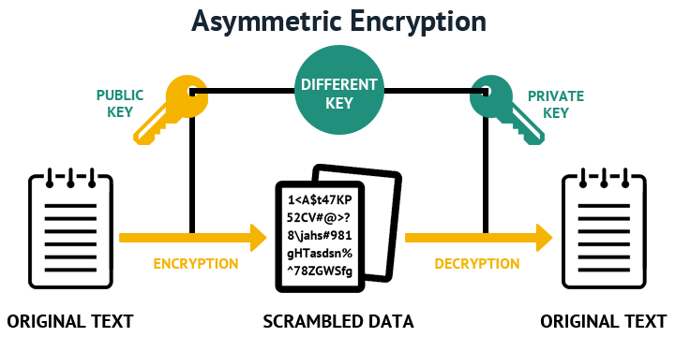

Slide 24
Asymmetric Algorithms
Also called public key cryptography
Two keys are used for each party: a public key and a private key
The public key can be shared
The private key must never be shared
Often used to both encrypt/decrypt (provide confidentiality) and sign (provide authentication and non-repudiation)
Non-repudiation – The signer of the message can prove that they signed it.

Slide 25
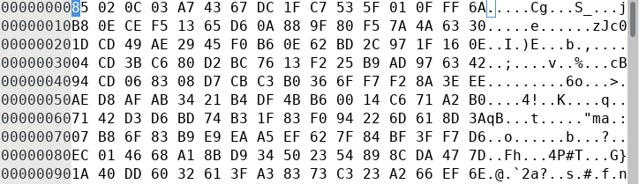
Asymmetric Encryption
(Sending sensitive data to Jim)
passwords.txt.gpg (shown in a hex editor)
passwords.txt
Encrypt
Cipher: PGP
Encryption Key: Jim’s Public Key
Signing Key: My Private Key
Username: khardy
Password: IL0v3Cryp40
passwords.txt
Decrypt
Cipher: PGP
Verification Key: My Public Key
Decryption Key: Jim’s Private Key
Username: khardy
Password: IL0v3Cryp40

Slide 26
Asymmetric Encryption Algorithms
Rely on mathematically hard trapdoor functions
  Functions that are easy in one direction, but hard in the other direction
Example: Prime Factorization - Multiplying two prime numbers together is easy. Factoring this large number into its two primes is difficult.
  What is 5683 x 8803? (it’s 5002749)
  What are the two factors of 14273419? (How would you solve this?)

Slide 27
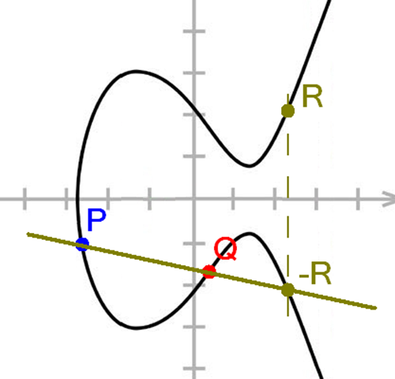
Asymmetric Encryption Algorithms
Answer: 14273419 = 3109 x 4591
Another Example: Elliptic Curve Cryptography (ECC) – Using a 3rd order polynomial curve, following a line between points is easy. If you only know the end result, reversing the process is hard.
  P + Q = R

Slide 28
Asymmetric Cryptographic Algorithms
RSA – One of the first public key cryptosystems. Usually used to encrypt a symmetric key, which is used to encrypt data. (electronic key exchange)
DSA – Digital Signature Algorithm. Used to sign and authenticate data.
Diffie-Hellman – The gold standard for key exchange. Allows the sharing of a secret key between two people who have not previously contacted each other.

Slide 29
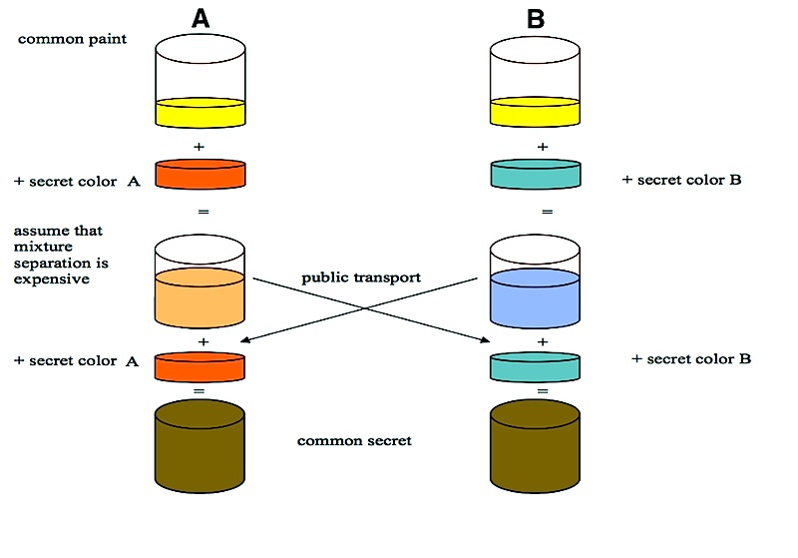
Diffie-Hellman Key Exchange

Slide 30
Symmetric vs. Asymmetric
Symmetric Cipher | Asymmetric Cipher
Faster Good for bulk data All keys must be protected | Slower Good for smaller datasets Easier key management
How about using both Symmetric & Asymmetric ciphers together?
SSL does this using a Session Key.
The data is encrypted with a symmetric cipher using a random symmetric key.
The asymmetric cipher is used to encrypt a symmetric key.

Slide 31
Asymmetric Algorithms in PHP
openssl_public_encrypt()
openssl_public_decrypt()
openssl_private_encrypt()
openssl_private_decrypt()
sodium_crypto_box() / sodium_crypto_box_open()

Slide 32
Weak Algorithms
Errors in ciphers may create vulnerabilities.
Ciphers rely on difficult mathematical problems, which may be easier to solve as computers get more powerful.
As ciphers become weak, disable them in your systems.
Examples: DES, 3DES, MD5, SHA-1

