Slide 1
repoze.who.plugins
Kris Hardy

Slide 2
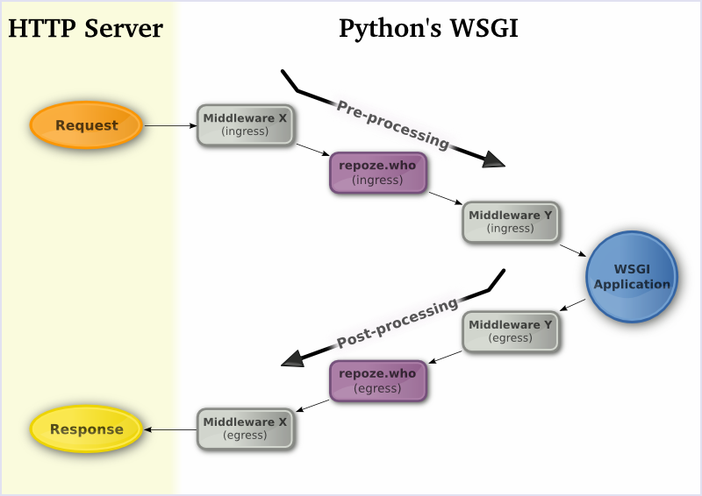
http://gustavonarea.net/blog/posts/repoze-auth/

Slide 3
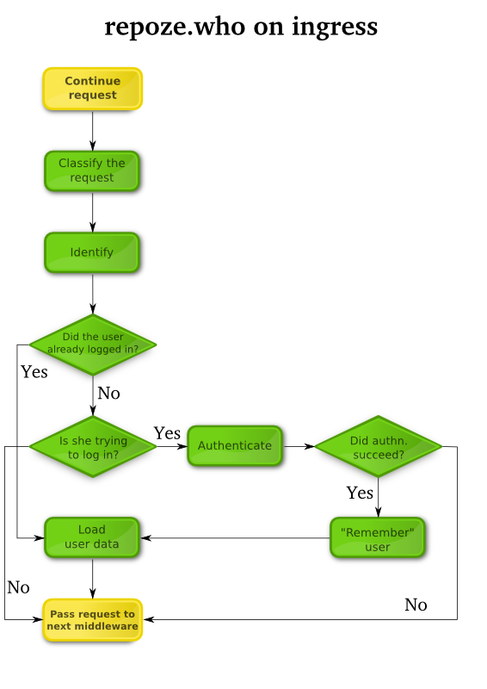
http://gustavonarea.net/blog/posts/repoze-auth/

Slide 4
repoze.who request lifecycle
Classification
  Determines the type of request, classifies it, and passes it back
  Brower, xmlrpc, oauth, etc.
Identification
  Extracts and prepares credentialsfor the user
  auth_tkt (cookie), form, oauth, etc.
Authentication
  Authenticates the credentials
  htpasswd,sql, sqlalchemy, etc.
Metadata
  Supplements the identity with additional data (email address, first name, last name, groups, roles, etc.)
  repoze.what 1.0 is a metadata provider

Slide 5
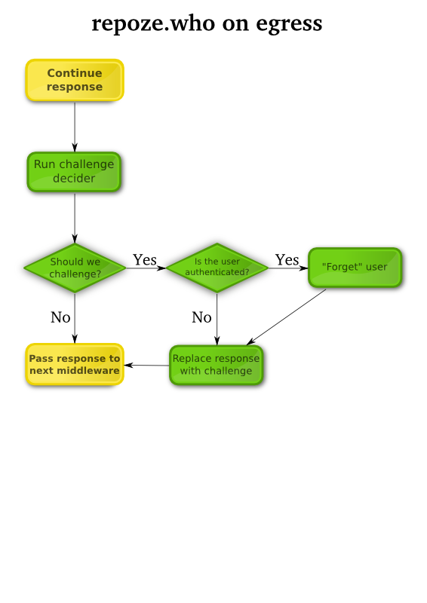
http://gustavonarea.net/blog/posts/repoze-auth/

Slide 6
repoze.who response lifecycle
Challenge Decision
Determines if a challenge should be issued
  HTTP Status Code 401, etc.
Challenge Decision = True: Challenge
  Returns a challenge if the identifcation did not succeed
  browser, xmlrpc, oauth, etc.
Challenge Decision = False: Remember
  The identifier that returned the best set of credentials will be directed to “remember” the credentials.

