Slide 1

By
Arun Krishnan A

Slide 2
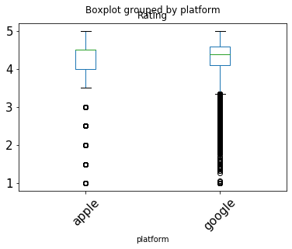
platform | count | mean | Std | min | 25% | 50% | 75% | max
apple | 6268.0 | 4.04969 | 0.72694 | 1.0 | 4.00000 | 4.500 | 4.50000 | 5.0
google | 31996.0 | 4.27120 | 0.49963 | 1.0 | 4.09090 | 4.375 | 4.58333 | 5.0
Our means 4.0496 and 4.2712
There's no significant difference between Google Play app reviews and Apple Store app reviews.
The observed difference is 0.22150

Slide 3
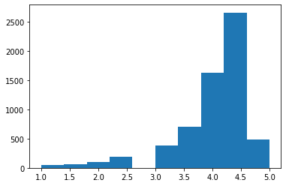
Apple
Reviews
Ratings

Slide 4
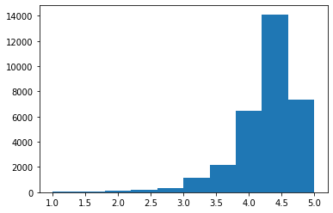
Google
Reviews
Ratings

Slide 5
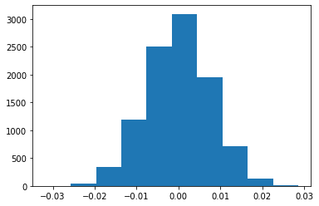
Difference in the means

Slide 6
Conclusion
So actually, zero differences are at least as extreme as our observed difference.
So the p-value of our observed data is 0.
Our observed data is statistically significant, and we reject the Null.
We conclude that platform does impact on ratings.

