Slide 1
eBook SubscriberIntelligence
Who stays, who leaves, and what to do about it — a subscriber engagement
analysis with a live Streamlit dashboard
Krisha Kadam · Industrial Research Project · October 2026
5,455 subscribers scored · recency + logins + session minutes · Python · pandas · Streamlit

Slide 2
What this project is
One project, one question — what makes an eBook subscriber stay?
The question
Which subscribers are still reading, which have gone quiet, and which are already gone — and what should the business do with each group?
The data
Two files, one project: the customer file (16,404 customers, 33.2% subscribed) and the engagement file (5,455 subscribers with real reading behaviour).
The answer
A 0–100 engagement score per subscriber, an Active / Inactive / Churned status, and a recommended strategy for each group.
Most subscribers are staying
55.3% of classified subscribers are Active (logged in within 30 days). 28.0% are Inactive — quiet for 31–90 days and still win-backable. 16.6% are Churned — silent for more than 90 days.
Every number in this deck comes from the dataset — nothing is simulated or invented.
eBook Subscriber Intelligence · K. Kadam · October 2026
2 / 27

Slide 3
How the analysis works
Five steps — every rule approved in writing before it was applied
1
2
3
4
5
Clean
Drop 45 duplicate rows, collapse 23 genre spellings into 8 genres, flag 144 median-filled rows. Recency is never invented.
Explore
Charts and correlations first — what the data shows decides what goes into the score, not the other way round.
Score
100 × (0.40 × inverted recency + 0.35 × logins + 0.25 × session minutes). Books excluded: r = 0.88 with logins.
Classify
Active ≤ 30 days · Inactive 31–90 · Churned > 90. 33 rows with missing recency stay Unclassified.
Act
Three strategy cards — Retain, Win back before day 90, Win-back — each tied to a finding and a literature theme.
→
→
→
→
Ground rules: weights and thresholds were proposed and approved before use · every chart carries a takeaway caption · associations are reported as associations, never as causes.
eBook Subscriber Intelligence · K. Kadam · October 2026
3 / 27

Slide 4
The engagement score
One number per subscriber — and every ingredient visible
Score = 100 × (0.40 × inverted recency
+ 0.35 × logins + 0.25 × session minutes)
Why books is not in the score
Books accessed correlates r = 0.88 with logins — both measure usage frequency. Counting both would weight the same behaviour twice, so books stays descriptive (and becomes a useful independent check later).
Recency (days since last login)
0.40
inverted — fewer days scores higher
How the score becomes a tier
Terciles — the data's own one-third and two-third marks: Low ≤ 40.80 · Medium ≤ 51.25 · High above. Equal thirds, no invented round-number cutoffs.
Average logins per month
0.35
how often they come back
Average session minutes
0.25
how long they stay
The honest caveat
Three of four inputs reappear in the behaviour charts, so part of the tier separation is by construction — the books panel is the independent test.
eBook Subscriber Intelligence · K. Kadam · October 2026
4 / 27

Slide 5
Who is Active, Inactive or Churned
Recency thresholds — approved in writing before being applied
Active
3,001
55.3%
Logged in within the last 30 days, at least 1 login/month
Inactive
1,520
28.0%
Quiet for 31–90 days (or under 30 days with zero logins)
Churned
901
16.6%
No activity for more than 90 days — median 152 days
Unclassified
33
—
Recency missing or invalid — never guessed, shown separately
Status is recency-based by definition — that is why the behavioural comparisons in this deck are honest: the chart is not simply repeating the rule.
eBook Subscriber Intelligence · K. Kadam · October 2026
5 / 27

Slide 6
The dashboard — a guided tour
7 pages · Start Here · Final Report · Explore the Data · Customer Lookup ·
Method and Data · Glossary · Propensity Model — every chart explains what it shows, how to read it, and what it means.
eBook Subscriber Intelligence · K. Kadam · October 2026
6 / 27

Slide 7
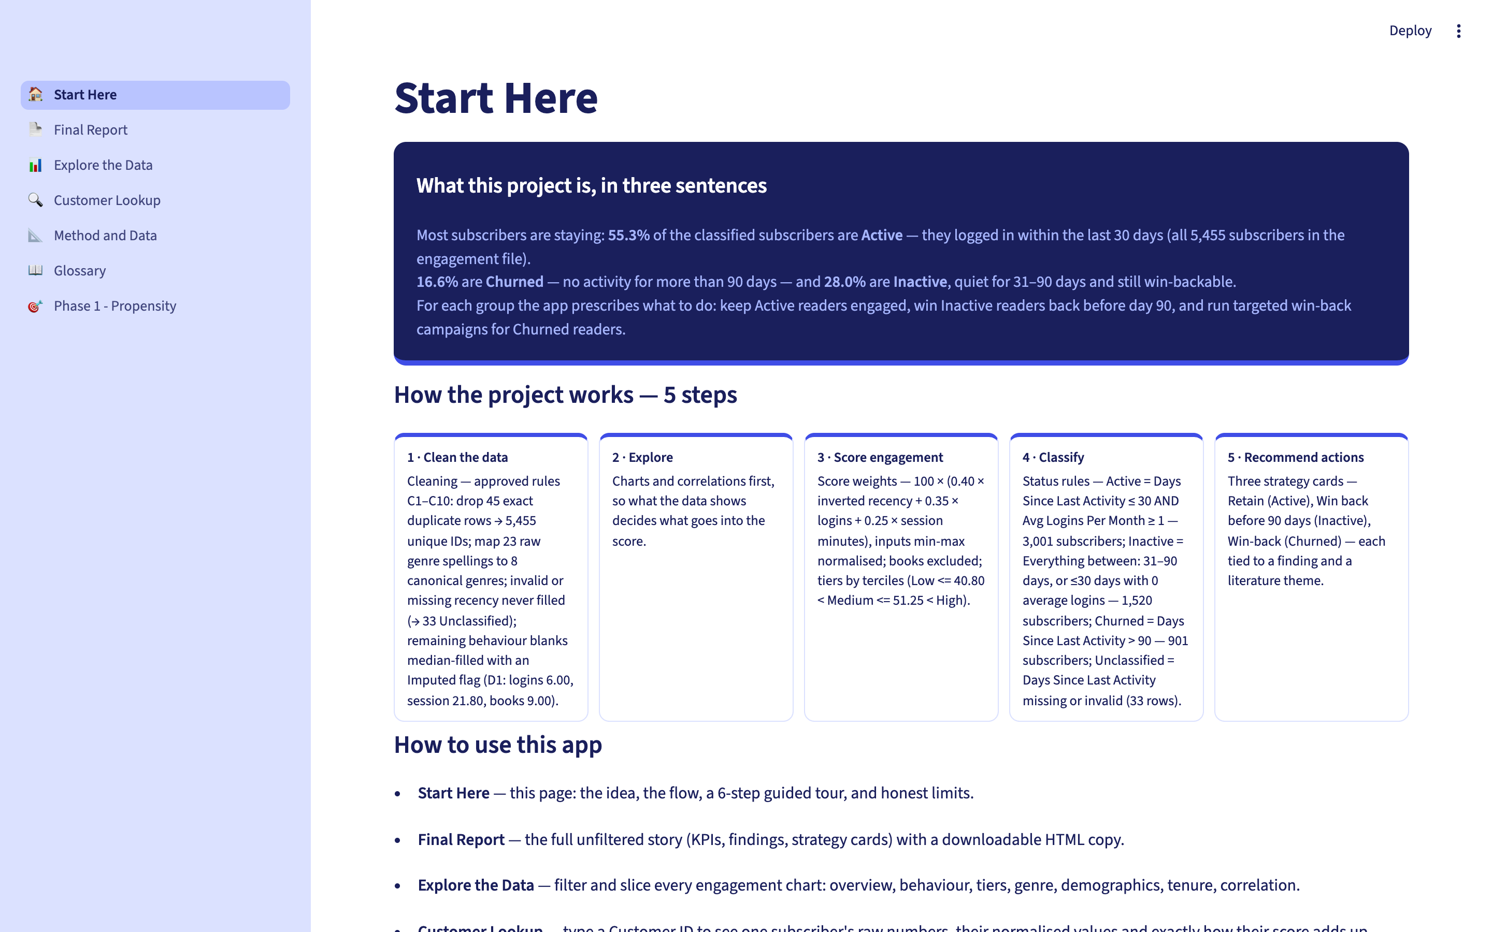
Page 1 · Start Here
Orientation page — what the project is, in plain language
Takeaway: New visitors are told what the app can and cannot tell them before any chart is shown.
eBook Subscriber Intelligence · K. Kadam · October 2026
7 / 27

Slide 8
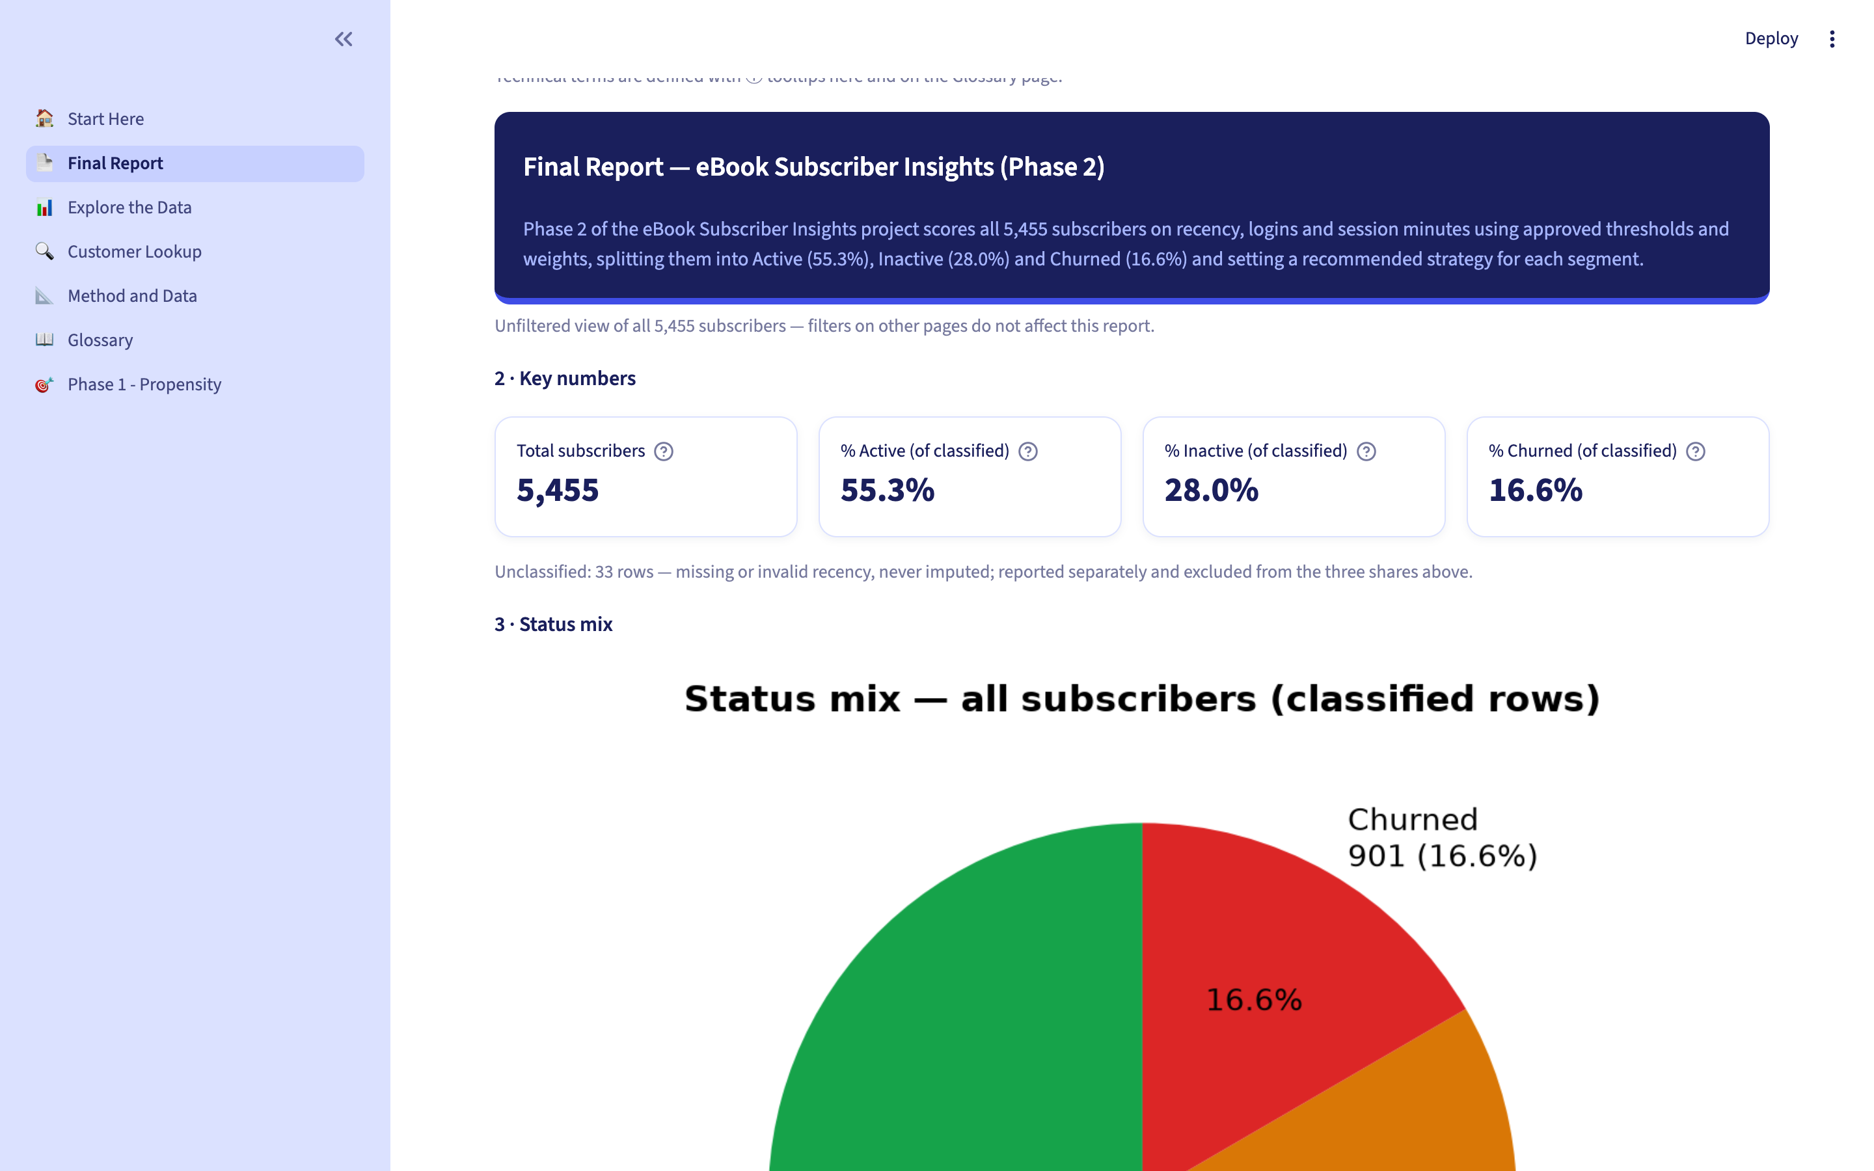
Page 2 · Final Report — key numbers
The unfiltered story of all 5,455 subscribers
Takeaway: 55.3% Active · 28.0% Inactive · 16.6% Churned — the headline every stakeholder sees first.
eBook Subscriber Intelligence · K. Kadam · October 2026
8 / 27

Slide 9

Page 2 · Final Report — status mix
The staying-versus-leaving problem, sized
Takeaway: Most subscribers stay; the actionable middle group is the 1,520 Inactive readers.
eBook Subscriber Intelligence · K. Kadam · October 2026
9 / 27

Slide 10

Page 2 · Final Report — tiers & watchlist
Low / Medium / High tiers, with an early-warning list
Takeaway: 11 subscribers are Active today but already Low tier — the earliest possible warning list.
eBook Subscriber Intelligence · K. Kadam · October 2026
10 / 27

Slide 11

Page 2 · Final Report — strategy cards
One recommended strategy per status group
Takeaway: Retain Active · Win back Inactive before day 90 · Win-back Churned — each tied to evidence.
eBook Subscriber Intelligence · K. Kadam · October 2026
11 / 27

Slide 12
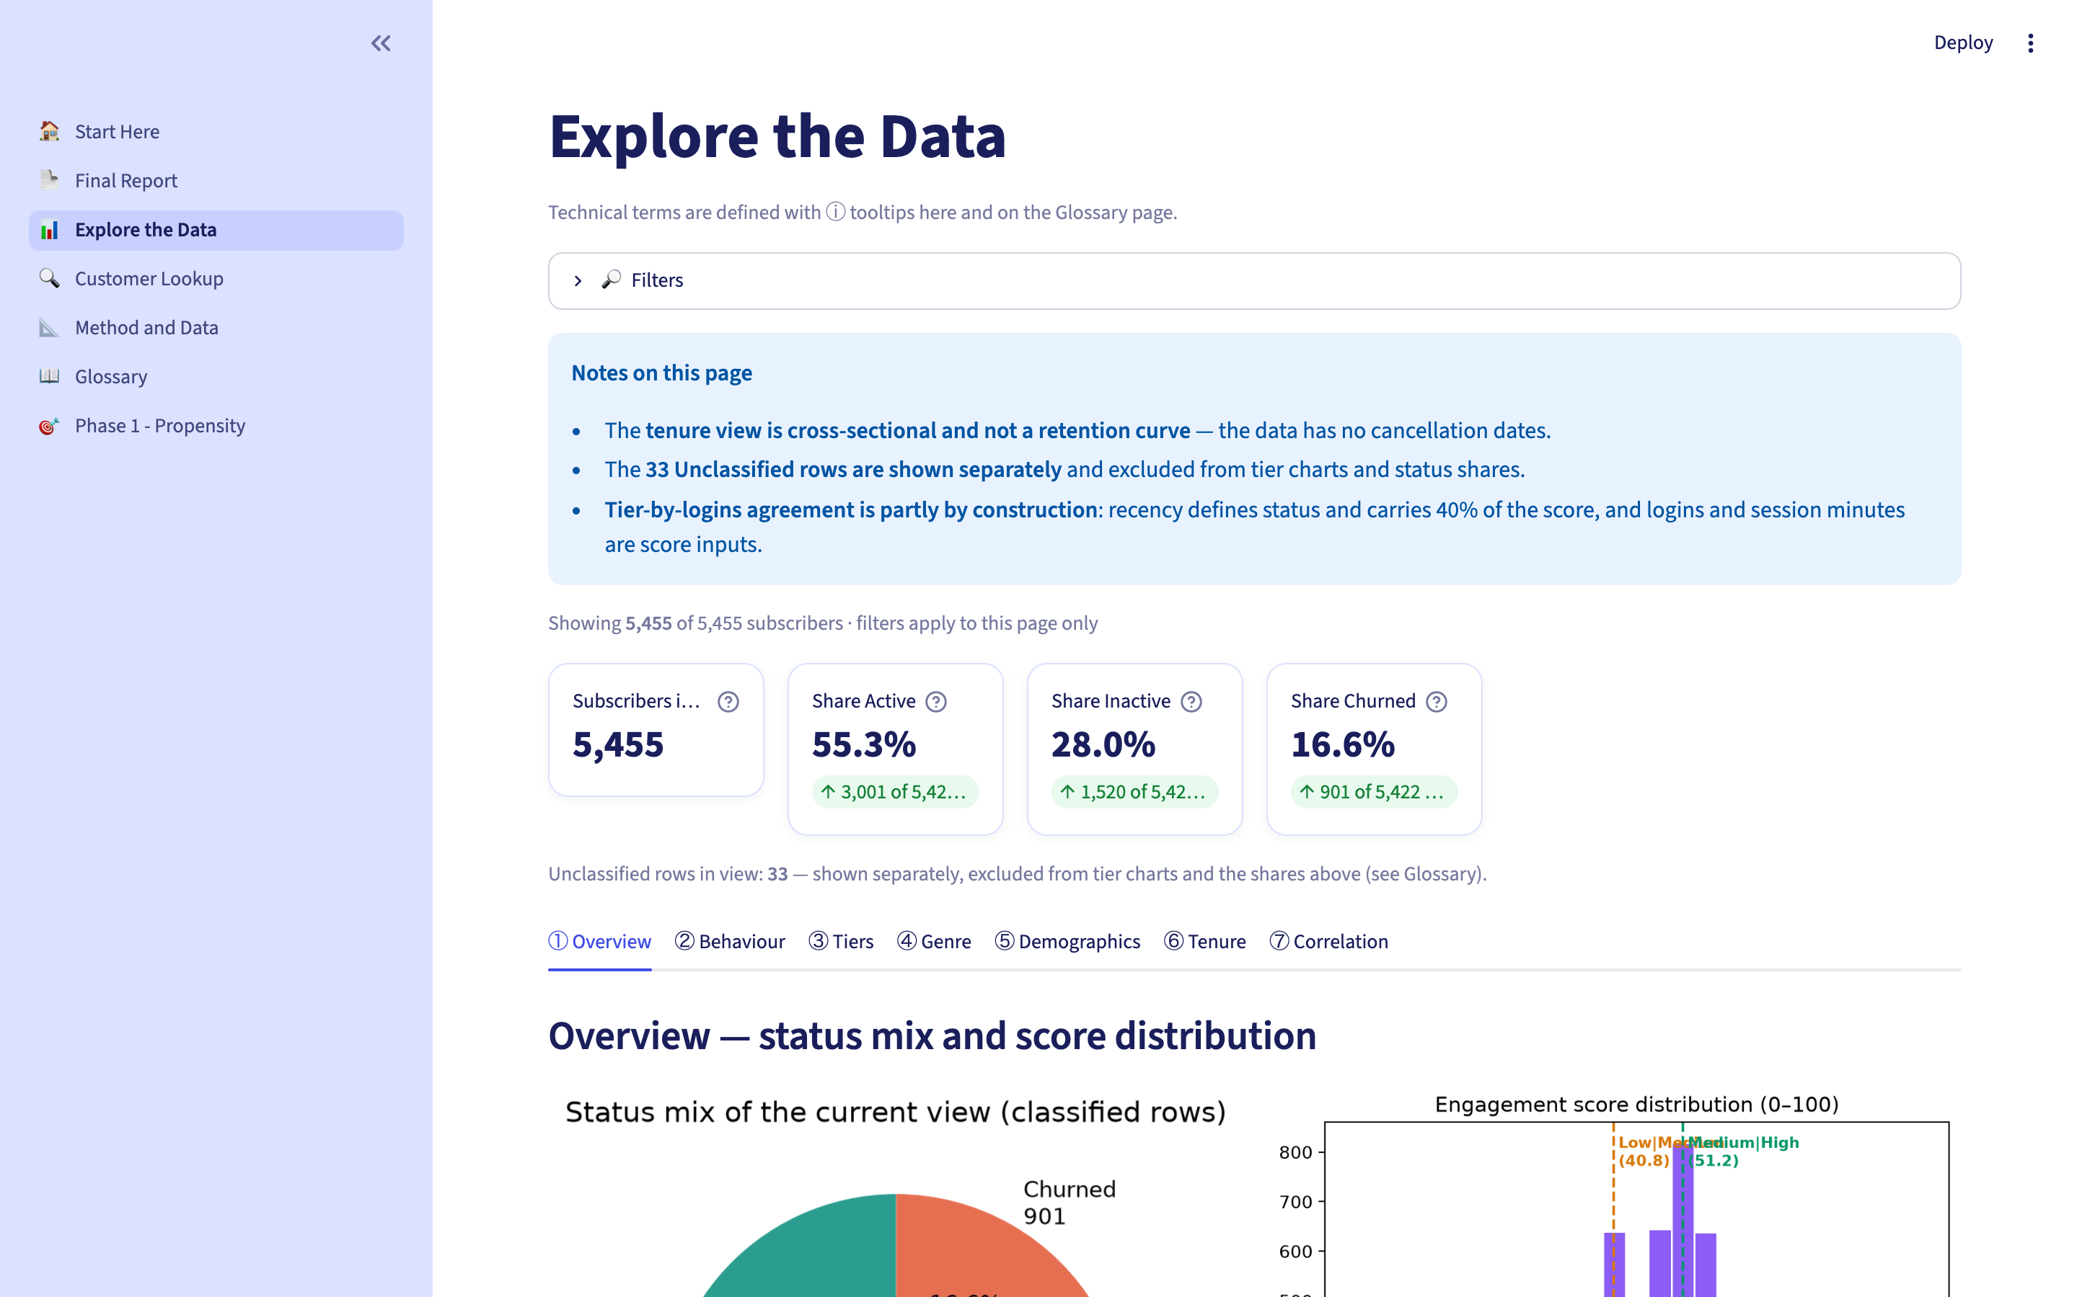
Page 3 · Explore the Data
7 filterable views of the subscriber base
Takeaway: Filters update every chart below — status, tier, genre, age, occupation, education, tenure, state.
eBook Subscriber Intelligence · K. Kadam · October 2026
12 / 27

Slide 13
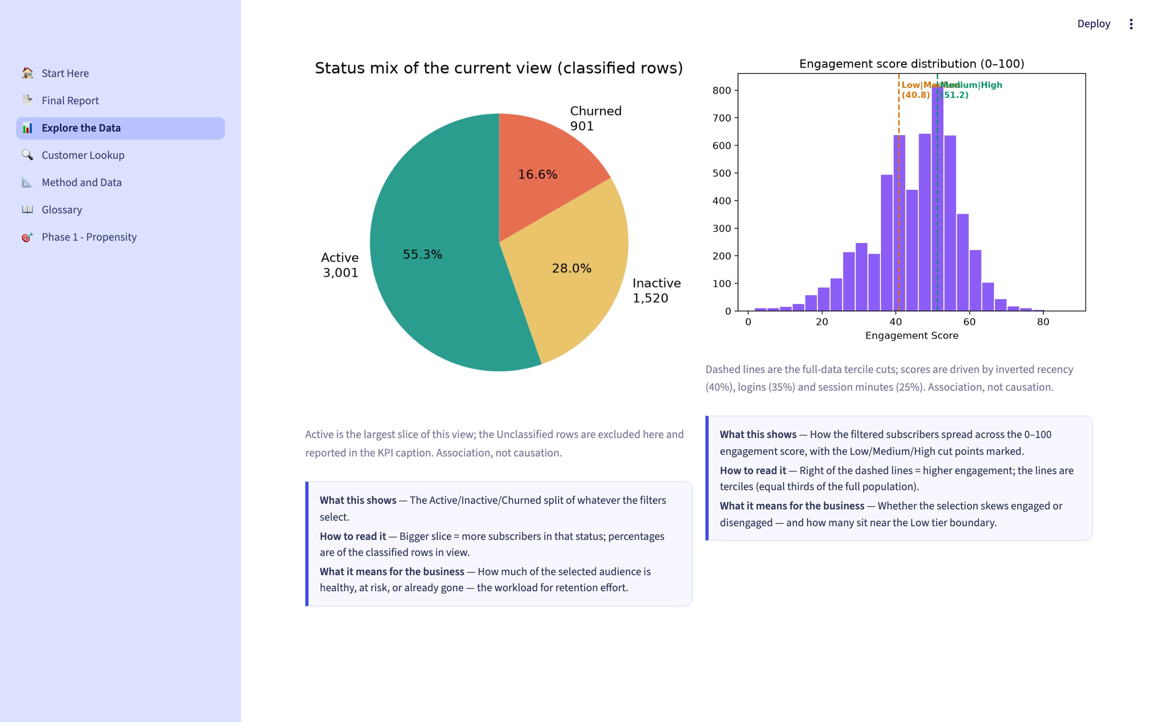
Explore · Overview
Status mix and score distribution of the current view
Takeaway: Where the selected audience sits between healthy, at risk and already gone.
eBook Subscriber Intelligence · K. Kadam · October 2026
13 / 27

Slide 14
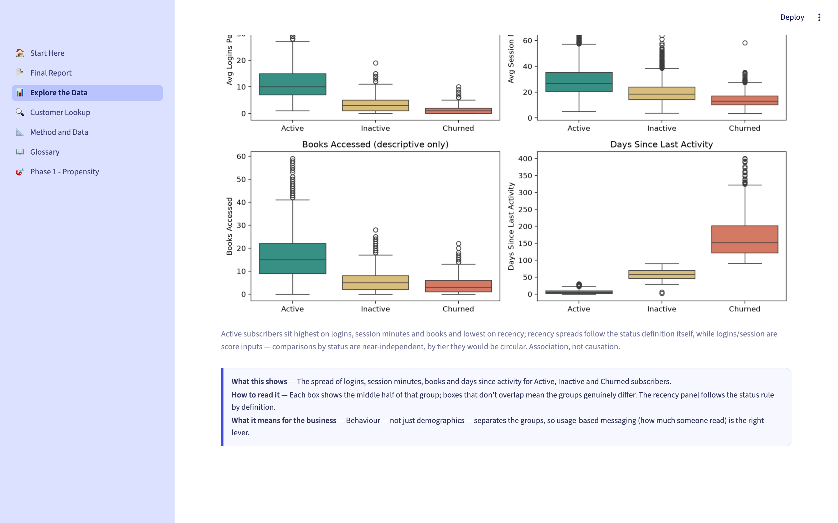
Explore · Behaviour
Logins, session minutes, books and recency by status
Takeaway: Behaviour — not just demographics — separates the groups: Active 11.7 logins vs Churned 1.5.
eBook Subscriber Intelligence · K. Kadam · October 2026
14 / 27

Slide 15
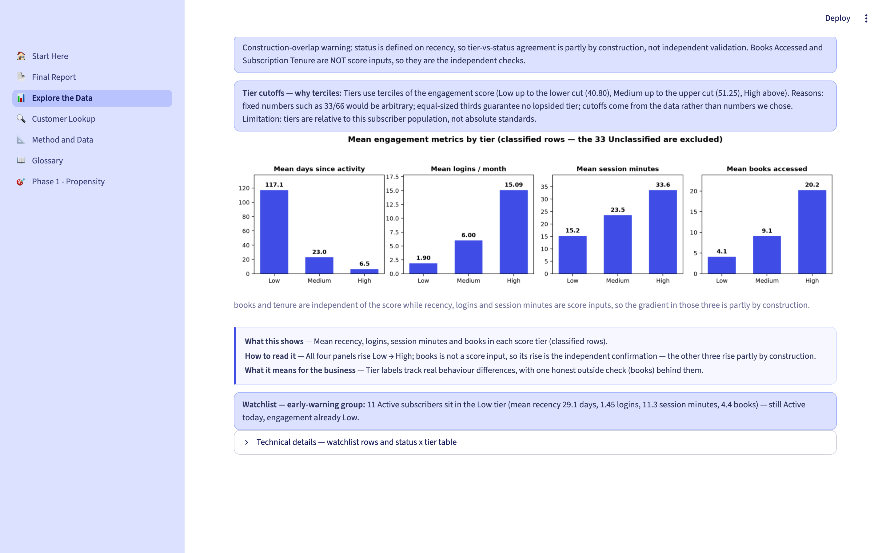
Explore · Tiers
What the Low, Medium and High tiers really look like
Takeaway: Books rise 4.1 → 9.1 → 20.2 across tiers — the independent check that the score means something.
eBook Subscriber Intelligence · K. Kadam · October 2026
15 / 27

Slide 16
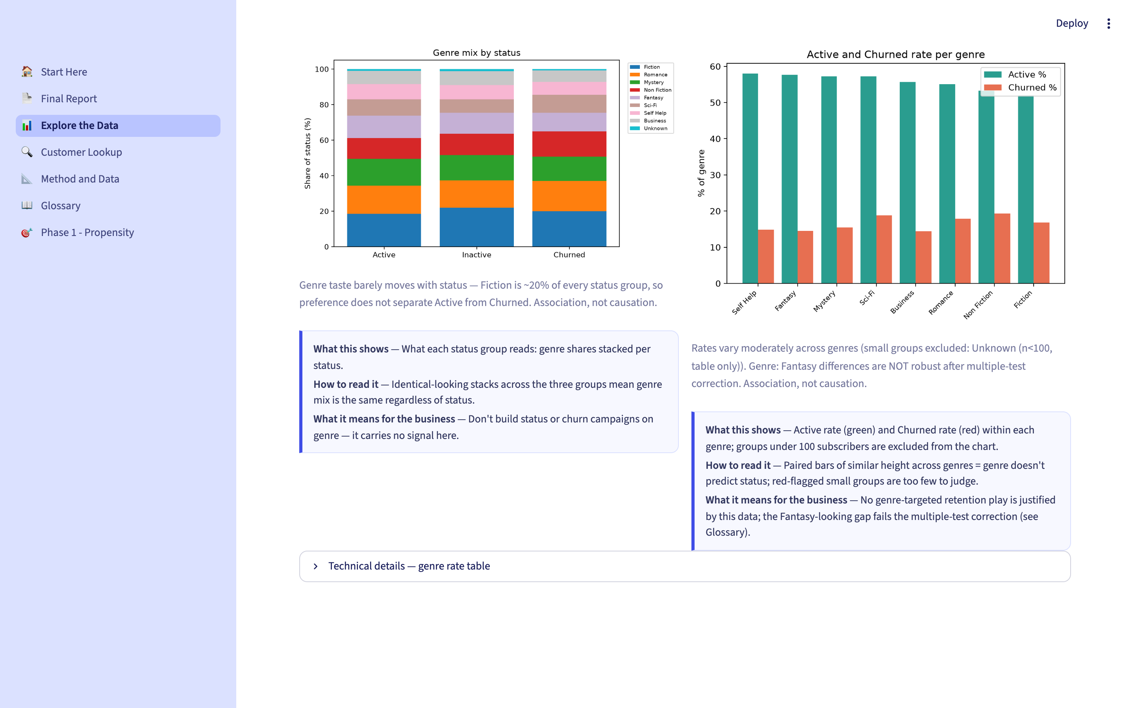
Explore · Genre
Does what people read predict whether they stay?
Takeaway: No — Active rates span only 52–58% across genres. A null finding, reported honestly.
eBook Subscriber Intelligence · K. Kadam · October 2026
16 / 27

Slide 17
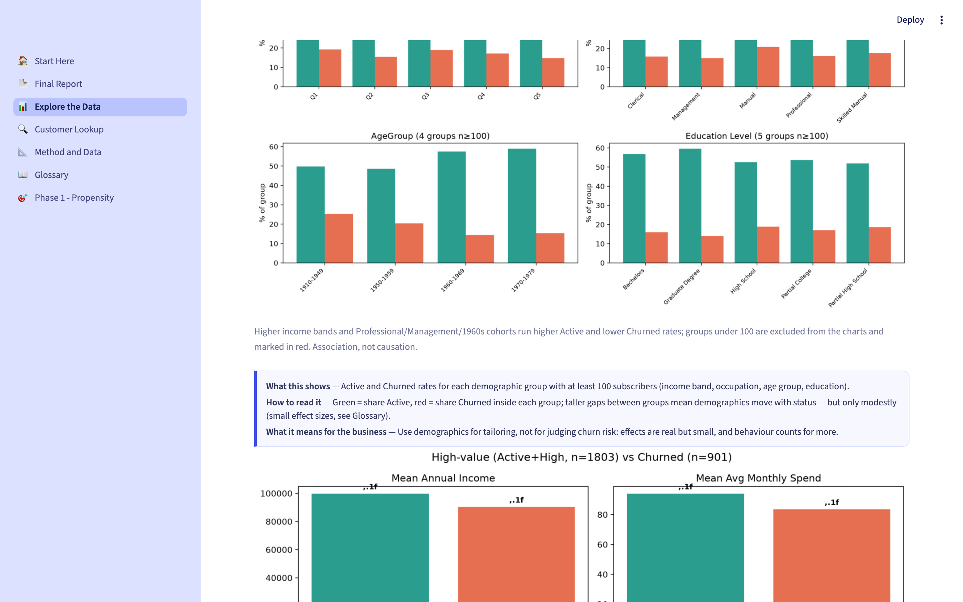
Explore · Demographics
Income, occupation, age and education vs status
Takeaway: Demographic effects are real but small (d ≈ 0.2–0.3) — tailor with them, don't judge churn on them.
eBook Subscriber Intelligence · K. Kadam · October 2026
17 / 27

Slide 18
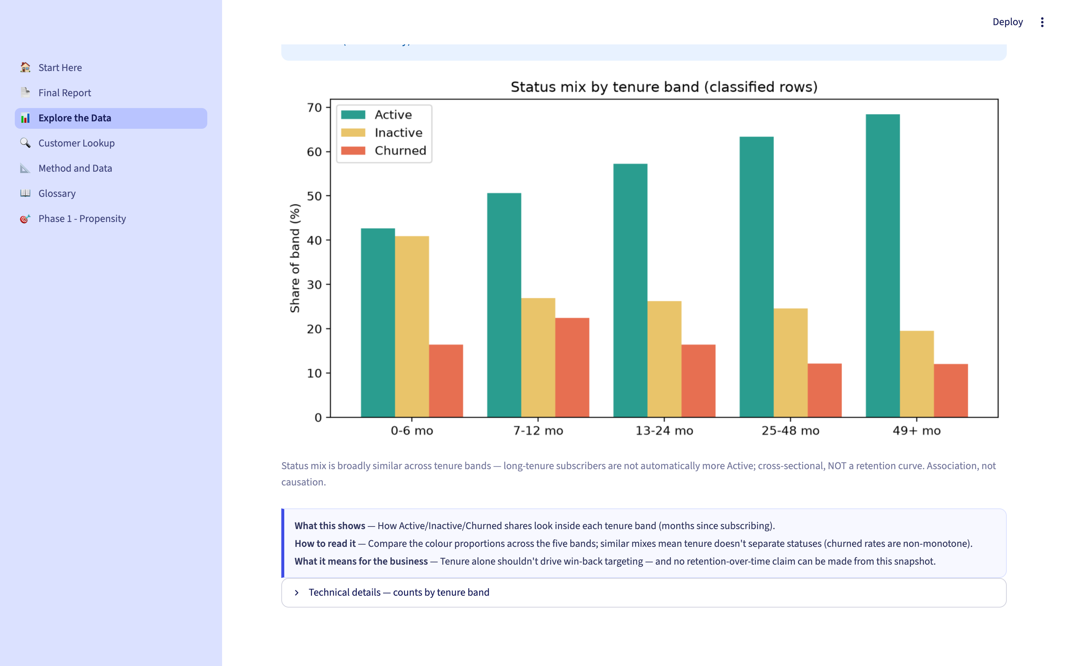
Explore · Tenure
Status mix by months since subscribing
Takeaway: Tenure does not reliably separate churn — cross-sectional, not a retention curve.
eBook Subscriber Intelligence · K. Kadam · October 2026
18 / 27

Slide 19
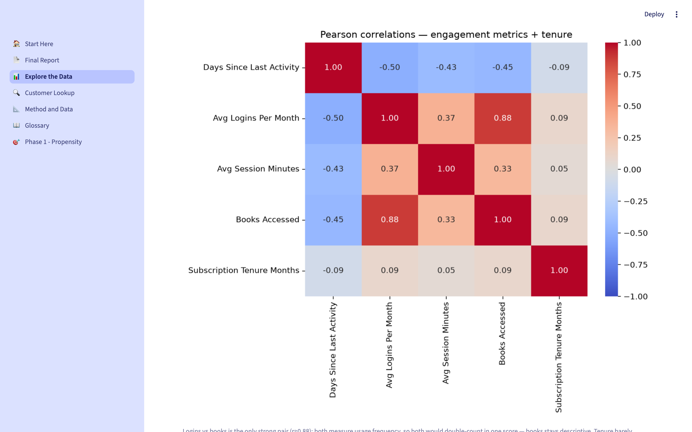
Explore · Correlation
How the engagement metrics move together
Takeaway: Logins ↔ books r = 0.88 — the double-counting that justified excluding books from the score.
eBook Subscriber Intelligence · K. Kadam · October 2026
19 / 27

Slide 20
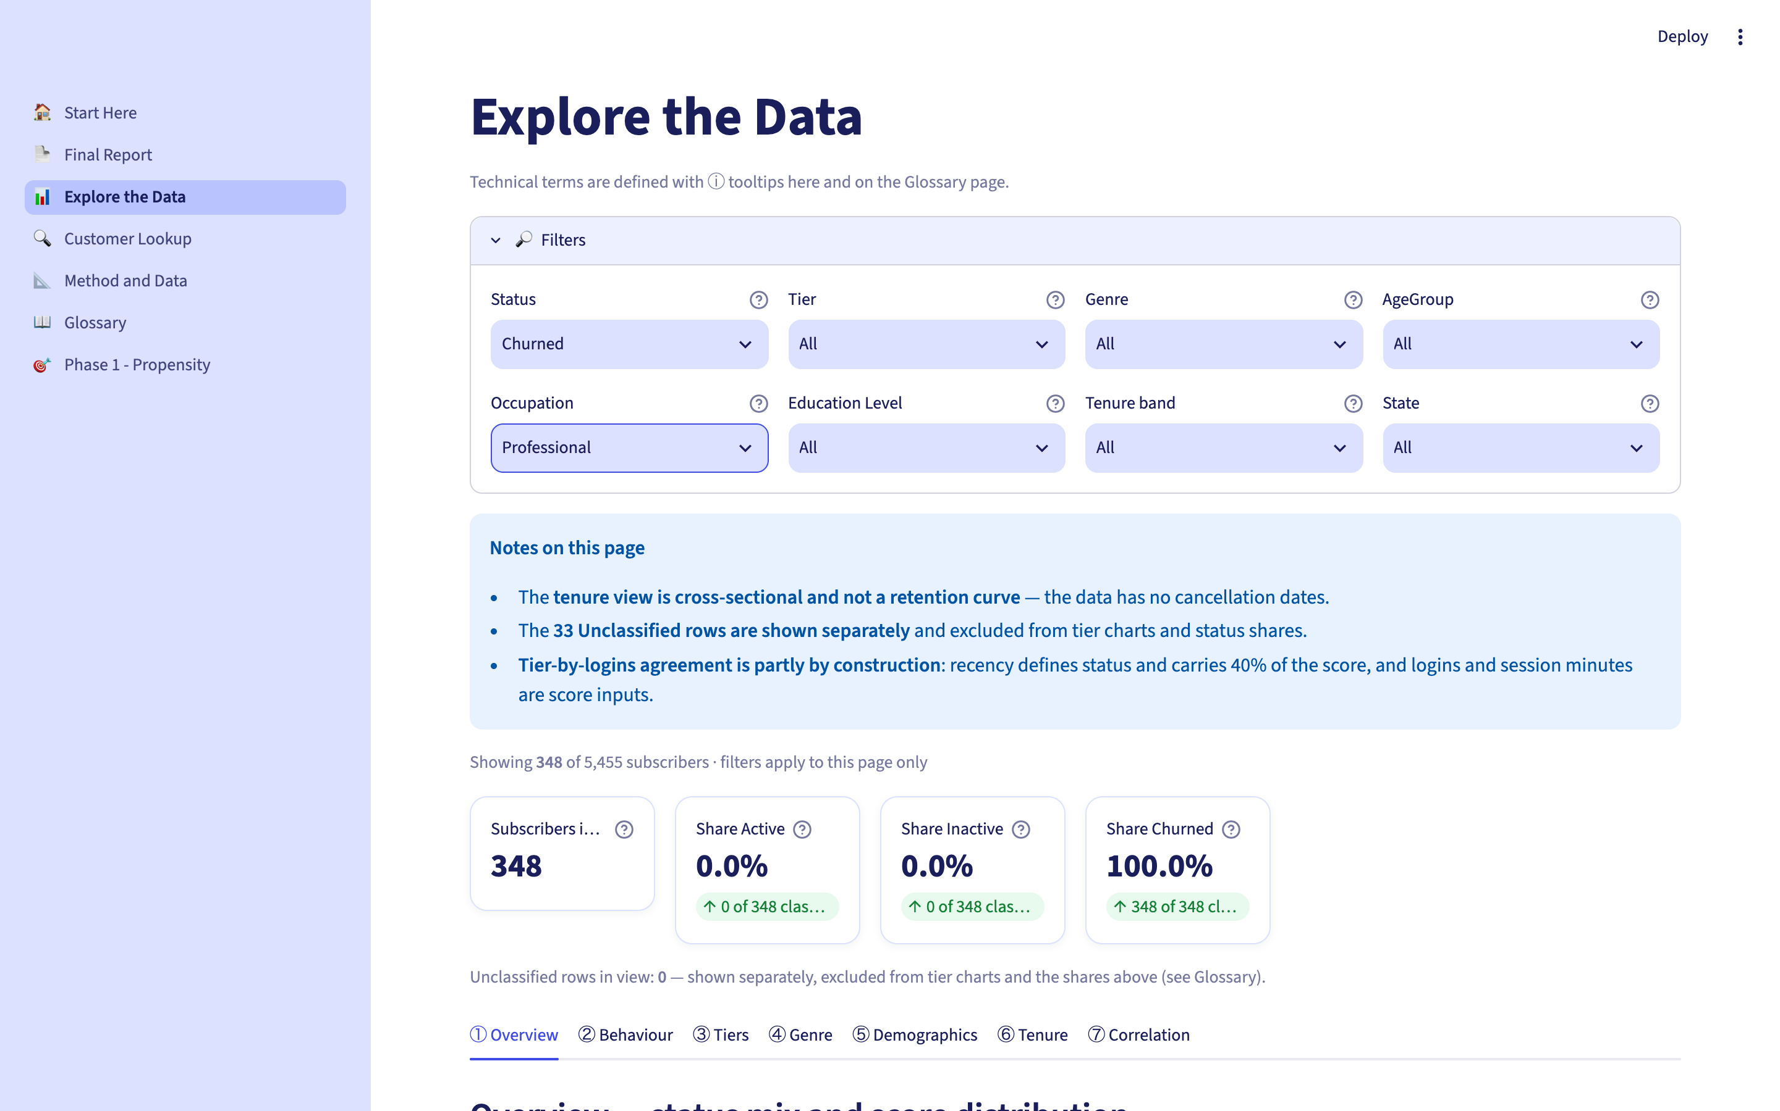
Demo · Filtering
Status = Churned + Occupation = Professional
Takeaway: Every chart and KPI updates together — segment-specific strategies are one click away.
eBook Subscriber Intelligence · K. Kadam · October 2026
20 / 27

Slide 21
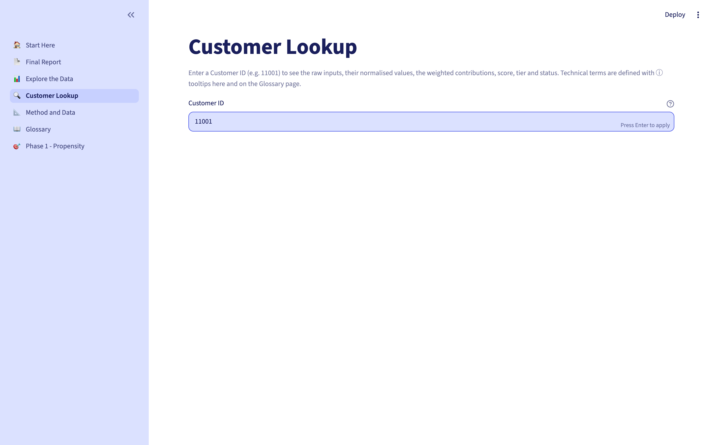
Page 4 · Customer Lookup
One subscriber, fully explained
Takeaway: Raw values → normalised 0–1 → weighted contributions → score: the whole model in one row.
eBook Subscriber Intelligence · K. Kadam · October 2026
21 / 27

Slide 22
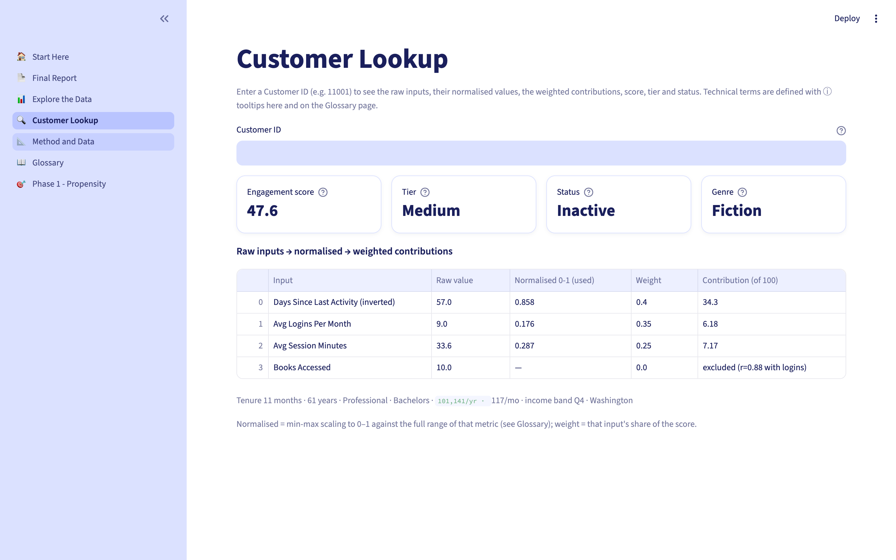
Page 5 · Method and Data
Everything needed to reproduce the analysis
Takeaway: Data profile, cleaning rules, weights and thresholds — the anti-black-box page.
eBook Subscriber Intelligence · K. Kadam · October 2026
22 / 27

Slide 23
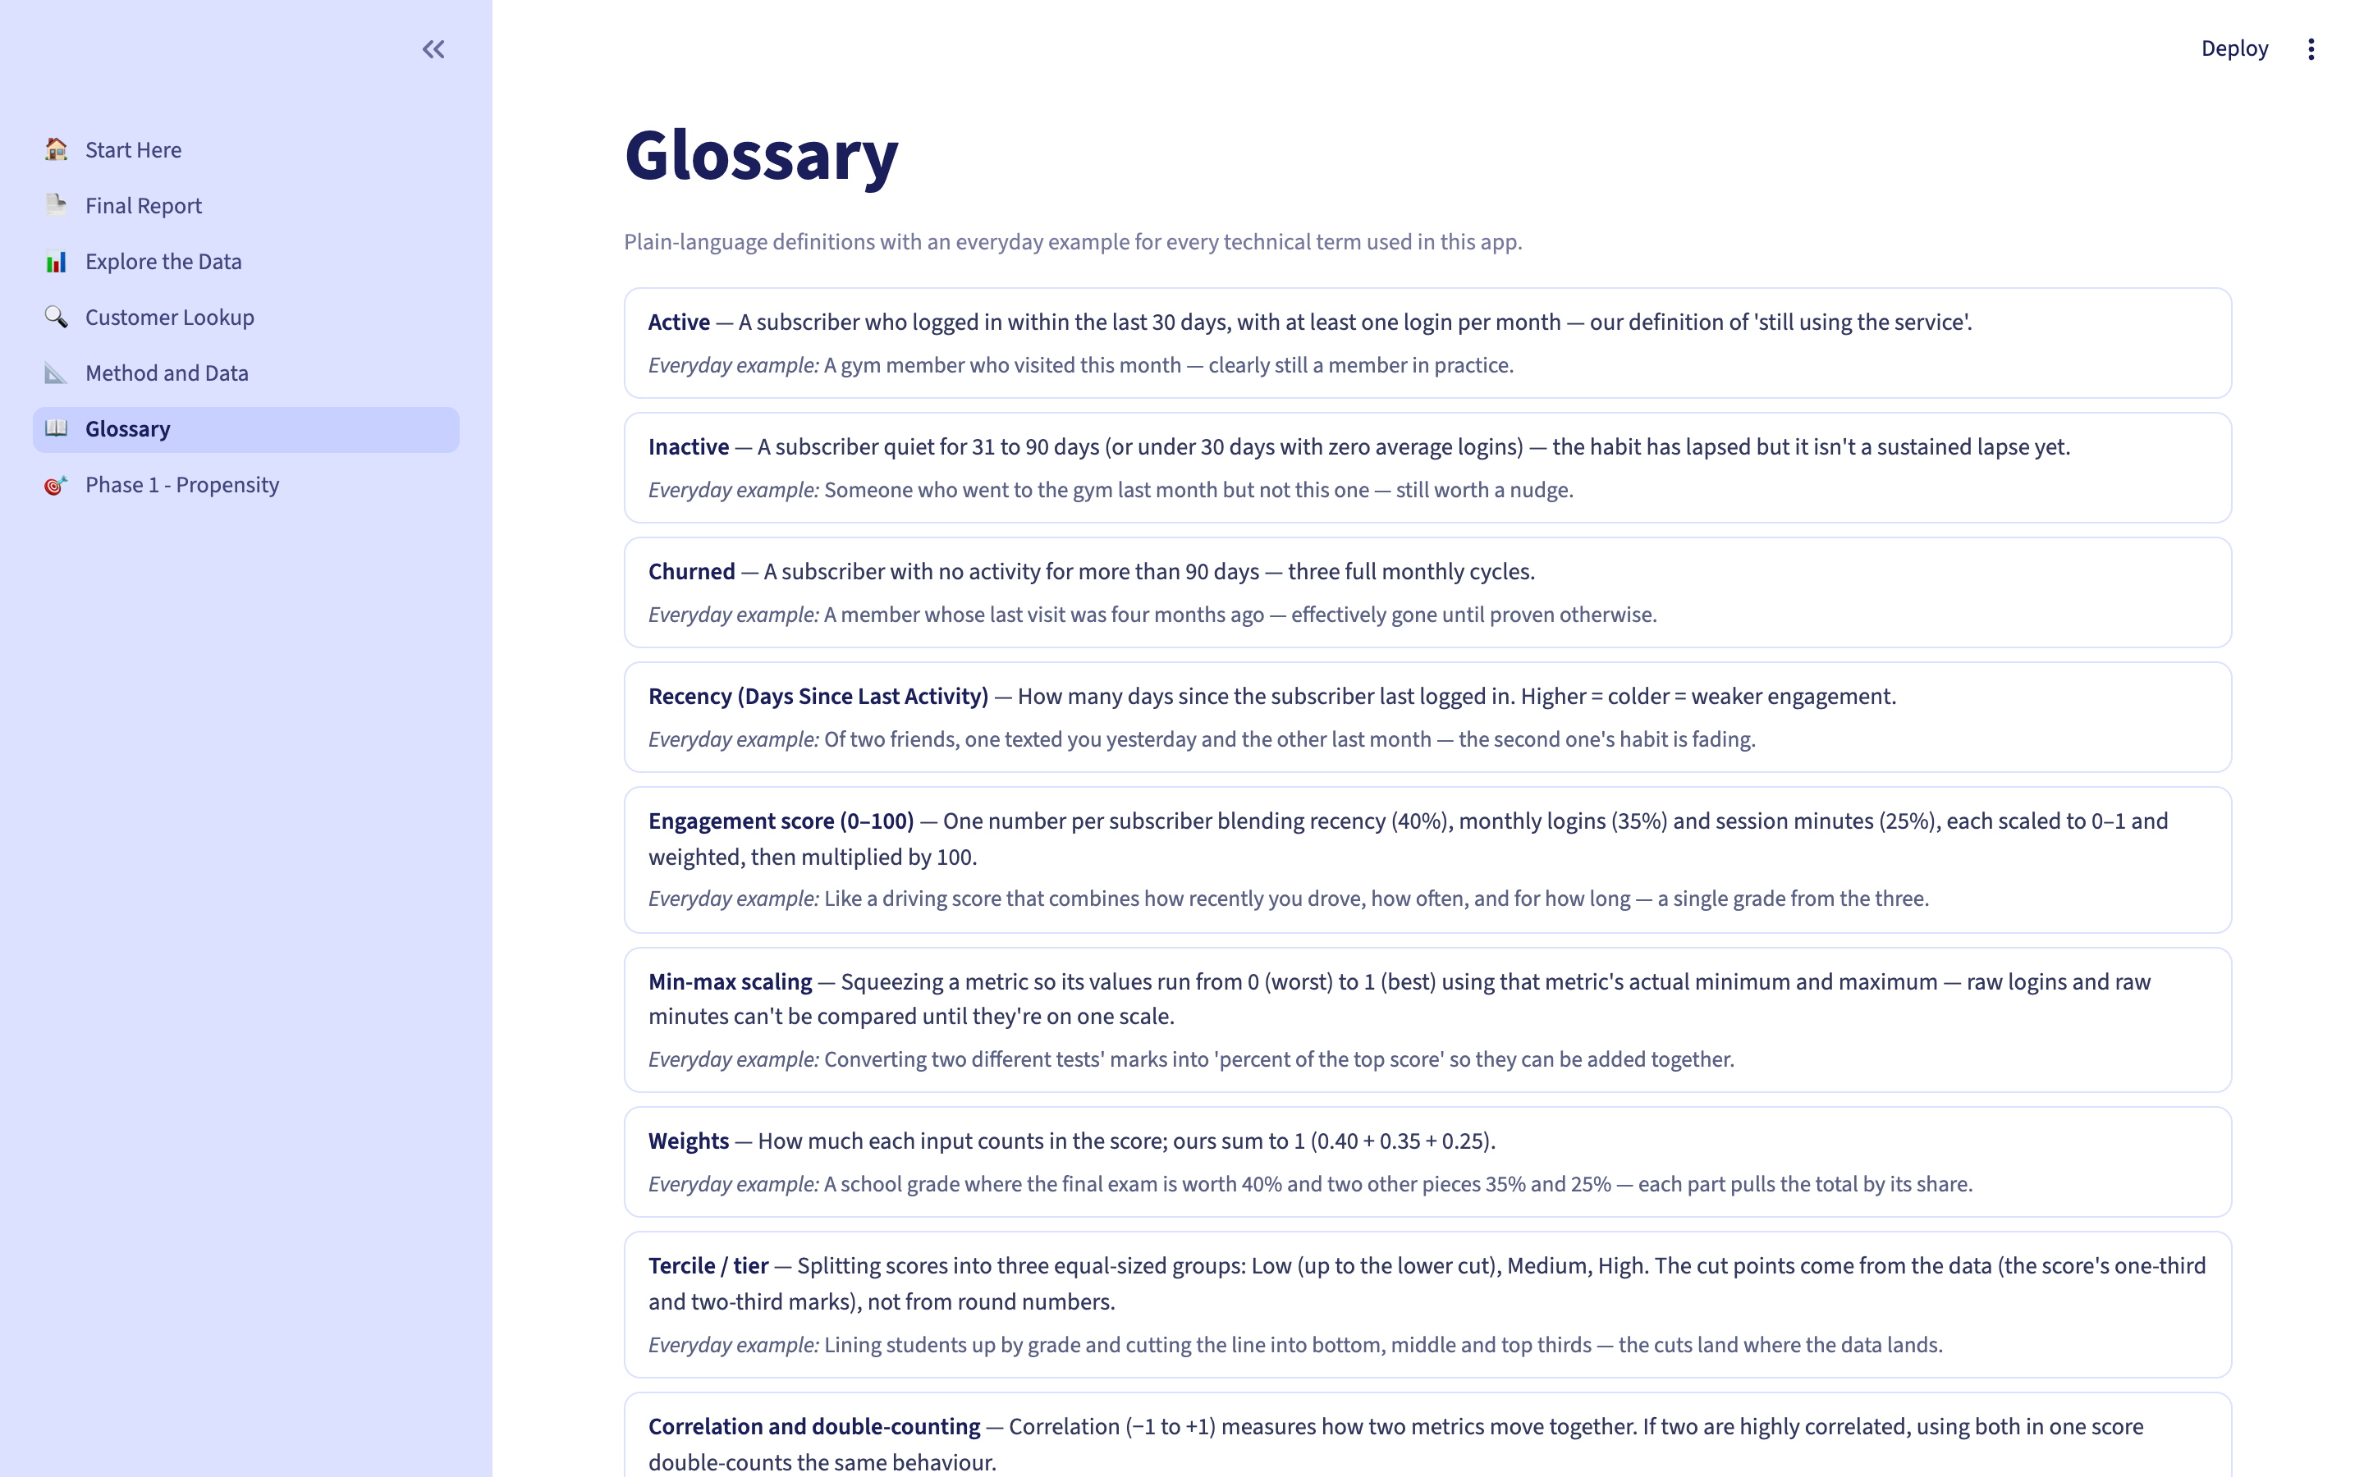
Page 6 · Glossary
Every technical term in plain language
Takeaway: Recency, tercile, correlation, p-value, effect size — each with an everyday example.
eBook Subscriber Intelligence · K. Kadam · October 2026
23 / 27

Slide 24
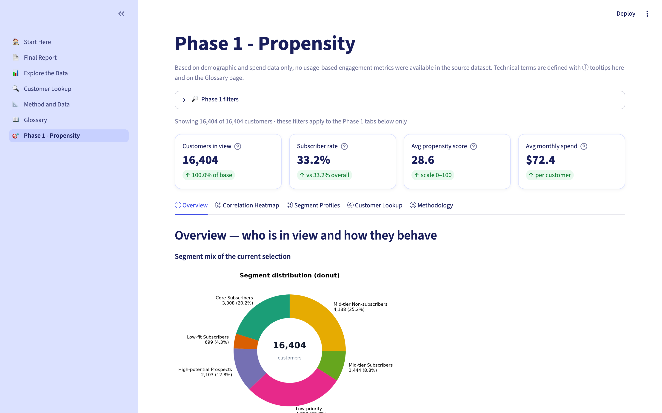
Page 7 · Propensity Model
The original customer-file model: who is likely to subscribe
Takeaway: The first dataset's view — demographic propensity scoring and six customer segments.
eBook Subscriber Intelligence · K. Kadam · October 2026
24 / 27

Slide 25
What the data says
Four findings that survive the honest checks
The behaviour gap is large
Active subscribers average 11.69 logins and 29.1 session minutes a month; Churned average 1.54 and 14.2 — a 7.6× gap in visits. Median last activity: 5 days vs 152 days.
The score passes an independent test
Books and tenure are not score inputs, yet books rise 4.1 → 9.1 → 20.2 across tiers — the score tracks real behaviour, not just its own ingredients.
Demographics help, but only a little
High-value subscribers earn ~$99.8k vs $90.3k and spend $94.1 vs $83.5 a month — significant, but small effects (d ≈ 0.2–0.3).
Genre and tenure do not predict churn
Active rates span only 52–58% across genres and churn rates are non-monotone across tenure bands — null findings reported as such.
All associations — strongest in this dataset, not proven causes. 9 tests run; Bonferroni-corrected bar 0.0056; the Fantasy-genre gap does not survive it.
eBook Subscriber Intelligence · K. Kadam · October 2026
25 / 27

Slide 26
What to do about it
Three strategies — each tied to a finding and a literature theme
Retain
3,001 Active · 55.3%
Win back before day 90
1,520 Inactive · 28.0%
Win-back
901 Churned · 16.6%
Keep the habit going: personalised recommendations built on each reader's own genre and history — the high-value group (1,803) is the priority.
Trigger a message the day a reader passes 30 days of silence (early warning signs), send 'pick up where you left off' nudges — they still average 3.3 logins.
Sequences keyed to declining login frequency; all 901 sit in the Low tier — intervene before day 90 for anyone sliding toward it.
Themes from the literature: declining login frequency · early warning signs · personalised recommendations · relevant communication · segment-specific strategies.
eBook Subscriber Intelligence · K. Kadam · October 2026
26 / 27

Slide 27
What this analysis does not claim
Association, not causation — nothing here shows that acting on a factor will change status.
No cancellation reasons — we show who leaves and when, never why.
No cancellation dates — the tenure view is a cross-section, not a retention curve.
Status is recency-based by definition; behavioural comparisons account for that.
Only the single most-read genre per subscriber is recorded.
The dataset is synthetic — conclusions illustrate method, not market claims.
33 rows with missing recency stay Unclassified — never imputed, shown separately.
Thank you · Questions welcome
Live dashboard · final_report.html (offline) · methodology, watchlist and all charts in outputs/v2/
eBook Subscriber Intelligence · K. Kadam · October 2026
27 / 27

