Slide 1
Blockchain Developer Internship At Sireto Technology
Kushal Acharya
BSc. CSIT – 8th Semester

Slide 2
The Internship Journey
Practical Exposure: Gain invaluable practical experience that extends beyond theoretical classroom learning.
Real-World Projects: Understand and contribute to actual project environments within a leading technology company.
Blockchain Focus: Dive deep into blockchain development, specializing in decentralized systems and smart contracts.
Hands-On Experience: Acquire direct, hands-on experience that will set the foundation for a successful career in blockchain.

Slide 3


About Sireto Technology:
Since its establishment in 2018, Sireto Technology has been at the forefront of blockchain innovation, dedicated to crafting decentralized solutions.
Smart Contract Development
Building secure and efficient self-executing contracts.
Decentralized Applications (DApps)
Creating user-centric applications on blockchain networks.

Slide 4
Internship Objectives
Hands-on Blockchain Experience: Gain practical proficiency with cutting-edge blockchain technologies.
Haskell & Plutus : Develop smart contracts using industry-leading languages and frameworks.
DApp Development: Build and deploy innovative decentralized applications from concept to execution.
Security & Deployment: Understand the intricacies of blockchain testing, secure deployment, and ongoing maintenance.
Problem-Solving & Teamwork: Enhance critical thinking and collaborative skills within a professional development environment.

Slide 5
Roles & Responsibilities
Smart Contract Engineering: Design, write, and rigorously test smart contracts using cutting-edge tools.
Plutus & Tooling: Work effectively with Plutus development tools and diverse blockchain test environments.
Simulation & Debugging: Perform comprehensive contract simulations, debugging, and optimization.

Slide 6
Internship Timeline
Month 1: Foundation & Initial Builds
Environment setup and onboarding.
Intensive research and learning of Haskell/Plutus and blockchain technology.
Month 2: Development & Advanced Contracts
Focus on developing core DApp features.
Advanced smart contract development and optimization.
Initiation of comprehensive testing and debugging procedures.

Slide 7
Month 3: Deployment & Finalization
Deployment of developed solutions to a testnet environment.
Thorough documentation of all project aspects.
Preparation and delivery of the final report and presentation.

Slide 8
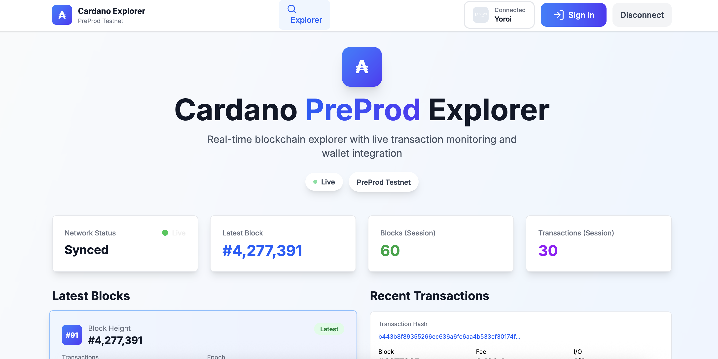
Projects
Made a real-time Cardano blockchain explorer with Rust + Oura + WebSockets + Next.js that gives live blocks & transactions streaming from PreProd testnet.

Slide 9
Learning Outcomes
This internship at Sireto Technology offers an unparalleled opportunity to develop critical skills and knowledge in the burgeoning field of blockchain.
Smart Contract Expertise: Knowledgwable in Haskell and Plutus for robust smart contract development.
DApp Integration: Proficiency in integrating and managing DApps within blockchain workflows.
Enhanced Technical Skills: Significant improvement in coding, testing, and debugging abilities.
Real-World Industry Experience: Invaluable practical experience gained within the dynamic blockchain industry.

