Slide 1
PROJECT ID: PRJ_IT_5_2026_26
ExpiryIQ
AI-Powered Smart Family Life Assistant

Slide 2

Agenda
Quick Recap: What ExpiryIQ Is | 3
Progress Since Last Review | 4
Notification System (In-App + Browser Push) and OCR scanning | 5
Authentication & OTP Security | 7
Technology Used | 8
Challenges Faced | 9
Current Status | 10
Next Steps | 11

Slide 3

Quick Recap
Indian households manage dozens of recurring, time-critical responsibilities with no unified system.
ExpiryIQ is a unified, AI-powered platform that helps Indian families track and get reminded about everything with an expiry or due date — medicines, documents, insurance, bills, groceries, appliances, and family events — all in one dashboard.

Slide 4
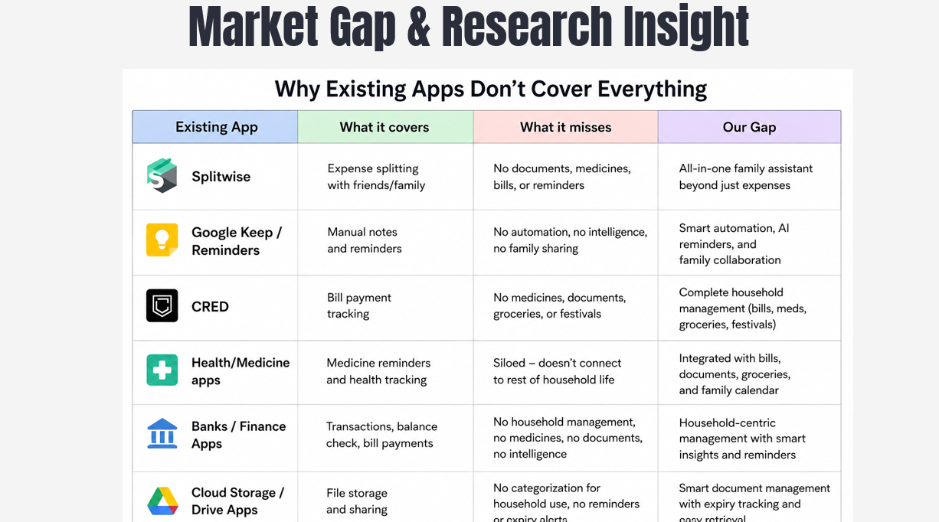

Slide 5
  Full authentication system with OTP verification
  Multi-profile family account system (JioHotstar-style)
  All 10 modules connected to a live MongoDB Atlas database
  OCR-based AI scanning
  In-app and browser push notification system
  User-configurable reminder timing per item
  AI Assistant answering from real account data
Progress Since Last Review
Since our last review, we moved from a largely designed system to a functionally working application:

Slide 6
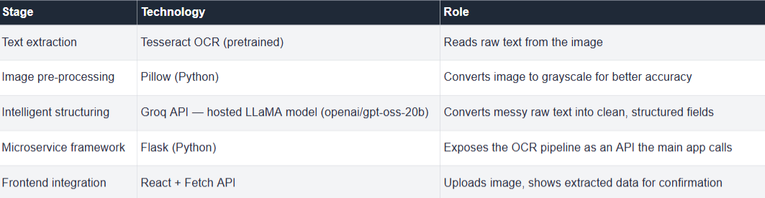
OCR Scanning: What It Does
OCR Scanning: What It Does
ExpiryIQ lets users scan a medicine strip or document instead of manually typing in details. The system automatically extracts the item name, manufacturing date, and expiry date from the photo — reducing manual data entry, which is the one reason tracking apps get abandoned.

Slide 7
Steps
1. User uploads/captures a photo
↓
2. Image sent to Python microservice (Flask)
↓
3. Image converted to grayscale (Pillow) — improves OCR accuracy
↓
4. Tesseract OCR extracts raw text from the image
(e.g., "PARACETAMOL 500MG MFG: 03/2025 EXP: 03/2027")
↓
5. Raw text sent to Groq's LLaMA model with a structured prompt
↓
6. AI returns clean JSON:
{"item_name": "Paracetamol 500mg", "mfg_date": "2025-03-01", "expiry_date": "2027-03-01"}
↓
7. Data pre-fills the Add Item form — user reviews & confirms before saving
↓
8. Saved to MongoDB, treated identically to manually entered data

Slide 8

Notification System Overview
1. In-App Notifications
A notification bell in the dashboard shows real-time alerts with an unread count, pulled from a backend-scheduled daily check across all modules.
2. Browser Push Notifications
Using the Web Push API, users receive real OS-level notifications even when the ExpiryIQ tab or browser is closed — powered by a Service Worker running in the background and VAPID-based secure push authentication.
3. User-Configurable Reminder Timing
Instead of a fixed "remind me 7 days before" rule for everyone, users can now set their own preferred reminder window per item — e.g., "remind me 3 days before this bill is due" or "remind me 30 days before this policy renews." The system respects each user's chosen timing rather than a one-size-fits-all default.

Slide 9
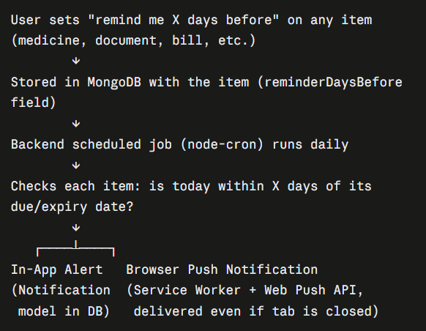
How Notifications Actually Work

Slide 10
OTP-Based Authentication Flow
Account creation security:
  When a user registers a new family member login, an OTP is sent to verify.
  This confirms the account owner has genuine access to the registered family member, preventing fake or mistyped-member signups
Family member addition security:
  When a new family member profile is added under an existing account, an OTP is also sent — to the account owner, not the new member
  This ensures only the verified account owner can authorize new profiles being created under their family account, preventing unauthorized additions

Slide 11

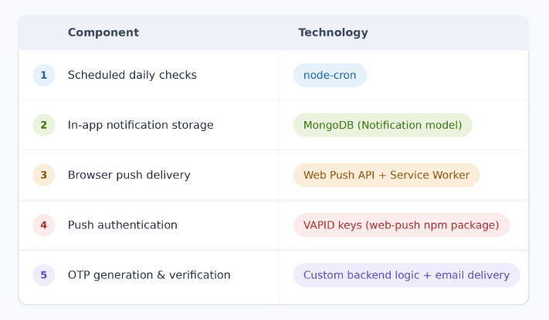
Technology Used for Notifications

Slide 12
Challenges Faced
  Implementing OTP verification correctly for two different flows (account creation vs. family member addition) without confusing which email receives the code
  Configuring the Service Worker and VAPID push authentication correctly — required careful setup of file paths, permissions, and key generation
  Generalizing the notification scheduler to respect each user's own custom reminder timing per item, rather than one fixed rule for everyone.

Slide 13
Current Status
  Authentication, OTP, and multi-profile system — complete
  All 10 modules connected to live data
  OCR AI scanning — working on MediTrack and DocuVault
  Notification system (in-app + browser push + configurable timing) — complete

Slide 14
Next Steps
  1. Direct Purchase Integration
  Add Amazon/Flipkart buy links to medicines and pantry items
  When stock is low or close to expiry, user can click a "Reorder Now" button that opens the product directly on the retailer's site
  Removes the manual step of searching for the same item again — closes the loop from "alert" to "action"
  2. Spending Analytics Dashboard
  Visual graphs showing total money spent across the household
  Breakdown by module — medicines, bills, insurance premiums, pantry restocking — so users can see where most of their spending goes
  Helps families track and plan monthly household expenses, not just track expiry dates.

Slide 15
Conclusion
ExpiryIQ transforms household management from reactive and fragmented into proactive and unified.
By combining automation, prediction, and cultural relevance, it addresses a real, everyday problem faced by millions of Indian families — one that no existing application has fully solved.
"Because every household deadline deserves the same intelligence as a work deadline."

