Slide 1
+2
+3
+1
+2
+1
+2
-1
+1
An example cell for marching cubes algorithm. Values of vertices represent the distance field value. The orange triangle is the 0 isosurface.

Slide 2
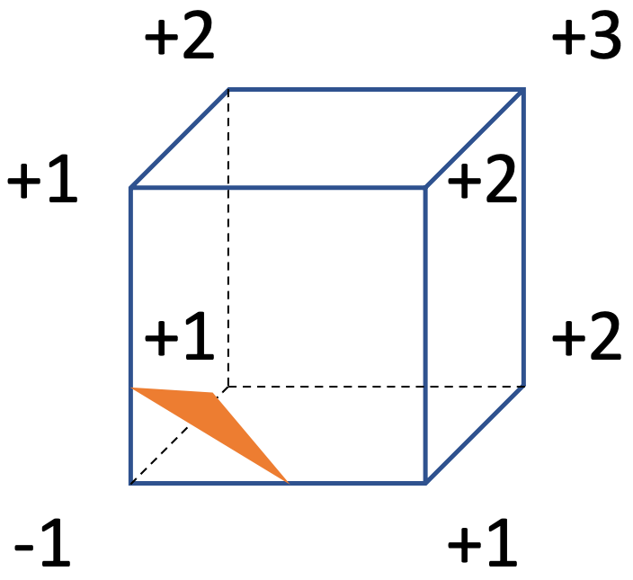

Slide 3
Initialize nodes on surface cells
Select node in queue
Consider far neighbor nodes
Extrapolate and update distance
surface cell
0.9
0.5
0.3
0.9
0.5
0.3
0.9
0.5
0.3
0.9
0.5
0.3
accepted
0.7
0.2
-0.1
-0.4
0.7
0.2
-0.1
-0.4
0.7
0.2
-0.1
-0.4
0.7
0.2
-0.1
-0.4
0.9
0.1
-0.4
-0.9
0.9
0.1
-0.4
-0.9
0.9
0.1
-0.4
-0.9
0.9
0.1
-0.4
-0.9
-1.2
chosen vertex
grid
0.8
-0.1
-0.9
0.8
-0.1
-0.9
0.8
-0.1
-0.9
0.8
-0.1
-0.9
considered
0.5
-0.5
0.5
-0.5
0.5
-0.5
0.5
-0.5
0.3
-0.6
0.3
-0.6
0.3
-0.6
0.3
-0.6
far
surface

Slide 4
Select node in queue
0.9
0.5
0.3
0.7
0.2
-0.1
-0.4
surface cell
0.9
0.1
-0.4
-0.9
accepted
0.8
-0.1
-0.9
0.5
-0.5
chosen vertex
0.3
-0.6
considered
surface
grid
far

Slide 5
Consider far neighbor nodes
0.9
0.5
0.3
0.7
0.2
-0.1
-0.4
surface cell
0.9
0.1
-0.4
-0.9
accepted
0.8
-0.1
-0.9
0.5
-0.5
chosen vertex
0.3
-0.6
considered
surface
grid
far

Slide 6
Extrapolate and update distance
0.9
0.5
0.3
0.7
0.2
-0.1
-0.4
surface cell
0.9
0.1
-0.4
-0.9
-1.2
accepted
0.8
-0.1
-0.9
0.5
-0.5
chosen vertex
0.3
-0.6
considered
surface
grid
far

Slide 7
1st iteration
2nd iteration
(i-1)^{th} iteration
i^{th} iteration
(i+1)^{th} iteration
surface cell
0.9
0.5
0.3
0.9
0.5
0.3
2.1
1.6
0.9
0.5
0.3
2.1
1.6
0.9
0.5
0.3
2.1
1.6
0.9
0.5
0.3
0.7
0.2
-0.1
-0.4
0.7
0.2
-0.1
-0.4
1.6
0.7
0.2
-0.1
-0.4
1.6
0.7
0.2
-0.1
-0.4
1.6
0.7
0.2
-0.1
-0.4
accepted
grid
0.9
0.1
-0.4
-0.9
-1.2
0.9
0.1
-0.4
-0.9
-1.2
0.9
0.1
-0.4
-0.9
-1.2
0.9
0.1
-0.4
-0.9
-1.2
0.9
0.1
-0.4
-0.9
-1.2
chosen vertex
0.8
-0.1
-0.9
0.8
-0.1
-0.9
0.8
-0.1
-0.9
-1.6
-2.3
0.8
-0.1
-0.9
-1.6
-2.2
0.8
-0.1
-0.9
-1.6
-2.2
0.5
-0.5
0.5
-0.5
-1.3
0.5
-0.5
-1.3
-2.3
0.5
-0.5
-1.3
-2.3
0.5
-0.5
-1.3
-2.3
considered
0.3
-0.6
0.3
-0.6
0.3
-0.6
-1.6
0.3
-0.6
-1.6
0.3
-0.6
-1.6
far
surface

Slide 8
2nd iteration
0.9
0.5
0.3
0.7
0.2
-0.1
-0.4
surface cell
0.9
0.1
-0.4
-0.9
-1.2
accepted
0.8
-0.1
-0.9
0.5
-0.5
-1.3
chosen vertex
0.3
-0.6
considered
surface
grid
far

Slide 9
(i-1)^{th} iteration
2.1
1.6
0.9
0.5
0.3
1.6
0.7
0.2
-0.1
-0.4
surface cell
0.9
0.1
-0.4
-0.9
-1.2
accepted
0.8
-0.1
-0.9
-1.6
-2.3
0.5
-0.5
-1.3
-2.3
chosen vertex
0.3
-0.6
-1.6
considered
surface
grid
far

Slide 10
i^{th} iteration
2.1
1.6
0.9
0.5
0.3
1.6
0.7
0.2
-0.1
-0.4
surface cell
0.9
0.1
-0.4
-0.9
-1.2
accepted
0.8
-0.1
-0.9
-1.6
-2.2
0.5
-0.5
-1.3
-2.3
chosen vertex
0.3
-0.6
-1.6
considered
surface
grid
far

Slide 11
(i+1)^{th} iteration
2.1
1.6
0.9
0.5
0.3
1.6
0.7
0.2
-0.1
-0.4
surface cell
0.9
0.1
-0.4
-0.9
-1.2
accepted
0.8
-0.1
-0.9
-1.6
-2.2
0.5
-0.5
-1.3
-2.3
chosen vertex
0.3
-0.6
-1.6
considered
surface
grid
far

Slide 12
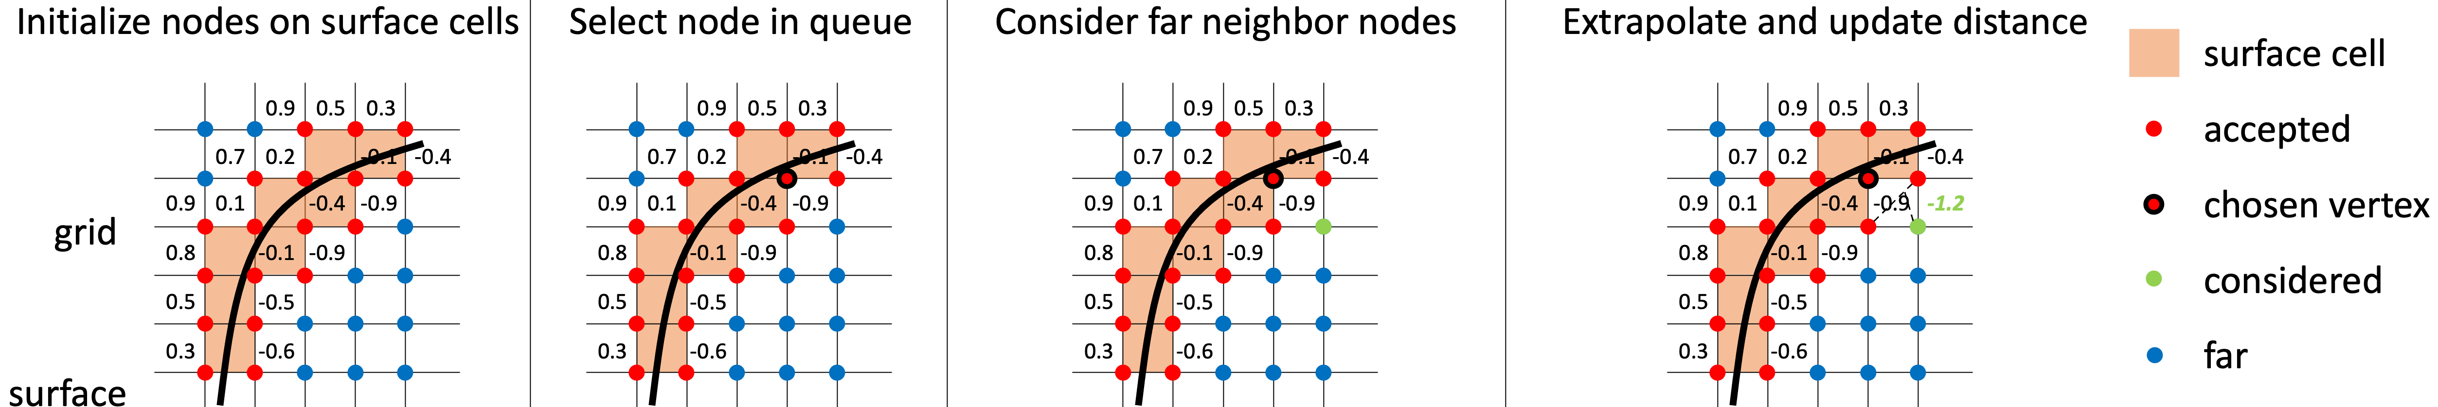
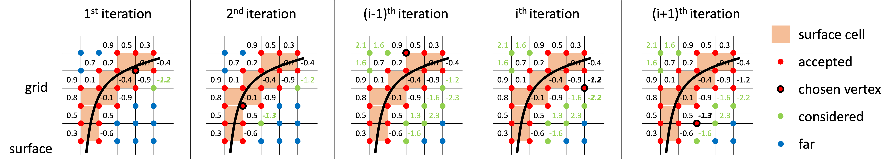

Slide 13
0.9
0.5
0.3
0.7
0.2
-0.1
-0.4
0.9
0.1
-0.4
-0.9
0.8
-0.1
-0.9
0.5
-0.5
0.3
-0.6

Slide 14
