Slide 1

Work-let Name: Multi-Level Detail Enhancement Detection for RAW DNG Buffers
Worklet Details
  Worklet ID: 25VI40TU
  College Name: Thapar Institute of Engineering and Technology
    Problem scope and evaluation criteria clarified for multi-level detail classification on RAW DNG buffers.
    Completed a comparative study of objective IQA metrics suitable for deriving enhancement levels.
  Absence of a predefined ground-truth labeling scheme for multi-level detail/enhancement classification.
  Ambiguity in defining absolute enhancement levels versus relative detail-based levels.
KPIs achieved till now
Any Challenges/ Issues faced
Next Steps
C
  early distinguished between applied enhancement and inherent detail-level estimation in RAW images.
  Built a strong theoretical foundation by analyzing IQA-based labeling strategies and their applicability.
  Prepared a technically consistent problem interpretation aligned with PRISM objectives.
Key Achievements/ Outcome till now
Date: 23/01/26

Slide 2
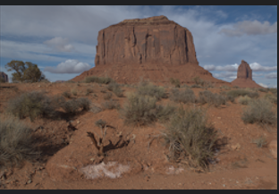
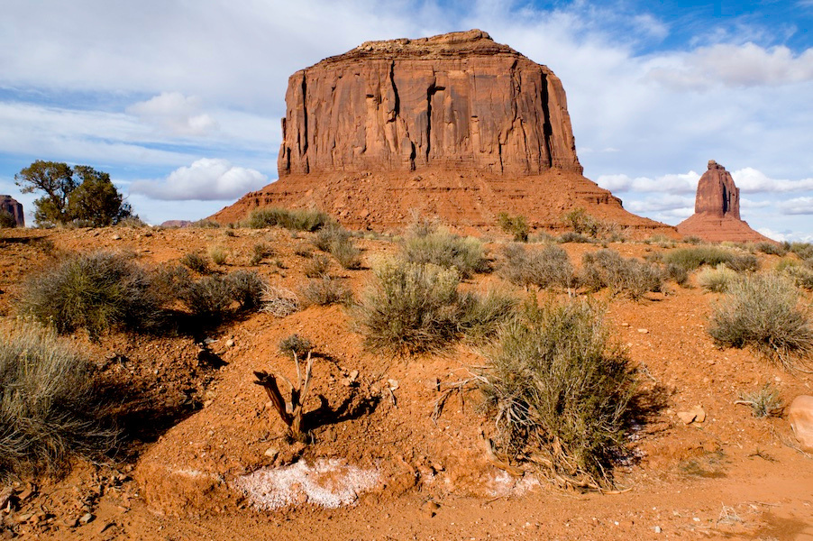
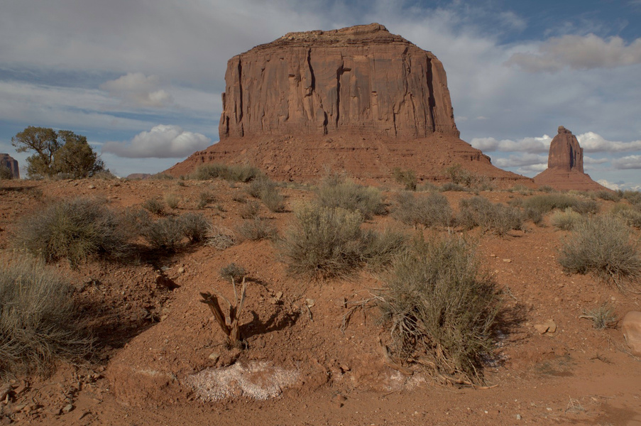
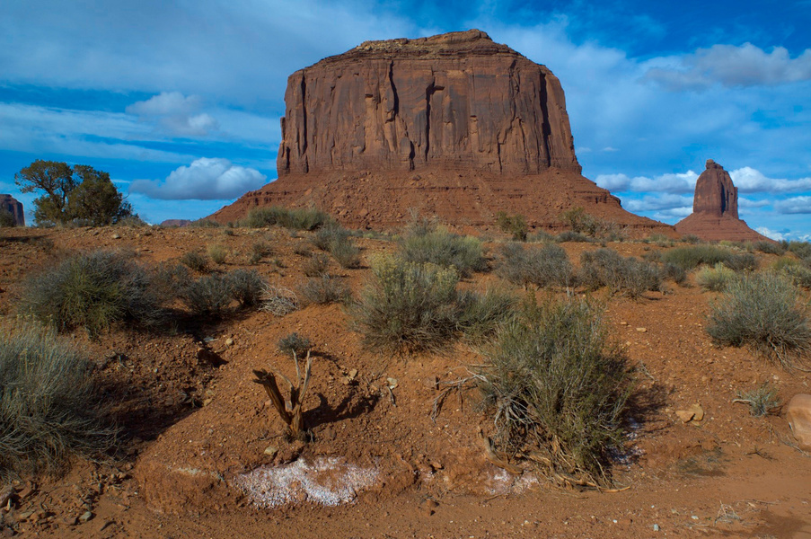
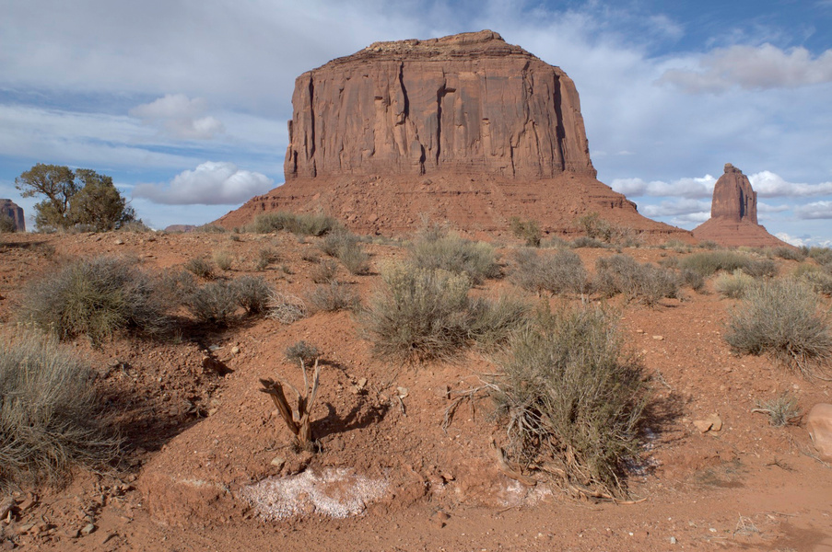
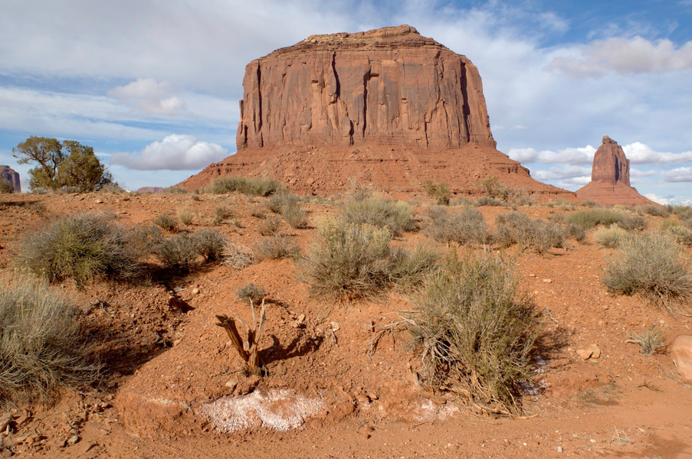
reference image
a
b
c
d
e

Slide 3
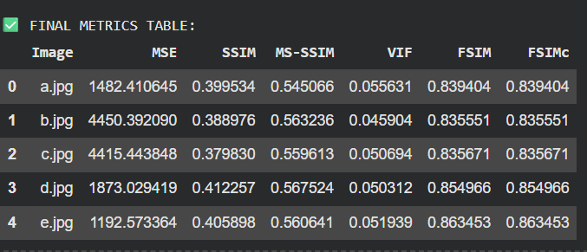
  MSE: Average pixel-wise error (lower = better).
  SSIM: Measures structural similarity (higher = better).
  MS-SSIM: Multi-scale SSIM for better perceptual accuracy (higher = better).
  VIF: Visual information preserved after enhancement (higher = better).
  FSIM: Feature similarity using edges/phase features (higher = better).
  FSIMc: FSIM + color information (higher = better).

Slide 4
Work-let Name: Multi-Level Detail Enhancement Detection for RAW DNG Buffers
Worklet Details
  Worklet ID: 25VI40TU
  College Name: Thapar Institute of Engineering and Technology
Dataset access — Ready
Compute (Colab/Kaggle GPU) — Ready
Storage (Drive) — Ready
Required libraries/tools — Ready
Backup system (college lab GPU) — Optional / If needed
Resource Requirement Identified with Status
Github Repository Link and PRISM Portal Registration Status
Any Anticipated Break (Due to exams etc)
https://www.kaggle.com/datasets/weipengzhang/adobe-fivek
Data Collection Information
Date: 23/01/26

Slide 5
Work-let Name: Multi-Level Detail Enhancement Detection for RAW DNG Buffers
Worklet Details
  Worklet ID: 25VI40TU
  College Name : Thapar Institute of Engineering and Technology
Professor Comments (To be filled in and presented by professor (Either)
COMPUTATION RESOURCE Details:
Primary: Google Colab (GPU enabled)
Secondary (backup): College Lab GPU / High-end PC (if needed)
Workload: preprocessing + enhancement metrics + training classification model
Date: 23/01/26

