Slide 1

Nethryx
Network Packet Analyzer Dashboard
Mini-project presentation · Computer Networks Laboratory (CSE20110)
TEAM
Krish Bhensdadia 1262250028
Pooja Shah 1262251181
Aayush Potdar 1262250835
Adarsh Bhosale 1262252198
Aditya Dharankar 1262250024
Group 5 · Panel E · Batch E1 · Faculty: Dr. Swati · Academic Year 2026–2027 · 21 October 2026
Notes:
~15 seconds. Introduce the project title and the team only; do not read out every PRN.

Slide 2
Nethryx at a glance
A web dashboard that turns raw packet captures into clear, visual summaries.
Built for students and instructors studying computer networks. It is an educational tool, not a replacement for a full intrusion detection system.
ANALYZE
FLAG
AUTOMATE
Parses PCAP and PCAPNG with Scapy: packets, bytes, protocols and hosts.
Two transparent rules highlight scan-like and unusually long DNS patterns.
Groq plans browser tasks and Playwright runs them, with optional live capture.
Notes:
~20 seconds. One-sentence overview: a web dashboard for packet captures, with transparent flags and optional AI-assisted browser automation. It is an educational tool, not a full intrusion detection system.

Slide 3
Problem and objectives
THE PROBLEM
Parse captures
Accept valid PCAP/PCAPNG files and reject invalid uploads.
Packet captures are hard to read quickly.
O1
Summarize traffic
Packet volume, protocols, timeline and visible hosts.
Captures mix many protocols. Beginners struggle to spot the busiest protocols, data volume, visible hosts and patterns worth a closer look.
O2
Flag and automate
Transparent pattern flags, plus browser tasks with optional live capture.
Scope: uploaded .pcap / .pcapng files and browser traffic during controlled automation.
O3
Notes:
~30 seconds. Packet captures are large and mixed; beginners need a fast summary. State the three objectives briefly: parse, summarize, flag and automate.

Slide 4
Scope and boundaries
IN SCOPE
OUT OF SCOPE
Uploaded .pcap and .pcapng files up to 200 MB
Totals tracked across the whole file; 300,000 rows kept for charts
Live capture from the selected network adapter
Browser tasks on allowed domains only
Decrypting TLS traffic
Proving malicious intent
A complete IDS/IPS
Persistence across restarts: analysis is held in memory
Notes:
~20 seconds (optional). Be clear about what Nethryx does and does not do: it does not decrypt TLS, prove malicious intent or replace an IDS/IPS, and analysis state is held in memory.

Slide 5
System architecture
FastAPI Backend
REST API + WebSocket
PCAP Analysis
Scapy PcapReader
Upload
User / Browser
React dashboard
HTTP / WS
Live Capture
Scapy + Npcap
Capture
Automation task
Browser Automation
Playwright + Chrome
Groq API
Task planning, capture Q&A
HTTPS
Notes:
~40 seconds. Walk left to right: the React dashboard talks to the FastAPI backend over HTTP and WebSocket. The backend feeds Scapy for PCAP analysis and the live sniffer. Automation tasks go to Playwright, which uses Groq over HTTPS for planning.

Slide 6
Tools and protocols
FRONTEND
BACKEND
AUTOMATION AND AI
React 18 + Vite
Tailwind CSS
Recharts, Lucide icons
Python 3.10+, FastAPI
Uvicorn, HTTPX
Scapy PcapReader
Playwright + Chrome
Groq API (plans, Q&A)
Npcap for live capture
HTTP
Uploads and REST APIs
WebSocket
Streams plan, step and packet events
localhost:5173
UI talks to the API on 127.0.0.1:8000
Notes:
~20 seconds. Name the stack at a glance. Mention that HTTP carries uploads and REST calls, WebSocket carries live automation events, and the dev setup runs on localhost ports 5173 and 8000.

Slide 7
How it works
OFFLINE ANALYSIS
Upload
Validate
Parse
Classify
Aggregate
Dashboard
Files up to 200 MB. Wrong extensions and invalid headers are rejected before parsing.
AI AUTOMATION
Prompt
Groq plan
Validate steps
Playwright
Live capture
Runs only on allowed sites: YouTube, GitHub, Google, Wikipedia, LinkedIn. Capture is optional.
Notes:
~40 seconds. Offline flow: upload, validate, parse with Scapy, classify protocols, aggregate, render. AI flow: the prompt goes to Groq for a JSON plan, steps are validated against allowed sites and actions, Playwright runs them, and live capture is optional.

Slide 8
Running Nethryx
Install prerequisites
Python 3.10+ and Node.js 18+
Set up the backend
Create a virtual environment, then pip install -r requirements.txt
1
2
Add the Groq key
Copy .env.example to .env; keep the key on the backend only
Start the API
python -m uvicorn main:app --reload --port 8000
3
4
Start the UI
In frontend/: npm install, npm run dev, open localhost:5173
Windows live capture
Install Npcap and run the backend terminal as Administrator
5
6
Notes:
~20 seconds (optional). Summarize the setup: install Python and Node, create the backend environment, configure the Groq key on the backend only, start the API and UI, and on Windows install Npcap for live capture.

Slide 9
What it reports
200 MB
300k
20+
50+
Maximum size of an uploaded capture
Packet rows kept for detailed charts and filtering
Distinct ports hit by SYN traffic raises a flag
Characters in a DNS query name raises a flag
DASHBOARD OUTPUTS
Packet and byte totals · Protocol distribution · Traffic over time · Visible hosts and DNS names
Flags are indicators for a person to review, not proof of an attack.
Notes:
~25 seconds. Explain the limits and the two transparent rules. Stress that flags are indicators for a human to interpret, not proof of an attack.

Slide 10
Testing and results
ID | Test | Expected | Status
T1 | Upload a valid .pcap or .pcapng | Totals and charts returned | Pending live run
T2 | Upload a wrong extension or bad header | Rejected with a clear error | Code-checked; live run pending
T3 | Run an allowed browser task with Groq | Plan, step and packet events appear | Pending live run
Results are recorded during the live run. No figure is reported until it has been observed.
Notes:
~30 seconds. Be honest: the test plan is defined and the validation paths exist in code, but runtime outcomes are recorded live. Do not quote figures that were not observed.

Slide 11
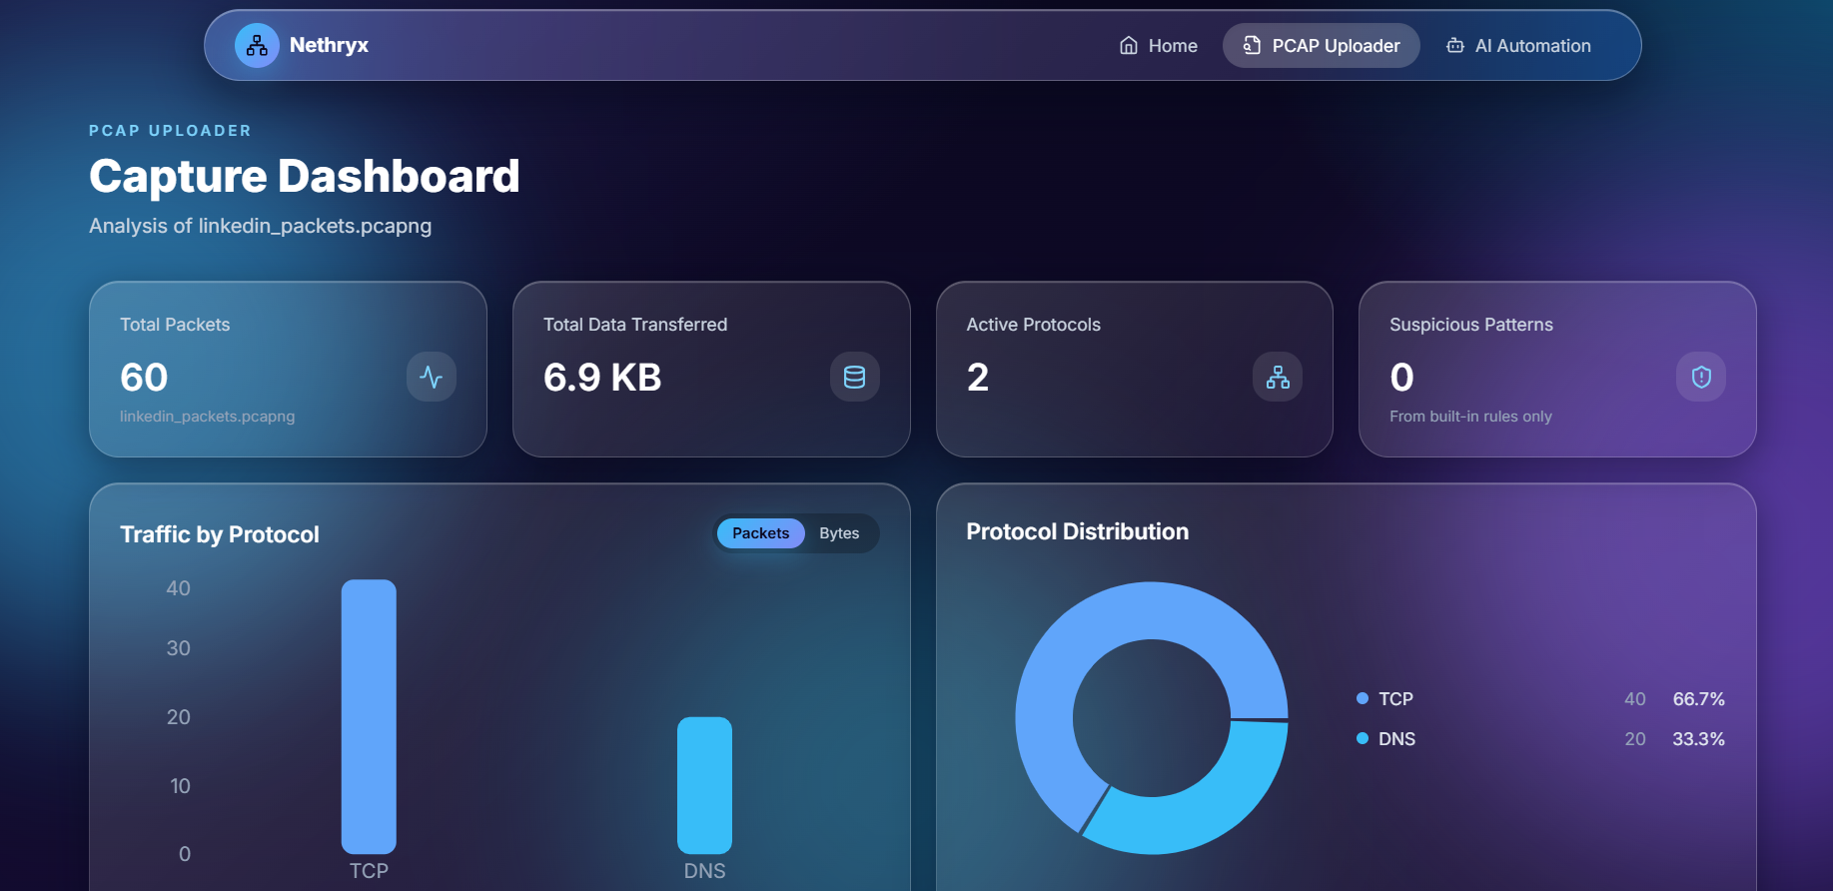
Live demonstration
1
Start both servers
uvicorn on port 8000, npm run dev on 5173
2
Upload a real capture
Open the PCAP page and choose a .pcap or .pcapng
3
Walk through the output
Totals, protocol chart, hosts, timeline and flags
Notes:
~60 seconds. Prepare the project before the timer starts. Upload a real capture, then explain totals, protocol chart, hosts, timeline and flags. Keep a screenshot or short recording as a backup and say so if you use it.

Slide 12
Troubleshooting
Issue | Likely cause | Fix
Backend unreachable | API not running on port 8000 | Start Uvicorn on port 8000; check VITE_API_URL
AI planning fails | GROQ_API_KEY missing or API down | Set the key in the backend .env; never commit it
Live capture unavailable | Npcap missing or no admin rights | Install Npcap; run the backend as Administrator
Add the issues you actually hit during setup, with the fix you verified.
Notes:
~20 seconds (optional). Three setup issues from the report: backend unreachable, AI planning failing, and live capture unavailable on Windows. Replace or add the real issues the team hit.

Slide 13
Conclusion
OUTCOME
APPLICATIONS
One interface for offline capture analysis, rule-based flags and AI-assisted browser automation.
Learning protocol behaviour, inspecting DNS and endpoints, and troubleshooting traffic.
LIMITATIONS
FUTURE SCOPE
TLS payloads stay encrypted, protocol labels are heuristic, and flags are not proof of an attack.
Persistent storage, exportable reports, configurable rules and tests with known PCAP fixtures.
AI use: Groq plans browser steps and answers capture questions; outputs are checked against extracted statistics.
Notes:
~30 seconds. Summarize the outcome, the educational use, and be upfront about limitations. Mention AI use: Groq plans browser steps and answers capture questions, and outputs are checked against extracted statistics.

Slide 14
References
1
Scapy Project, “Scapy Documentation.”
scapy.readthedocs.io
2
FastAPI, “FastAPI Documentation.”
fastapi.tiangolo.com
3
Microsoft, “Playwright Python Documentation.”
playwright.dev/python
4
Groq, “Groq API Documentation.”
console.groq.com/docs
Notes:
Backup slide for questions.

