Slide 1

Energy Consumption Forecasting for Smart Grid Optimization
To analyze, predict, and optimize energy consumption patterns in a smart home setting using machine learning.
Made by:
KRISH CHOUDHARY

Slide 2
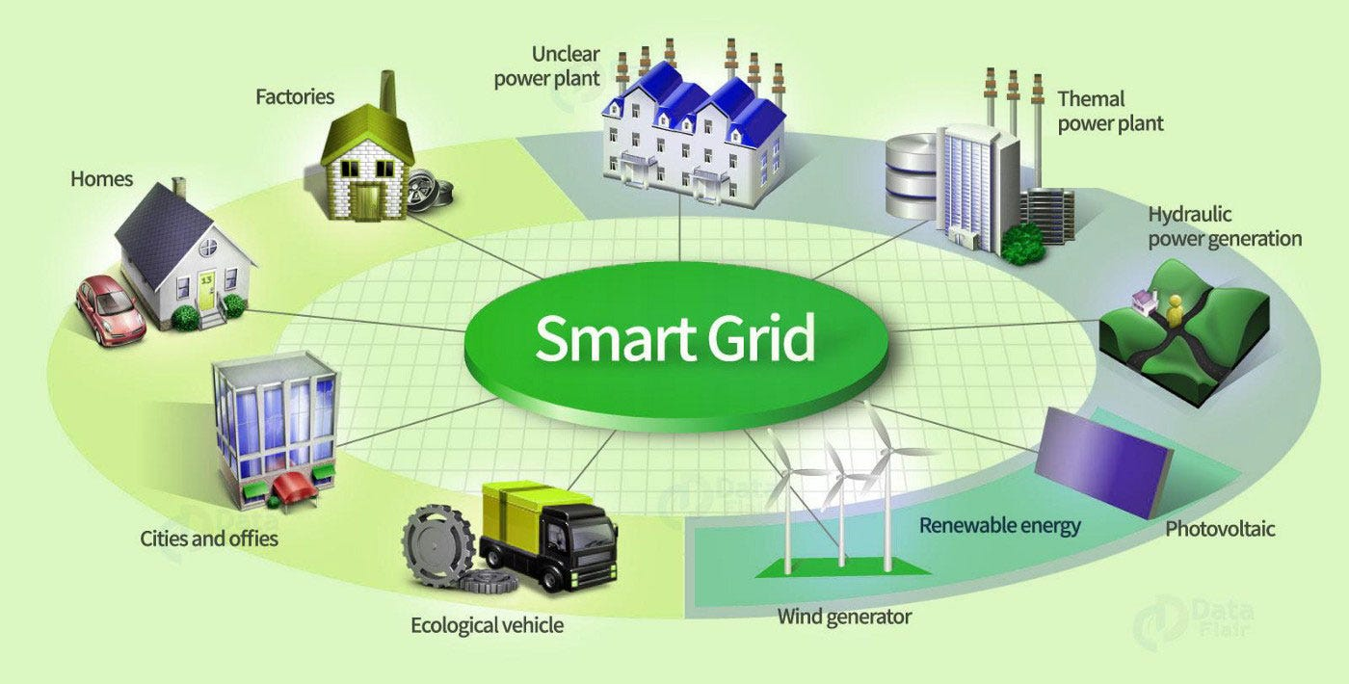
Introduction
As energy consumption patterns become more complex with the usage of renewable resources of energy, the need for efficient analysis and optimization of energy consumption has become highly necessary, this way we can improve energy efficiency and support grid optimization.

Slide 3
Key Goals
Collecting high-frequency energy consumption data from smart meters installed in households.
Developing accurate forecasting model to predict future energy consumption using time series forecasting.
Identifying consumption patterns and grouping them using clustering.
Classifying energy as efficient/inefficient for better management.

Slide 4
Methodology
Data Pre-processing:
Imputation of missing values using mean/mode for numeric columns.
Aggregated minute-level data to daily totals for trend analysis and prediction.
Standardized numerical features for uniformity.
Removed features with correlation>0.8 after feature selection.
Models and Techniques used
Forecasting
Clustering
Classification

Slide 5
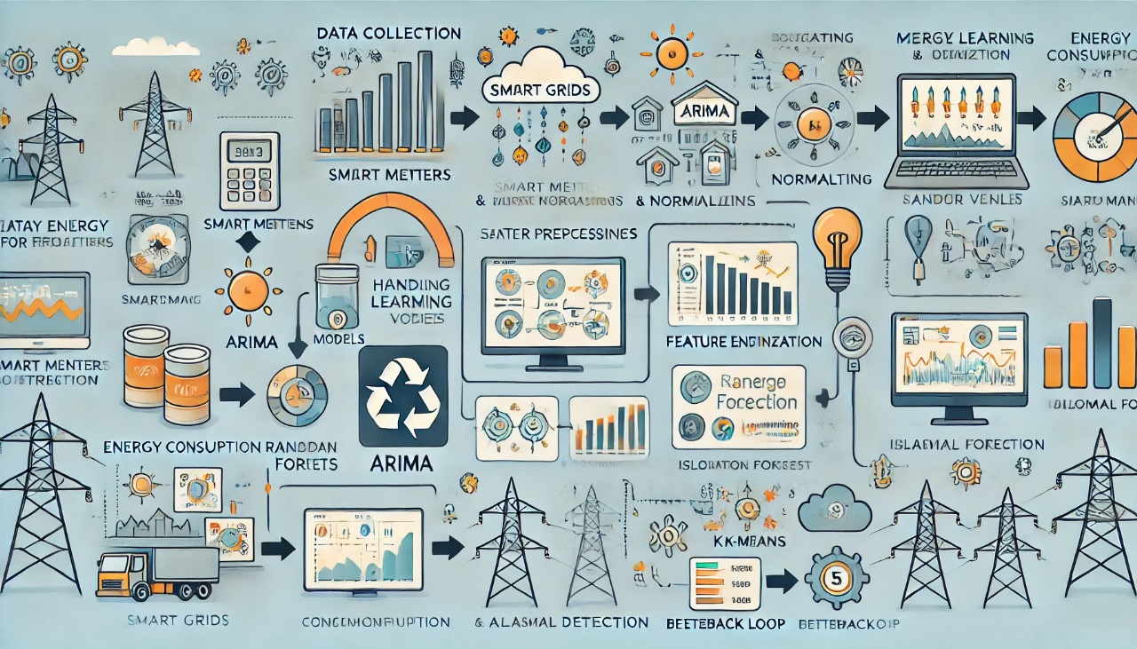

Slide 6
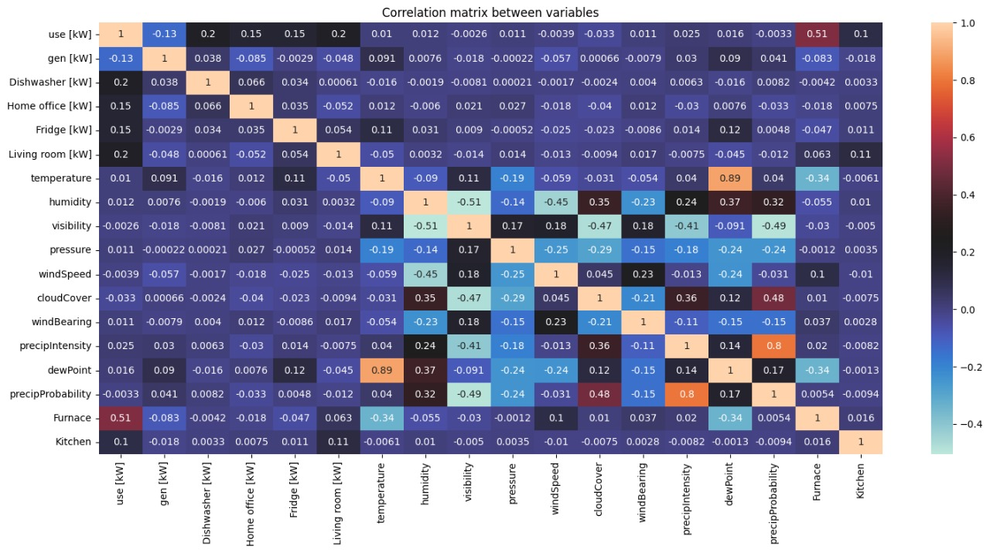
Exploratory Data Analysis
Correlation Analysis:
Identified significant correlations among appliance loads (e.g., Kitchen appliances with Dishwasher) and among weather features like apparent temperature etc.

Slide 7
Forecasting models
Arima and Sarimax Models
Purpose:- Predict daily Energy Consumption for efficient planning
Arima:- Uses historical consumption patterns for prediction. It is simple and effective for basic trend forecasting.
Sarimax:- Also incorporates external variables(eg: temperature , humidity etc). It gives improved accuracy for energy demand forecasting.

Slide 8
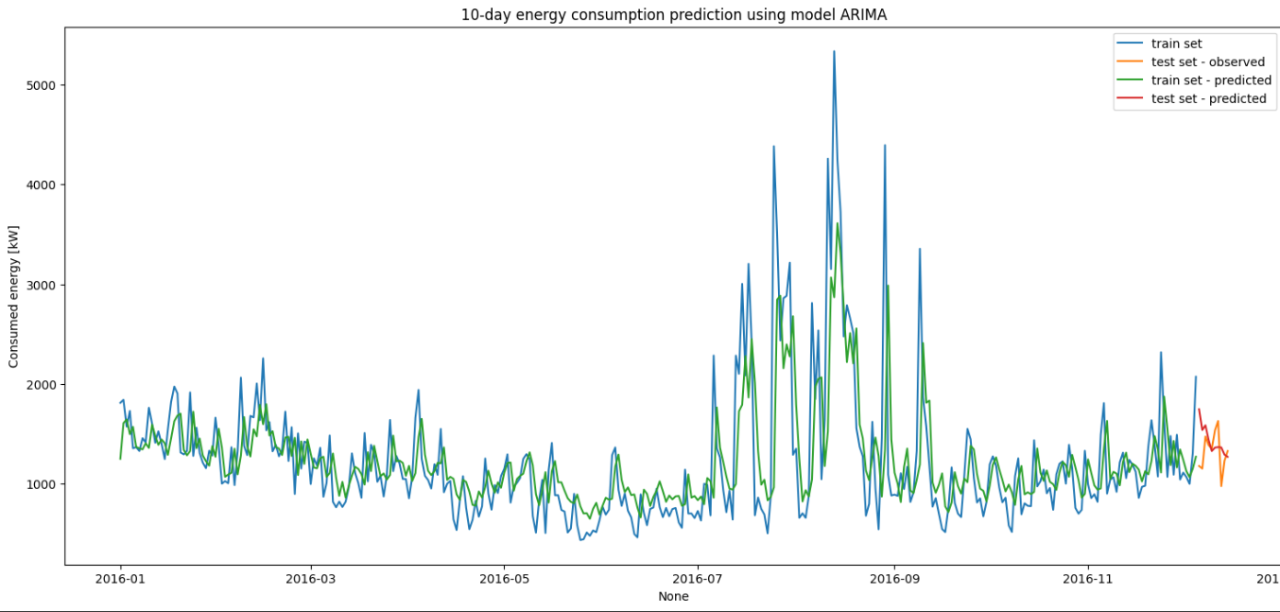
Arima Accuracy Metrics
RMSE:- 273.41 kW
MAPE:- 17.2%

Slide 9
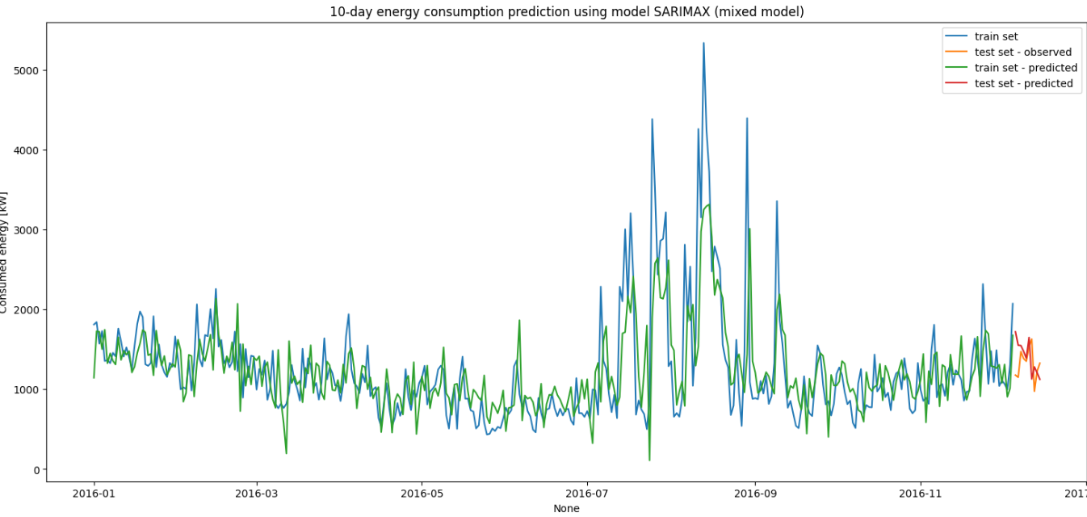
Sarimax Accuracy Metrics
RMSE:- 294.79 kW
MAPE:- 18.21%

Slide 10
Clustering
Used K means clustering to identify clusters based on energy consumption patterns to support grid optimization.
Three clusters were found:
High Consumption(Peak energy users)
Medium Consumption(Average users)
Low Consumption(Energy efficient users)

Slide 11
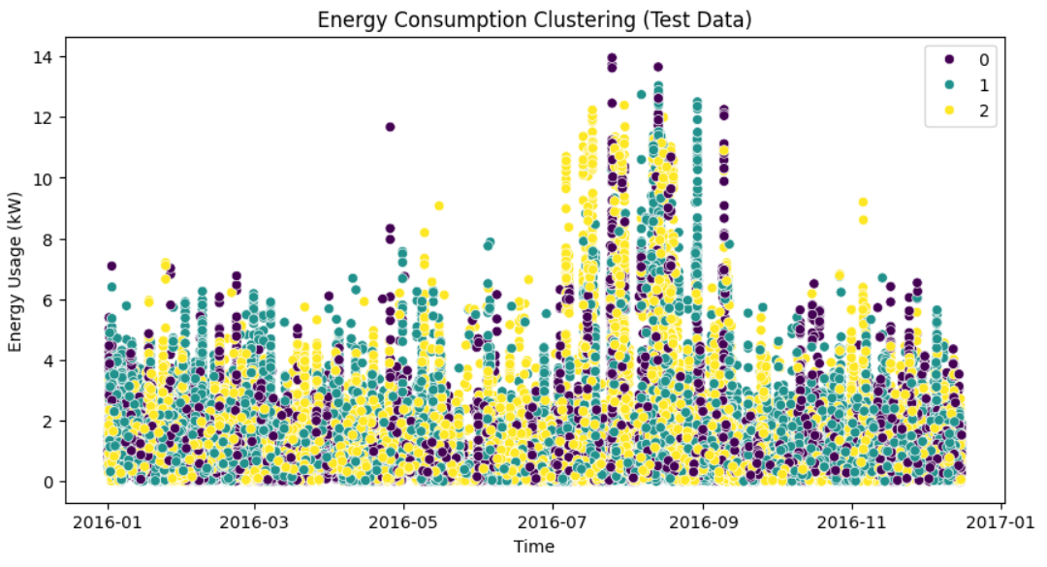

Slide 12
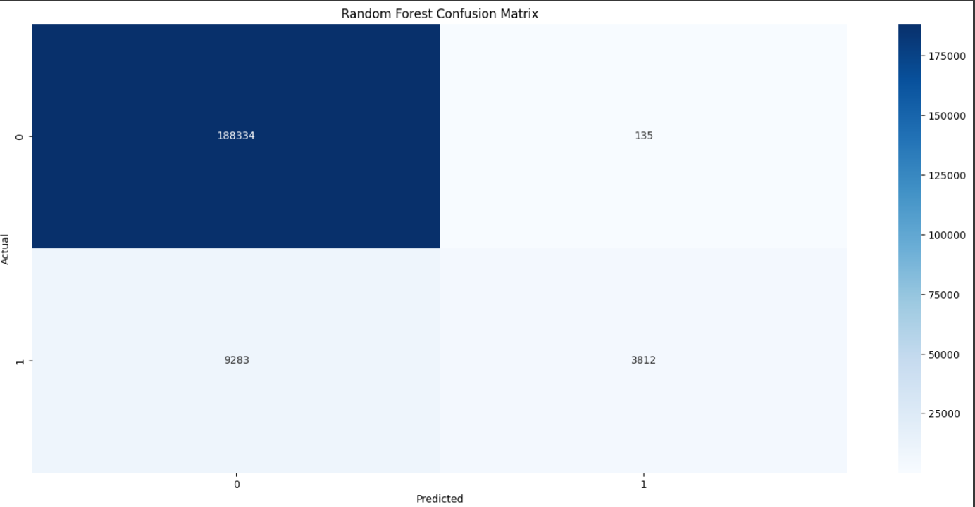
Classification
Used Random Forest to classify energy usage as “efficient” or “inefficient” to provide insights for optimization .
Accuracy-95.33%

Slide 13
Conclusion
Forecasting: While ARIMA showed slightly lower prediction errors, SARIMAX offered greater interpretability by incorporating weather features, such as temperature and humidity, into the model. This provided valuable insights.
Clustering: Identified distinct consumer behavior patterns to support personalized energy solutions.
Classification: Random Forest successfully labeled energy usage efficiency, providing actionable recommendations.
This project demonstrates how machine learning can enhance smart grid optimization, reduce wastage, and improve sustainability.

