Slide 1
GitHub
Krishna Chaitanya Rakonda
U1411226

Slide 2
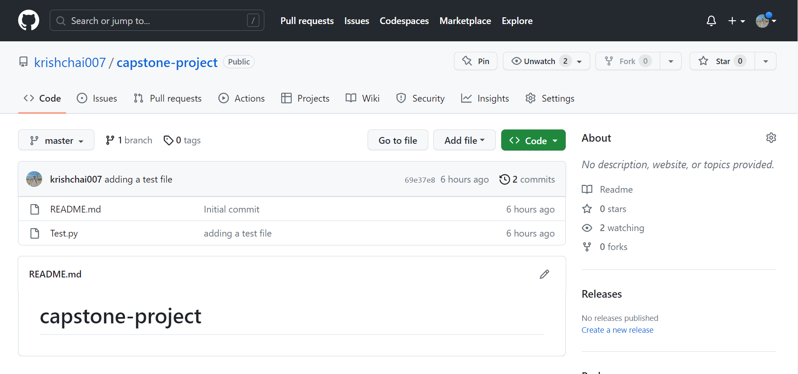
GitHub
A version control platform where one can store and manager code keeping track of changes.
Multiple people on the team can review code and merge changes simultaneously
Helps simplify development process and enhances productivity

Slide 3
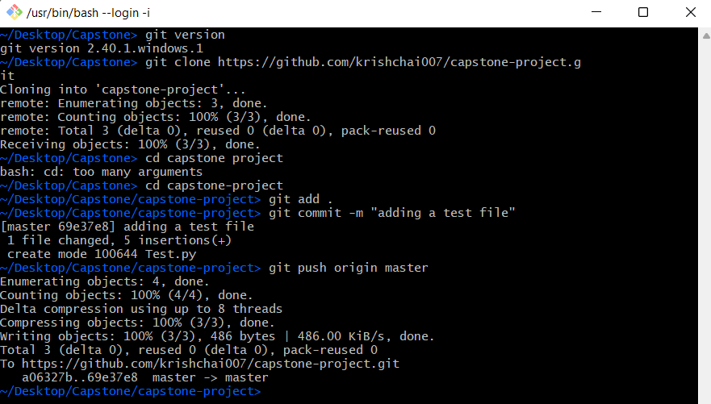
GitHub
These are the commands I used to push files from my local system to my GitHub repository
First I cloned the GitHub repository on my local machine and used add and commit commands to get the files ready for pushing it onto the master branch of my repository.
These commands can be used to push changes into the branch when necessary

Slide 4
