Slide 1

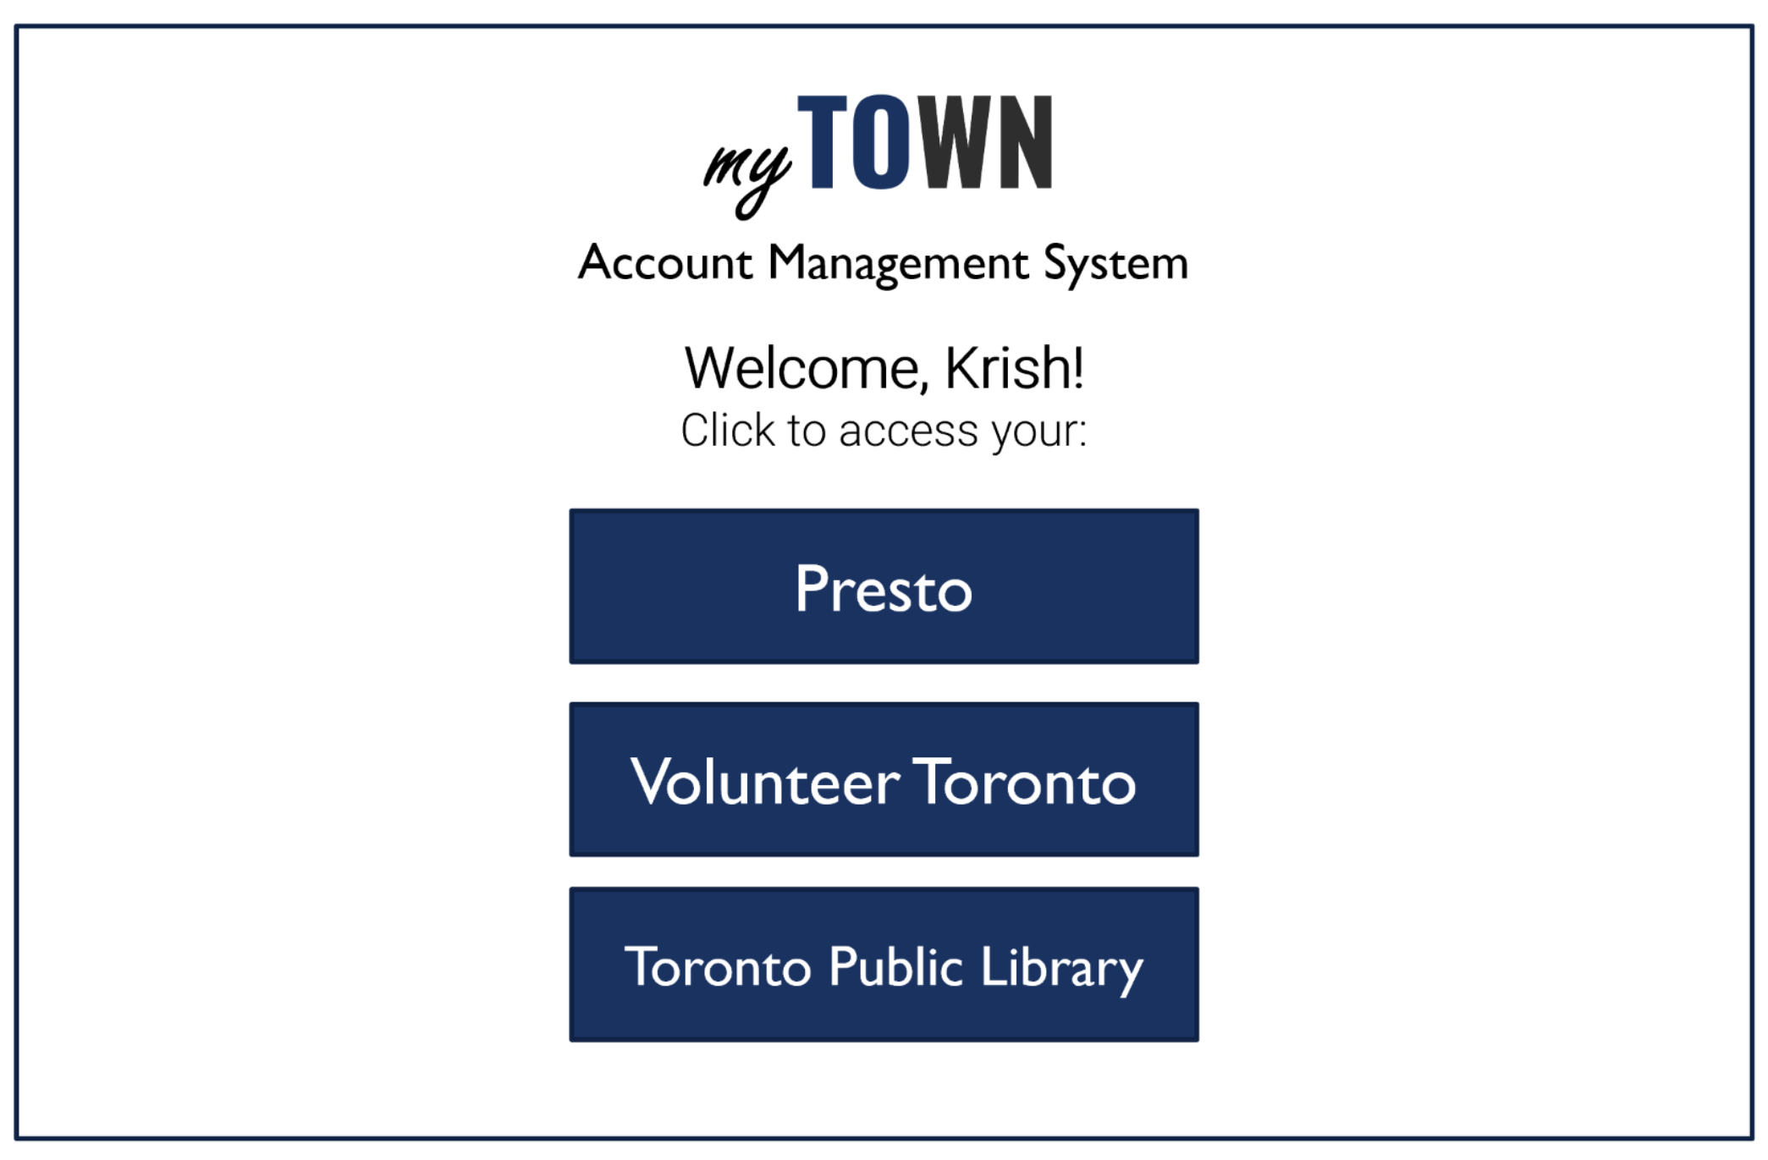

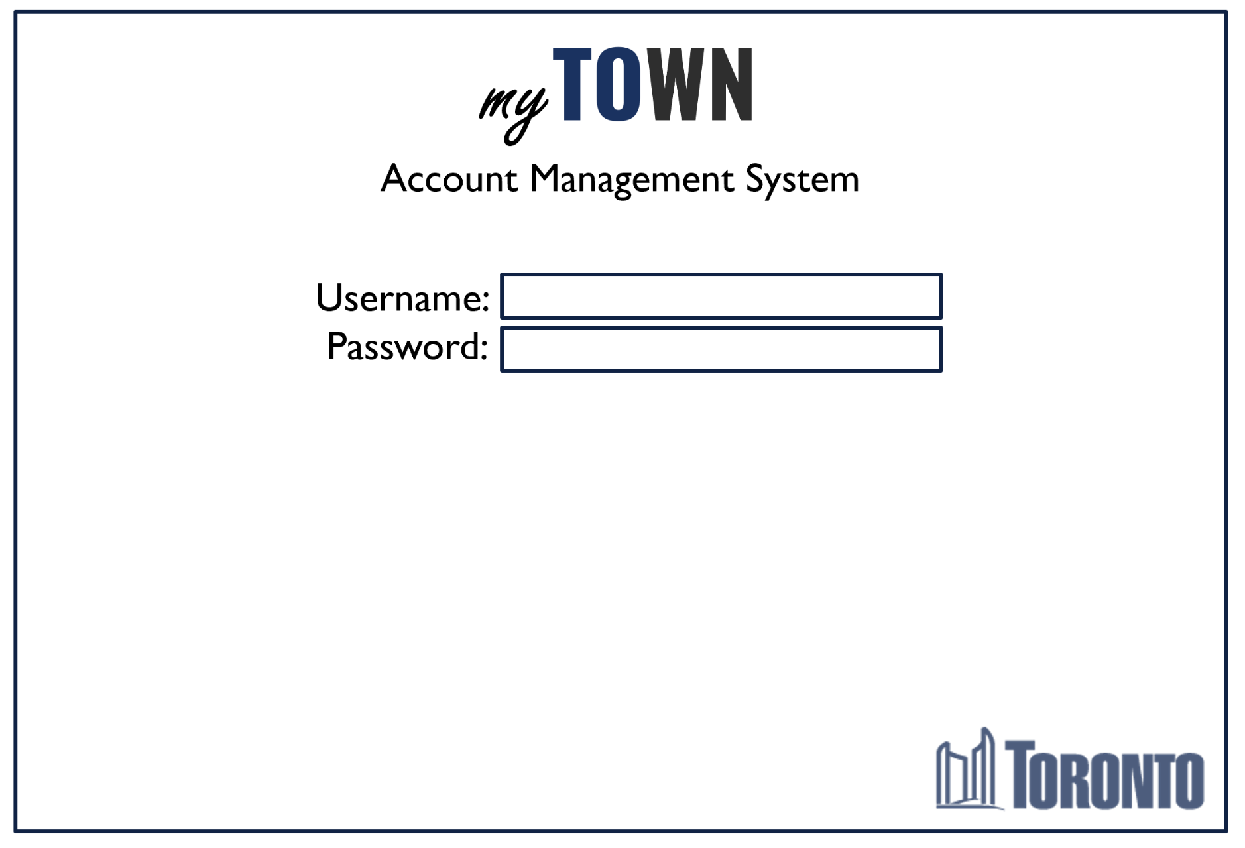
City of Account Management Solution
Presented by Team Cool Force
Simple, Secure, Convenient Making a simple process simple again, for everyone.

Slide 2
Krish Chowdhary (University of Toronto) Robert Nash (Ryerson University) Quynh Dinh (Sheridan College) Mary Ma (Sheridan College)
Notes:
Toronto families lead busy lives.
With the working (sometimes multiple jobs), commuting, and the endless number of responsibilities that come with [adulting], Torontonians don’t want to have to spend lots of time on tasks that should be simple.

Slide 3
City of Account Management Solution
Presented by Team Cool Force

Slide 4
Time: we can never have enough
Notes:
Toronto families lead busy lives.
With the working (sometimes multiple jobs), commuting, and the endless number of responsibilities that come with [adulting], Torontonians don’t want to have to spend lots of time on tasks that should be simple.

Slide 5
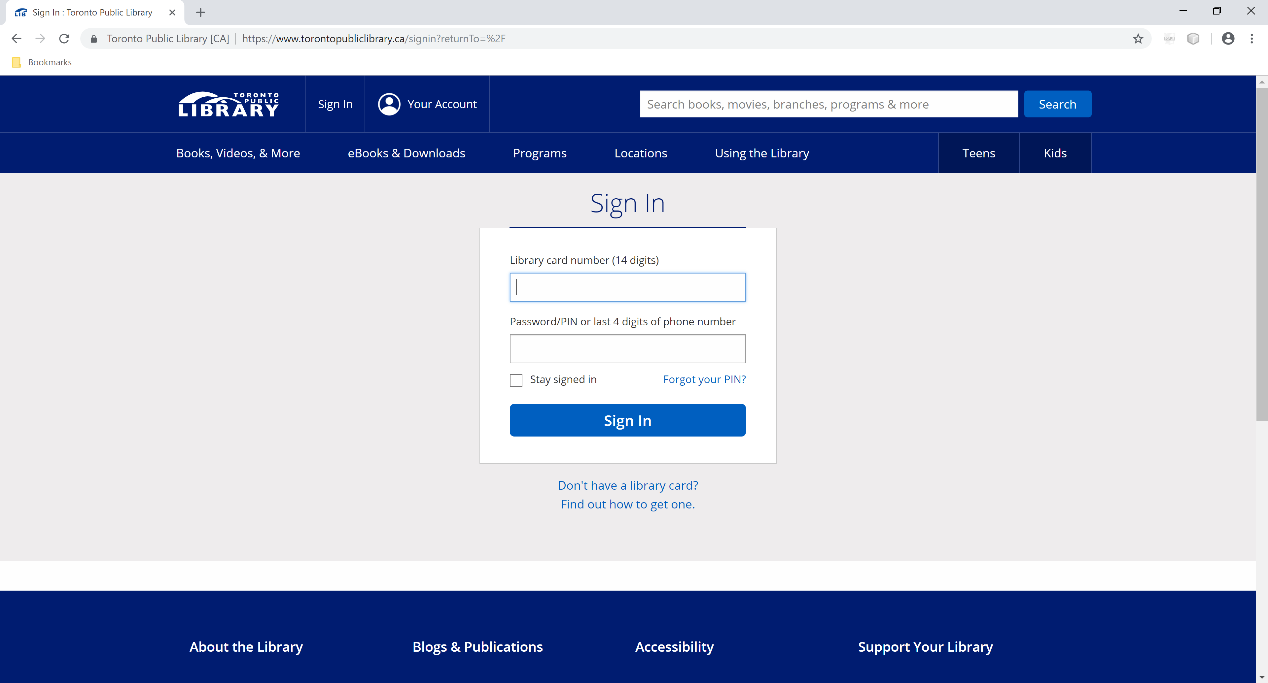
Notes:
For example, logging into an account.
It’s a simple task: you go to the website, you click “sign in”, you enter your login id and password, and go!

Slide 6









…and more?!
Notes:
But when you have multiple accounts for multiple services, you have to spend time:
Navigating to each site website
Providing a separate login ID and password to every single site
A process that should be easy becomes more and more time consuming
At home, you can save your logins and passwords, but families who don’t have access to home computers can’t save their account information on public terminals.
Maybe the computer they’re using doesn’t have a bookmark to the site they’re looking for.
Then they have to take the extra step of searching for the site, which takes more time.

Slide 7
myTOWN
Account Management System
Username:
Password:
Notes:
[Our solution] makes the process easy again. [OS] is an application designed for public computers, such as library computers.
A single sign-on to our app will:
provide users with a landing page that will take them directly to the web sites
sign users into all of their saved accounts
making the process simple again.

Slide 8
Simple, Secure, Convenient
One step sign in process
Landing page for convenient navigation
Continuous integration
Data security
Account timeout
Notes:
One step sign-in: log in done and you’re done
Landing page: go directly to the sites you need, without having to search for them
Continuous integration: our log-in algorithm allows us to continuously add sites that users need to our service
Data security: we protect your account information in an encrypted database
Account timeout: if you forget to log out, we’ll make sure you’re logged out after a certain period of time

Slide 9
Live demo

Slide 10
Ideas for Future Implementation
Ability for users to be able to save account information from any web site
Host as a web service, for accessibility from any computer
Mobile capabilities
Multilingual platform

Slide 11
How much time are you saving?
Notes:
How much time are you saving with the overlooked conveniences of being able to access accounts from your own computer?
We’re bringing this capability to everyone with [OS].
Torontonians have enough in their lives to keep track of. We’ll keep track of this for you.

Slide 12
Thank you!
What questions do you have?

