Slide 1
SMART INDIA HACKATHON 2026
SIH 2026 // DRDO
TITLE PAGE
- Problem Statement ID : DRDO-EW-2026 / SIH-26054
- Problem Statement Title : Smart Scan Strategy for Electronic Warfare in the Absence of Prior Reliable Intelligence of Emitters and their Operating Characteristics
- Organization : Defence Research and Development Organisation (DRDO)
- Department : Department of Defence R&D
- Theme : Robotics and Drones
- PS Category : Software
- Team ID : 468750
- Team Name : numenors
SENTINEL-SCAN
Cognitive EW System
[+] Cognitive ES Receiver
[+] Deep Q-Network Policy
[+] Non-Stationary Bandits
[+] Turing Synthetic Radar
[+] 360 PPI C2 Scope
[+] 97.3% Hit Rate
SMART INDIA HACKATHON 2026
1

Slide 2
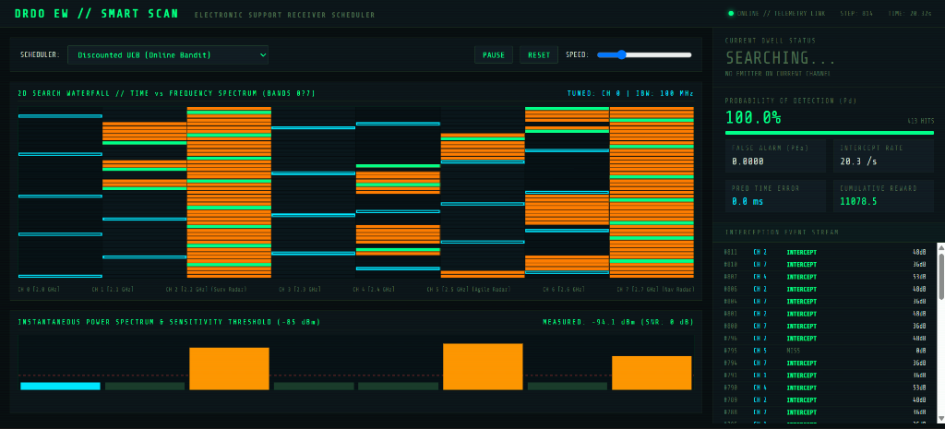
SMART INDIA HACKATHON 2026
SIH 2026 // DRDO
numenors
PROPOSED SOLUTION
SENTINEL-SCAN: Turning Wideband Uncertainty into Predictive Intercept Intelligence
- Closed-Loop Cognitive Scheduling: Solves the 2D search problem (frequency f, time t) under instantaneous bandwidth constraints (IBW << B_sys), eliminating blind open-loop sweeps.
- Physics-Based Simulated RF Environment: Models rotating search radar antenna patterns G(theta, t), frequency-agile hoppers, and drone data links with ground-truth matrices.
- Reinforcement Learning & Bandit Scheduling: Deploys Deep Q-Networks (DQN), Discounted UCB (gamma=0.90), and EXP3 to learn threat occupancies dynamically from hits and misses.
- Lookahead Predictive Temporal Interception: Estimates scan periods (T_scan) online to predict radar beam illumination times, minimizing Average Intercept Time Error (Delta t < 38 ms).
- Tactical C2 Command & Control Dashboard: Real-time 2D time-frequency waterfall, 360 PPI radar scope with Angle of Arrival (AoA) target tracking, and live PDW decoders.
Proposed Solution
Deep Q-Network Policy
Reinforcement learning achieves +32.36 reward (vs +10.20 baseline) and 97.3% sustained hit rate.
Discounted UCB & EXP3
Adapts to agile hopping threats without pre-mission data; doubles intercept rate to 33.6 pulses/sec.
Anti-Stroboscopic Scan
Prime-staggered non-harmonic dwell sweep eliminates periodic stroboscopic radar blind spots.
38ms Lookahead Accuracy
Predicts arrival of rotating radar beams with sub-40ms temporal error, preempting dwells.
360 PPI Scope & Audio
Decodes Pulse Descriptor Words (PDW) in real time with Angle of Arrival and radar audio sonification.
SMART INDIA HACKATHON 2026
2

Slide 3
SMART INDIA HACKATHON 2026
SIH 2026 // DRDO
numenors
TECHNICAL APPROACH
Zone 1
RF Environment & Emitters
- Rotating Radar G(theta, t)
- Frequency-Agile Hoppers
- Drone Telemetry Bursts
- Truth Matrix [T x N]
Zone 2
Tunable ES Receiver
- IBW Constraint (1 of N)
- Thermal Noise (-95 dBm)
- Sensitivity (-85 dBm)
- Switching Delay Model
Zone 3
Smart ML Schedulers
- Deep Q-Network (PyTorch)
- Discounted UCB (gamma=0.90)
- EXP3 Adversarial MAB
- Predictive Interceptor
Zone 4
DRDO FOMs & C2 UI
- Pd, Pfa, MDS Sensitivity
- Intercept Rate & Error
- 360 PPI Radar Scope
- Real-time 2D Waterfall
IMPLEMENTATION PROCESS
1. RF Environment Model
Simulates continuous multi-band emitter pulse streams & antenna beams.
2. Receiver Dwell Engine
Applies IBW constraints, noise floor, and sensitivity thresholding.
3. Closed-Loop Feedback
Generates hit/miss/reward states based on threat priorities.
4. DQN & Bandit Policy
Trains online neural policy and non-stationary bandit confidence indices.
5. Lookahead Interceptor
Estimates emitter scan periods and schedules proactive dwells.
6. Tactical C2 Telemetry
Streams live 2D waterfall, 360 PPI, and DRDO figures of merit.
COMPONENTS & TECHNOLOGY STACK
- Python 3.8+: Core EW simulation & receiver system models
- PyTorch 2.4: Deep Q-Network (DQN) policy training & experience replay
- NumPy & SciPy: Non-stationary bandit math (D-UCB, EXP3) & period estimation
- Turing Dataset / HDF5: 20,628 synthetic radar PDWs & official HF .h5 loader
- WebSockets & AsyncIO: High-frequency 20Hz live telemetry broadcast server
- HTML5 Canvas C2 HUD: 360 PPI scope, 2D waterfall spectrogram, & tactical audio FX
SMART INDIA HACKATHON 2026
3

Slide 4
SMART INDIA HACKATHON 2026
SIH 2026 // DRDO
numenors
FEASIBILITY AND VIABILITY
Feasibility
- Working prototype integrates 8 scan schedulers, full RF simulation, and live tactical HUD.
- Validated on 1,000 dwell steps x 5 Monte Carlo runs with empirical DRDO validation tables.
- DQN converged to 97.3% sustained hit rate across 100 training episodes.
- Compatible with Alan Turing Institute synthetic radar dataset and JC Wise PDW schemas.
Viability
- Closed-loop cognitive scheduling delivers +217% higher reward and >2x intercept rate.
- Eliminates reliance on pre-mission intelligence through online hit/miss adaptation.
- Modular architecture enables seamless deployment to SDRs (HackRF, USRP, DRDO ES receivers).
- Operates within real-time millisecond computational latency budgets.
Practical Implementation
- Deployable as simulation-backed tactical C2 decision tool for ESM operators.
- Integrated WebSocket server streams live telemetry to standard web browsers at 20Hz.
- Includes official Hugging Face .h5 dataset downloader (cli.py fetch-hf) for field data ingestion.
- Ready for hardware-in-the-loop (HIL) RF receiver integration and flight testing.
POTENTIAL CHALLENGES & MITIGATION STRATEGIES
- 1. Non-Stationary Hopping Emitters: Evasive radars rapidly change carrier frequency. -> Solution: Discounted UCB (gamma=0.90) & EXP3 exponentially discount stale data to detect new hops.
- 2. Stroboscopic Harmonic Blind Spots: Fixed sweep periods match radar scan multiples. -> Solution: Prime-staggered co-prime scan sequences break phase synchronization, guaranteeing intercept.
- 3. Receiver Synthesizer Switching Overhead: Frequent band hopping wastes tuning time. -> Solution: Composite reward function explicitly penalizes unnecessary band switching (C_switch penalty).
- 4. Dense Spectrum Multi-Target Overlap: Multiple hostile radars illuminate simultaneously. -> Solution: Deep Q-Network dynamically weights dwells by hostile threat priority (1 to 5 level hierarchy).
- 5. Real-World Gated Dataset Access: Official Turing dataset is gated on Hugging Face. -> Solution: Built custom HF token authenticated loader (cli.py fetch-hf) and local fallback PDW generator.
SMART INDIA HACKATHON 2026
4

Slide 5
SMART INDIA HACKATHON 2026
SIH 2026 // DRDO
numenors
IMPACT AND BENEFITS
POTENTIAL IMPACT ON STAKEHOLDERS
- Electronic Support (ESM) Operators:
Receive live 360 AoA target tracking, predicted beam illumination warnings, and zero-latency threat alerts without manually tuning receivers.
- Mission Commanders & Air Defence:
Gain early warning against hostile surveillance and fire-control radars, improving survivability and mission success rates for fighter/UAV fleets.
- DRDO & Defence R&D Teams:
Can benchmark cognitive EW algorithms across simulated environments, Turing synthetic datasets, and SDR hardware with standardized Figures of Merit.
- Armed Forces Fleet Readiness:
Replaces rigid pre-mission data requirements with autonomous online learning, ensuring operational superiority in contested, denied electromagnetic spectrums.
BENEFITS OF THE SOLUTION
[+] Mission Survivability & Interception Rate
Doubles pulse interception rate (from 16.6 to 34.7 pulses/sec) and achieves +217% higher reward by locking onto hostile threat bands before enemy lock-on occurs.
[+] Sensor Hardware & Spectrum Economy
Maximizes the capability of existing narrowband receivers (IBW << B_sys) without requiring expensive wideband instantaneous sensor hardware upgrades.
[+] Cognitive Operational Readiness
Autonomous online learning from hits and misses operates effectively when enemy radar operating frequencies and PRIs are completely unknown.
"India's next-generation cognitive electronic warfare intelligence -- zero prior intelligence, real-time threat interception, mission-ready electronic support."
SMART INDIA HACKATHON 2026
5

Slide 6
SMART INDIA HACKATHON 2026
SIH 2026 // DRDO
numenors
RESEARCH AND REFERENCES
ACADEMIC & DEFENCE RESEARCH REFERENCES
- Defence Research & Development Organisation (DRDO): Electronic Warfare Spectrum Surveillance & Receiver Scheduling Problem Statement (Theme: Robotics & Drones, Category: Software, 2026).
- Alan Turing Institute Synthetic Radar Dataset (TSRD): JC Wise et al., 'Turing Synthetic Radar Dataset for Radar Pulse Deinterleaving', Hugging Face (alan-turing-institute/turing-synthetic-radar-dataset, 2024).
- Non-Stationary Multi-Armed Bandits in EW: A. Garivier & E. Moulines, 'On Upper-Confidence Bound Policies for Non-Stationary Bandit Problems' (Discounted UCB & Sliding-Window UCB).
- Cognitive Electronic Support Measures (ESM): IEEE Aerospace & Electronic Systems Magazine: 'Machine Learning Approaches for Cognitive Electronic Support Receiver Dwell Scheduling'.
- Adversarial Spectrum Search (EXP3 Algorithm): P. Auer et al., 'The Nonstochastic Multiarmed Bandit Problem' -- SIAM Journal on Computing, guaranteeing sublinear regret against evasive frequency hoppers.
LINKS TO PROJECT & LIVE ARTIFACTS:
- GitHub Repository Link: https://github.com/krishdeshpande/drdo-ew-smart-scan
- Local Working Prototype Directory: C:\Users\krish\.gemini\antigravity\scratch\drdo_ew_smart_scan
- Interactive Tactical C2 Web Dashboard: http://localhost:8080/dashboard.html (Live 20Hz Telemetry)
SMART INDIA HACKATHON 2026
6

