Slide 1
Home Energy Optimization System
Group 7

Slide 2
Home Energy Optimization
Tracks home energy consumption patterns.
Provides optimizations for energy usage
User can control and schedule devices usage

Slide 3
Benefits of Smart Home App
Home energy diagnostics currently cost $300-500 [1]
Our app can significantly reduce this cost
Optimizations can save 10-30% on utility costs [1]
Average utility cost is $4700 in Virginia [2]
Our app can help save $1000 per year
Continuous monitoring and control of energy usage
References: [1] https://rpsc.energy.gov/energy-data-facts
[2] https://www.sofi.com/cost-of-living-in-virginia/

Slide 4
App Feature Breakdown

Slide 5
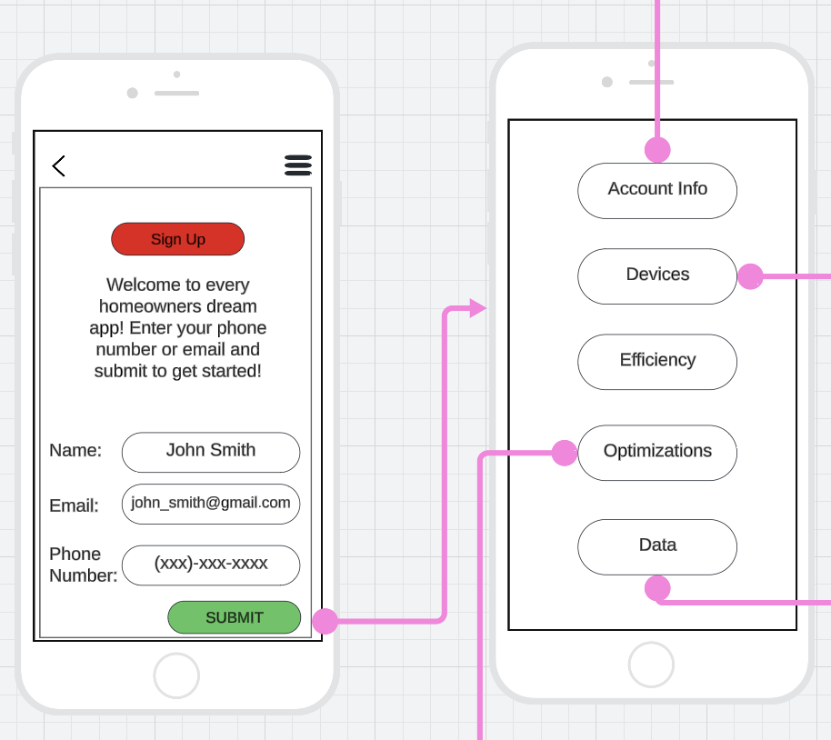
Home/Landing Page
Notes:
Sign up
Four tabs

Slide 6
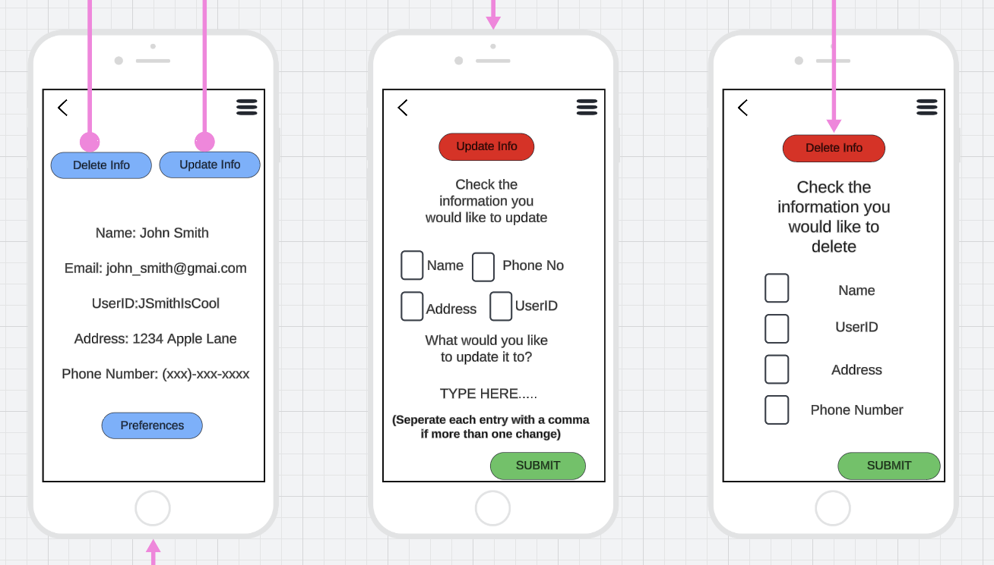
Account/User
Notes:
Sign up through email/phone
Delete account logic
Update account information (email, phone, name, password, etc)
Automatic calibration if moving to a new house

Slide 7
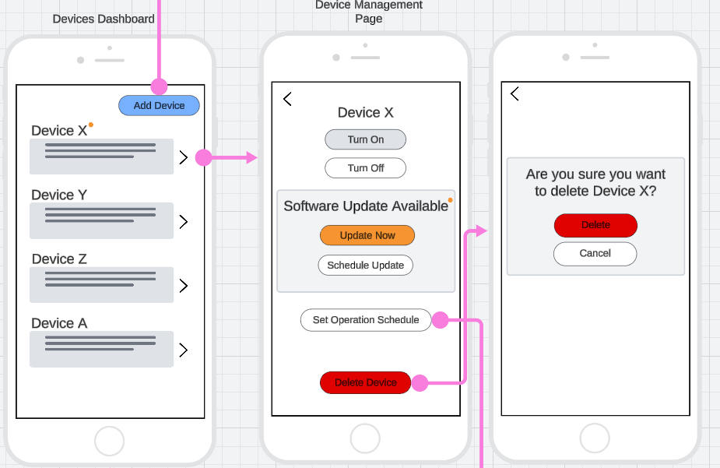
Devices - Dashboard

Slide 8
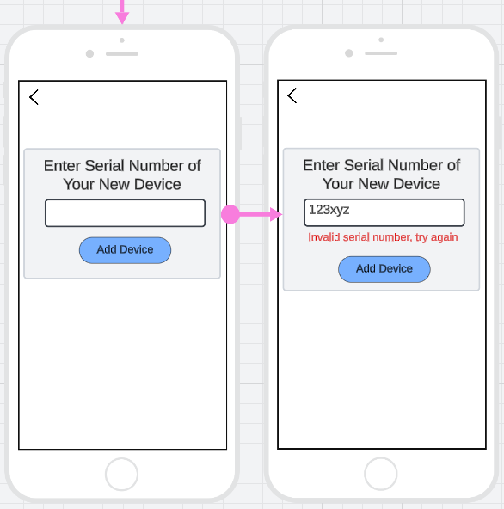
Devices - Add Device
Notes:
add/remove a device through a specific number
Software updates for a specific device
Turn off/on a device
Schedule device operations based on predefined user settings

Slide 9
Devices - Device Management

Slide 10
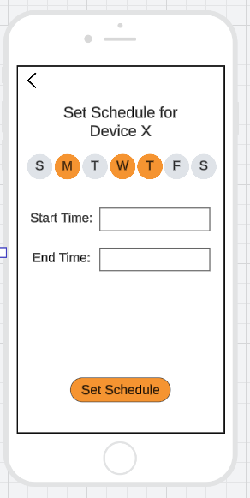
Devices - Scheduling

Slide 11
Devices
Software updates for a specific device
Add/remove a device through a specific number
Turn off/on a device
Schedule device operations based on predefined user settings

Slide 12
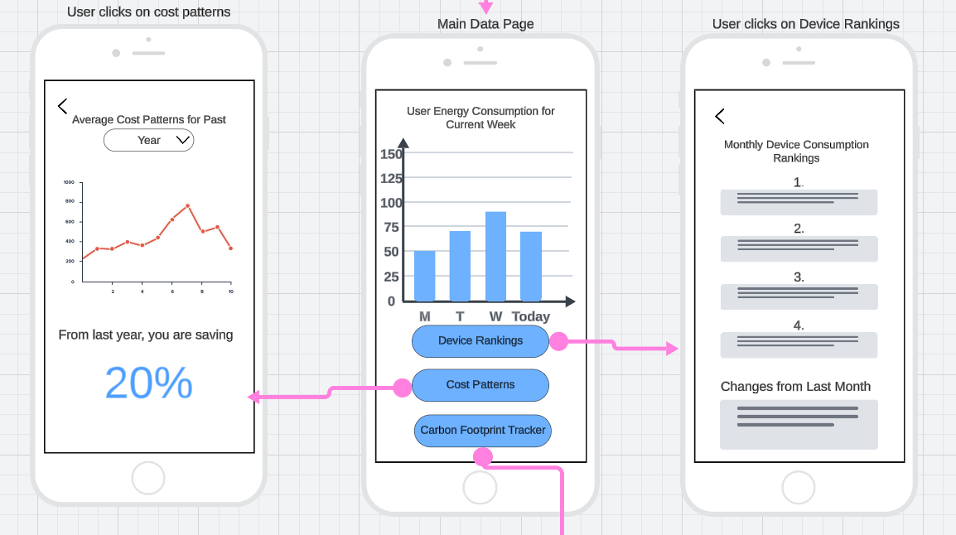
Data
Notes:
Display total energy consumption by user, display cost patterns over time, display Carbon Footprint based on usage, rank devices by energy usage for current month

Slide 13
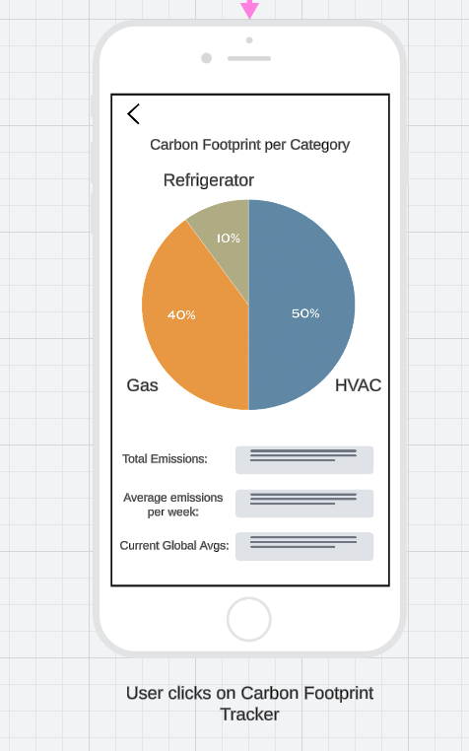
Data - Carbon Footprint Tracker
Notes:
Display total energy consumption by user, display cost patterns over time, display Carbon Footprint based on usage, rank devices by energy usage for current month

Slide 14
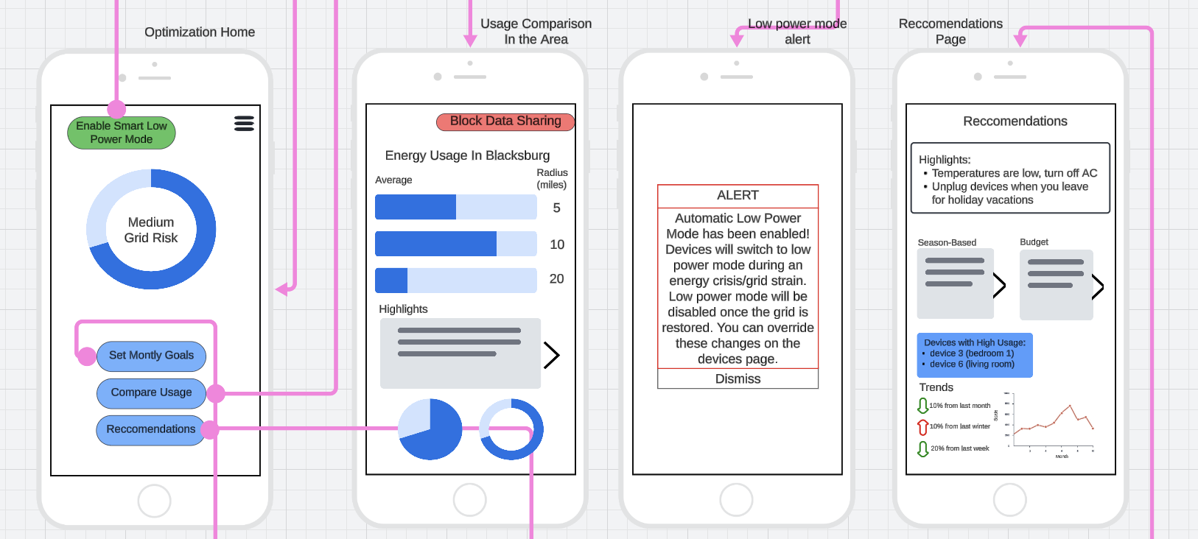
Optimization
Notes:
Automatically switch to low-energy mode in the midst of an emergency like a power outage or a grid strain.
Determine average price + usage of energy around the area and compare that with what the homeowner data
Provide recommendations on how to adjust energy consumption during seasonal changes.

Slide 15
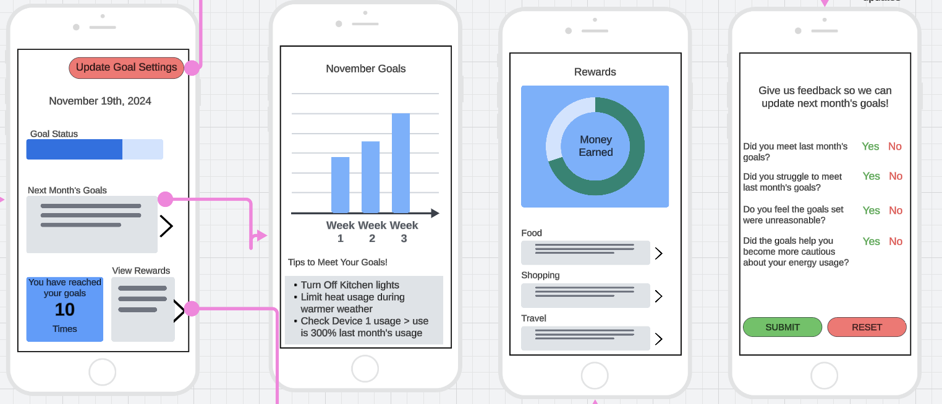
Optimization - Goals
Goal dashboard
Summary
Reward
Goal Feedback
Notes:
Set monthly goals for energy consumption
Display graphs of energy usage trends and give tips to help the user reach their monthly goals
Establish a reward system where the user is rewarded for reaching their monthly goals (food, shopping, gas, etc. vouchers)
Allow the user to provide feedback on the goals set, so they can be updated if deemed necessary by the algorithm

Slide 16
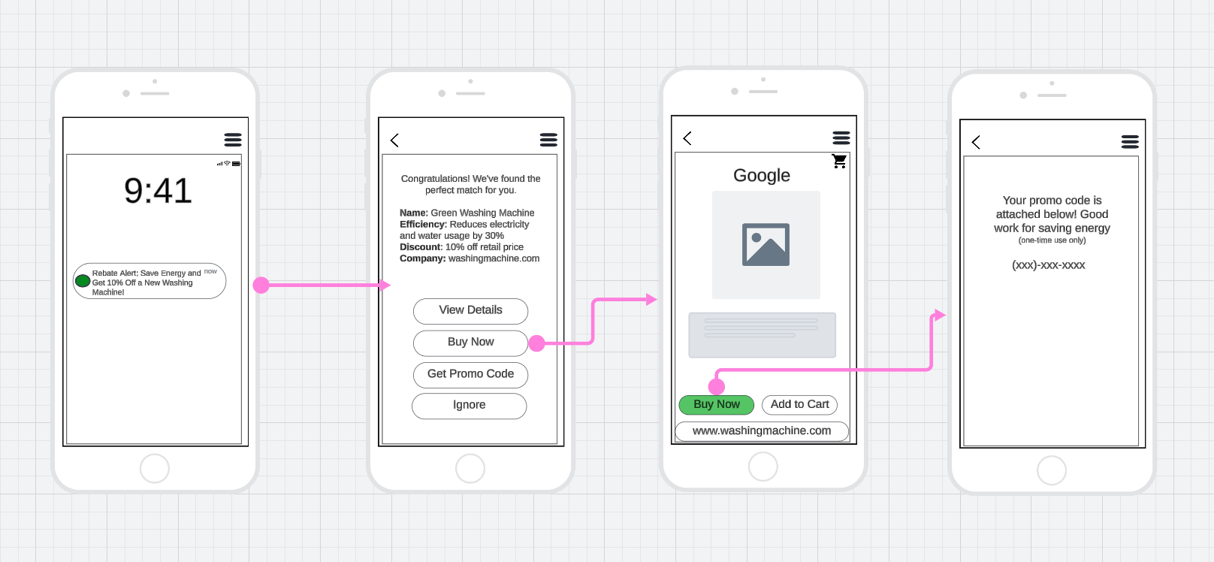
Alerts - Rebates

Slide 17
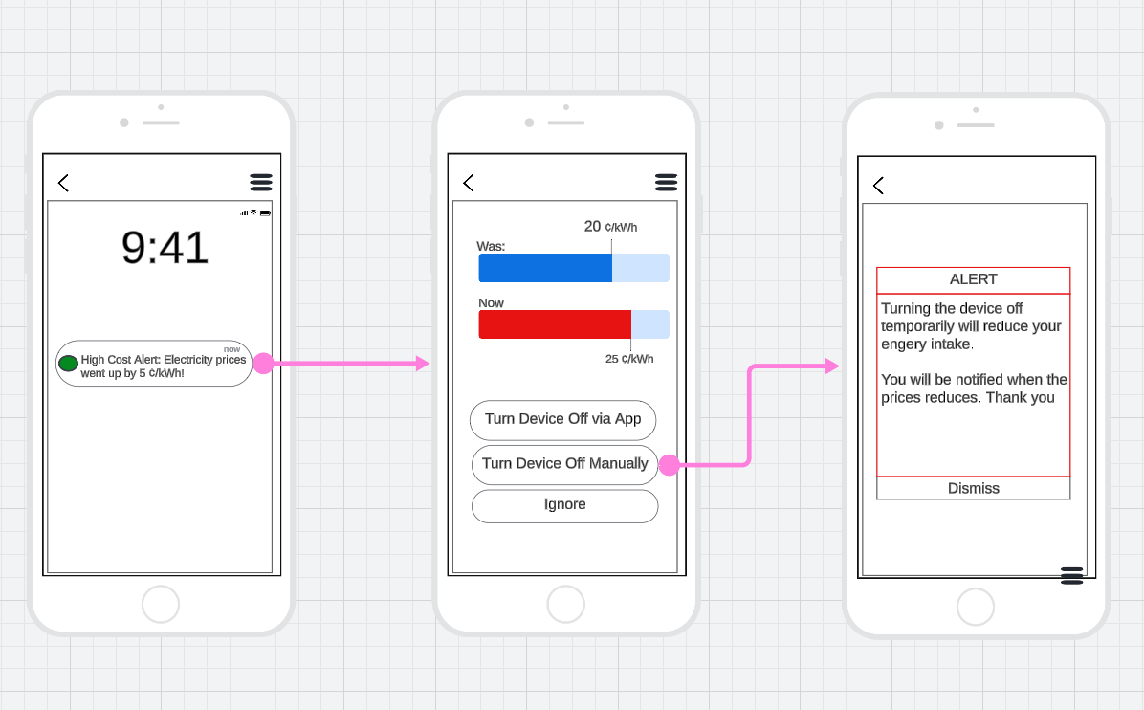
Alerts - Detect Inflation

Slide 18
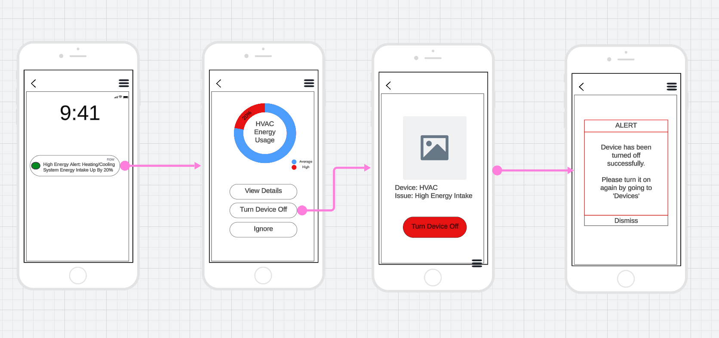
Alert - Energy Irregularities

Slide 19
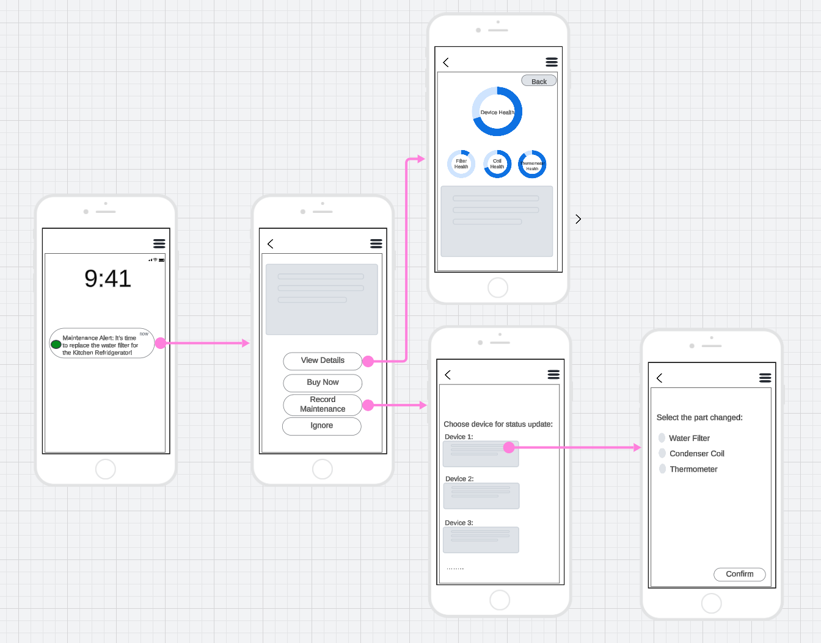
Alert - Maintenance

Slide 20
Challenges and Solutions
Maintaining a uniform design and vision between group members
Solution: Continuous communication and iterative design check-ins
Establishing classes and fields with high cohesion and low coupling
Solution: Defining data needs before assigning to specific classes
Deriving relationships between classes
Solution: Determining shared data be passed between classes
Adhering to the Single-Responsibility principle of OOD
Solution: Modularizing classes so each class has only one major job

Slide 21
Lessons Learned
Early Prototyping: Developing clear team goals for early design models allowed for minimal setbacks on pseudocode and UI/UX design
Balance between Features and Simplicity: Having a clear vision on the app complexity allowed the app design to be simple while still providing all important features
Team Feedback on Individual Parts: Holding team members accountable and providing feedback through each step ensured that we had a uniform design

Slide 22
Thank you

