Slide 1


KGiSL Institute of Technology
(Approved by AICTE, New Delhi; Affiliated to Anna University, Chennai)
Recognized by UGC, Accredited by NBA (IT)
365, KGiSL Campus, Thudiyalur Road, Saravanampatti, Coimbatore – 641035.
Department of Artificial Intelligence & Data Science
Name of the Faculty : Mrs.M.Akilandeeswari
Subject Name & Code : CCS344 ETHICAL HACKING
Branch & Department : B.Tech & AI&DS
Year & Semester : 2023 / VI
Academic Year :2023-24
CW3551/DIS/III AI&DS/V SEM/KG-KiTE

Slide 2
UNIT I INTRODUCTION 6
Ethical Hacking Overview - Role of Security and Penetration Testers. - Penetration-Testing Methodologies- Laws of the Land - Overview of TCP/IP- The Application Layer - The Transport Layer - The Internet Layer - IP Addressing. - Network and Computer Attacks - Malware - Protecting Against Malware Attacks. - Intruder Attacks - Addressing Physical Security
UNIT II FOOT PRINTING, RECONNAISSANCE AND SCANNING NETWORKS 6
Footprinting Concepts - Footprinting through Search Engines, Web Services, Social Networking Sites, Website, Email - Competitive Intelligence - Footprinting through Social Engineering -Foot printing Tools - Network Scanning Concepts - Port-Scanning Tools - Scanning Techniques -Scanning Beyond IDS and Firewall
UNIT III ENUMERATION AND VULNERABILITY ANALYSIS 6
Enumeration Concepts - NetBIOS Enumeration – SNMP, LDAP, NTP, SMTP and DNS Enumeration - Vulnerability Assessment Concepts - Desktop and Server OS Vulnerabilities -Windows OS Vulnerabilities
UNIT IV SYSTEM HACKING 6
Hacking Web Servers - Web Application Components- Vulnerabilities - Tools for Web Attackers and Security Testers Hacking Wireless Networks - Components of a Wireless Network –War driving- Wireless Hacking - Tools of the Trade –
UNIT V NETWORK PROTECTION SYSTEMS 6
Access Control Lists. - Cisco Adaptive Security Appliance Firewall - Configuration and Risk Analysis Tools for Firewalls and Routers - Intrusion Detection and Prevention Systems - NetworkBased and Host-Based IDSs and IPSs - Web Filtering - Security Incident Response Teams –Honeypots.
CW3551/DIS/III AI&DS/V SEM/KG-KiTE

Slide 3
TEXTBOOKS
1. Michael T. Simpson, Kent Backman, and James E. Corley, Hands-On Ethical Hacking and
Network Defense, Course Technology, Delmar Cengage Learning, 2010.
2. The Basics of Hacking and Penetration Testing - Patrick Engebretson, SYNGRESS,
Elsevier, 2013.
3. The Web Application Hacker’s Handbook: Finding and Exploiting Security Flaws, Dafydd
Stuttard and Marcus Pinto, 2011.
REFERENCES
1. Black Hat Python: Python Programming for Hackers and Pentesters, Justin Seitz , 2014
CW3551/DIS/III AI&DS/V SEM/KG-KiTE

Slide 4
SYLLABUS
UNIT II FOOT PRINTING, RECONNAISSANCE AND SCANNING NETWORKS 6
Footprinting Concepts - Footprinting through Search Engines, Web Services, Social Networking Sites, Website, Email - Competitive Intelligence - Footprinting through Social Engineering -Foot printing Tools - Network Scanning Concepts - Port-Scanning Tools - Scanning Techniques -Scanning Beyond IDS and Firewall
CW3551/DIS/III AI&DS/V SEM/KG-KiTE

Slide 5
Course Outcomes
COURSE OUTCOMES:
At the end of this course, the students will be able:
CO1: To express knowledge on basics of computer based vulnerabilities
CO2: To gain understanding on different foot printing, reconnaissance and scanning methods.
CO3 To demonstrate the enumeration and vulnerability analysis methods
CO4: To gain knowledge on hacking options available in Web and wireless applications.
CO5: To acquire knowledge on the options for network protection.
CO6: To use tools to perform ethical hacking to expose the vulnerabilities.
CW3551/DIS/III AI&DS/V SEM/KG-KiTE

Slide 6

2.1 Foot printing
CW3551/DIS/III AI&DS/V SEM/KG-KiTE

Slide 7
2.1 Foot printing
Footprinting is an ethical hacking technique used to gather as much data as possible about a specific targeted computer system, an infrastructure and networks to identify opportunities to penetrate them.
It is one of the best methods of finding vulnerabilities.
Definition:
The process of cyber security footprinting involves profiling organizations and collecting data about the network, host, employees and third-party partners.
CW3551/DIS/III AI&DS/V SEM/KG-KiTE

Slide 8
2.1 Foot printing
This information includes
the OS used by the organization
firewalls,
network maps,
IP addresses, domain name system information,
security configurations of the target machine,
URLs, virtual private networks, staff IDs, email addresses and phone numbers.
CW3551/DIS/III AI&DS/V SEM/KG-KiTE

Slide 9
2.1 Foot printing
Footprinting, also known as fingerprinting,
is a methodology used by penetration testers, cybersecurity professionals, and even threat actors to gather information about a target organization to identify potential vulnerabilities
Footprinting is the first step in penetration testing.
CW3551/DIS/III AI&DS/V SEM/KG-KiTE

Slide 10
2.1 Foot printing
It involves
scanning open ports,
mapping network topologies,
and collecting information about hosts,
their operating systems, IP addresses, and user accounts.
This gathered data helps to generate a comprehensive technical blueprint of the target organization.
CW3551/DIS/III AI&DS/V SEM/KG-KiTE

Slide 11
2.1 Foot printing
There are two types of footprinting in ethical hacking:
active footprinting
passive footprinting
Active footprinting describes the process of using tools and techniques, like using the traceroute commands or a ping sweep -- Internet Control Message Protocol sweep -- to collect data about a specific target.
This often triggers the target's intrusion detection system (IDS).
It takes a certain level of stealth and creativity to evade detection successfully.
CW3551/DIS/III AI&DS/V SEM/KG-KiTE

Slide 12
2.1 Foot printing
Passive footprinting involves collecting data about a specific target using innocuous methods,
like performing a Google search
looking through Archive.org,
using NeoTrace, browsing through employees' social media profiles,
looking at job sites and using Whois(a website that provides the domain names and associated networks fora specific organization)
It is a stealthier approach to footprinting because it does not trigger the target's IDS.
CW3551/DIS/III AI&DS/V SEM/KG-KiTE

Slide 13
2.1 Foot printing
Website footprinting
This technique monitors and analyzes the target website for information, including IP address, domain owner, domain name, subdirectories, parameters, site host, scripting platform, and operating system details.
Tools such as web spiders, web mirrors, monitoring tools, and web data extracting tools are used for these techniques.
CW3551/DIS/III AI&DS/V SEM/KG-KiTE

Slide 14
2.1 Foot printing
Footprinting through social engineering
Sensitive data could be obtained through social engineering techniques such as eavesdropping, shoulder surfing, and impersonation.
WHOIS footprinting
WHOIS provides current domain and owner details, offering access to information such as domain name, owner contact information, creation date, and the public network range.
CW3551/DIS/III AI&DS/V SEM/KG-KiTE

Slide 15
2.1 Foot printing
Stages of footprinting
Both penetration testers and threat actors follow a four-step process in footprinting to gather important information.
Target identification – The first step involves recognizing the target organization and its systems for footprinting. This can be done by scanning networks for open ports or using IoT search engines such as Shodan and Censys.
CW3551/DIS/III AI&DS/V SEM/KG-KiTE

Slide 16
2.1 Foot printing
Information gathering – Gathering vital information, including IP addresses, open ports and services, usernames, and passwords from the identified target
Result analysis – Extracted data is analyzed for vulnerabilities across multiple systems, or results are compared against known exploits.
Attack planning – The final stage is the attack phase, where the threat actor develops custom exploits or chooses a suitable attack vector based on the data collected to compromise vulnerable systems.
CW3551/DIS/III AI&DS/V SEM/KG-KiTE

Slide 17
2.1 Foot printing
Types of Information Collected through Footprinting
Following are the various types of information that are generally aimed at by the hackers through Footprinting:
IP Addresses
Whois Records
Types of Applications used
Presence of a Firewall
Security Configurations
Domain Names
Network Numbers
Authentication Mechanisms
E-Mail addresses and Passwords
CW3551/DIS/III AI&DS/V SEM/KG-KiTE

Slide 18
2.1 Foot printing
Forms of Footprinting
There are various forms and varieties of Footprinting. Some of them are as follows:
E-Mail Footprinting
Google Hacking
Social Engineering
Whois Footprinting
Network Footprinting
Website Footprinting
CW3551/DIS/III AI&DS/V SEM/KG-KiTE

Slide 19
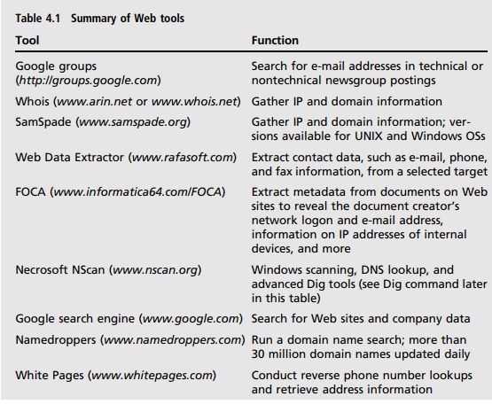
some of the many tools available for footprinting
CW3551/DIS/III AI&DS/V SEM/KG-KiTE

Slide 20
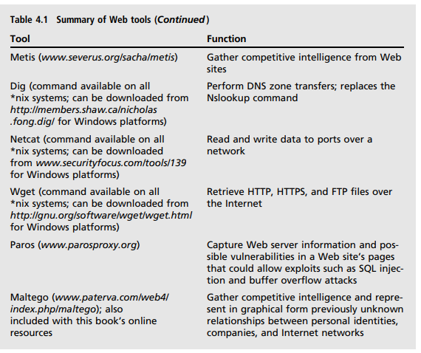
some of the many tools available for footprinting
CW3551/DIS/III AI&DS/V SEM/KG-KiTE

Slide 21
Analyzing a Company’s Web Site
Network attacks often begin by gathering information from a company’s Web site because Web pages are an easy way for attackers to discover critical information about an organization.
Many tools are available for this type of information gathering.
For example, Paros is a powerful tool for UNIX and Windows OSs that can be downloaded free (www.parosproxy.org).
CW3551/DIS/III AI&DS/V SEM/KG-KiTE

Slide 22
Other Footprinting Tools:
The Whois utility is a commonly used Web tool for gathering IP address and domain information.
CW3551/DIS/III AI&DS/V SEM/KG-KiTE
CW3551/DIS/III AI&DS/V SEM/KG-KiTE

Slide 23
Using HTTP Basics:
HTTP operates on port 80.
A security tester can pull information from a Web server by using HTTP commands. You’ve probably seen HTTP client error codes before, such as 404 Not Found.
CW3551/DIS/III AI&DS/V SEM/KG-KiTE
CW3551/DIS/III AI&DS/V SEM/KG-KiTE

Slide 24
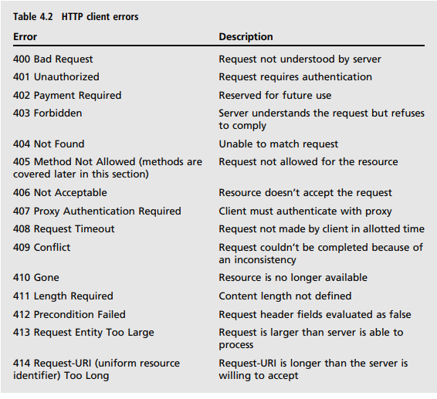
Using HTTP Basics:
CW3551/DIS/III AI&DS/V SEM/KG-KiTE
CW3551/DIS/III AI&DS/V SEM/KG-KiTE

Slide 25
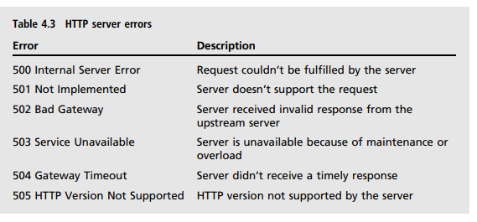
Using HTTP Basics:
CW3551/DIS/III AI&DS/V SEM/KG-KiTE
CW3551/DIS/III AI&DS/V SEM/KG-KiTE

