Slide 1



SMART INDIA HACKATHON 2026
Problem Statement ID : SIH26124
Problem Statement Title : AI Powered Mobile Urban Intelligence Platform Using Public Transport Fleet
Theme : Smart Automation
PS Category : Software
Team Name : TENSORS
College Name : Netaji Subhash University of Technology

Slide 2
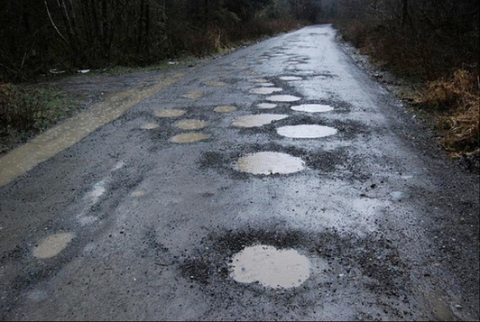
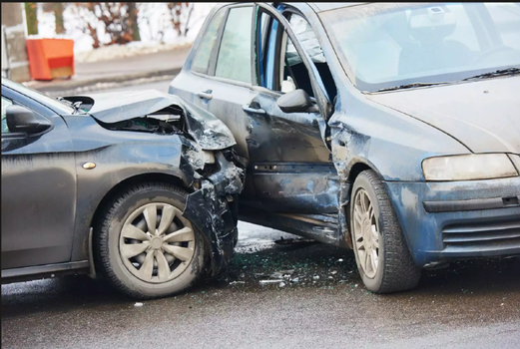
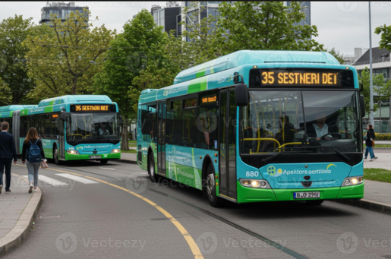
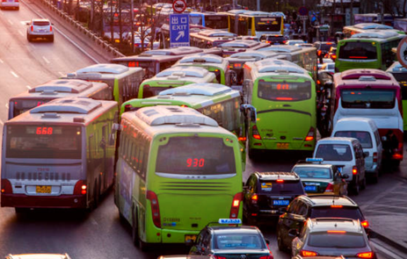
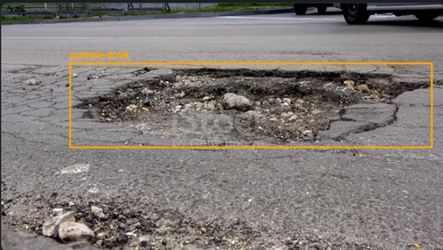
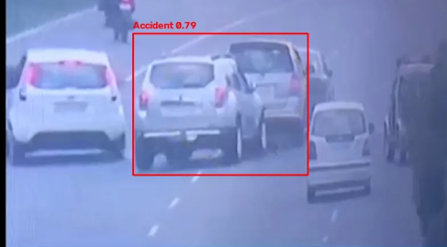
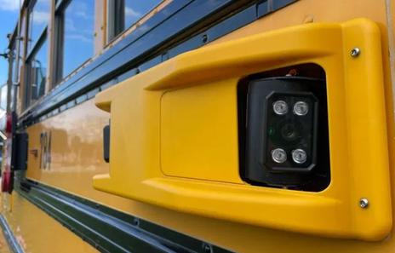

TENSORS
IDEA TITLE : RoadSense -Edge-AI
Potholes and Accident Detection for Public Transport Fleets
Road Defects like path holes
Car accidents
Public transport fleets as mibile sensors
Every journey becomes source of road data
Pothole detected by on-device AI
Accident detected by on-device AI
Existing onborad cameras for road monitoring
Turning road data into actionable insights
2

Slide 3
TENSORS
TECHNICAL APPROACH -> Technologies:
Python, OpenCV, Ultralytics YOLO, Node.js, Express, MongoDB, ImageKit
Bus Camera
Captures live footage
On-device YOLO
Detects pothole or accident
Temporal Voting
Confirms real detections
Live Dashboard
Displays confirmed detections
MongoDB and ImageKit
Stores record and image
Express and Multer
Receives confirmed event
3

Slide 4
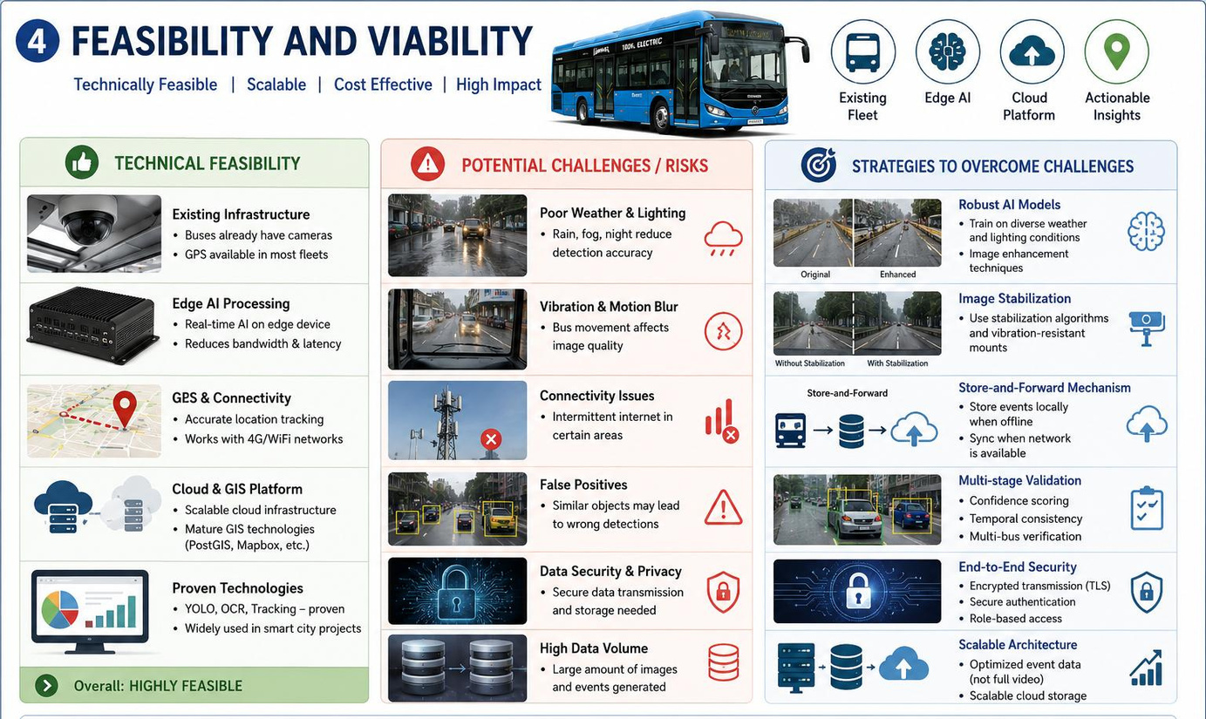
TENSORS
FEASIBILITY AND VIABILITY
4

Slide 5
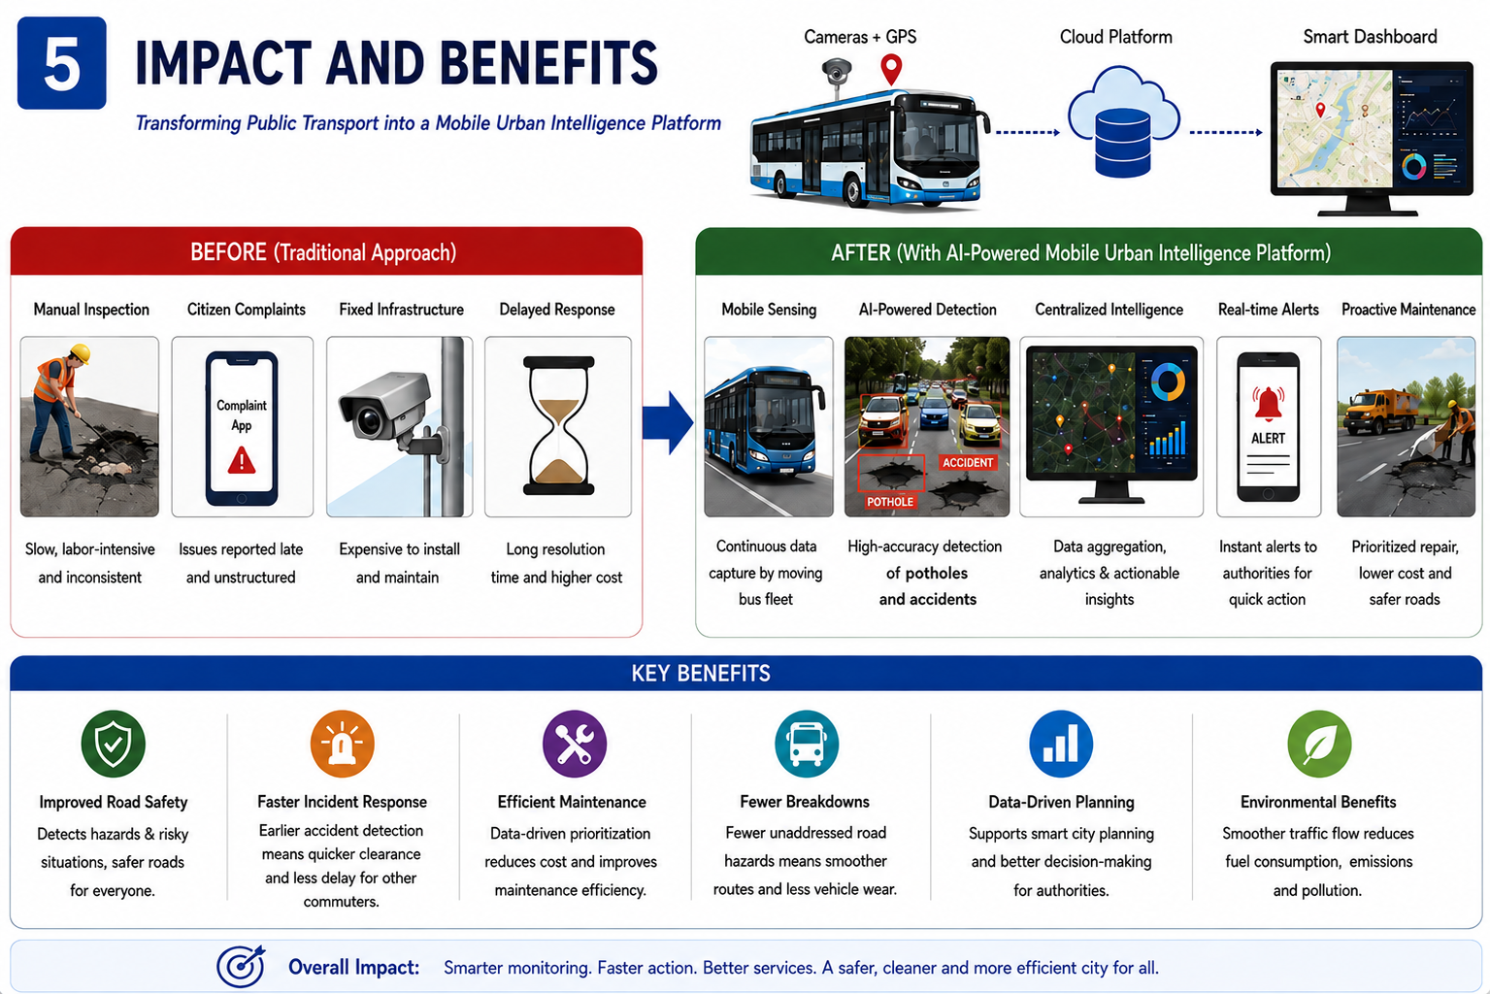
TENSORS
IMPACT AND BENEFITS
5

Slide 6




TENSORS
RESEARCH AND REFERENCES
YOLO OBJECT DETECTION
POTHOLE DETECTION
Real-time detection of objects and events from camera/video stream
Online images collected for pothole-detection training
ACCIDENT DETECTION
OPEN CV -VIDEO PROCESSING
Online images collected for accident-detection training
Processes camera/video streams frame by frame for CV analysis
[1] YOLO / Ultralytics → UltralyticsYOLO Documentation
[2] OpenCV-> OpenCV Documentation
[3] Image Data → Publicly available web images,manually collected and annotated
[4] Roboflow → Roboflow Dataset Annotation & Training Platform
6

