Slide 1
E-COMMERCE SALES
ANALYSIS DASHBOARD
Business Intelligence • Interactive Power BI Report
Presented by: Krish Suryavanshi Gupta
BBA – Business Analytics | Submitted to: Mr. Arif Raza Roll No.: 1240645097
POWER BI PROJECT PRESENTATION

Slide 2
01 | Executive Summary
A single view of sales, profit, products and customer behaviour
• This project uses Power BI to convert e-commerce transaction data into an interactive visual dashboard.
• The report brings together four headline indicators: Amount, Quantity, Profit and Average Order Value (AOV).
• Additional visuals compare state-level sales, category mix, monthly profit, customer contribution, payment modes and sub-category profitability.
• The goal is to make performance patterns easier to explore and to support evidence-based business questions.

Slide 3
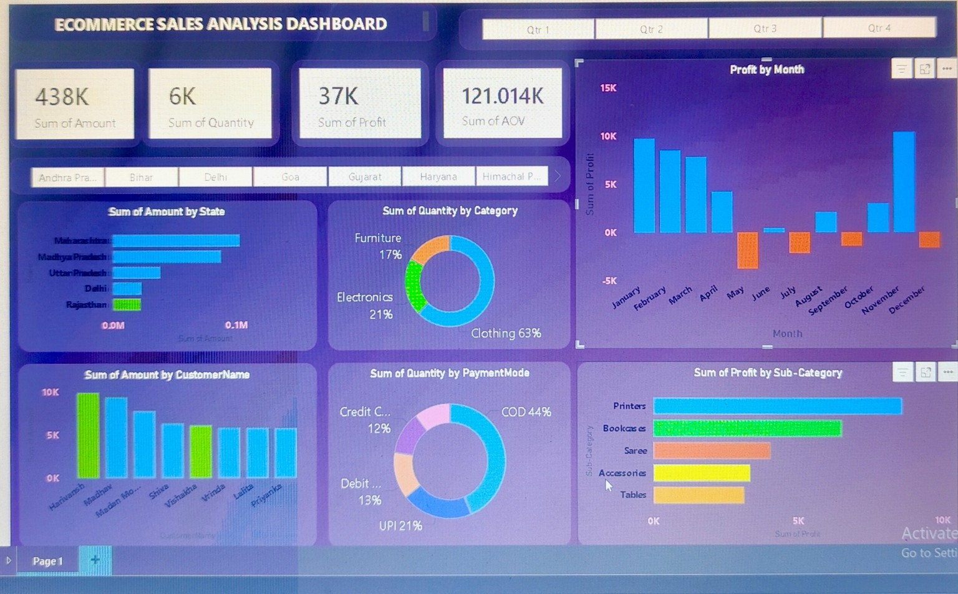
02 | Dashboard at a Glance
The submitted Power BI dashboard

Slide 4
03 | Key Performance Indicators
Headline values visible in the dashboard screenshot
438K
6K
37K
121.014K
Total Amount
Total Quantity
Total Profit
Sum of AOV shown
• Amount and Quantity summarize overall recorded sales volume.
• Profit provides a headline view of the dataset’s recorded profitability.
• The AOV card should be validated: confirm whether the intended metric is average order value or a sum of row-level AOV values, and format it appropriately before final submission.

Slide 5
04 | Visual Analysis
What each visual helps the viewer investigate
State comparison
Product mix
Amount by State identifies which displayed states contribute higher recorded sales.
Quantity by Category compares the distribution of clothing, electronics and furniture.
Monthly profit
Customer contribution
Profit by Month highlights months with positive and negative recorded profit.
Amount by Customer Name compares the customers shown in the visual.
Payment behaviour
Sub-category profit
Quantity by Payment Mode compares COD, UPI, debit and credit card categories.
Profit by Sub-Category compares the displayed product sub-categories.

Slide 6
05 | Business Insights & Questions
Use the dashboard to investigate patterns—not just display charts
• Which states contribute the highest sales amount in the selected data?
• How is quantity distributed across the three product categories?
• Which months show negative profit and should be investigated further?
• Which payment modes account for the largest share of recorded quantity?
• Which sub-categories have comparatively higher or lower profit?
• Quarter and state filters can help compare performance across selected segments.

Slide 7
06 | Methodology & Quality Checks
A reliable dashboard needs correct data and correctly defined measures
• Load the source dataset into Power BI Desktop and confirm column data types.
• Use Power Query to check missing values, duplicate rows and inconsistent category/state labels.
• Build visuals using the relevant fields and measures; ensure the quarter controls filter the intended charts.
• Validate Amount, Quantity and Profit against the source data; check AOV calculation and formatting carefully.
• This dashboard is descriptive analytics: it summarizes historical records and does not, by itself, predict future outcomes.

Slide 8
07 | Recommendations & Next Steps
Turning dashboard observations into useful follow-up analysis
• Investigate negative-profit months by reviewing discounts, costs, product mix and transaction details where those fields are available.
• Compare state and sub-category performance before proposing inventory or marketing actions.
• Review payment-mode patterns alongside order value and profit rather than quantity alone.
• Add date, category and state slicers only where they improve usability and do not overcrowd the report.
• Document the data source, metric definitions and any assumptions in the final project README.

Slide 9
CONCLUSION
The E-commerce Sales Analysis Dashboard consolidates key sales and profit measures into one interactive Power BI report. It enables quick comparison across states, categories, months, customers, payment methods and sub-categories.
Thank you
Questions & Discussion

