Slide 1
KYUBIC V2 · Stonefish simulator · ROS 2
Camera-only navigation for KYUBIC V2
Autonomous (AUV) and piloted (ROV) control from one camera: no IMU, DVL or depth sensor
1
9 / 9
± 2 mm
1.5 ms
sensor used for control:
the forward camera
simulation test scenarios
passed (incl. fault cases)
sideways centring
on the buoy
joystick to simulator
(median, ROV)
Krish Gupta · 28 October 2026
Notes:
This project makes KYUBIC V2 find and approach a yellow buoy using only its forward camera. No IMU, DVL or depth sensor is used for control. Everything runs in the Stonefish simulator with a true-scale model of KYUBIC built from our CAD. Two modes: AUV (fully autonomous) and ROV (a pilot drives with a game controller while the robot keeps itself safe). The headline numbers: all 9 test scenarios pass, the robot centres on the buoy to within 2 mm sideways, and a joystick press reaches the simulator in 1.5 ms (median).

Slide 2
Can KYUBIC navigate with its camera alone?
Motivation, research question and what the paper would contribute
Motivation
Proposed contributions
Navigation normally relies on an IMU, a DVL and a depth sensor: extra cost, size and failure points
The camera is already on board for the mission targets
Underwater vision work usually keeps an IMU or depth sensor in the loop
1
Camera-only state estimation
Kalman filters driven by identified thrust models, corrected by the buoy's position and optical flow
2
Real-size KYUBIC V2 in simulation
Built from the team's CAD at true scale (39.4 kg, 6 × T200), with the team's buoy design
RESEARCH QUESTION
Can KYUBIC find, approach and stop at a target, and hold its depth for a pilot, using only its forward camera and a model of its own thrusters?
3
Detector trained without hand labels
2,656 simulator images labelled from the buoy's 3D mesh; precision 0.97, recall 0.98
4
Evaluation in AUV and ROV modes
9 test scenarios including faults, and latency with a real camera in the loop
To complete the paper
Repeat runs
Sensor baseline
Ablations
Real KYUBIC
mean ± SD for every scenario
same controller with IMU, DVL and depth sensor
without optical flow; without the thrust model
short validation test in a pool
KYUBIC V2 · camera-only navigation
2
Notes:
Why this matters: an AUV like KYUBIC normally navigates with an IMU, a DVL and a depth sensor. The DVL in particular is expensive and bulky, and every extra sensor is one more thing that can fail. The camera is on board anyway to find the mission targets, so the question is how far the camera alone can go. Most underwater vision work still keeps an IMU or a depth sensor in the loop (I will confirm this with a proper literature review). Research question: can KYUBIC find, approach and stop at a target, and hold its depth for a pilot, with only its forward camera and a model of its own thrusters? Contributions: (1) camera-only state estimation, where Kalman filters are driven by identified thrust models and corrected by what the camera sees; (2) a real-size KYUBIC V2 simulation built from our CAD, with our buoy design; (3) a detector trained on simulator images whose labels are computed exactly from the buoy's 3D mesh; (4) an evaluation in both AUV and ROV modes, including fault cases and latency. Before writing the paper: repeat every scenario several times for statistics; run the same controller with the simulated IMU, DVL and depth sensor as a baseline (the code already has switches for this); ablations without optical flow and without the thrust model; and ideally a short test on the real KYUBIC.

Slide 3
Predict from thrust, correct with the camera
How the robot estimates its own motion with no navigation sensors
Robot model (one per axis)
m · dv/dt = τ − d₁ v − d₂ v|v|
commanded thrust τ
predict
Camera
Detector + flow
correct
Kalman observer
Controller
6 × T200
forward view, 21 fps
YOLO26n buoy box, optical flow
depth · heading · speed
AUV mission or ROV assist
thrust allocation
KYUBIC moves, and the camera sees the result
1
See: find the buoy
2
Predict: robot model
3
Correct and act
YOLO26n trained on 2,656 simulator images, labelled from the buoy's 3D mesh
Held-out test: precision 0.97, recall 0.98
Box size gives range; box position gives bearing and height
m, d₁, d₂ fitted per axis (surge, sway, heave, yaw) from thrust step tests
Real-size KYUBIC: fits explain 94–98% of the motion (R²)
Gives speed, turn rate and depth between camera corrections
Kalman filters correct the model with buoy range, buoy height and optical flow
AUV: search, align, approach, stop ~8 cm short, back off, surface
Speed limits from the model; surfaces if the camera is lost
KYUBIC V2 · camera-only navigation
3
Notes:
The core idea: the robot predicts its own motion from the thrust it commands, and the camera corrects that prediction. The camera image goes to YOLO26n, which finds the buoy, and to an optical-flow estimator. The Kalman observer (dark box) combines these with the robot model to estimate depth, heading and forward speed; the controller acts on that estimate, the six T200 thrusters move the robot, and the camera sees the result. The robot model is what stands in for the navigation sensors. For each axis it is m dv/dt = tau - d1 v - d2 v|v|, where tau is the commanded thrust, m an effective mass and d1, d2 drag coefficients (heave has an extra constant for net buoyancy). We fitted them from thrust step tests on the real-size KYUBIC in Stonefish, with R-squared 0.94 to 0.98. The fitted m is larger than the 39.4 kg dry mass (about 92 kg in surge) because it includes the water the robot has to push and any thrust losses. At this size drag is mostly linear. These values come from the simulator, so they still need checking on the real robot. Detection: labels are computed exactly by projecting the buoy's 3D mesh into the image, so no hand labelling; on 377 held-out images precision is 0.97 and recall 0.98. Range comes from the box size with a pinhole camera model. Correction and control: buoy range from the box size, buoy height from the elevation angle, and optical flow with the rotation part removed. The AUV state machine searches, aligns, approaches, stops about 8 cm short, backs off and surfaces; speeds are limited with the model, and if the buoy or the depth estimate is lost the robot surfaces slowly.

Slide 4
AUV mode: autonomous buoy approach
Search, align, approach, stop, back off and surface with no pilot
Case video 1
Insert ▸ Video ▸ This Device, then delete this frame
AUV mode video
Insert ▸ Video ▸ This Device, then delete this frame
Case video 2
Insert ▸ Video ▸ This Device, then delete this frame
9 / 9
7.6–8.1 cm
≤ 6 mm
≤ 0.10 m/s
scenarios passed, incl. buoy behind, deeper and absent
stop distance in front of the buoy
off the bulb's centre (≤ 2 mm sideways)
top speed; 0.04 m/s near the buoy
KYUBIC V2 · camera-only navigation
4
Notes:
Main video: a full autonomous mission. Case videos: two of the test scenarios (for example the buoy behind the robot, which needs a search turn, and the buoy deeper than the robot). Results from the latest real-size test suite: all 9 scenarios pass, including fault cases (no detector, no depth estimate, no buoy). The robot stops 7.6 to 8.1 cm in front of the buoy, centred to within 2 mm sideways and 6 mm vertically, with the buoy within 4 pixels of the image centre. Top speed is under 0.10 m/s and under 0.04 m/s near the buoy. Depth comes only from the camera; its error versus the truth is under 0.1 m on average and at most 0.33 m.

Slide 5
ROV mode: pilot drives, robot stays safe
The pilot gives speeds; the robot holds heading and depth and guards the buoy
Sticks set speeds
up to 0.145 m/s forward, with gentle ramps
Holds heading and depth
depth within about 3 cm through 30 s of turning or sliding
Collision guard
ROV mode video
forward speed falls to zero about 0.12 m from the buoy
Insert ▸ Video ▸ This Device, then delete this frame
Real camera moves the buoy
same picture position in both cameras; error 1–2% of the frame
1.5 ms
≤ 3 cm
0.12 m
0 sensors
joystick press to simulator (median)
depth change in 30 s turns and slides
closest approach with full forward stick
besides the camera: no IMU, DVL or depth sensor
KYUBIC V2 · camera-only navigation
5
Notes:
In ROV mode a pilot flies KYUBIC with a game controller. The sticks command speeds rather than raw thrust (at most 0.145 m/s forward), and the robot holds its heading and depth by itself, camera-only: depth stays within about 3 cm through 30 s of turning or sliding sideways. A collision guard uses the buoy's box size to bring forward speed to zero about 0.12 m from the buoy, even with the stick held fully forward. A real USB camera with its own YOLO can move the simulated buoy so both cameras show it in the same place, with an error of 1 to 2 percent of the frame. A joystick press reaches the simulator in 1.5 ms (median).

Slide 6
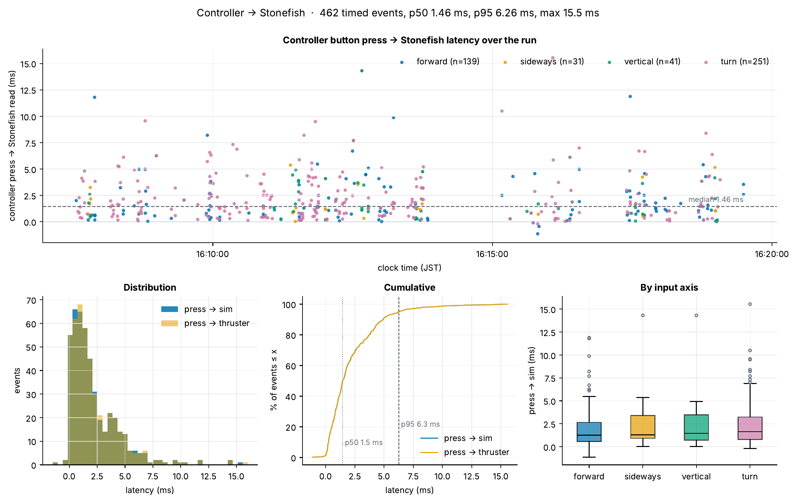
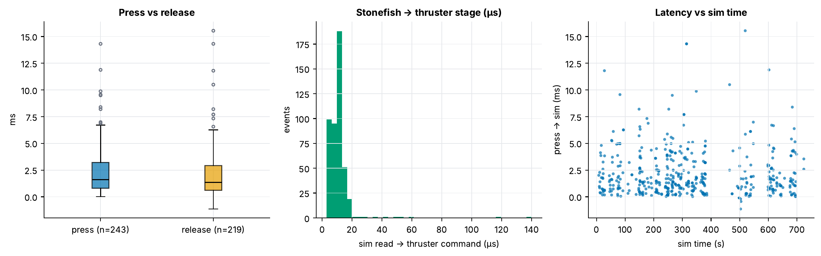
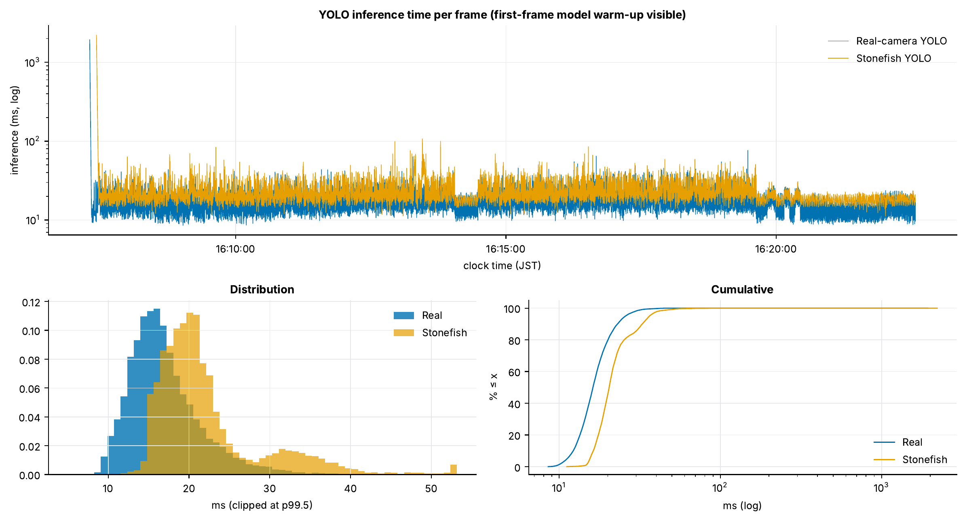
ROV latency: stick to thruster in 1.5 ms
Latency through the ROV pipeline, real and Stonefish cameras side by side · ROV run, 18 Oct 2026
metric (ms) | n | mean | p50 | p95 | p99 | max
Controller press → sim | 462 | 2.20 | 1.46 | 6.26 | 11.01 | 15.54
Controller press → thruster | 462 | 2.21 | 1.46 | 6.28 | 11.02 | 15.55
Real: camera → ROS | 26,867 | 56.96 | 12.50 | 276.96 | 315.66 | 340.82
Stonefish: camera → ROS | 9,067 | 8.69 | 7.22 | 17.23 | 20.82 | 1,015.45
Real: YOLO inference | 26,867 | 17.11 | 16.18 | 25.77 | 32.20 | 1,932.81
Stonefish: YOLO inference | 9,067 | 22.61 | 20.40 | 36.31 | 47.92 | 2,211.88
Real: ROS rx → control | 26,652 | 84.24 | 21.62 | 312.39 | 676.48 | 2,337.29
Stonefish: ROS rx → control | 9,067 | 133.61 | 24.74 | 653.83 | 868.27 | 2,213.66
Real: camera → thruster | 26,652 | 141.40 | 41.98 | 438.50 | 766.29 | 2,352.43
Stonefish: camera → thruster | 9,067 | 142.31 | 37.32 | 664.74 | 883.40 | 2,227.49
Joystick press to thruster command: 1.5 ms median, 6.3 ms p95
Camera frame to thruster command: 42 ms (real) and 37 ms (Stonefish) median
The ~2 s maxima come from start-up, when YOLO loads its model on the first frame
KYUBIC V2 · camera-only navigation
6
Notes:
Measured over a 15-minute ROV session with 462 timed joystick events. A stick press reaches the simulator in 1.46 ms (median) and the thruster command almost immediately after (the Stonefish-to-thruster stage is microseconds). For the cameras, a frame reaches a thruster command in about 40 ms (median) in both the real and the Stonefish pipeline; YOLO itself takes 16 to 20 ms. The p95 and p99 tails come from frames waiting for the control loop, and the 2-second maxima are the first frame of the run, when YOLO loads its model (the spike at the start of the inference graph).

Slide 7
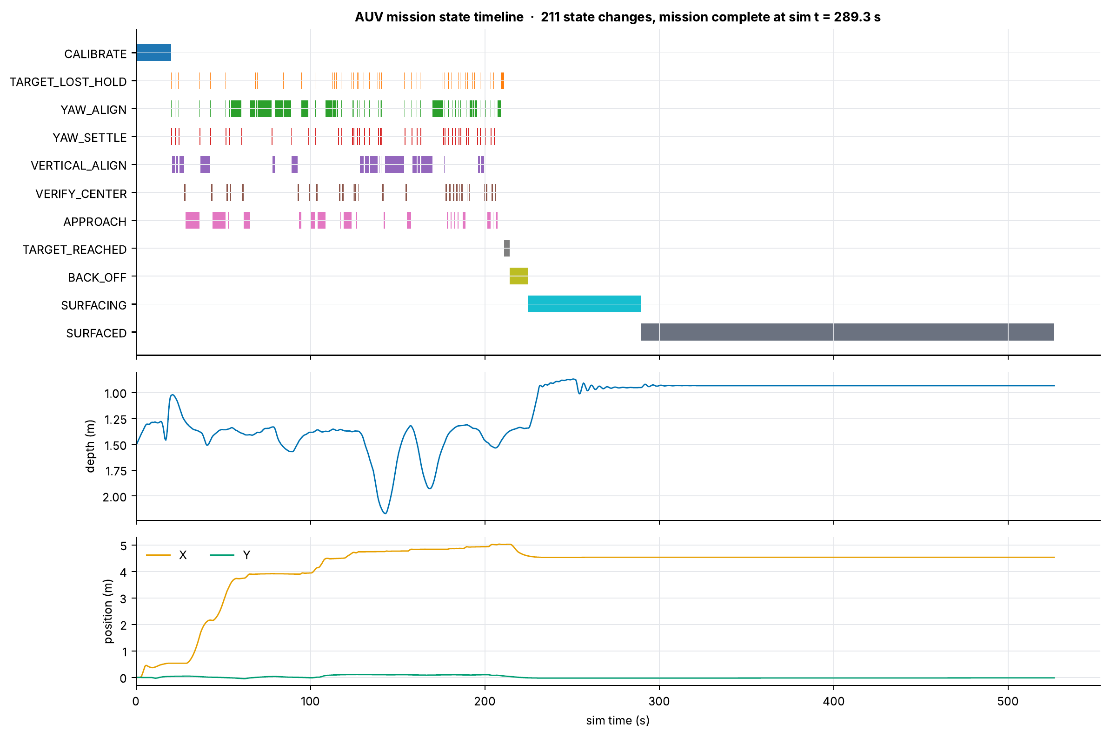
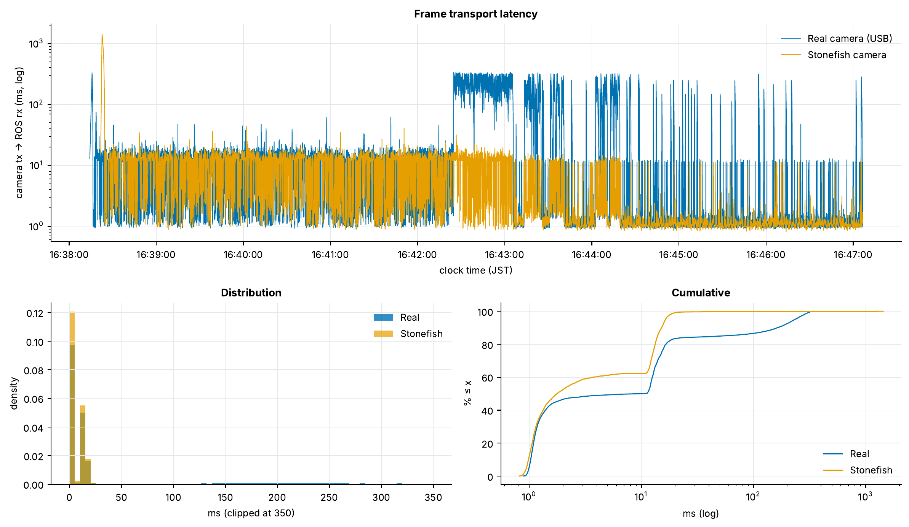
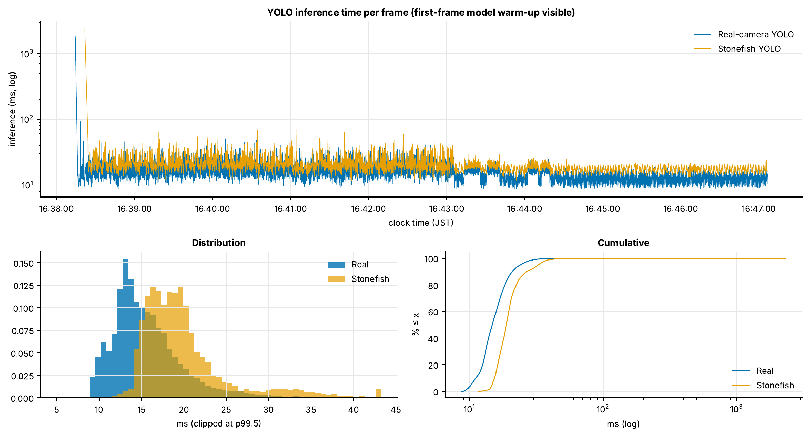
AUV latency: frame to thruster in 24–31 ms
Median frame-to-command time through the AUV pipeline · AUV run, 18 Oct 2026 (enlarged demo world)
metric (ms) | n | mean | p50 | p95 | p99 | max
Real: camera → ROS | 15,620 | 35.35 | 9.90 | 233.25 | 303.35 | 340.88
Stonefish: camera → ROS | 5,230 | 8.18 | 1.77 | 16.40 | 19.58 | 1,429.88
Real: YOLO inference | 15,620 | 15.73 | 14.74 | 23.76 | 30.24 | 1,837.76
Stonefish: YOLO inference | 5,230 | 20.52 | 18.77 | 32.41 | 39.81 | 2,329.90
Real: ROS rx → control | 14,924 | 65.69 | 17.49 | 279.56 | 431.10 | 2,454.37
Stonefish: ROS rx → control | 5,065 | 98.71 | 20.96 | 568.26 | 893.28 | 2,232.86
Real: camera → thruster | 14,924 | 102.00 | 30.89 | 345.97 | 590.49 | 2,708.50
Stonefish: camera → thruster | 5,065 | 104.81 | 24.10 | 575.67 | 908.06 | 2,244.54
Real camera → sim target moved | 11 | 184.03 | 176.88 | 395.95 | 430.85 | 439.58
Camera frame to thruster command: 31 ms (real) and 24 ms (Stonefish) median
A real-camera move reaches the simulated buoy in 177 ms (median of 11 moves)
The real USB camera's transport jumps to ~300 ms for stretches of the run (lower left)
KYUBIC V2 · camera-only navigation
7
Notes:
Measured over a 9-minute AUV run. The graph on the right shows the mission: calibration, repeated align and approach cycles, the stop at the buoy, back-off and surfacing (this run was in the enlarged demo world, so depths are larger than in the real-size pool). A camera frame becomes a thruster command in 24 ms (Stonefish) and 31 ms (real camera) at the median. When the real object moves, the simulated buoy follows in 177 ms (median of 11 moves). The lower-left graph shows that the real USB camera's transport latency jumps to about 300 ms for stretches of the run, which is where the 233 ms p95 comes from; YOLO inference itself stays around 15 to 20 ms (lower-middle graph).

