Slide 1
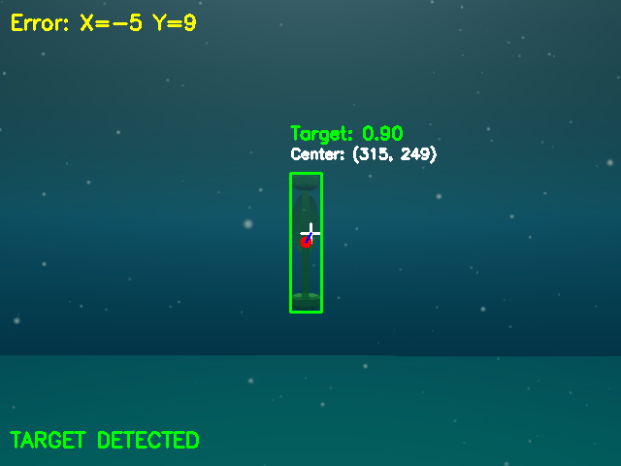
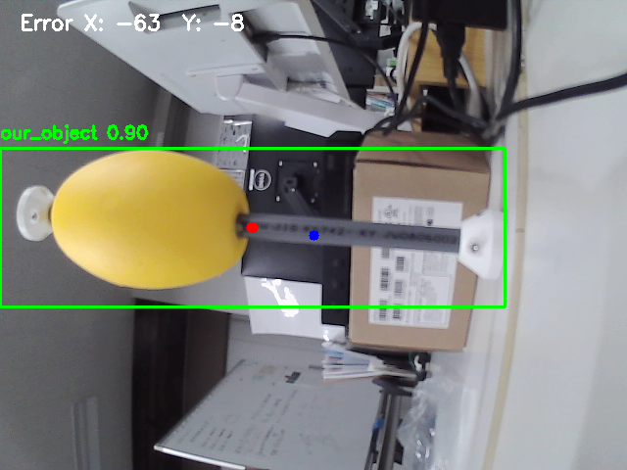
Autonomous Visual Servoing for an Underwater ROV
Camera to YOLO detection to a safe approach, stop and surfacing, verified end-to-end in the Stonefish simulator
Krish Gupta · Kyushu Project · October 2026
Stonefish front camera · YOLO detects the target (confidence 0.90)
Same pipeline, real camera
Real-camera YOLO finds the physical target (0.90) and moves the simulated one in case 6
7 / 7
0
≈30%
test cases passed
contacts with the target
faster approach
Notes:
Goal: an underwater ROV that finds a target with its camera, centres on it, approaches without ever touching it, then backs off and surfaces. Because the real robot is expensive, every behaviour was developed and verified in the Stonefish simulator first, using the same ROS 2 + YOLO pipeline that runs on the real camera.
Headline results: all 7 test cases pass against simulator ground truth, with zero contacts, and the latest tuning made the approach about 30% faster without reducing the stopping distance.

Slide 2
One launcher connects camera, YOLO and simulator
./start_pipeline.sh starts all five stages in order, logs each one, and stops them together
1
2
3
4
5
External camera
Real-camera YOLO
rqt_image_view
Stonefish YOLO
Stonefish sim
Innomaker USB camera by stable by-id path
real_camera_v1 model on the live feed
Live view of both detection streams
stonefish_v1 model on the simulated camera
Task2Manager state machine drives 6 thrusters
640×480 @ ~25 Hz
~28 Hz, confidence 0.90
operator monitoring
10 Hz, centre + box
100 Hz control loop
/external_camera/image_raw
/object/position
…/detection_image
/stonefish/target/detection, /bbox
/usv/control_debug
Root causes found and fixed during integration
Topic mismatch: detector and controller never connected
Vertical thrusters cancelled: counter-rotating pair, same command
7.4° nose-up trim: ballast moved forward + pitch compensation
Wrong camera: /dev/video0 was the laptop webcam
No range input: YOLO now publishes the box size
Real camera · YOLO 0.90
Stonefish camera · YOLO 0.90
Kyushu Project · Autonomous underwater ROV
2 / 6
Notes:
The whole system starts from the kyushu_project root with ./start_pipeline.sh (option --case N selects the scenario). Stage 1 opens the Innomaker USB camera through its /dev/v4l/by-id path, so the device number can change without breaking anything. Stage 2 runs the real-camera YOLO model and publishes the object pixel position, which moves the simulated target in case 6. Stage 3 shows both annotated streams in rqt. Stage 4 runs the Stonefish YOLO model and publishes the centre error plus the bounding box. Stage 5 is the simulator with the Task2Manager controller.
Measured live: camera 16.7-25 Hz, Stonefish detection 9.9 Hz, both YOLO detectors confident at 0.90.
Why the robot originally did not move: the detector published on a different topic and format than the controller expected; the vertical thruster pair cancelled out; a 7.4 degree trim biased depth alignment; and the 'external' camera was actually the laptop webcam.

Slide 3
Mission logic with layered safety
Built for an expensive robot: each layer works on its own, so no single sensor or estimate error can cause a collision
Calibrate
Search
Align
Approach
Terminal
Stop
Back off
Surface
thruster signs
≤ 1 full turn
yaw, then depth
≤ 0.22 m/s
last 1.2 m
~0.2 m gap
0.5 m
slow ascent
Fail-safe exits: no target after a full turn, or detector silent for 30 s → hold position, then surface slowly
1
Braking-aware speed profile
2
Stopping-distance guard
3
Terminal approach lock
Speed limited to √(2·a·d). Plans 0.02 m/s² braking, below half the measured 0.045 m/s²
Uses the actual measured speed: brakes at once if it could not stop in time
From 1.2 m, heading and depth lock; close-up detections can only shorten the range
4
Retreat when lost close
5
Contact / stall detector
6
Moving-target standoff
Target lost within 1.5 m: back straight away to 1.8 m and look again
Pushing forward but not moving: stop immediately, back off, surface
Case 6 never drives blind; it stops 1.0 m away while still seeing the target
Kyushu Project · Autonomous underwater ROV
3 / 6
Notes:
Mission: after a 20 s thruster sign calibration the robot searches (at most one full turn), aligns yaw then depth, and approaches. In the last 1.2 m the target fills the camera and YOLO becomes unreliable (about 30% dropouts below 1 m), so heading and depth are locked and the robot creeps the rest of the way on odometry. It stops about 0.2 m from the target, holds 3 s, backs off 0.5 m and surfaces at up to 0.10 m/s.
Safety: (1) the speed profile only plans with 0.02 m/s^2 of braking, less than half of what was measured (0.111 m/s^2 per unit thrust command, about 0.045 m/s^2 at the command limit); (2) a stopping-distance guard checks the real speed every control step; (3) during the terminal approach a detection may only make the range shorter; (4) a target lost close by is never searched for on the spot - the robot retreats to where detection is reliable; (5) a stall detector catches contact; (6) the moving target in case 6 is never approached blind.

Slide 4
All 7 test cases pass against simulator ground truth
YOLO pipeline, final tuning · stop gap = front of hull to target surface, measured in the simulator
0
0.27–0.37 m
≤ 0.10 m/s
≤ 8 cm
contacts in all runs
closest approach, cases 1–5
speed within 1 m
centring error, cases 1–5
Case | Scenario | Stop gap | Lateral | Vertical | Result
1 | Target in front | 0.37 m | −0.06 m | +0.01 m | Pass
2 | Target above | 0.31 m | 0.00 m | −0.01 m | Pass
3 | Target below | 0.34 m | 0.00 m | +0.02 m | Pass
4 | Behind (search) | 0.33 m | +0.08 m | −0.01 m | Pass
5 | Behind + below | 0.35 m | +0.01 m | 0.00 m | Pass
6 | Moving (real cam) | 1.07 m* | −0.01 m | −0.28 m | Pass
7 | No target | 380° search, surfaced safely |  |  | Pass
* case 6 stops 1.0 m from the moving target by design · HSV-detector and no-detector checks also pass
Kyushu Project · Autonomous underwater ROV
4 / 6
Notes:
Every number here is measured against simulator ground truth, not the robot's own estimate. Stop gap is the distance from the front of the hull to the target surface when the robot stopped; lateral and vertical are the offsets between the camera axis and the target centre.
No run made contact. Cases 1-5 stop 0.27-0.37 m from the target (the design target is 0.2 m; the range model is rounded so errors make it stop early). Within 1 m of the target the speed never exceeded 0.10 m/s. Case 4 and 5 start with the target behind the robot, so it first searches. Case 6 is driven by the real camera and stops 1.0 m away by design. Case 7 has no target: one full search turn, then a safe surfacing.
Chart: after the speed-up (braking-aware profile, acceleration feed-forward) the approach is 25-43% faster and back-off went from 20.4 s to 8.6 s, while the stopping distance increased.

Slide 5
Simulation demonstrations
Full missions in Stonefish with the YOLO pipeline: search, align, approach, stop, back off, surface
Video 1
Video 2
Insert the Case 1 recording here
Insert the Case 5 recording here
Case 1 · Target in front, 8 m
Case 5 · Target behind and below
23 s
65 s
77 s
129 s
72 s
114 s
167 s
253 s
aligned
stops 0.37 m from target
backed off
surfaced
found by search
yaw + depth aligned
stops 0.35 m away
surfaced
Kyushu Project · Autonomous underwater ROV
5 / 6
Notes:
HOW TO ADD THE VIDEOS: click the dashed frame, press Delete (it is one group), then Insert > Video > This Device. In Video Format > Size set the video to 5.95" x 3.35" and position it at the frame's spot: Video 1 left 0.6", top 1.8"; Video 2 left 6.78", top 1.8". If you show different cases, update the caption and the four timeline boxes below each video (times are simulation seconds from the logged runs).
Talking points: Case 1 is the baseline - target straight ahead 8 m away; the robot aligns in about a second, approaches, locks heading and depth for the last 1.2 m and stops 0.37 m from the target. Case 5 is the hardest static case - the target starts behind and below, so the robot searches about 180 degrees, aligns yaw and then depth, and completes the same safe approach.

Slide 6
ROV mode and the path to the real robot
Manual ROV operation alongside autonomy, and what has to happen before pool trials
Next steps before pool trials
1
Retrain both YOLO models
Add close-up target images (Stonefish) and low-light images (real camera)
2
Measure the real KYUBIC values
Video 3
Camera-to-front distance, target size, thrust and depth gains
Insert the ROV mode recording here
3
Verify odometry / DVL accuracy
The last 1.2 m of the approach relies on it
ROV mode demonstration
4
Tethered, slow first trials
Press M to switch between autonomous and manual. W/S forward and back, A/D turn, R/F up and down, SPACE stops all thrusters
Start below the simulated speeds and widen the stop distance
Kyushu Project · Autonomous underwater ROV
6 / 6
Notes:
HOW TO ADD THE VIDEO: delete the dashed frame group, Insert > Video > This Device, then size it to 6.4" x 3.6" at left 0.6", top 1.8".
ROV mode: the same controller can be switched to manual control with M (keyboard or game controller); SPACE or the B button stops all thrusters immediately.
Next steps: (1) YOLO loses confidence closer than about 1 m in the simulator and fails in low light on the real camera, so both datasets need those images; (2) the controller constants are fitted to the simulated 2.4 m hull and must be re-measured for KYUBIC; (3) the terminal approach depends on odometry, so DVL accuracy must be checked; (4) first real trials should be tethered and slower than the simulation.

