Slide 1
END-TO-END DATA ANALYTICS PROJECT
Pharmaceutical Supply Chain Analytics
From cleaned source data → SQL analysis → Power BI dashboards → business decisions
Power Query | SQL Server | Power BI | DAX | Business Analysis
Portfolio Case Study
Krish Gurjar • 2026

Slide 2
Executive Summary
A single analytical workflow covering commercial, operational and supply-chain risk.
₹217.39 Cr
54.31M
4.86M
95.84%
Gross order value reviewed
Production units
Inventory on hand
QC pass rate
66.57%
3.85M
118
34 / 46
Completed-shipment on-time rate
Units in >70% shelf-life screen
Potential dead-stock batches
Suppliers above ₹10K review threshold
Management takeaway
• Inventory risk is the largest working-capital signal: 3.85M units were in batches crossing the project's 70% shelf-life screening threshold.
• Procurement review is broad: 34 of 46 suppliers exceed the ₹10,000 average material-cost review threshold.
• Logistics needs attention: 478 completed shipments were late; the 66.57% ( 952 ) of 1430 on-time rate excludes records without both delivery dates.
• Commercial revenue is diversified by customer, while Antibiotic, Cardiac and NSAID categories contribute about 45.4% of analyzed order value.
Pharma Supply Chain Analytics • Krish Gurjar • 2

Slide 3
Business Objective & Questions
The project turns operational records into questions a supply-chain team can act on.
Production
Quality & Logistics
Inventory
How much is produced? Which products/categories lead output? How does production vary by plant and month?
What is the QC pass rate? Which exceptions need review? Where are shipment delays occurring?
How much stock is on hand? Which batches are aging? Which batches are potential dead stock?
Commercial
Procurement
What is the order-value base? Which therapeutic categories drive revenue? How does revenue change over time?
Which suppliers have high material costs? How diversified is each supplier? Where should procurement review focus?
Decision lens
Protect cash • reduce inventory risk • control procurement cost • improve service • strengthen data quality
Pharma Supply Chain Analytics • Krish Gurjar • 3

Slide 4
Data Landscape
11 cleaned Excel tables feed the analytical model; 21,104 source rows were reviewed.
Customers
250
Customer master, type, geography, credit
Raw Material
120
Materials, supplier, category, unit cost
Inventory
2,200
Batch, warehouse, quantity, stock status
Sales Order
3,000
Customer, warehouse, order date/status
Order Details
7,396
Product/batch quantities, price, discount
Shipment
3,000
Courier, delivery dates, freight, status
Production Batch
2,500
Batch, product, plant, dates, output, cost
Suppliers
46
Supplier master, rating, activity
Products
80
Category, dosage, strength, MRP, storage
Warehouse
12
Warehouse master, type, cold storage, capacity
Quality Control
2,500
QC tests, final result, remarks
Analytical scope spans product, production, inventory, supplier, QC, logistics, cost, revenue, customer and shelf-life analytics.
Pharma Supply Chain Analytics • Krish Gurjar • 4

Slide 5
Data Preparation & Analytical Workflow
Power Query prepares analysis-ready tables before SQL and Power BI consume the cleaned structure.
01
02
03
04
05
06
Source data
→
Power Query
→
SQL Server
→
DAX / Power BI
→
Dashboards
→
Insights
11 Excel tables
Clean / standardize / type fields
Relational analysis + validation
KPIs, time intelligence, risk metrics
Interactive decision support
Actions + controls
Preparation focus
• Standardized date fields support monthly and operational time analysis.
• Cleaned table names and business-friendly fields support consistent SQL and Power BI references.
• Missing values are retained where they represent real data-quality gaps; they are not silently converted into business events.
Pharma Supply Chain Analytics • Krish Gurjar • 5

Slide 6
SQL Analysis & Technical Methods
13 practical SQL questions were used to convert relational records into measurable business signals.
Business analysis
Advanced SQL
• Upcoming batches within 90 days of expiry
• Production quantity by product
• Average material cost by supplier/category
• Supplier diversification by distinct materials
• Revenue by customer
• Potential dead-stock candidates
• Batches with missing QC records
• Orders vs shipments mismatch audit
• Suppliers above ₹10,000 average material cost
• QC pass-rate buckets using CTE + CASE
• Customer revenue ranking within state
• Plant-wise monthly running production total
• Batches past 70% shelf life with inventory
• NULL / consistency checks and reconciliation
Techniques: INNER / LEFT / RIGHT / FULL OUTER JOIN • GROUP BY • HAVING • CTE • CASE • RANK() • PARTITION BY • RUNNING TOTAL • DATEDIFF / DATEADD / GETDATE / DATEFROMPARTS
Pharma Supply Chain Analytics • Krish Gurjar • 6

Slide 7
SQL Findings
The SQL layer identifies the highest-priority operational and commercial signals.
₹217.39 Cr
3.85M
118
Order value reviewed
On-hand units in >70% shelf-life screen
Potential dead-stock batches
Commercial baseline
Working-capital / expiry risk
Inventory carrying risk
34 / 46
0
0
Suppliers above ₹10K threshold
Unmatched order/shipment records
Batches without QC record
Procurement review population
Reconciliation check passed
QC record completeness check
Important: these are analytical signals and screening outputs—not automatic proof of disposal, supplier overpricing, or process failure.
Pharma Supply Chain Analytics • Krish Gurjar • 7

Slide 8
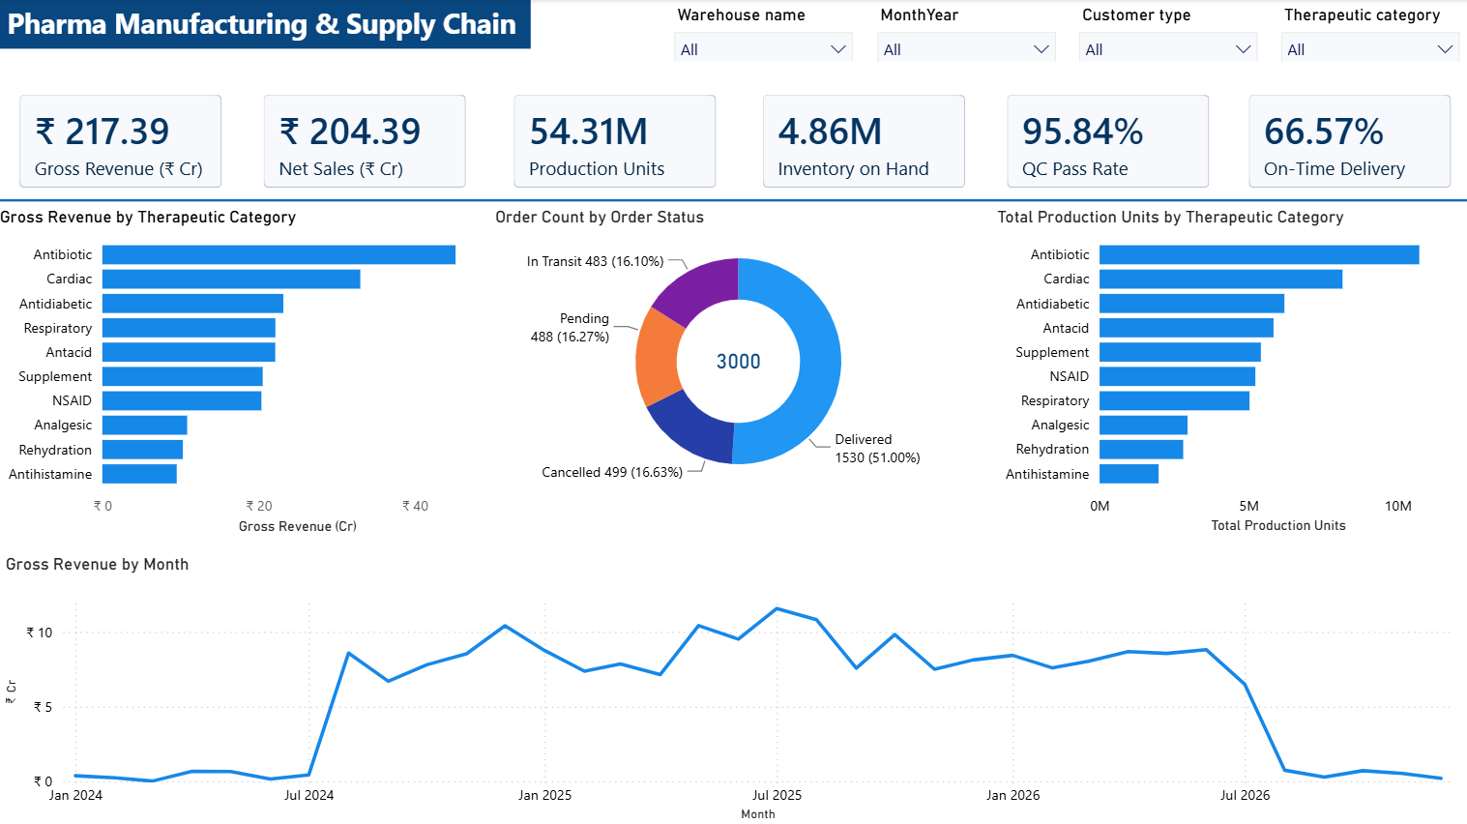
Power BI Dashboard 1 — Pharma Manufacturing & Supply Chain Overview
Executive commercial and operational overview with slicers, DAX KPIs and category/time analysis.
Pharma Supply Chain Analytics • Krish Gurjar • 8

Slide 9
Dashboard 1 — What It Answers
The first dashboard is designed for executive monitoring and commercial performance review.
Revenue scale
₹217.39 Cr gross order value and ₹204.39 Cr net sales after discounts provide the commercial baseline.
Revenue drivers
Antibiotic, Cardiac and NSAID categories together contribute ~45.4% of analyzed gross order value.
Production scale
54.31M units across 2,500 production batches show the scale of manufacturing activity.
Quality
95.84% QC pass rate indicates strong overall pass performance, while 104 non-pass QC records remain exceptions for review.
Service
66.57% on-time delivery is calculated only on shipments with both actual and expected delivery dates; 478 completed shipments were late.
Customer concentration
Top 10 customers account for ~7.5% of gross order value, indicating a relatively diversified customer base.
Pharma Supply Chain Analytics • Krish Gurjar • 9

Slide 10
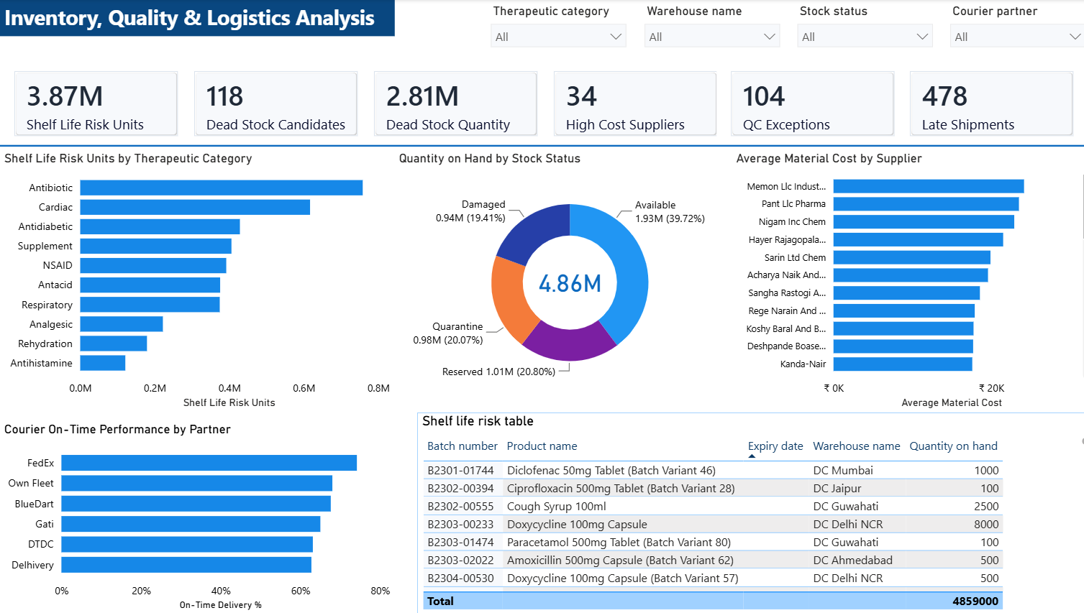
Power BI Dashboard 2 — Inventory, Quality & Logistics Analysis
Operational risk, supplier cost, stock status, courier performance and batch-level expiry review.
Pharma Supply Chain Analytics • Krish Gurjar • 10

Slide 11
Dashboard 2 — Risk & Control Insights
The second dashboard moves from executive totals to exception-oriented operational control.
Shelf-life exposure
Potential dead stock
3.85M units of on-hand inventory fall inside the >70% shelf-life screening rule, equal to ~79.3% of total on-hand quantity.
118 production batches were never matched to an order-detail record and are therefore candidates for operational validation.
Procurement
Inventory status
34 of 46 suppliers exceed the ₹10,000 average material-cost review threshold; this is a prioritization signal, not proof of overpricing.
Available stock is 1.93M units; Reserved 1.01M; Quarantine 0.98M; Damaged 0.94M.
Logistics
Exception table
478 completed shipments were late. Courier on-time performance can be – compared in the dashboard to focus service reviews.
Batch-level expiry dates, warehouse and quantity-on-hand provide a practical – shortlist for FEFO/near-expiry review.
FEFO : first expired , first out
Pharma Supply Chain Analytics • Krish Gurjar • 11

Slide 12
Power BI & DAX Skills Demonstrated
The PBIX contains two dashboard pages, a DateTable and a dedicated Measures table.
Modeling
Relationships across production, inventory, orders, products, customers, suppliers, warehouses, QC and shipments.
Date intelligence
DateTable logic supports month-level analysis and operational date context.
DAX KPIs
Gross Revenue, Net Sales, Production Units, Inventory on Hand, QC Pass Rate, On-Time Delivery.
Risk measures
Shelf Life Risk Units, Dead Stock Candidates, Dead Stock Quantity, High-Cost Suppliers, QC Exceptions, Late Shipments.
Interactive analysis
Therapeutic category, warehouse, customer type, stock status, courier and month slicers.
Visual communication
KPI cards, category bars, status donut, supplier-cost ranking, courier performance and exception table.
Pharma Supply Chain Analytics • Krish Gurjar • 12

Slide 13
Integrated Business Insights
Combining SQL findings with the Power BI layer creates a coherent decision story.
Business area
Evidence
Management implication
Working capital
3.87M units / 79.3% of on-hand quantity
Prioritize aging inventory and demand alignment.
Expiry control
247 batches expire within 90 days of 2026-08-30
Build a near-expiry exception queue and FEFO review.
Dead stock
118 candidate batches / 2.81M produced units
Validate demand, batch status and commercial utility before write-off.
Procurement
34 suppliers above ₹10K average material cost
Segment by cost, volume and strategic importance before negotiation.
Quality
95.84% QC pass rate / 104 exceptions
Review rework/fail records and preserve exception traceability.
Logistics
66.57% on-time / 478 late completed shipments
Review courier/service patterns and delivery-date completeness.
Revenue
Top 3 therapeutic categories ≈45.4% of order value
Protect high-value categories while monitoring mix and demand.
Customer concentration
Top 10 ≈7.5% of order value
Revenue is relatively diversified; focus on category and operational drivers.
Pharma Supply Chain Analytics • Krish Gurjar • 13

Slide 14
Business Recommendations & Improvement Roadmap
Move from one-time analysis to recurring operational control.
01
Protect cash
02
Reduce dead stock
Prioritize near-expiry and aging inventory; use demand-aware stock rotation / FEFO where appropriate.
Create an exception queue for unsold batches; validate commercial – utility before disposal or write-off.
03
Optimize sourcing
04
Improve service
Review high-cost suppliers using cost, volume, quality and – strategic dependency—not cost alone.
Investigate late shipments by courier, route, warehouse and date – completeness; monitor on-time KPIs.
05
Strengthen quality
06
Scale BI
Track rework/fail exceptions by product and batch; preserve QC traceability.
Publish the Power BI KPIs with scheduled refresh and recurring exception
reporting.
Pharma Supply Chain Analytics • Krish Gurjar • 14

Slide 15
Data Quality, Definitions & Limitations
A professional analysis separates observed facts from screening assumptions.
Missing manufacturing dates
81 production-batch records have missing Manufacturing_date; age/shelf-life calculations are not fully observed for every record.
Missing expiry dates
77 production-batch records have missing Expiry_date; these remain blank in the Power BI exception table rather than being invented.
Delivery-date completeness
1,519 of 3,000 shipment rows have no actual delivery date; the 66.57% on-time metric uses only 1,430 shipments with both actual and expected dates.
Shelf-life definition
>70% shelf-life is a screening rule based on manufacturing and expiry dates plus inventory quantity; it is not a confirmed expiry event.
Dead-stock definition
118 batches are candidates because their batch_id never appears in order details; operational validation is required.
Supplier cost threshold
₹10,000 is a review threshold; crossing it does not prove a supplier is overpriced.
SQL QC rate
The original SQL QC bucketing uses integer arithmetic in SQL Server; Power BI provides the displayed 95.84% metric with percentage precision.
Pharma Supply Chain Analytics • Krish Gurjar • 15

Slide 16
Final Portfolio Deliverables
The project demonstrates an end-to-end analyst workflow, not only a dashboard.
Data
11 cleaned Excel tables covering 21,104 rows across the supply-chain domain.
SQL
13 business questions using joins, aggregation, CTE, CASE, window functions and date logic.
Power BI
2 interactive dashboards with DAX KPIs, slicers, time analysis and exception reporting.
Presentation
Executive case study combining methodology, findings, business insights and recommendations.
README
Documented project objective, data, workflow, SQL scope, Power BI layer, findings and limitations.
Portfolio signal
Shows the ability to translate raw operational data into decision-oriented business analysis.
Outcome: SQL-driven analysis → Power BI monitoring → prioritized business actions
Pharma Supply Chain Analytics • Krish Gurjar • 16

Slide 17
PHARMACEUTICAL SUPPLY CHAIN ANALYTICS
Turning operational data into business decisions
Data Preparation • Power Query • SQL • Power BI • DAX • Business Insights
Krish Gurjar
Data Analyst Portfolio Case Study • 2026

