Slide 1

Project Title –seasonal agriculture performance
Krish Yadav
College Name- Shree L.R. Tiwari College of Engineering
AICTE STU ID : STU6a5e3cf32d8e71784560883

Slide 2

PROBLEM STATEMENT
(Agricultural activities are influenced by seasonal variations in environmental conditions, farming practices, resource availability and market conditions. As a result, agricultural performance may differ from one season to another. However, raw agricultural data does not clearly explain how agricultural performance changes across seasons or what patterns can be observed in different seasonal conditions. The problem is to analyze the given agricultural dataset and investigate seasonal differences in agricultural performance by identifying meaningful patterns, trends, relationships and variations within the available data.

Slide 3
Project Description
Seasonal Agriculture Performance Analysis
Analyzes agricultural performance across different seasons.
Compares crop yield, production, resource usage, costs, revenue and profit.
Studies the impact of factors such as rainfall, temperature, soil conditions, fertilizer and water usage.
Compares performance across different crops and regions.
Uses data visualization to identify patterns, trends and seasonal differences.
Provides data-driven insights and recommendations to improve agricultural efficiency and profitability.

Slide 4

WHO ARE THE END USERS?
The main users who can benefit from this analysis are:
Farmers — to make better decisions about crops, resources and seasons.
Agricultural planners — to understand seasonal production patterns.
Government & Agriculture Departments — for agricultural planning and policy decisions.
Irrigation/Water Management Authorities — to analyze water usage and efficiency.
Agricultural Consultants — to provide data-based recommendations to farmers.
Agribusiness Companies — to understand crop production, costs and market performance.
Researchers & Analysts — for studying relationships between weather, resources and agricultural output.

Slide 5

Technology Used
Technologies / Libraries
Python — Main programming language
Pandas — Data cleaning, manipulation and analysis
NumPy — Numerical calculations and statistical computations
Matplotlib — Data visualization and charts
Seaborn — Statistical visualization and advanced charts
Google Colab / Jupyter Notebook — Development environment
CSV Dataset — Source of agricultural data

Slide 6
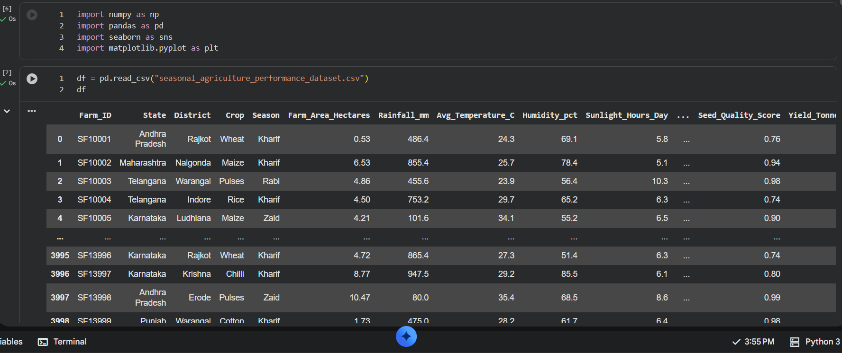
RESULTS

Slide 7
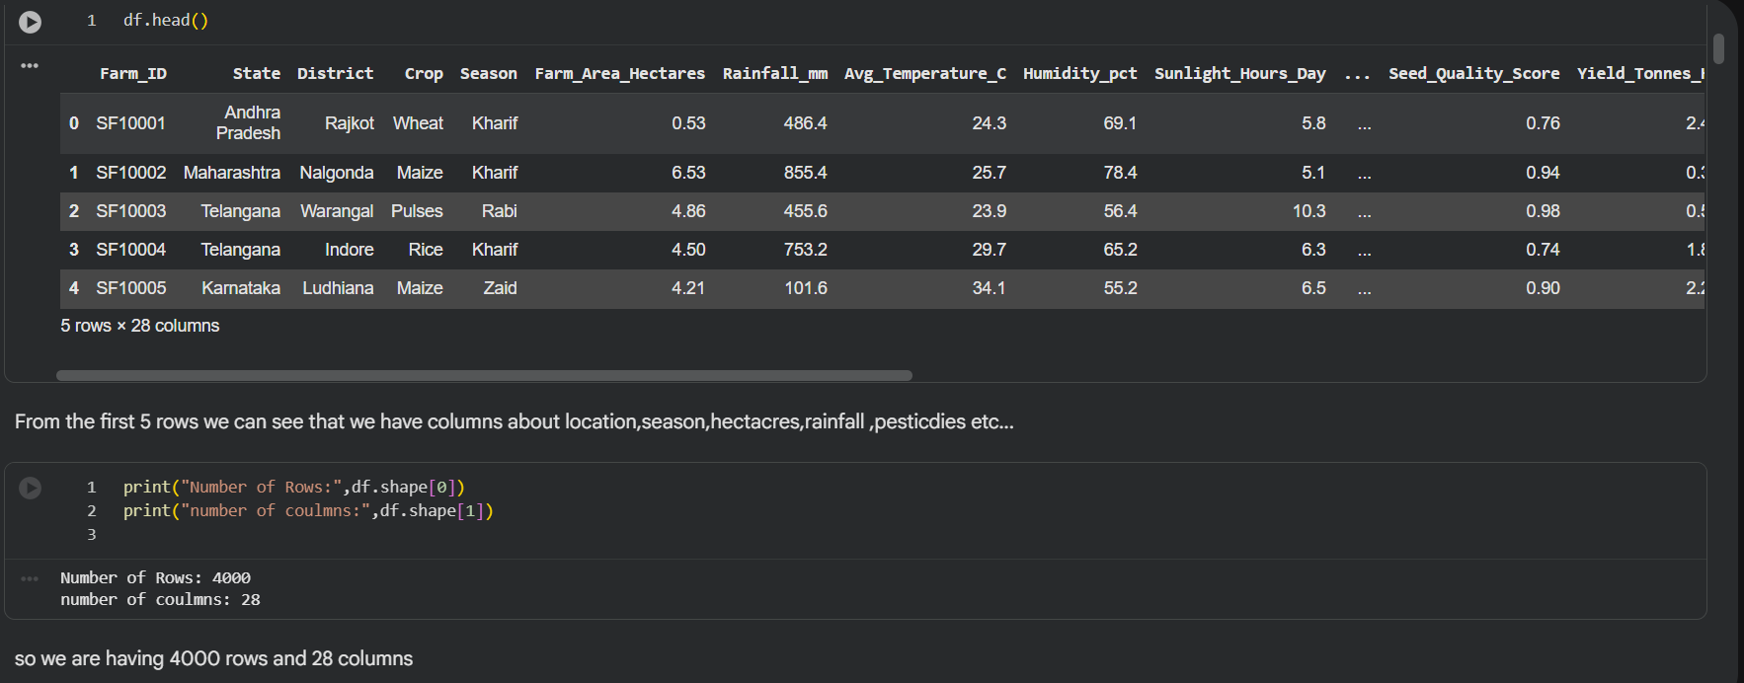
RESULTS
[Add screen shots of your code ]

Slide 8
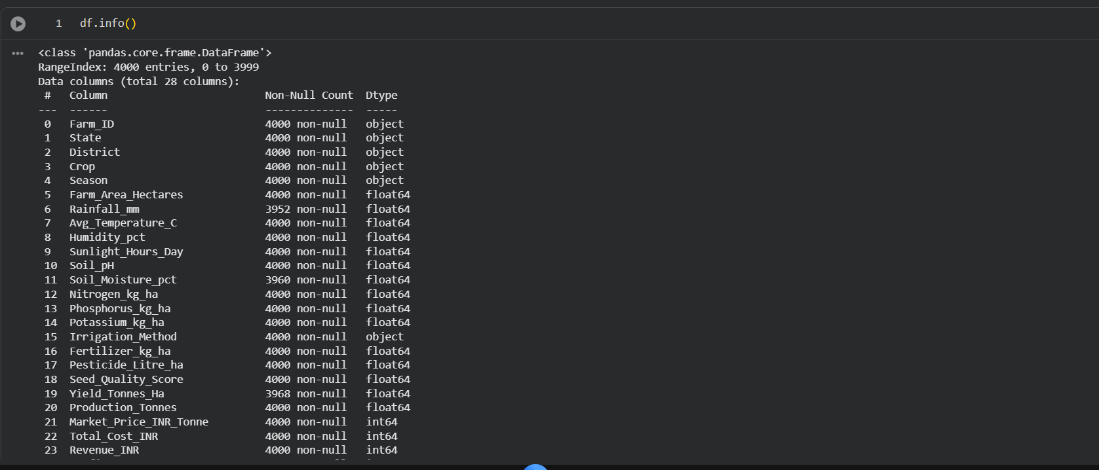
RESULTS
[Add screen shots of your code ]

Slide 9
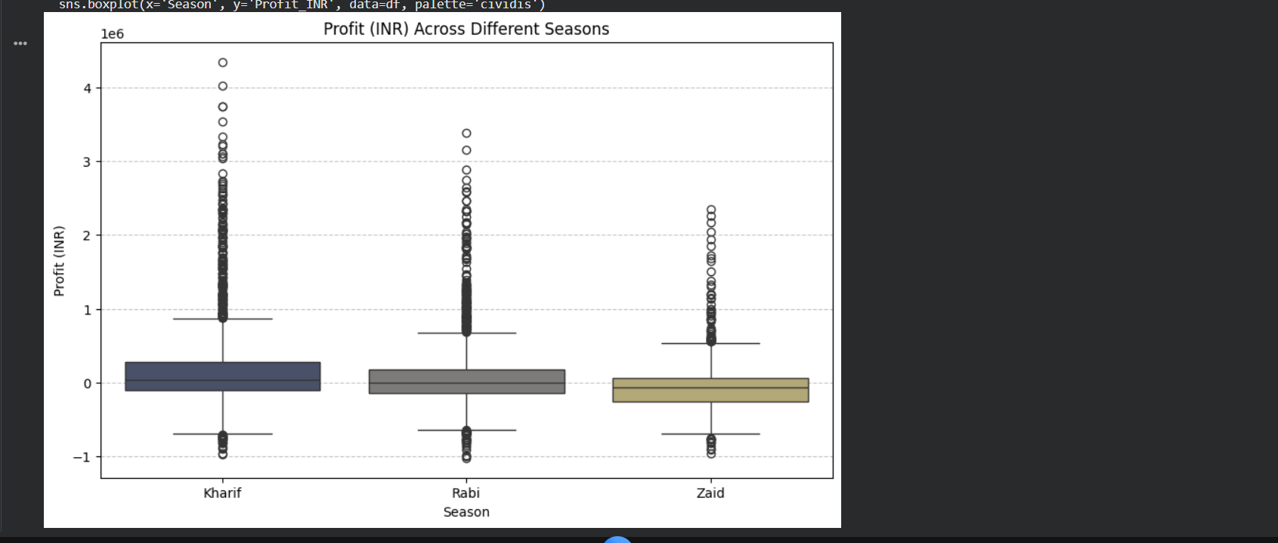
RESULTS
[Add screen shots of your code ]

Slide 10
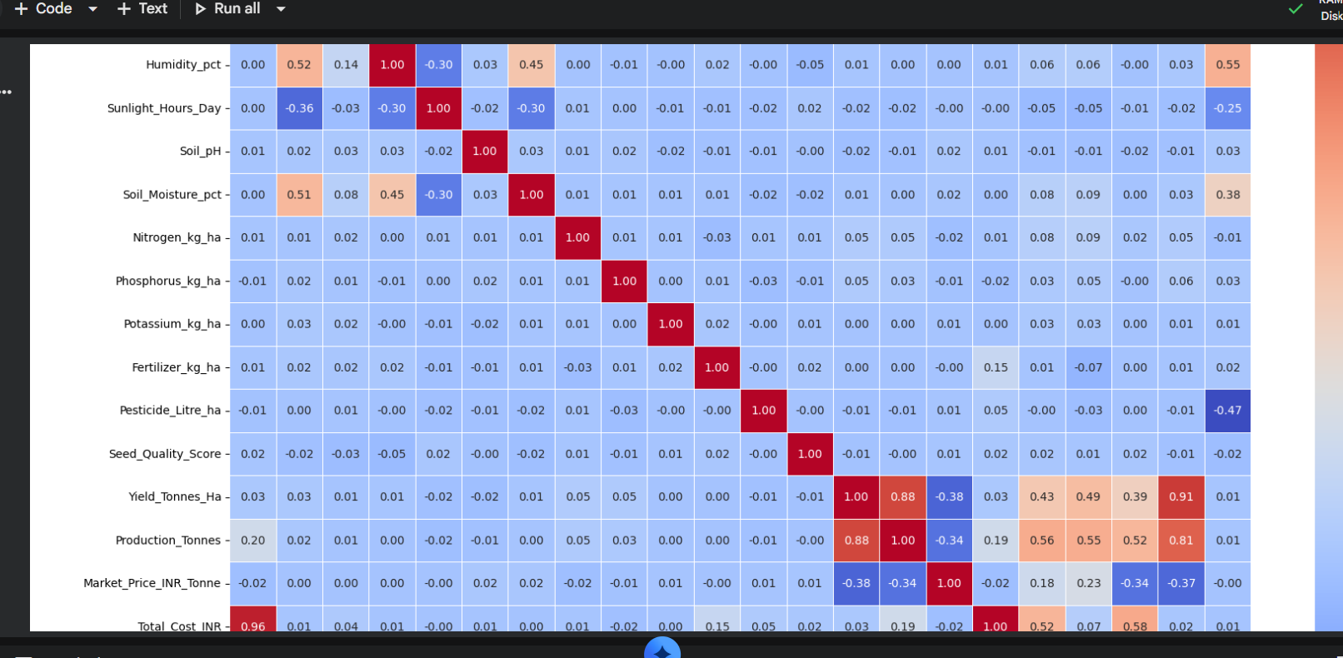
RESULTS
[Add screen shots of your code ]

Slide 11
Future scope
Real-time weather data integration to provide updated agricultural insights.
Machine Learning models to predict crop yield for upcoming seasons.
Crop recommendation system based on soil, weather and seasonal conditions.
Profit prediction to estimate expected revenue and profit before cultivation.
Smart irrigation recommendations to reduce unnecessary water consumption.
Disease and pest prediction using environmental and historical data.
Real-time dashboards for farmers and agricultural authorities.
Satellite/remote-sensing data integration for large-scale crop monitoring.
Mobile application to make recommendations directly accessible to farmers.
Integration with IoT sensors to collect real-time soil moisture, temperature and other farm conditions.

Slide 12
GitHub Link
https://github.com/krishh4426/seasonal_agriculture_performance

Slide 13

VOIS Course completion certificate -
Course name- Data Visualization

Slide 14
Thank you
.
.

