Slide 1
AI-Generated Image Detection
Evaluating Generalisation Across Generative Model Generations
Krishi Rajeshkumar Shah (220968905) · Supervisor: Mona Nasery
EECS 4080 · York University · Summer 2026

Slide 2
The Problem
• Detectors look strong on older benchmarks (CIFAKE, ProGAN-era sets).
• Newer generators (SD3, Midjourney v6, GPT-4o) are more photorealistic.
• Critical question: do existing detectors still work — and why/why not?

Slide 3
Research Question & Hypothesis
• RQ: How well do benchmark-trained detectors generalise to next-gen generators?
• Hypothesis: models rely on generator-specific low-level artefacts.
• Those artefacts weaken in newer models → measurable generalisation gap.

Slide 4
Related Work & Gap
• Wang 2020: GAN→GAN transfer with augmentation.
• Corvi 2023: GAN↔diffusion gap + frequency analysis.
• Bird & Lotfi 2024: CIFAKE benchmark.
• Our gap: multi-family eval + calibration + Grad-CAM + measure + resolution control.

Slide 5
Approach
• Fine-tune EfficientNet-B3 on CIFAKE (SD v1.4).
• Temperature scaling (T = 1.2189) + Grad-CAM (conv_head).
• Evaluate StyleGAN, SD3/Flux, Midjourney v6, GPT-4o, Janus-Pro (300 each).
• Diagnose GPT-4o with FFT, t-SNE, quantitative Grad-CAM.
• Resolution-matched real-image control (notebook 07).

Slide 6
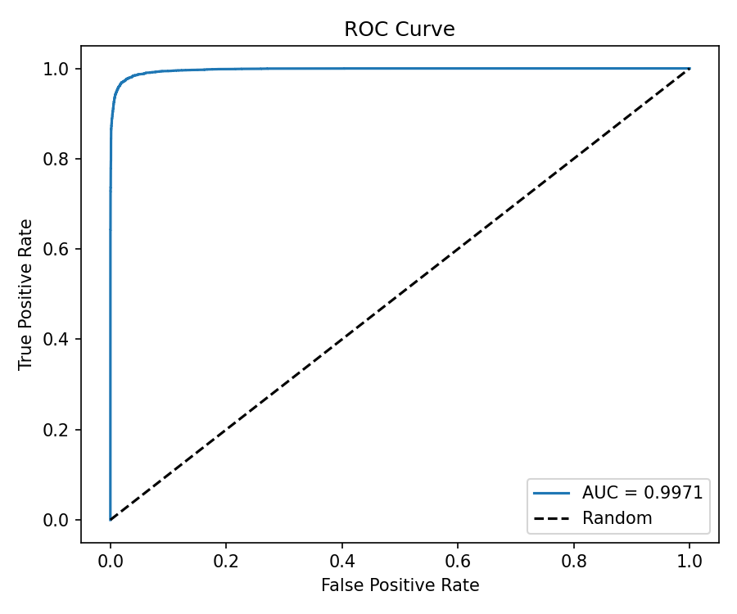
Baseline Results (CIFAKE)
• Accuracy 96.96% · AUC 0.9971 · ECE 0.0026 (pre-T).
• FAKE recall 95.3% / REAL recall 98.6%.
• Temperature scaling slightly raised ECE (NLL≠ECE).

Slide 7
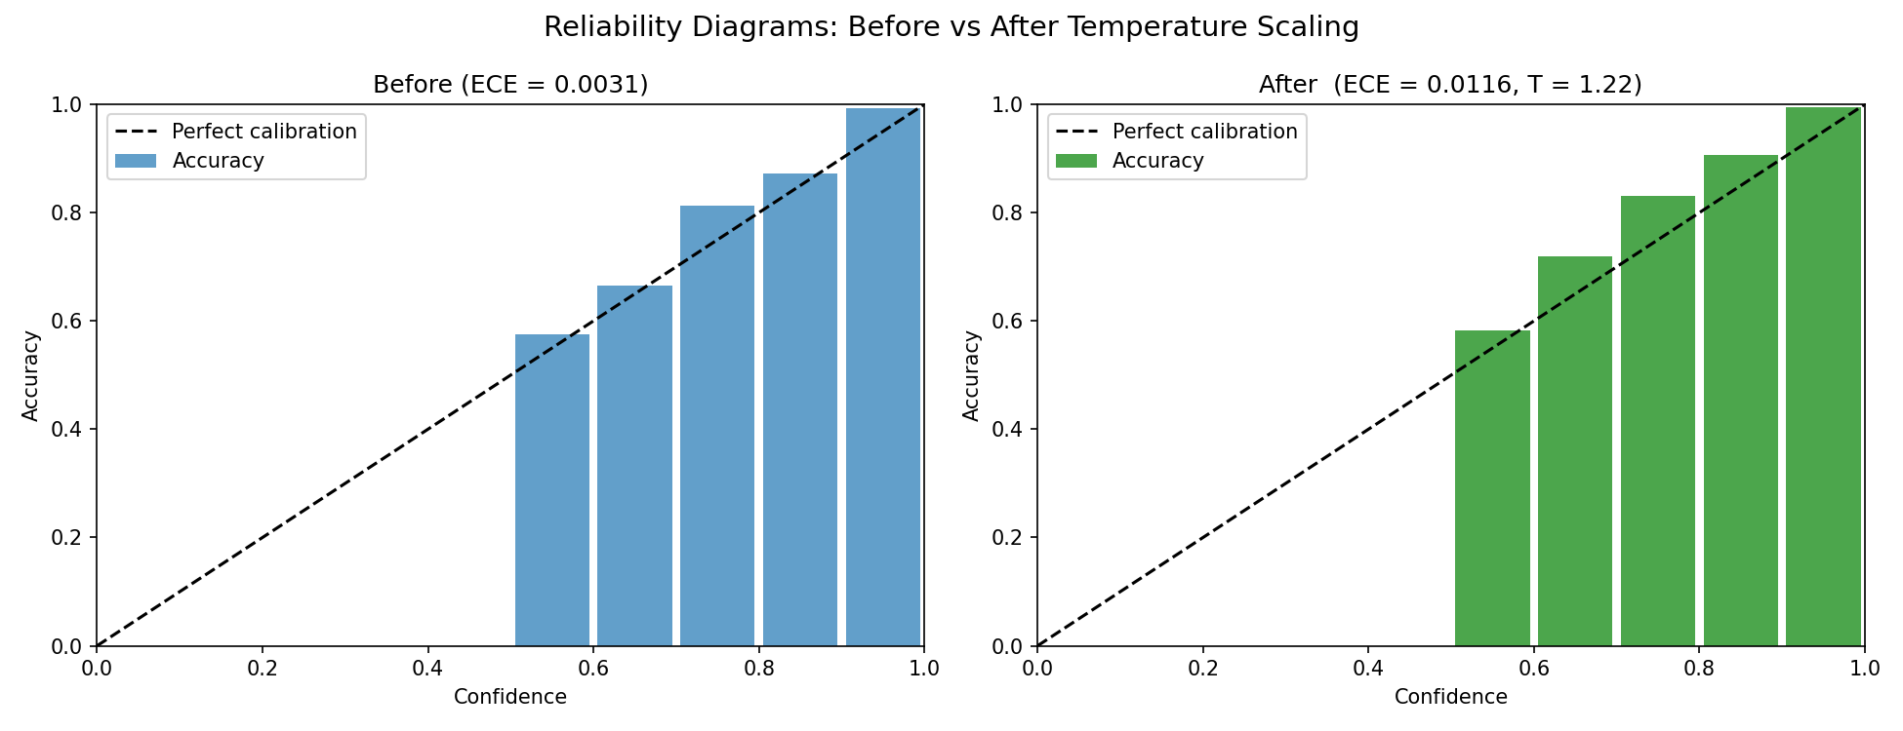
Calibration
• Learned T = 1.2189 on validation set (L-BFGS).
• Already well-calibrated in-distribution.
• Under OOD generators, CIFAKE-fit T worsens ECE.

Slide 8
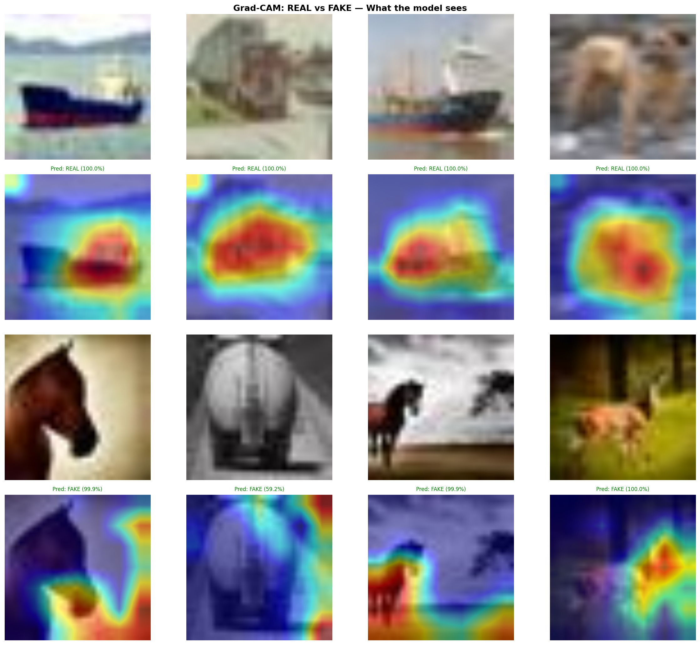
Grad-CAM
• REAL: diffuse texture attention, high confidence.
• FAKE: localised artefact hotspots.
• Suggests SD v1.4-specific cues — motivates generalisation study.

Slide 9
Cross-Generator Design
• Five families × 300 fakes + 300 CIFAKE reals.
• Primary OOD metric: fake detection rate (not overall accuracy).
• Caveat: resolution confound → Experiment 5 control.

Slide 10
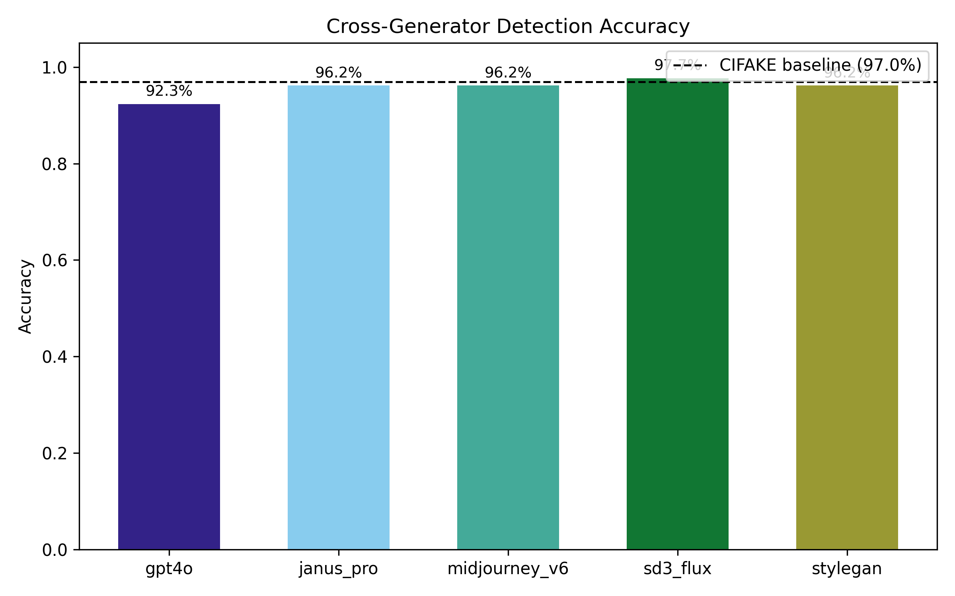
Cross-Generator Results
• StyleGAN / MJ / Janus-Pro: ~94% fake detection.
• SD3/Flux: 97% fake detection (strong transfer).
• GPT-4o: 86.3% fake detection — only meaningful gap (4.8% acc. drop).

Slide 11
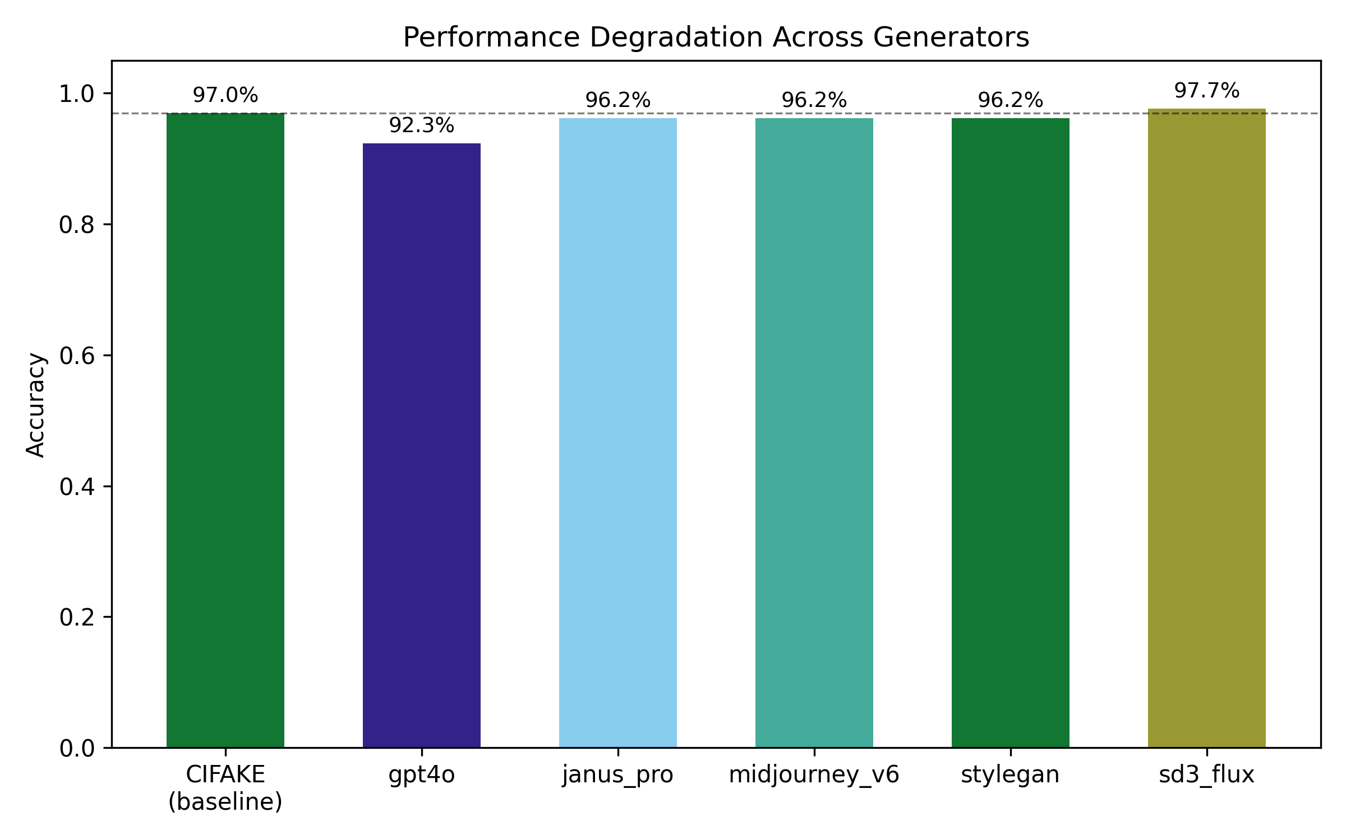
Hypothesis Revised
• Naive protocol: transfer looks strong except GPT-4o.
• Control: 93% of high-res reals called FAKE → confound.
• After matching: broad gap (fake detection ~35–62%).
• GPT-4o feature-absence remains a secondary native-protocol finding.

Slide 12
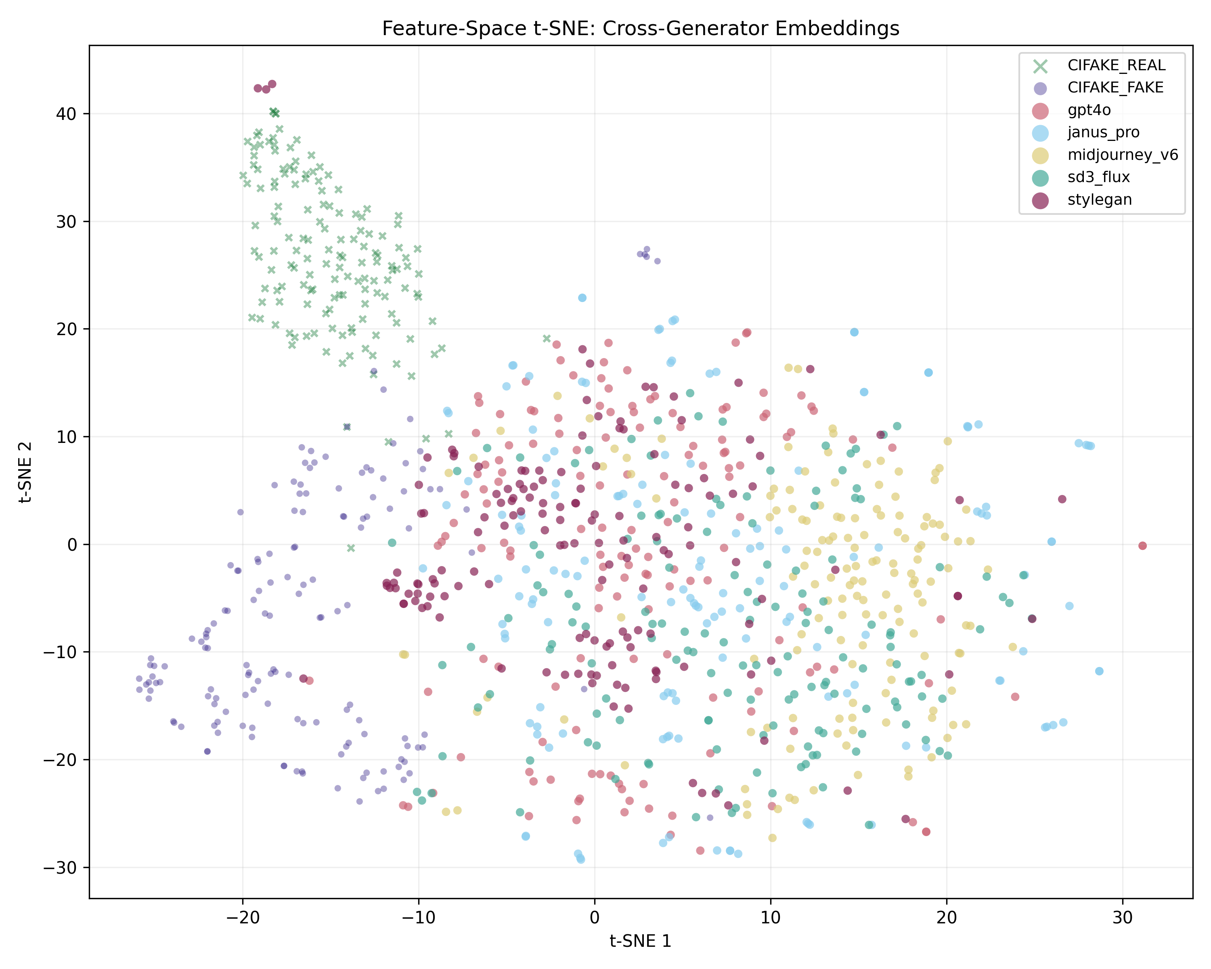
Why GPT-4o Fails
• FFT: spectra closer to real photos.
• t-SNE: embeddings near real cluster.
• Grad-CAM metrics: not uniquely unfocused vs Midjourney/SD3.
• Conclusion: feature absence, not attention failure.

Slide 13
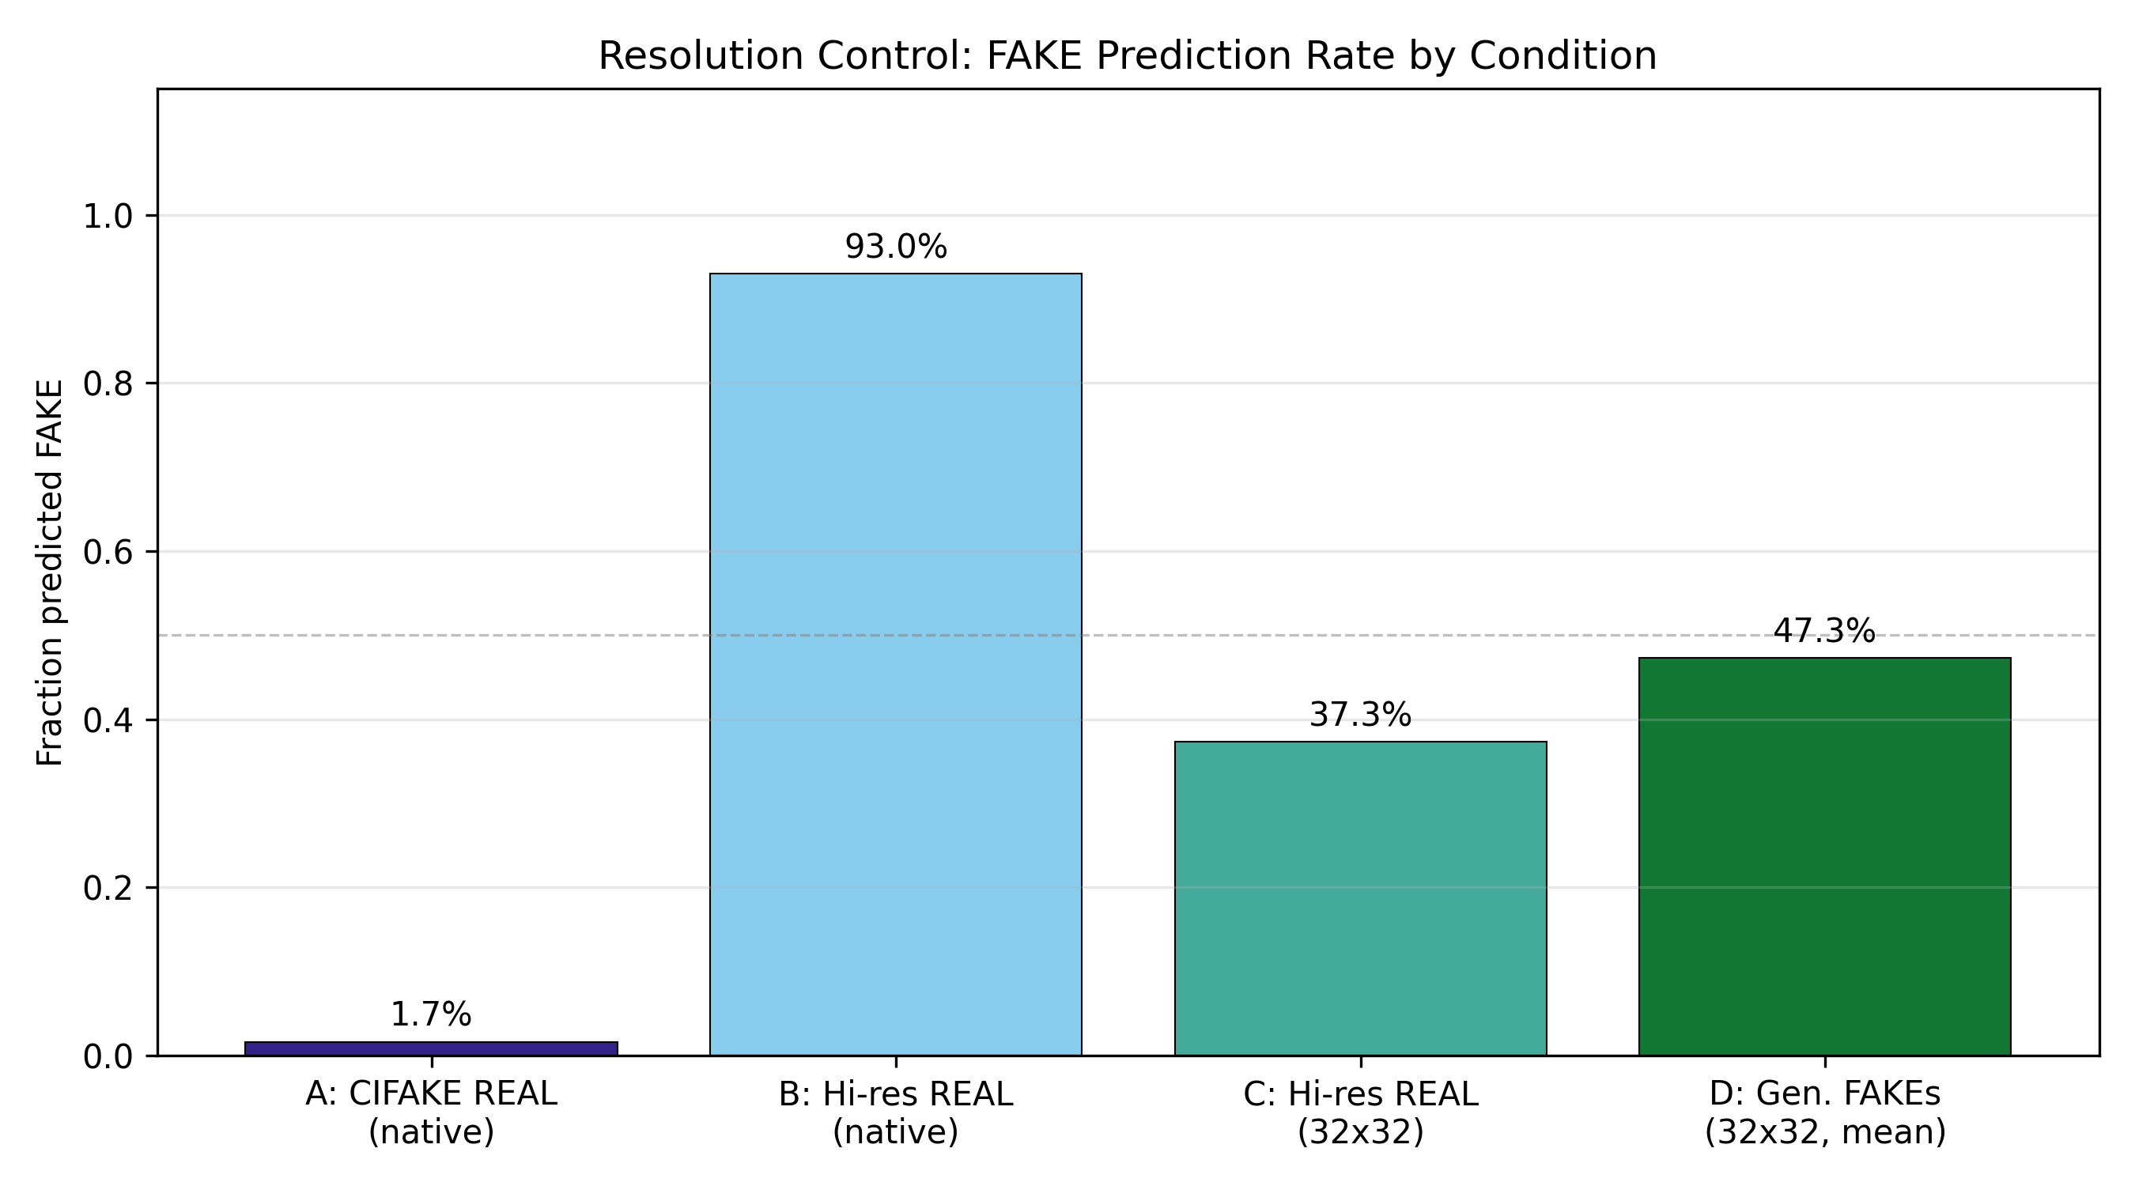
Resolution Control — Confound Confirmed
• A CIFAKE REAL: 1.7% predicted FAKE.
• B Hi-res REAL: 93.0% predicted FAKE — not generator detection.
• C Same photos →32×32: FAKE-rate falls to 37.3%.
• Matched fakes collapse: Midjourney 94%→35%, StyleGAN 94%→38%.
• Experiment 3 transfer was largely resolution-driven.

Slide 14
Live Demo
• Gradio app: classification + calibrated confidence + Grad-CAM.
• Samples: CIFAKE real/fake, StyleGAN, Midjourney, GPT-4o.
• python app.py or python app.py --share
• See reports/demo_script.md for the spoken runbook.

Slide 15
Limitations & Future Work
• Single-generator training; 32×32 CIFAKE origin.
• N=300/family; single backbone.
• Future: multi-generator training, higher-res data, frequency features, recalibration.

Slide 16
Conclusions
• Strong CIFAKE detector in-distribution (96.96%, AUC 0.9971).
• Naive cross-generator transfer was resolution-confounded.
• Matched-resolution eval reveals a broad generalisation gap.
• GPT-4o: feature absence under native protocol (FFT / t-SNE / Grad-CAM).
• Low-res benchmarks need matched-resolution real controls.
• Code, tests (71), report, demo: github.com/krishi-shah/ai-image-detection

