Slide 1


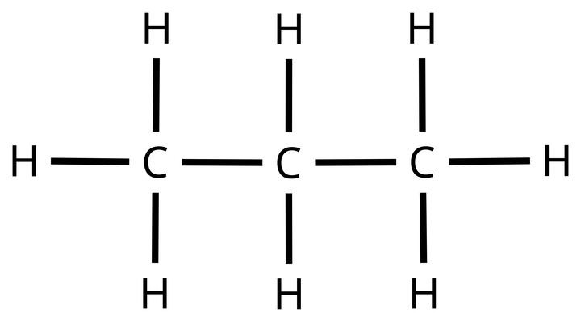
1-PROPANE (C₃H₈)
  Molecular Formula
  Lewis Structure
C₃H₈
  Condensed Structural Formula
  Bond-Line Formula
CH₃CH₂CH₃
Atom count verified: 3 C, 8 H
Valence checked: each C has 4 bonds, each H has 1
Same connectivity confirmed: CH₃CH₂CH₃

Slide 2
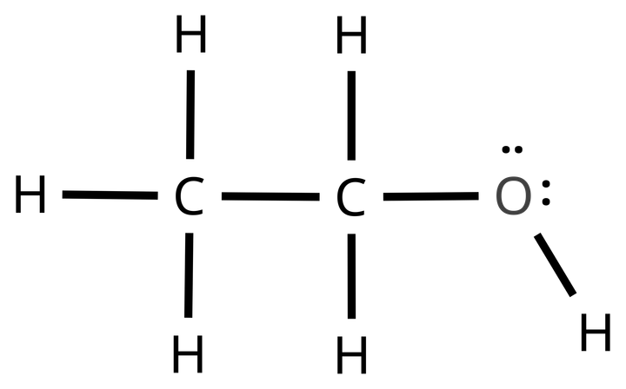

2-Ethanol (c₂h₆o)
  Molecular Formula
  Lewis Structure
C₂H₆o
  Condensed Structural Formula
  Bond-Line Formula
CH₃CH₂OH
Atom count verified: 2 C, 6 H, 1 O
Valence checked: C 4 bonds, O 2 bonds, + 2 lone pairs
Same connectivity confirmed: CH₃CH₂OH

Slide 3


3-aCETONE (PROPAN-2-ONE)
  Molecular Formula
  Lewis Structure
C₃H₆O
  Condensed Structural Formula
  Bond-Line Formula
CH₃C(=O)CH₃
Atom count verified: 3 C, 6 H, 1 O
Valence checked: C=o counts as 2 bonds, O has 2 lone pairs
Same connectivity confirmed: CH₃C(=O)CH₃

Slide 4


4-ACETIC ACID (ETHANOIC ACID)
  Molecular Formula
  Lewis Structure
C₂H₄0₂
  Condensed Structural Formula
  Bond-Line Formula
CH₃C(=O)OH
Atom count verified: 2 C, 4 H, 2 O
Valence checked: 1 C=O, 1 O-H, each O has 2 lone pairs
Same connectivity confirmed: CH₃C(=O)OH

Slide 5


5-ETHYL ACETATE (ETHYL ETHANOATE)
  Molecular Formula
  Lewis Structure
C₄H₈O₂
  Condensed Structural Formula
  Bond-Line Formula
CH₃C(=O)OCH₂CH₃
Atom count verified: 4 C, 8 H, 2 O
Valence checked: C=O + ether O, 4 lone pairs total
Same connectivity confirmed: CH₃C(=O)OCH₂CH₃

Slide 6
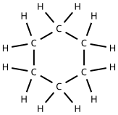

6-CYCLOHEXANE
  Molecular Formula
  Lewis Structure
C₆H₁₂
  Condensed Structural Formula
  Bond-Line Formula
(CH₂)₆
Atom count verified: 6 C, 12 H
Valence checked: each C has 2 ring bonds + 2 H
Same connectivity confirmed: (CH₂)₆ ring

Slide 7
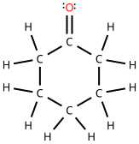

7-CYCLOHEXANONE
  Molecular Formula
  Lewis Structure
C₆H₁₀O
  Condensed Structural Formula
  Bond-Line Formula
(CH₂)₅C=O
Atom count verified: 6 C, H 10, 1 O
Valence checked: carbonyl C has no H, O has 2 lone pairs
Same connectivity confirmed: (CH₂)₅C=O

Slide 8
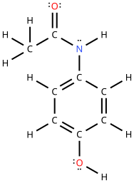
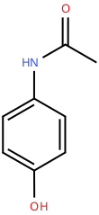
8-ACETAMINOPHEN (PARACETAMOL)
  Molecular Formula
  Lewis Structure
C₈H₉NO₂
  Condensed Structural Formula
  Bond-Line Formula
CH₃C(=O)NH-C₆H₄-OH
Atom count verified: 8 C, 9 H, 1 N, 2 O
Valence checked: N 3 bonds + 1 lone pair, each O 2 lone pairs
Same connectivity confirmed: NH and OH on opposite ring carbons (para), CH₃C(=O)NH-C₆H₄-OH

Slide 9
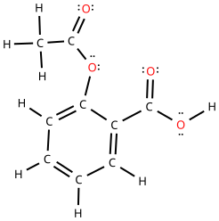
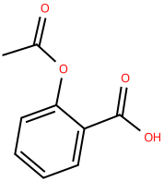
9-aSPIRIN (ACETYLSALICYLIC)
  Molecular Formula
  Lewis Structure
C₉H₈O₄
  Condensed Structural Formula
  Bond-Line Formula
CH₃C(=O)O-C₆H₄-C(=O)OH
Atom count verified: 9 C, 8 H, 4 O
Valence checked: 2 C=O, each O has 2 lone pairs
Same connectivity confirmed: COOH and OC(=O)CH₃ on neighboring ring carbons (ortho), CH₃C(=O)O-C₆H₄-COOH

Slide 10
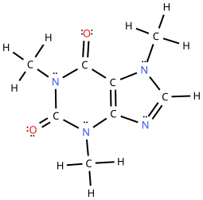
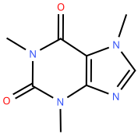
10-CAFFEINE
  Molecular Formula
  Lewis Structure
C₈H₁₀N₄O₂
  Condensed Structural Formula
  Bond-Line Formula
CH₃NC(=O)C₂=C(N=CHN₂CH₃)N(CH₃)C=O
Atom count verified: 8 C, 10 H, 4 N, 2 O
Valence checked: each N 3 bonds + 1 lone pair, each O 2 lone pairs
Same connectivity confirmed: fudes 6- and 5-ring, 3 N-CH₃, 2 C=O

