Slide 1

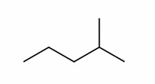
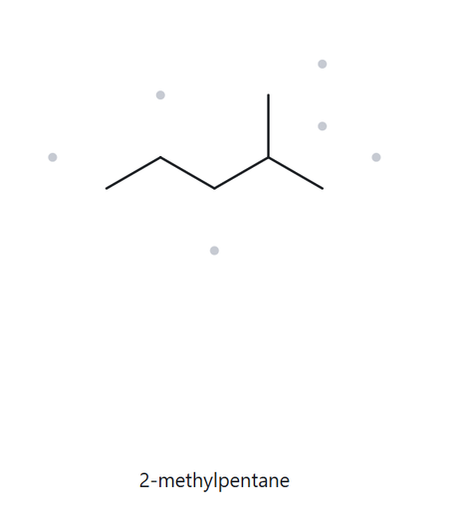


CARD A01 – Structure → Name
Level: Foundation Molecular Formula: C6H14
  NUMBERED PARENT
  MY NAME
2-methylpentane
  THE ALKANE CHECK
5
3
4
2
1
  NAMING TRAIL
Parent: longest chain = 5 C (pentane) and carries one methyl at 2C
Numbering: right to left
Substituents: methyl on C2 (2-methyl)
Match
longest chain confirmed
lowest locant
lowest alphabetical order
punctuation
formula counted

Slide 2
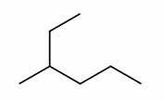
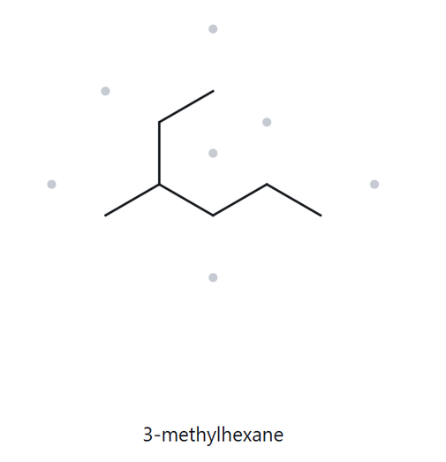
CARD A02 – Structure → Name
Level: Foundation Molecular Formula: C7H16
  NUMBERED PARENT
  MY NAME
1
3-methylhexane
2
  THE ALKANE CHECK
3
5
4
6
  NAMING TRAIL
Parent: longest chain = 6 C (hexane) and carries one methyl at 3C
Numbering: top tip and go downward, then to the right
Substituent: methyl on C3 (3-methyl)
Match
longest chain confirmed
lowest locant
lowest alphabetical order
punctuation
formula counted

Slide 3
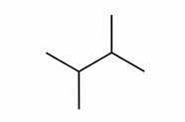
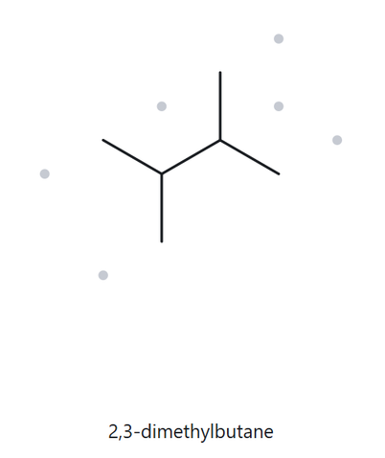
CARD A03 – Structure → Name
Level: Foundation Molecular Formula: C6H14
  NUMBERED PARENT
  MY NAME
4
2,3-dimethylbutane
3
  THE ALKANE CHECK
2
1
  NAMING TRAIL
Parent: longest chain = 4 C (butane) and carries two methyl
Numbering: top tip then go downward or vice versa
Substituent: methyl groups on 2C and 3C (2,3-dimethyl)
Match
longest chain confirmed
lowest locant
lowest alphabetical order
punctuation
formula counted

Slide 4
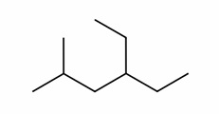
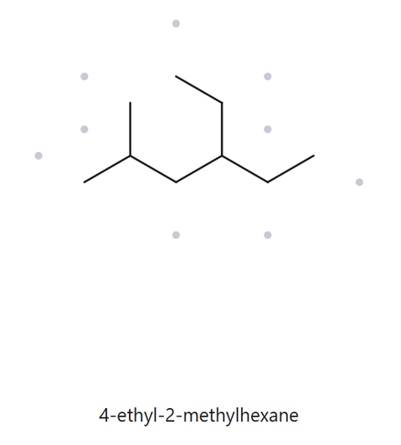
CARD A04 – Structure → Name
Level: Developing Molecular Formula: C9H20
  NUMBERED PARENT
  MY NAME
4-ethyl-2-methylhexane
  THE ALKANE CHECK
1
2
3
4
5
6
  NAMING TRAIL
Parent: longest chain = 6 C (hexane) and carries one methyl at 2C and one ethyl at 4C
Numbering: left to right
Substituent: one methyl on 2C and one ethyl on 4C (4-ethyl-2-methyl)
Match
longest chain confirmed
lowest locant
lowest alphabetical order
punctuation
formula counted

Slide 5
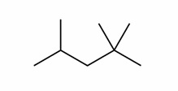
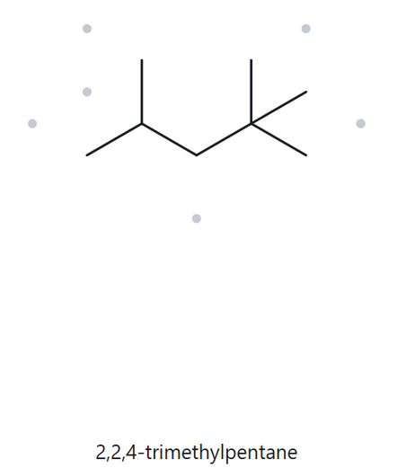
CARD A05 – Structure → Name
Level: Developing Molecular Formula: C8H18
  NUMBERED PARENT
  MY NAME
2,2,4-trimethylpentane
  THE ALKANE CHECK
5
4
3
2
1
  NAMING TRAIL
Parent: longest chain = 5C (pentane) and carries two methyl on 2C and another one on 4C
Numbering: right to left or vice versa
Substituent: 2,2,4-trimethyl
Match
longest chain confirmed
lowest locant
lowest alphabetical order
punctuation
formula counted

Slide 6
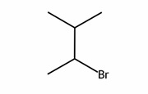
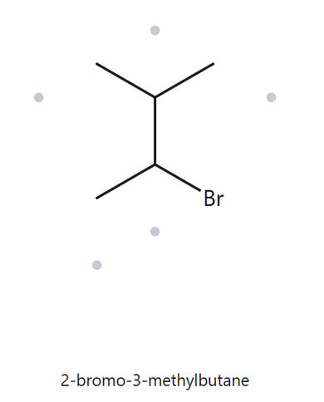
CARD A06 – Structure → Name
Level: Developing Molecular Formula: C5H11Br
  NUMBERED PARENT
  MY NAME
4
2-bromo-3-methylbutane
3
  THE ALKANE CHECK
2
1
  NAMING TRAIL
Parent: longest chain = 4 C (butane)
Numbering: top right to bottom left or vice versa
Substituent: bromo (halogen) on 2C and methyl on 3C (2-bromo-3-methylbutane)
Match
longest chain confirmed
lowest locant
lowest alphabetical order
punctuation
formula counted

Slide 7
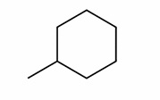
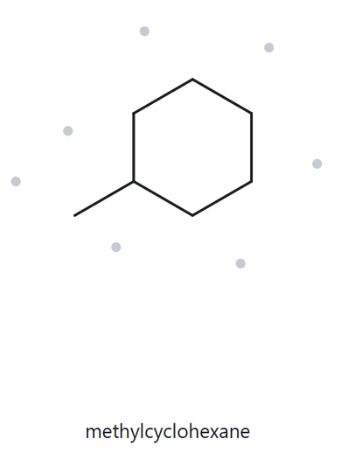
CARD A07 – Structure → Name
Level: Developing Molecular Formula: C7H14
  NUMBERED PARENT
  MY NAME
methylcyclohexane
5
6
4
  THE ALKANE CHECK
1
3
2
  NAMING TRAIL
Parent: 6C ring (cyclohexane) and carries one methyl.
Numbering: around the ring, starting at the substituent carbon, then go in either direction
Substituent: methyl on 1C (methyl)
Match
longest chain confirmed
lowest locant
lowest alphabetical order
punctuation
formula counted

Slide 8
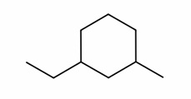
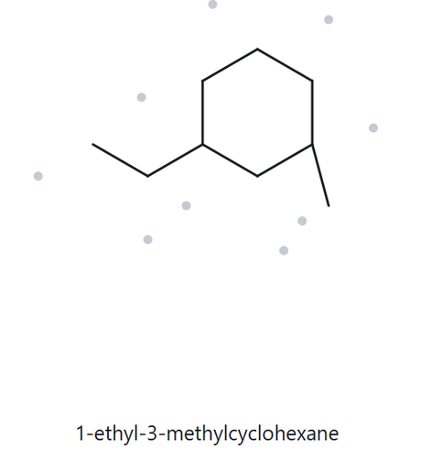
CARD A08 – Structure → Name
Level: Challenge Molecular Formula: C9H18
  NUMBERED PARENT
  MY NAME
1-ethyl-3-methylcyclohexane
5
6
4
  THE ALKANE CHECK
1
3
2
  NAMING TRAIL
Parent: longest chain = 6C ring (cyclohexane)
Numbering: start at ethyl and go to methyl (path with shortest distance between them) then go around the ring
Substituent: ethyl on 1C and methyl on 3C (1-ethyl-3-methyl)
Match
longest chain confirmed
lowest locant
lowest alphabetical order
punctuation
formula counted

Slide 9
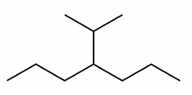
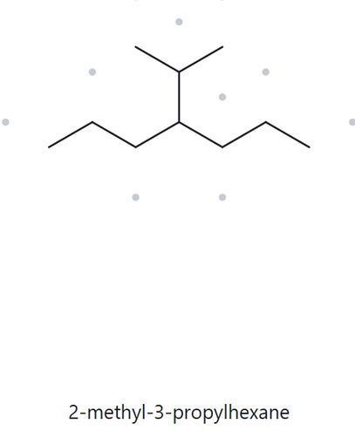

CARD A09 – Structure → Name
Level: Challenge Molecular Formula: C10H22
  NUMBERED PARENT
  MY NAME
4-isopropylheptane
  THE ALKANE CHECK
1
2
3
4
5
6
7
  NAMING TRAIL
Parent: longest chain = 7C (heptane)
Numbering: left to right or vice versa
Substituent: isopropyl on 4C (4-isopropyl)
✗ Mismatch. The tool chose a 6-carbon parent (hexane), but the longest chain is 7 carbons (heptane). Correct name: 4-isopropylheptane.
longest chain confirmed
lowest locant
lowest alphabetical order
punctuation
formula counted

Slide 10
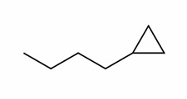
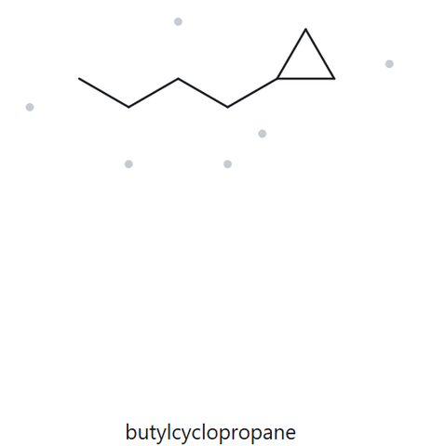
CARD A10 – Structure → Name
Level: Challenge Molecular Formula: C7H14
  NUMBERED PARENT
  MY NAME
butylcyclopropane
3
  THE ALKANE CHECK
1
2
  NAMING TRAIL
Parent: 3C ring (cyclopropane) is the parent even though the butyl chain (4C) is longer
Numbering: start from substituent carbon then go either way
Substituent: butyl at C1 (butyl)
Match
longest chain confirmed
lowest locant
lowest alphabetical order
punctuation
formula counted

