Slide 1
Adaptive Sampling &
Time Series Compression
A Comparative Study
Krishiv Geriani (220545) | Vishap Raj (221208)
Supervisors: Prof. Amitangshu Pal & Prof. Adrish Banerjee

Slide 2
Agenda
1. Project Objectives
4. Time Series Compression Methods (Part 2)
2. Adaptive Sampling Techniques (Part 1)
5. Results & Comparison
3. Datasets Used
6. Conclusions & Recommendations

Slide 3
Project Objectives
01
Adaptive Sampling
02
Time Series Compression
Study and implement five adaptive sampling learners (1D, 2D, Discrete, Sequence, Balancing) from scratch in Python — without relying on any existing libraries.
Apply nine compression algorithms to three real-world datasets and identify the best method in terms of compression ratio vs. reconstruction accuracy (RMSE).

Slide 4
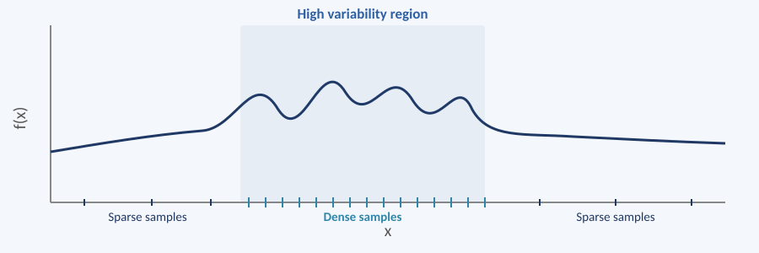
Adaptive Sampling — Overview
Learner1D
1D continuous domain. Bisects the interval with highest interpolation error.
Illustrative Example (Learner1D)
Learner2D
2D rectangular domain. Refines the rectangle with largest center deviation.
DiscreteLearner
Finite set of discrete points. Evaluates all unseen points.
SequenceLearner
Integer-indexed sequences. Bisects by interpolation error.
BalancingLearner
Coordinates multiple learners. Picks whichever has highest pending error.

Slide 5
Datasets
1. Solar Cycle
2. Temperature / Power
3. Geomagnetic
Source: NOAA SWPC
Type: Monthly sunspot indices
Nature: Smooth, slow, near-sinusoidal
Source: Open-Meteo API
Type: Hourly temp, New Delhi
Nature: Strong 24-hr daily periodicity
Source: USGS Observatory, Barrow AK
Type: 1-min H-component (nT)
Nature: Noisy, non-stationary bursts

Slide 6
Compression Methods (9 Total)
Lossless
Lossy
Delta Encoding — stores differences between consecutive values
Delta + RLE — run-length encodes repeated delta values
Delta + Huffman — entropy coding; shortest codes for most frequent deltas
DCT — keeps top 10% frequency coefficients
Piecewise Polynomial — quadratic fit per 128-sample window
PAA — replaces each window with its mean
Wavelet (db4) — keeps top 10% magnitude coefficients
Adaptive (2-Method) — variance-guided: wavelet on smooth, Huffman on complex segments
Adaptive Forecast — AR(20)-guided segmentation variant of above

Slide 7
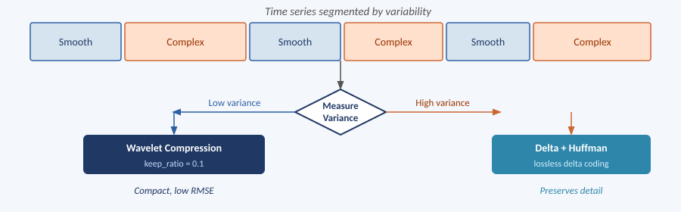
Our Adaptive Methods (Novel Contribution)
Core idea: segment the signal and apply different compression to smooth vs. complex regions.
Method 1 — Variance-Based
Scheme Illustration (Method 1)
Step 1: Segment → compute std. deviation. Step 2: Bottom 30% (smooth) → Wavelet. Top 70% (complex) → Delta + Huffman.
Method 2 — AR Forecast-Guided
Step 1: Fit AR(20) model → forecast RMSE per segment. Step 2: Low error (predictable) → Wavelet. High error (unpredictable) → Delta + Huffman.

Slide 8
Results — All Three Datasets
Method | Solar Ratio | Solar RMSE | Temp Ratio | Temp RMSE | Geo Ratio | Geo RMSE
Delta | 1.0000 | 0.00 | 1.0000 | 0.00 | 1.0000 | 0.00
Delta + RLE | 0.9898 | 0.00 | 0.9583 | 0.00 | 0.9992 | 0.16
Delta + Huffman | 0.1501 | 0.00 | 0.0911 | 0.00 | 0.1845 | 0.16
DCT | 0.0998 | 21.51 | 0.0952 | 1.28 | 0.1000 | 24.29
Piecewise Poly | 0.0274 | 42.97 | 0.0417 | 5.08 | 0.0275 | 48.81
PAA | 0.0078 | 61.99 | 0.0119 | 5.14 | 0.0078 | 72.70
Wavelet | 0.1013 | 16.52 | 0.1131 | 3.67 | 0.1005 | 12.16
Adaptive (2-method) | 0.1166 | 8.60 | 0.1020 | 8.41 | 0.1223 | 4.94
Adaptive Forecast | 0.1166 | 8.60 | 0.1020 | 8.41 | 0.1220 | 6.32

Slide 9
Key Findings
Best Lossless
Delta + Huffman — 80–91% size reduction, zero reconstruction error across all datasets.
Best for Smooth/Periodic
DCT — excellent on temperature data (RMSE = 1.28 at ratio 0.095). Degrades on noisy signals.
Best for Noisy Data
Wavelet — outperforms DCT on geomagnetic data (RMSE 12.2 vs 24.3) due to local time-frequency resolution.
Best Overall Lossy
Adaptive (2-Method) — lowest RMSE among lossy methods on all three datasets at ~0.11 ratio.
Highest Compression
PAA — smallest ratio (~0.008) but very high error. Suitable only for coarse trend analysis.

Slide 10
Conclusions
No single method dominates across all signal types — choice depends on the data and the acceptable error.
Adaptive segmentation (variance-based) consistently outperforms fixed-strategy lossy methods.
Forecast-guided (AR) segmentation performed comparably to variance-based segmentation on smooth data, but offered no advantage on noisy, non-stationary signals.
Wavelet compression is more robust than DCT for real-world scientific signals with irregular structure.
PAA and Piecewise Polynomial are only suitable for coarse-level trend detection, not accurate reconstruction.

Slide 11
Thank You
Questions & Discussion
Krishiv Geriani (220545) | Vishap Raj (221208)
github.com/krishivg22/Adaptive_Sampling-Time_Series_Compression

