Slide 1
Implementation of Smoke Detection System Using Optical Smoke Sensor and MSP430FRxxxx
Krishiv .S. Rana

Slide 2
Table of Content
Motivation & Problem Definition
Project Introduction
System Overview & Block Diagram
Optical Smoke Sensor – Features & Architecture
MSP430FRxxxx Microcontroller
I²C Protocol & Sensor Interfacing
UART, RS485 & Frame Layer Protocol
Algorithms Applied
Firmware & Software Design
Testing & Results
Conclusion

Slide 3
Motivation & Problem Definition
Smoke Detection Importance & Solution
Smoke is the earliest sign of fire → enables early warning, saving lives and property
Industrial challenge: detect fine particles while avoiding false alarms (dust, steam)
Limitation: single-wavelength detectors cannot differentiate real smoke from noise
Solution: dual-wavelength optical method improves accuracy and reliability
Ensures faster response time and enhances overall fire safety systems

Slide 4
Project Introduction
System Architecture & Communication
3-Layer Architecture: Sensor (optical dual-LED + ADC) → MSP430 MCU → Python host (live PTR graph)
Signal Flow: Smoke → Sensor → (I2C @100kHz) → MCU →(UART / RS485 @9600) → Python → Graph
Key Interfaces: I²C (addr 0x64), UART 9600 baud (8N1), RS485 half-duplex
Data Handling: 4-byte request, 21-byte response with CRC16 validation

Slide 5
System Overview
Objective: Early and accurate smoke detection with low false alarms
Concept: Dual-wavelength optical sensing (Blue + IR) for particle discrimination
System Layers:
Sensing: Optical Smoke Sensor
Processing: MSP430FRxxxx MCU
Monitoring: Python-based host system
Key Functions: Detection → Signal Processing → Data Transmission → Visualization

Slide 6
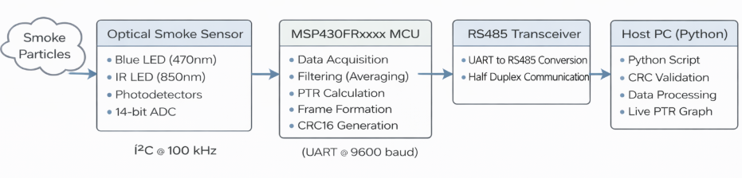
Block Diagram

Slide 7
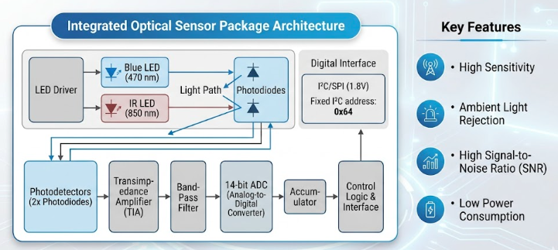
Optical Smoke Sensor – Features & Architecture

Slide 8
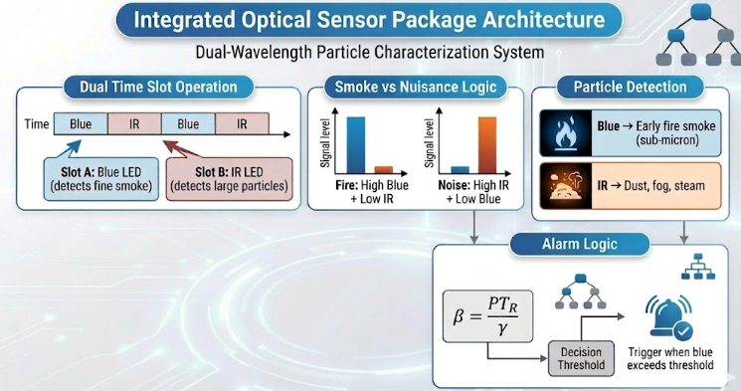

Slide 9
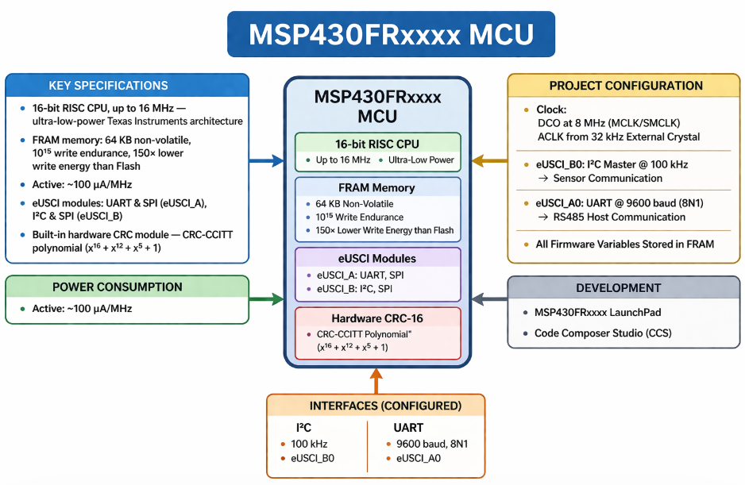
MSP430FRxxxx Microcontroller

Slide 10
I²C Protocol & Sensor Interfacing
I²C Bus Configuration
Two-wire communication: SDA (data) and SCL (clock)
Master (MCU) controls communication; sensor acts as slave (0x64)
Operates at 100 kHz (Standard Mode)
Uses START, STOP, and ACK signals for data transfer
Supports both read and write operations using register addressing

Slide 11
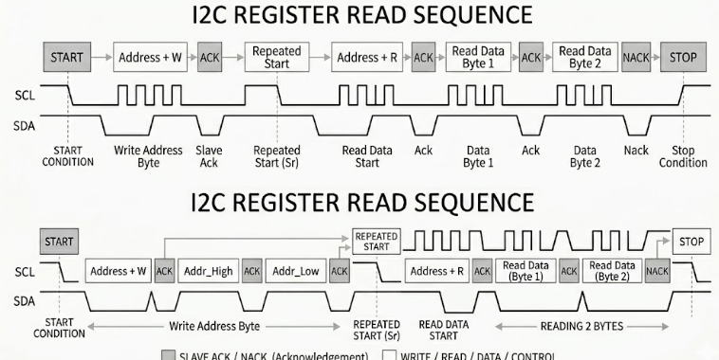

Slide 12
UART & RS485
UART Configuration (8N1)
9600 baud, 8 data bits, no parity, 1 stop bit — eUSCI_A0 on MSP430FRxxxx
16× oversampling for accurate bit sampling and noise immunity
Interrupt-driven RX (UART ISR) + polling-based TX via DE/RE GPIO control
RS485 Physical Layer
Differential signaling — immune to common-mode noise in industrial environments
Half-duplex: MCU switches between TX and RX mode using DE and RE GPIO pins

Slide 13
Algorithms Applied
Moving Average Filter
8-sample circular buffer in FRAM for both Blue and IR channels
Running sum updated each sample — avoids full re-computation each cycle
Reduces high-frequency noise without introducing significant lag
Baseline Calibration
On startup: 8 samples averaged to establish clean-air baseline PTR
+1 guard added to baseline prevents negative obscuration in clean air

Slide 14
Adaptive Baseline Tracking
Exponential Moving Average (EMA) tracker updates baseline slowly over time
Prevents smoke events from corrupting the baseline reference
Obscuration Calculation
β = PTR / γ (γ = 0.64 for Blue 470 nm | γ = 0.24 for IR 850 nm)
Scaled ×100 and stored as 16-bit unsigned integer in frame — resolution of 0.01 %/ft

Slide 15
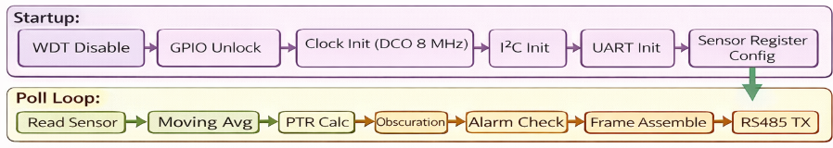
Firmware & Software Design
Firmware Architecture – Foreground/Background Model
Foreground (ISR): UART RX interrupt receives 4-byte request frame, sets processing flag
Background (Main Loop): I²C sensor poll → signal processing → frame build → RS485 TX
Main Program Flow

Slide 16
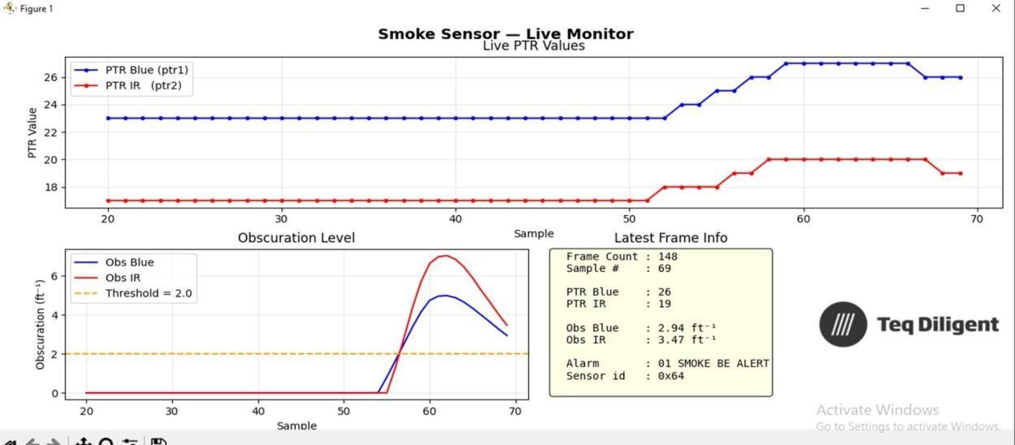
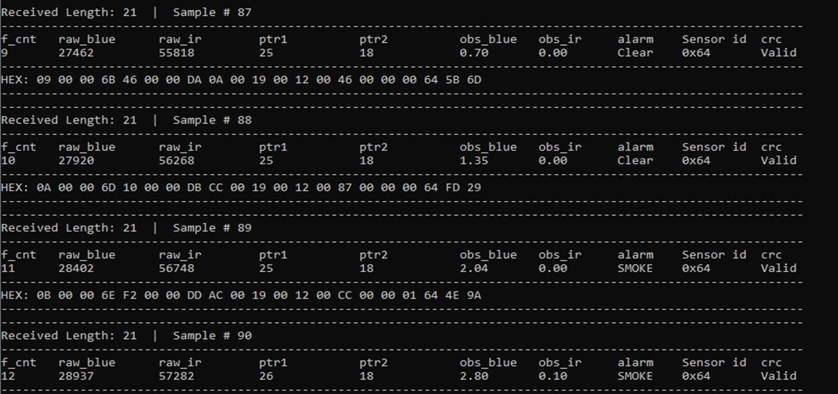
Testing & Results
Live PTR Graph During Smoke Detection Test
Terminal Frame Output During Smoke Event

Slide 17
Conclusion
Low-power optical smoke detection using a dual-wavelength approach for accurate early fire detection.
Zero false alarms, ensuring reliable and dependable operation.
Efficient I²C communication for stable sensor interfacing.
Real-time processing and data transmission handled by the MSP430 microcontroller.
Efficient data transmission to PC through UART
Suitable for industrial and safety-critical applications.

Slide 18
References
Texas Instruments, MSP430FR58xx, MSP430FR59xx, and MSP430FR6xx Family User’s
https://www.ti.com/lit/pdf/SLAU367
Analog Devices, Inc., AN-2033: Calibrating the Optical Smoke and Aerosol Detection Module, June 2021.
https://www.analog.com/en/resources/app-notes/an-2033.html
NXP Semiconductors, UM10204: I2C-Bus Specification and User Manual, Rev. 7.0, 1 October 2021.
https://www.nxp.com/docs/en/user-guide/UM10204.pdf

Slide 19
Q&A

