Slide 1
Can a model tell AI writing from human writing?
Sample model output
AI-Generated
Estimated Human
21.7%
Estimated AI
78.3%
AI vs Human Text Classifier: an end-to-end Machine Learning project
ECSCI24302 – Machine Learning Essentials · Project-Based Learning
Team: [Name 1 – Enrollment No.] · [Name 2 – Enrollment No.] · [Name 3 – Enrollment No.]
Notes:
Introduce the team and the question. The bars on the right are a real output from the final model. Keep this under 30 seconds.

Slide 2
False AI flags harm real writers, so careful detection is the goal
Why this problem
Input
Raw text pasted by a user
AI text generators make it harder for teachers and editors to judge how a text was produced
A wrong AI flag can damage a real writer, so false positives matter most
Labelled examples exist, which makes this a supervised task
Model
Word + character TF-IDF with Logistic Regression
Task and goal
Binary classification on target generated: 0 = human, 1 = AI
Keep false AI flags low, still catch most AI text, and report estimates honestly
Output
Class plus estimated Human and AI probabilities
Notes:
Input is raw text, output is a class and two estimated probabilities. Supervised binary classification fits because each text has a label. Wrongly flagging a human is worse than missing some AI text, and that shaped every decision in the final model.

Slide 3
Essays, blogs and news give the model a wider view of human writing
Source (Kaggle) | Used as | Used in the final model
AI vs Human Text | Human essays and AI text | 40,000 essays for training, plus 15,000 for validation
Blog Authorship Corpus | Human, 2004 | Up to 20,000 posts sampled, 50–800 words
BBC Full Text | Human, 2004–2005 | Full set, de-duplicated
0
4
15–150
missing values or exact duplicates
blank rows removed
word snippets added to train on short text
Notes:
The main dataset is AI vs Human Text from Kaggle. It was clean: no missing values or exact duplicates, and only 4 blank rows removed. Classes are imbalanced, so we report false flags and detection rather than accuracy alone. Its human texts are all student essays, so we added 2004 blogs and 2004 to 2005 BBC news, which predate AI text generators. For memory reasons the final model trained on 40,000 essays, each also giving a 15 to 150 word snippet, plus the extra human text.

Slide 4
The final model reads writing style through words and characters
Text
clean_text()
Word TF-IDF
Character TF-IDF
Logistic Regression
Raw input
Lower-case, straighten quotes, collapse spaces
100,000 words, word pairs and punctuation
150,000 character 3–5-grams
C = 0.5, gives probabilities
Human-Written
Uncertain
AI-Generated
0
0.50
0.65
1.00
Estimated AI probability
Threshold 0.65: the highest value that still catches at least 90% of AI text on validation data. Under 50 words: never labelled AI, because very short text is unreliable.
Notes:
Walk through the pipeline left to right. clean_text runs inside the pipeline so training and prediction match. Function words and punctuation are kept because they carry style. Character 3 to 5 grams capture spelling and punctuation patterns. C = 0.5 applies more regularisation for 250,000 features. The threshold rule: on a 0.05 grid, take the highest threshold still catching at least 90 percent of AI text on validation data, which gave 0.65. The notebook has three outcomes; the web app currently shows 0.50 to 0.64 as Human-Written.

Slide 5
On held-out data, the model rarely flags human text and catches most AI
Dry test on new paragraphs
0.4%
short human essay snippets wrongly flagged as AI
Text | AI probability | Label
AI samples 1–3 | 99.4–100.0% | AI-Generated
Human sample 1 | 2.2% | Human-Written
Human sample 2 | 14.8% | Human-Written
Human sample 3 | 27.3% | Human-Written
0.1%
short human blog and news snippets wrongly flagged as AI
96.8%
full-length AI essays correctly detected
Six paragraphs are a sanity check, not a measurement. All outputs are estimates, never proof of authorship.
Notes:
These results come from data not used for training or for choosing the threshold. Short snippets are 15 to 150 words. The dry test uses new paragraphs; its numbers were re-checked against the saved model. Six paragraphs are a sanity check, not a measurement, and some of the human paragraphs were known hard cases during development.

Slide 6
The model leans on punctuation and style, not only topic
Punctuation tokens and function words rank at the top, so the model reads style
Weights are correlations in this training data, so they describe the dataset and not all AI writing
Notes:
These are the top word-feature weights read from the saved final model, among 250,000 features. Function words and punctuation dominate. Comma after like, comma plus I, and period then this push toward AI; repeated periods, hyphens, quotes, very and because push toward human. These are correlations in this training data and describe the dataset, not universal rules about AI.

Slide 7
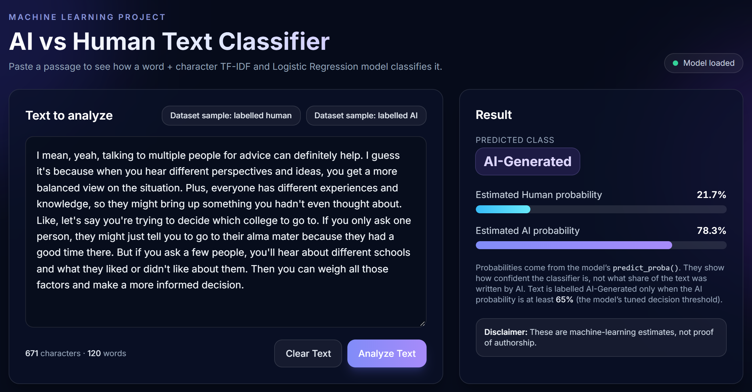
Demo: the model runs behind a fast web app
Benchmarks on a laptop
4.6 ms
to score a 400-word text
7.0 ms
API response, 400 words
215 MB
Actual app output for a dataset sample labelled AI: 78.3% AI, 21.7% Human.
server memory, stable after 500 requests
React + FastAPI + joblib: POST /predict calls the saved pipeline’s predict_proba().
Notes:
Switch to the live app: run run.bat, paste unseen text of at least 50 words, click Analyze Text. The backend loads the saved pipeline with joblib and calls predict_proba; nothing is retrained or faked. Benchmarks were measured on one laptop, a 13th Gen Intel Core i7-1360P with one server worker, so they are indicative. Remember: the app shows 0.50 to 0.64 as Human-Written and rejects texts under 50 words.

Slide 8
It gives evidence, not proof
Future work
Add AI-written blogs and news
Test on a fresh, untouched set
Check probability calibration
Compare with DistilBERT
Show Uncertain in the web app
AI examples are essay-only, so AI-written blogs or news could be missed
Held-out data guided development, so results may be slightly optimistic
Newer AI generators may write differently
Short and unusual text remains less reliable
Data from Kaggle: shanegerami/ai-vs-human-text · rtatman/blog-authorship-corpus · alfathterry/bbc-full-text-document-classification. Web app and slides built with AI coding assistance (Claude Code).
These are machine-learning estimates, not proof of authorship.
Notes:
The most important limit: AI examples are essay-like, but blogs and news were added only as human, so the model could treat non-essay style as human and miss AI-written blogs or news. Also, held-out data guided development, so a fresh test set is the correct next step. Close by repeating that outputs are estimates, then invite questions.

