Slide 1
Can a model tell AI writing from human writing?
Sample model output
AI-Generated
Estimated Human
21.7%
Estimated AI
78.3%
AI vs Human Text Classifier: an end-to-end Machine Learning project
ECSCI24302 – Machine Learning Essentials · Project-Based Learning
Team: [Name 1 – Enrollment No.] · [Name 2 – Enrollment No.] · [Name 3 – Enrollment No.]
Notes:
Welcome. Introduce the team and the question. Our project takes a real text dataset through the full ML pipeline and ends with a working demo. The bars on the right are a real output from our final model. Keep this under 30 seconds.

Slide 2
Near-perfect test scores still let human writing get flagged as AI, so we rebuilt
487,231
99.95%
8.5% → 0.4%
texts after cleaning, from a public Kaggle dataset
best test accuracy on the original split (Tuned Linear SVM)
short human essay snippets wrongly flagged as AI, original recipe vs final model
Final model: word + character TF-IDF with Logistic Regression, trained on essays, short snippets, blogs and news, using an AI threshold of 0.65. It runs behind a React + FastAPI web app.
Scores are estimates of class membership, never proof of authorship.
Notes:
This is the whole talk in one slide. On the dataset test split our models looked near perfect. When we tried text known to be human, the original Logistic Regression recipe wrongly called some of it AI. So error analysis drove a second model. The final model trades some raw detection for far fewer false accusations.

Slide 3
False AI flags harm real writers, so careful detection is the goal
Why this problem
Input
Raw text pasted by a user
AI text generators make it harder for teachers and editors to judge how a text was produced
A wrong AI flag can damage a real writer, so false positives matter most
Labelled examples exist, which makes this a supervised task
Model
TF-IDF features + Logistic Regression
Task and expected outcome
Binary classification on target generated: 0 = human, 1 = AI
A model that beats a baseline, keeps false AI flags low, and reports estimates honestly
Output
Class plus estimated Human and AI probabilities
Notes:
Stage 1, Problem Definition. Input is raw text, output is a class and two estimated probabilities. Supervised binary classification fits because each text has a label. Emphasise the asymmetric cost: wrongly accusing a human is worse than missing some AI text, and that shaped our later decisions.

Slide 4
One large Kaggle dataset, extended with pre-AI human writing
Dataset | Source | Size | Role
AI vs Human Text | Kaggle: shanegerami | 487,235 rows, 2 columns, 1.03 GB | Main dataset. text = input, generated = target (0/1)
Blog Authorship Corpus | Kaggle: rtatman | Up to 20,000 posts sampled (50–800 words) | Extra human text, written in 2004
BBC Full Text Classification | Kaggle: alfathterry | Full set, de-duplicated | Extra human text, 2004–2005 news
Main dataset classes
Why add extra data
305,797 human (62.76%) and 181,438 AI (37.24%) before cleaning. Sampled texts average about 390 words.
The main human class is only student essays. Pre-AI blogs and news give a trustworthy, wider range of human writing.
Notes:
Stages 2 and 3. Main dataset is AI vs Human Text from Kaggle: two columns, a text input and a label. There are no identifier, numeric or categorical columns other than the target. The two extra sets were added later in the project because all human text in the main set is student essays. They predate AI generators, so we can trust the human label.

Slide 5
The data was clean: only 4 of 487,235 rows had to be removed
How it was checked
0
0
0
Chunked reading (50,000 rows) to handle the 1 GB CSV
SHA-256 hash of every text to find duplicates
Label values validated against {0, 1}
missing text or labels
invalid labels
exact duplicate texts
Label noise found
0
4
487,231
After normalising case and spacing, 2 train-test pairs had effectively identical text but opposite labels. A small sign that labels are not perfect.
empty or non-string texts
whitespace-only rows, removed
rows kept for modelling
Notes:
Stage 4. We processed the 1 GB file in chunks to save memory. Exact duplicates were checked with SHA-256 hashes across all rows. After lower-casing and whitespace normalisation we also found two train-test pairs with effectively identical text but opposite labels: a school lunch essay and a Generic_City essay. That shows a small amount of label noise.

Slide 6
Classes are imbalanced, so accuracy alone would mislead
62.76% / 37.24%
human / AI split after cleaning
What this changes
Always guessing human already scores 62.76%, so that is our baseline
Macro F1 weights both classes equally
ROC-AUC measures ranking across thresholds
Stratified splitting preserves the ratio in train and test
Notes:
Stage 5, univariate analysis of the target. A model that always says human gets almost 63 percent. So we use macro F1 and ROC-AUC along with accuracy, and we stratify the split to keep the class ratio. Metrics chosen: precision matters because of false flags, recall because we still want to catch AI text, macro F1 treats both classes equally, ROC-AUC measures ranking across all thresholds.

Slide 7
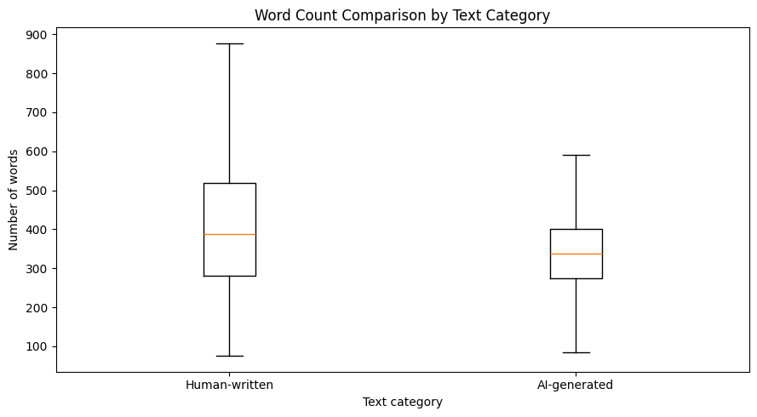
Human texts run longer, but length alone cannot separate them
20,000-record sample | Human | AI
Mean words | 421.17 | 342.90
Median words | 387 | 337
Mean characters | 2,350.27 | 2,116.55
Word range | 75–1,651 | 14–1,029
The distributions overlap, so text content must drive the model
Outliers are genuine texts and were kept; TF-IDF normalisation limits their effect
Notebook plot, sample of 20,000 records. Outliers hidden in plot.
Notes:
Stage 5, bivariate analysis on a reproducible random sample of 20,000 rows. Human essays average about 78 more words. The box plot shows a wider spread for human text, but the ranges overlap heavily. So we need features from the text itself. The plot hides outliers; word counts range from 14 to 1,651. These long and short texts are genuine writing, so we kept them. TF-IDF vectors are length-normalised, which limits their effect.

Slide 8
Preprocessing stays minimal, and fitted steps see training data only
487,235
487,231
341,061
146,170
raw rows
after removing 4 blank rows
training (70%)
test (30%), stratified
Missing values and encoding
Scaling
Leakage control
No missing values to impute. Labels are already 0/1 and there are no categorical inputs, so no encoding was needed.
TF-IDF vectors are L2-normalised by default, so linear models need no extra scaler.
TF-IDF sits inside a Pipeline during cross-validation and is fitted on training folds only. Train and test indexes do not overlap.
Notes:
Stages 6 and 9. Nothing to impute. Labels are already numeric and there are no categorical inputs, so no encoding. TF-IDF vectors are L2 normalised by default, so linear models do not need a separate scaler. Leakage control: vectorisers are fitted on training data only, and tuning puts TF-IDF inside a Pipeline so each CV fold fits its own vocabulary. We verified zero index overlap between train and test.

Slide 9
TF-IDF turns text into features, and its settings do the selection
Original setting | Value | Decision
ngram_range | (1, 2) | Keep word pairs for phrase context
stop_words | english | Remove function words (later reversed)
max_features | 50,000; 30,000 in tuning | Limit features for memory and time
min_df | 2 | Drop one-off terms
max_df | 0.95 | Drop near-universal terms
sublinear_tf | True | Dampen repeated words
TF-IDF(t, d) = TF(t, d) × IDF(t)
TF: how often term t appears in document d
IDF: how rare term t is across all documents
Result: a sparse vector per text
341,061 × 50,000
training matrix, only 0.34% of cells non-zero, stored as sparse CSR
Notes:
Stages 7 and 8. Explain TF-IDF: term frequency times inverse document frequency, so words common in one text but rare overall score high. Feature selection is built in: min_df drops rare terms, max_df drops very common ones, and max_features keeps the most frequent terms. This is the original recipe. Removing stop words later turned out to be a mistake, which we cover in error analysis.

Slide 10
A baseline plus three linear models suited to sparse text
B
Baseline
1
Model 1
2
Model 2
3
Model 3
Dummy Classifier
Multinomial Naive Bayes
Logistic Regression
Linear SVM
most_frequent strategy
alpha = 0.1
liblinear solver
LinearSVC
Reference point: always predicts human. Accuracy 62.76%.
Very fast and designed for word-frequency features. Accuracy 97.92%.
Gives probabilities and readable weights for each feature. Accuracy 99.70% when tuned.
Maximises the margin and works well in high dimensions. Accuracy 99.95% when tuned.
Notes:
Stages 10 to 12. Baseline always predicts the majority class. All three models handle high-dimensional sparse TF-IDF vectors efficiently, and train in reasonable time on 341,061 rows. Naive Bayes is the fast reference, Logistic Regression gives real probabilities and readable coefficients, Linear SVM is usually strong on text.

Slide 11
Tuning used 3-fold cross-validation on training data only
Search
Model | Search space | Selected | Mean CV macro F1
Logistic Regression | C ∈ {0.5, 1.0} | C = 1.0 | [re-run cell 28]
Linear SVM | C ∈ {0.5, 1.0} | [re-run cell 29] | [re-run cell 29]
Naive Bayes | Not tuned | alpha = 0.1 | Not applicable
Final LR v2 | Set by design, no grid | C = 0.5, stronger regularisation | Not grid-searched; threshold chosen on validation
GridSearchCV over C
Validation
Stratified 3-fold, shuffled
Scoring
Macro F1, then refit on all training data
One LR fit took about 3.6 minutes, so the grid was kept small. Smaller C means stronger regularisation.
Notes:
Stage 13. GridSearchCV with stratified 3-fold CV and macro F1 scoring over the regularisation strength C. Smaller C means stronger regularisation, which reduces overfitting. The grid was small because each fit took about 3.6 minutes. Replace the amber cells with values after re-running cells 28 and 29. Tuned LR selected C=1.0, confirmed from the saved tuned pipeline.

Slide 12
On the original test split, every model beat the baseline by a wide margin
Model | Best hyperparameters | Validation | Accuracy | Macro F1 | ROC-AUC | Observation
Dummy baseline | most_frequent | Not applicable | 0.6276 | 0.39 | n/a | Never predicts AI
Naive Bayes | alpha = 0.1 | Not tuned | 0.9792 | 0.9777 | 0.9976 | Fastest, weakest of three
Tuned LR | C = 1.0 | [CV F1] | 0.9970 | 0.9968 | 0.9999 | Gives real probabilities
Tuned Linear SVM | [C] | [CV F1] | 0.9995 | 0.9994 | 1.0000 | Best on this split
Why we did not stop here
Train and test come from the same essay collection, so these scores cannot show how a model handles other writing. Testing on known human text came next.
Notes:
Stages 14 and 15. All values are on the 146,170 record test set. Linear SVM scored highest with accuracy 99.95 percent. Scores this high should raise suspicion: the test set comes from the same source as training, so it says little about other writing. That is what the next slides explore.

Slide 13
Logistic Regression cut both error types compared with Naive Bayes
Multinomial Naive Bayes
Logistic Regression (C = 1.0)
Human flagged as AI
Actual ↓ / Predicted → | Human | AI
Human | 90,646 | 1,094
AI | 1,941 | 52,489
Actual ↓ / Predicted → | Human | AI
Human | 91,683 | 57
AI | 369 | 54,061
1.19% → 0.06%
AI text missed
3.57% → 0.68%
Naive Bayes → Logistic Regression, rates derived from the matrices.
Test set: 91,740 human and 54,430 AI records. Amber numbers are errors.
Scores like these look finished. The next test showed they were not.
Notes:
Prediction and error plots. These are the notebook confusion matrices on 146,170 test records, using the 50,000-feature TF-IDF and default C=1.0 for LR. False AI flags fell from 1,094 to 57. Missed AI text fell from 1,941 to 369. The notebook did not retain the tuned SVM matrix, so re-run Step 18 if you want to show it.

Slide 14
High scores hid a weakness: real human writing was flagged as AI
Original recipe on known human text
Why it happened
Human sample 2: AI probability
68.2%
1
Stop-word removal
Function words carry style, so the model leaned on topic and formal words
Human sample 3: AI probability
65.1%
2
Long essays only
Trained on about 400-word essays, then asked about short passages
Human sample 1: AI probability
27.9%
3
Fixed 0.5 threshold
Strongest features in the Linear SVM
Slightly formal text tipped straight into AI
AI: additionally, essay, important, essential, firstly
Human: people, venus, student_name, probably, percent
4
Student essays only
All main-dataset human text came from one kind of writing
Notes:
Stage 16. In a dry test with known human paragraphs, the original Logistic Regression recipe, retrained on the 40,000-essay subsample for a fair comparison, flagged two of three as AI. The SVM was not part of this dry test; its features are shown because the notebook interpreted that model. The top SVM features explain why: common formal words point to AI, and dataset-specific words like venus and student_name point to human. Student_name looks like an anonymisation token and venus an essay topic, so the model learned the dataset as well as writing style.

Slide 15
Four changes targeted those causes directly
1
Keep style signals
2
Train on short text
Keep function words and punctuation, and add character 3–5-grams. 100,000 word + 150,000 character features.
Each essay also contributes a random 15–150-word snippet, so 40,000 essays become 80,000 training rows.
3
Widen human writing
4
Decide with care
Add blogs and BBC news as human text, split 65 / 15 / 20 into train, validation and test.
Pick the AI threshold on validation data, add an Uncertain zone, and raise regularisation to C = 0.5.
Notes:
This is the core of model improvement. Each fix maps to a cause. Word settings keep function words and punctuation; character n-grams capture style. Snippets of 15 to 150 words teach the model about short text. Blogs and news widen human writing. The 250,000 feature count comes from the saved model. Training used a subsample of 40,000 essays to fit in free notebook memory.

Slide 16
A validation-chosen threshold separates three outcomes
Human-Written
Uncertain
AI-Generated
0
0.50
0.65
1.00
AI probability
Selection rule
Short-text guard
Web demo today
Highest threshold on a 0.05 grid that still catches at least 90% of AI text on validation data.
Texts under 50 words are never labelled AI in the notebook, because very short text is unreliable.
Shows two labels: 0.50–0.64 displays as Human-Written, and texts under 50 words are rejected.
Notes:
Threshold rule: from 0.50 to 0.95 in steps of 0.05, take the highest threshold that still catches at least 90 percent of AI text on validation data. That gave 0.65. It was chosen on validation, not test. The first attempt used the 99th percentile of human validation scores and was replaced. Be upfront: the notebook function has three outcomes; our web demo currently merges Uncertain into Human-Written.

Slide 17
False AI flags dropped sharply while most AI essays are still caught
Dry test on new paragraphs
Text | Original: AI % | Final: AI %
AI samples 1–3 | 99.0–99.7 | 99.4–100.0
Human sample 1 | 27.9 | 2.2
Human sample 2 | 68.2 wrong | 14.8
Human sample 3 | 65.1 wrong | 27.3
Final column re-verified against the saved model. Six paragraphs are a sanity check, not a measurement.
96.8%
of full-length AI essays are still detected. This is the price of fewer false flags.
Notes:
The two bars use different before models, as labelled: the original recipe for essays, and the first improved model for blogs and news. Test data is a 20,000-record held-out subsample plus held-out blogs and news. The Original column is the old recipe retrained on the same 40,000-essay subsample. Dry test uses paragraphs not in training: human samples 2 and 3 were fixed, and AI samples stayed correct. Six samples is a sanity check, not a measurement. The trade-off is 96.8 percent detection on full essays.

Slide 18
We chose Logistic Regression v2 over the higher-scoring SVM
Criterion | Tuned Linear SVM | Logistic Regression v2 (final)
Best evidence | 99.95% accuracy on the essay test split | 0.4% false flags on short essays; 96.8% of AI essays caught
Probability estimates | No predict_proba, margin scores only | Yes, predict_proba
Training text | Full student and AI essays only | Essays, short snippets, blogs and news
Decision rule | Fixed sign of margin | Threshold 0.65 chosen on validation
Interpretability | Linear weights | Linear weights over word and character features
Size and speed | Linear, 30,000 features | Linear, 250,000 features, about 10 MB file, runs on a laptop
These figures come from different test conditions, so they are not head-to-head. The choice rests on suitability: reliable estimates and fewer false AI flags.
Notes:
Justify with evidence, as the brief asks. SVM has the best number on the original split but no predict_proba, so it cannot directly give the estimates we show. It was also trained only on essays. LR v2 has probabilities, a tuned threshold, and evidence of fewer false flags. Be clear that these figures come from different test conditions, so we are not comparing them directly.

Slide 19
The final model leans on punctuation and style, not only topic
Punctuation tokens and function words now rank at the top, which is what the fix aimed for
Weights are correlations in this training data, so they describe the dataset and not all AI writing
Notes:
Stage 17. These are the top word-feature weights read from the saved final model, among 250,000 features. Function words and punctuation now dominate, which is what the fix aimed for. Comma after like, comma plus I, and period then this push toward AI; repeated periods, hyphens, quotes, very and because push toward human. These are correlations from this training data and describe the dataset, not universal rules about AI.

Slide 20
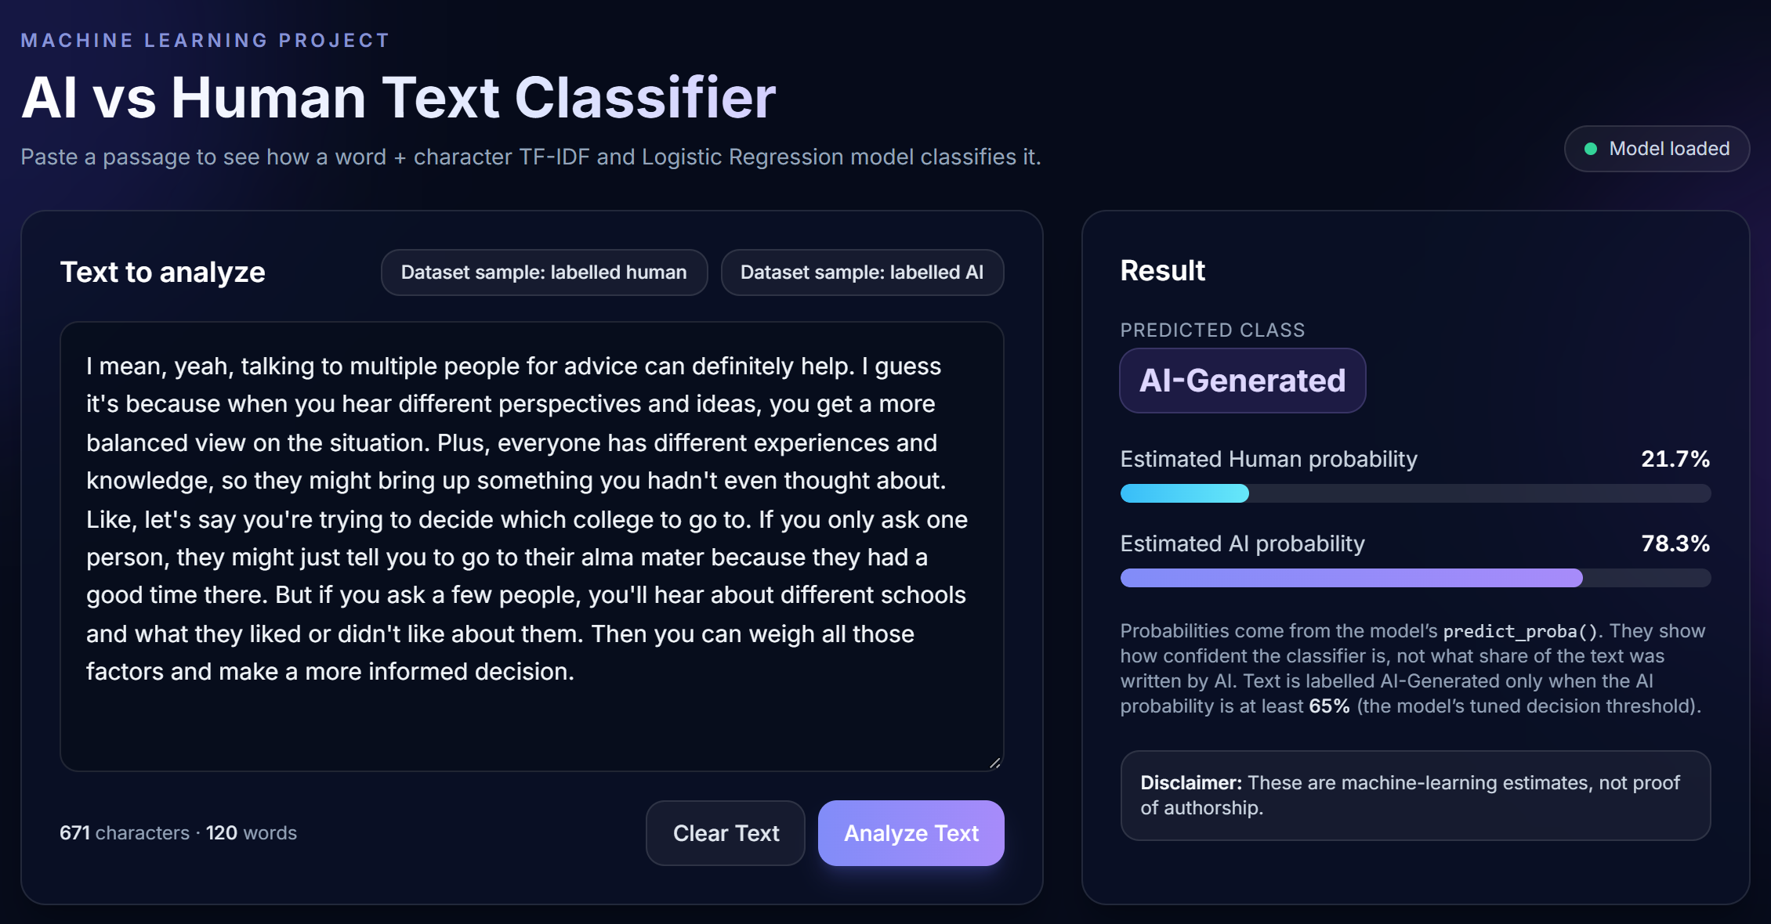
Demo: the final model runs behind a web app
How it fits together
React + Tailwind
Text input, bars, session history
FastAPI
POST /predict and GET /health
joblib pipeline
clean_text → TF-IDF → predict_proba
Actual app output for a dataset sample labelled AI: 78.3% AI, 21.7% Human.
Shows a clear setup error if the model file is missing; it never substitutes another model.
Notes:
Stage 18. Switch to the live app now: run run.bat, paste unseen text, click Analyze. The backend loads the saved pipeline with joblib and calls predict_proba. No retraining or fake results. The notebook planned Streamlit; the app was built with React and FastAPI instead. Remember the current label behaviour: 0.50 to 0.64 appears as Human-Written, and under 50 words is rejected.

Slide 21
Limits of this model: it gives evidence, not proof
AI side is essay-only
Test set reused
Generators change
Blogs and news are human-only, so non-essay style may simply read as human. AI blog posts could be missed.
Held-out data compared model versions, so the improvement figures may be slightly optimistic.
Newer AI models may write differently from those behind the training data.
Subsampled training
Small dry test
Label noise
The final model used 40,000 essays, not all 341,061 training records, to fit memory limits.
Six paragraphs show direction only. Short and unusual text remains less reliable.
Identical texts with opposite labels exist, and word weights reflect this dataset’s patterns.
Notes:
Stage 19, limitations. The most important one: AI examples are essay-like, but blogs and news were added only as human. So the model could learn that non-essay style means human, and may miss AI-written blogs or news. Also, the same held-out test data compared model versions, so reported improvement may be slightly optimistic; the brief warns about this, and a fresh test set would be the correct next step.

Slide 22
Error analysis mattered more than the top score
Future work
Add AI-written blogs and news
Evaluate on a fresh, untouched test set
Compare with transformer models such as DistilBERT
Check probability calibration
Show the Uncertain outcome in the web app
Full pipeline: EDA, cleaning, TF-IDF, baseline, three models, tuning, evaluation
Near-perfect test scores did not guarantee reliable results on other human writing
Style features, short text, wider human data and a tuned threshold reduced false AI flags
These are machine-learning estimates, not proof of authorship.
Notes:
Summarise: we completed the full pipeline, a baseline and three models, tuning with CV, then error analysis exposed false flags and led to a better suited model. Future work is listed on the right. Close by repeating that outputs are estimates. Invite questions.

Slide 23
References and acknowledgements
Datasets
Gerami, S. AI vs Human Text. Kaggle. kaggle.com/datasets/shanegerami/ai-vs-human-text
Tatman, R. Blog Authorship Corpus. Kaggle. kaggle.com/datasets/rtatman/blog-authorship-corpus
alfathterry. BBC Full Text Document Classification. Kaggle. kaggle.com/datasets/alfathterry/bbc-full-text-document-classification
Tools
Python, pandas, NumPy, Matplotlib, scikit-learn 1.6.1, joblib, kagglehub, Kaggle notebooks, FastAPI, React, Vite, Tailwind CSS.
Acknowledgement
The web application and this presentation were built with AI coding assistance (Claude Code).
Notes:
Required by the brief: all dataset sources cited and external help acknowledged. Add any further code sources your team used before submitting.

