Slide 1
Problem Statement No.12 -Agentic AI for Personalized Course Pathways.
CAPSTONE PROJECT
Presented By:
1. Krishna Koushik Padigala-Rajiv Gandhi University of Knowledge Technologies, RK Valley- CSE

Slide 2
OUTLINE
Problem Statement
Proposed System/Solution
System Development Approach
Algorithm & Deployment
Result (Output Image)
Conclusion
Future Scope
References

Slide 3
Problem Statement
Students often face difficulty in identifying a clear and effective learning path that aligns with their personal interests and long-term career goals. The overwhelming abundance of online courses, lack of structured guidance, and absence of personalized learning plans lead to confusion, wasted time, and demotivation. Without adaptive support, learners struggle to progress efficiently or stay aligned with their aspirations.

Slide 4
Proposed Solution
📥 Data Collection
Collect user inputs: interests, goals, current skill level.
Optionally enhance with preferences like content format and time availability.
🔍 Data Preprocessing
Clean and structure inputs.
Extract key features like learning gaps and user preferences.
🧠 AI Logic
Use AI agents to generate personalized learning paths.
Adjust roadmaps dynamically based on progress and feedback.
Recommend relevant resources, projects, and quizzes.
🚀 Deployment
Build a simple, interactive interface for students to receive and update their roadmaps.
Deploy on a scalable platform with support for real-time updates.
📊 Evaluation
Measure accuracy and relevance of recommendations.
Use metrics like user satisfaction, progress tracking, and feedback to refine the system.
✅ Result
LearnMate guides students with evolving, personalized learning paths—helping them stay focused, motivated, and goal-oriented.

Slide 5
System Approach
✅ System Requirements
🔹 Frontend
Chat UI built with HTML/CSS/JS or React
Form inputs for capturing goals, skills, and interests
Live chat or embedded iframe (for watsonx Assistant Preview)
🔹 Backend & AI
IBM watsonx.ai Preview Environment
Use prompt playground to experiment with different instructions and outputs
Leverage Mistral 7B or Granite Code/Chat models for generation
Use prompt templates and custom agent instructions for dynamic roadmap building
Vector Retrieval (Optional)
Upload vectorized documents (PDFs, Markdown) to IBM Knowledge Catalog or local FAISS
Use semantic search tools to enhance retrieval-based generation
🔹 User Data Handling
Store basic student data (interests, progress, preferences) in a lightweight DB (e.g., MongoDB or SQLite)
Implement session memory to align with watsonx agent memory (if supported)
🧠 Libraries & Tools (Client Side / Backend)
UseTool / LibraryAI Model Accesswatsonx.ai Playground / SDKLocal Testingtransformers, mistral (if self-hosted)Backend Serverflask, fastapi, requestsDocument Embeddingsentence-transformers, faiss, or IBM watsonx Knowledge StudioData Handlingpandas, numpyUIReact.js, Bootstrap, plain HTML/JSDeploymentIBM Cloud / Render / Vercel (frontend)

Slide 6
Algorithm & Deployment
🧠 Algorithm Sectio Algorithm Selection
For LearnMate, an Agentic AI-based recommendation system is used, leveraging LLMs (e.g., Mistral 7B Instruct or watsonx.ai Granite models) for dynamic, personalized roadmap generation. This approach is chosen because it can understand natural language inputs, adapt based on learner goals and skill levels, and retrieve or generate appropriate learning content. Traditional machine learning algorithms like classification or regression are insufficient due to the conversational and evolving nature of the problem.
🔹 Data Input
The algorithm takes the following input features:
User interests (e.g., Frontend Development, Cybersecurity, UI/UX)
Skill level (beginner, intermediate, advanced)
Learning goals (e.g., get job-ready in 6 months)
Content preferences (video, text, project-based)
Optional: time availability, preferred learning style, and past progress (if available)
🔹 Training Process
The system uses pre-trained LLMs (like Mistral or watsonx models), optionally fine-tuned or guided through prompt engineering and RAG (Retrieval-Augmented Generation).
Vectorized documents (curricula, course roadmaps, tutorials) are embedded using tools like sentence-transformers and stored in a vector database (e.g., FAISS, Pinecone, or IBM Knowledge Studio).
Prompts are optimized through iterative testing in watsonx.ai’s Prompt Lab, rather than traditional ML training with labels.
🔹 Prediction Process
During interaction:
The model interprets the user's inputs through natural language.
It retrieves relevant course modules or learning content based on semantic similarity.
Using the current context (interests, skill level, progress), the LLM generates a custom learning roadmap or suggestions.
The system updates over time based on feedback and engagement, adapting future suggestions accordingly.

Slide 7
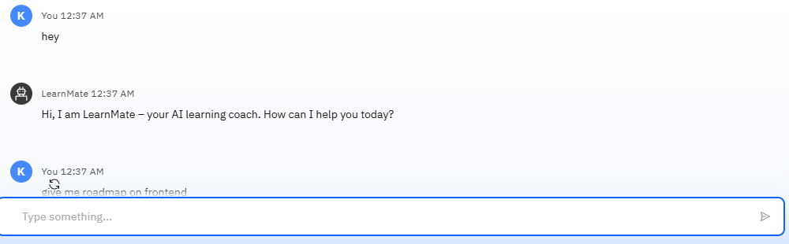
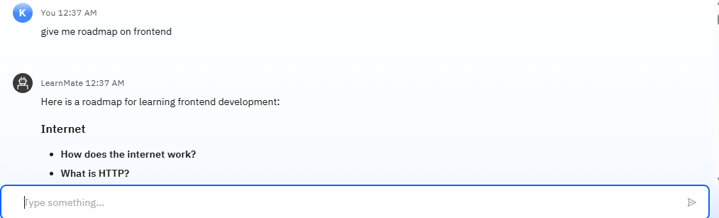
Result

Slide 8
Conclusion
LearnMate presents an innovative solution to the challenge of navigating the overwhelming world of online learning by offering personalized, adaptive learning paths through Agentic AI. By leveraging powerful language models like Mistral and watsonx.ai, combined with vectorized document retrieval and user-centric design, the system can understand individual learner profiles and guide them toward their goals efficiently. With continuous feedback and contextual adaptation, LearnMate has the potential to transform how students explore, engage with, and excel in skill-based learning journeys.

Slide 9
Future scope
🔮 Future Scope
Adaptive Assessments and Skill Tracking Integrate real-time quizzes and project evaluations to assess learners’ progress and dynamically update their learning paths with greater precision.
Integration with MOOCs and LMS Platforms Connect LearnMate with platforms like Coursera, edX, Udemy, and institutional LMSs to recommend and track real course enrollments directly within the system.
Multi-Agent Collaboration Introduce multiple specialized AI agents (e.g., Career Coach, Skill Assessor, Project Mentor) that collaboratively guide students in a more holistic learning experience.
Mobile App Deployment Expand accessibility through a cross-platform mobile application, enabling learning-on-the-go with personalized notifications and progress reminders.
Gamification Features Add achievements, leaderboards, and progress badges to improve learner engagement and motivation.
Support for Non-Technical Domains Extend the system to support other disciplines like arts, humanities, and commerce by incorporating domain-specific learning paths and content.
Multilingual and Voice Interaction Support Implement multilingual support and voice-based interaction to enhance accessibility for diverse learners across regions.
Data-Driven Personalization with Learning Analytics Use advanced analytics to provide deeper insights into learning patterns and recommend strategies for improvement and time management.

Slide 10
References
Fanaee-T, Hadi, and Gama, João. “Event labeling combining ensemble detectors and background knowledge.” Progress in Artificial Intelligence, vol. 2, no. 2–3, 2014, pp. 113–127.
Hyndman, Rob J., and Athanasopoulos, George. “Forecasting: Principles and Practice.” OTexts, 2nd edition, 2018. (Comprehensive resource for time-series forecasting methods such as ARIMA, Exponential Smoothing) https://otexts.com/fpp2
Brownlee, Jason. “Deep Learning for Time Series Forecasting: Predict the Future with MLPs, CNNs and LSTMs in Python.” Machine Learning Mastery, 2018. (Practical implementation of LSTM and deep learning models for time-series forecasting)
IBM Watsonx Documentation. “watsonx.ai: Next-generation AI and Data Platform for Business”, IBM, 2023. https://www.ibm.com/products/watsonx-ai (Used for AI model experimentation and evaluation)

Slide 11
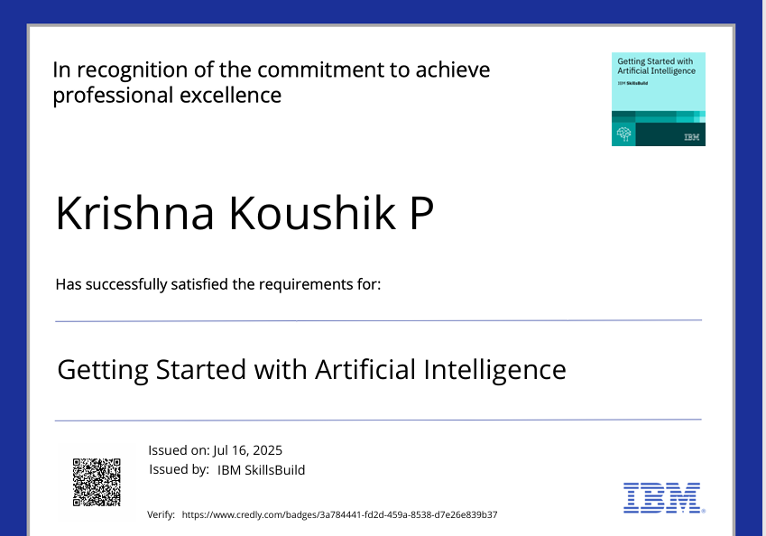
IBM Certifications

Slide 12
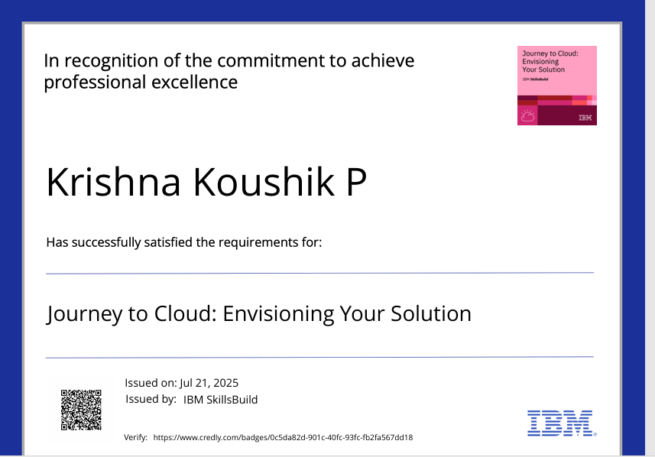
IBM Certifications

Slide 13
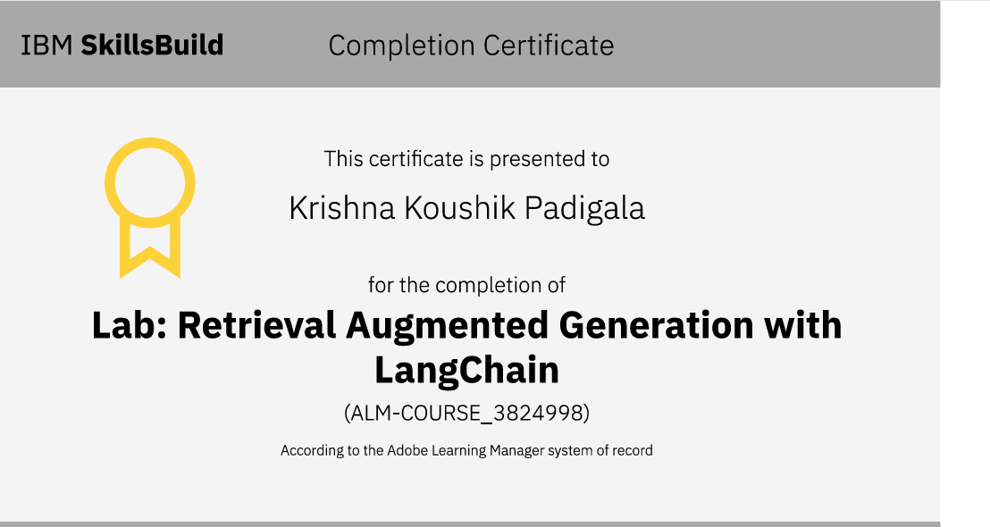
IBM Certifications

Slide 14
THANK YOU

