Slide 1


Design Thinking & Innovation
I-KRET:- Ai Integrated Medical Appointment Scheduling System for
Patients visiting Government Hospitals.
TEAM
FACULTY MENTOR
Team Name / Batch No: [ JUSTINOV ]
Year & Dept / Section: [ II-AI&DS-B ]
Members:
1. [ KALICHARAN K— 25AD086]
2. [ KANISH S — 25AD089 ]
3. [ KRISHKARTHIK S — 25AD107]
Name: Dr.G.Shobhana
Designation: Associate Professor
Department: AI-DS

Slide 2
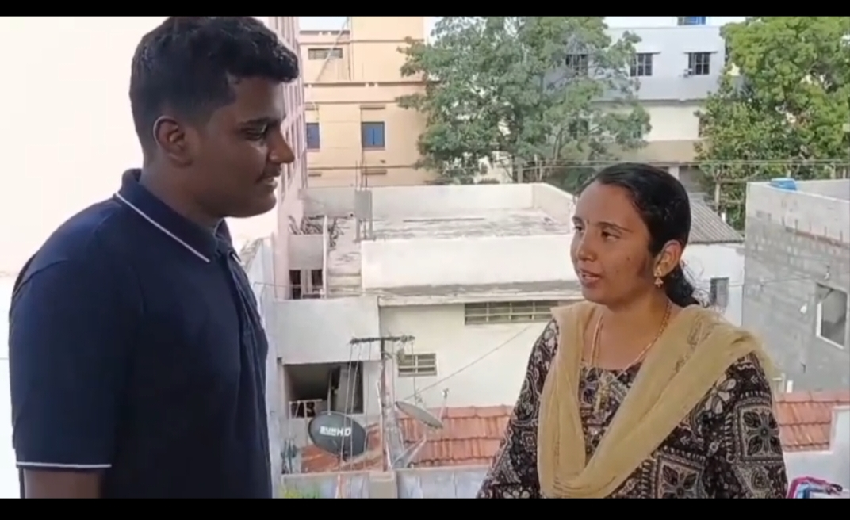


Meet Our User
Who are they?
Daily wage workers(Maheshkumar) who is working in a garment company, a housewife(Suganya) with diabetes and a small school student(Midhushi).
Role / Occupation
Age group
Daily wage worker , a housewife diagnosed with diabetes and a school student .
45-50 ,35-40 and 8-10
Location
Where we met them
Tirupur ,Tamil Nadu
We met them in their respective residence
Add a photo or sketch of your user
In their words
“Visiting Govt. hospital is not a solution for an illness ,It is just another illness to visit the Govt. hospital."
Sri Eshwar College of Engineering · Design Thinking & Innovation

Slide 3



How We Built Empathy
What to do: In each step, write what YOUR team actually did to understand your user. A sample is shown in grey — replace it with your own.
1
2
3
Observe
Interact
Understand
Watch them in their real setting. What do they struggle with — without saying a word?
Talk and listen. Ask “why” until you reach the real reason.
Step into their shoes. Separate what they say from what they truly need.
SAMPLE
SAMPLE
SAMPLE
Visited a government hospital and observed patients standing in long queues for registration. Noticed elderly and disabled patients struggling to wait for hours. Observed hospital staff manually recording patient details and managing appointments, causing delays.
Spoke with patients, doctors, and registration staff. Patients said they spend too much time waiting and often don't know whether the doctor is available.
Patients need a simple and accessible way to book appointments before visiting the hospital. Doctors need an organized schedule to manage consultations efficiently.
Sri Eshwar College of Engineering · Design Thinking & Innovation

Slide 4

User Interview
Play the recorded interview with your user during the presentation.
Paste your video link or Google Drive link of the video you captured in the user interview.
What we learned
We learned that the patients those who cannot afford to visit a private hospitals
Are the majority people who go to the government hospitals. But due to the lack of systematical- infrastructure they face difficulties in their day-to-day life.
.
Click to play
What surprised us
🔗 Video link: https://drive.google.com/file/d/1FQt1JgjHQcLWIqalvIuUxdV0ngpFP8I0/view?usp=drivesdk
The thing surprised us was the patients were waiting meaninglessly for several hours without knowing the exact time of appointment wasting their valuable time .
The mental stress and severity of the illness increases due to the overcrowding.
Sri Eshwar College of Engineering · Design Thinking & Innovation

Slide 5
Empathy Map Canvas
Designed for: [ Patients of Govt. Hospitals and Doctors]
Designed by: [ JUSTINOV ]
Date: [ 6th July 2026]
Version: [ v1.0]
GOAL
1
WHO are we empathizing with?
2
What do they need to DO?
Patients visiting government hospitals ,Doctors and hospital management.
Book doctor appointments online. Check doctor availability. Receive appointment confirmation and reminders. Cancel or reschedule appointments if needed.
3
What do they SEE?
4
What do they SAY?
5
What do they DO?
“The queue is too long."
"I don't know if the doctor is available."
"I have been waiting for hours."
Visit the hospital early to get a token.
Stand in long queues.
Ask hospital staff for appointment details. Wait for their turn.
Long queues at registration counters. Crowded waiting areas.
Delayed consultation due to manual processes.
6
What do they HEAR?
7
What do they THINK and FEEL?
“Come early if you want a token."
"The doctor is not available today.“
"Please wait for your number."
PAINS Frustration due to long waiting times. Anxiety about missing appointments.
GAINS Book appointments anytime from anywhere. Reduced waiting time. Instant appointment confirmation.
▶ Present your completed Empathy Map to reviewers — fill the canvas above, or paste a photo of your team's map here in this slide.

Slide 6

Insights & Pain Points
Read your map again — the gap between what the user SAYS and what they FEEL is where the insight hides.
Top 3 Pain Points
Key Insight
1
Pain point
The one thing we now understand about our user that we didn't before:
1. Long waiting time
Patients spend several hours waiting in queues just to register and meet a doctor, even for minor illnesses.
Government hospital patients don't just need online appointment booking—they need certainty that they can meet the right doctor at the right time without wasting an entire day.
2
Pain point
2. Difficulty getting appointments
Patients often don't know doctor availability, OP timings, or appointment slots before visiting the hospital.
.
This surprised us: Most patients are willing to use a simple digital system if it saves them time and avoids unnecessary travel.
3
Pain point
3. Poor access to hospital information
Many patients travel long distances only to find that the doctor is unavailable or the OP limit has already been reached.
Sri Eshwar College of Engineering · Design Thinking & Innovation

Slide 7
Problem Statement Canvas
Year & Dept/Section: [ II & AI-DS-B ] Team / Batch No: [ JUSTINOV] Members: [ KANISH ,KRISHKARTHIK,KALICHARAN ]
TARGET USER Who is facing the problem? (age group / role / location): [Government hospital patients ,Senior citizens ,Pregnant women ,People from rural areas , Working professionals who cannot wait in long queue ]
CONTEXT
PROBLEM
ALTERNATIVES
The problem occurs when patients visit government hospitals to register for outpatient consultation. They must stand in long queues without knowing doctor availability or waiting time.
Government hospitals mainly rely on manual registration, leading to overcrowding, long waiting times, inefficient appointment management, and poor communication regarding doctor schedules.
Currently patients:
Visit the hospital early in the morning
Stand in registration queues
Call hospital reception (often unanswered)
Depend on others for information
Return another day if appointments are full
CUSTOMERS
EMOTIONAL IMPACT
ALTERNATIVE SHORTCOMINGS
Frustrated
Stressed
Anxious
Uncertain whether they will meet the doctor
No real-time appointment availability Long queues and overcrowding Time-consuming manual registration No notification if a doctor is unavailable
Patients visiting government hospitals, especially:
Elderly people
Rural residents
Daily wage workers
Women with children
Patients requiring frequent follow-up visits
QUANTIFIABLE IMPACT
Reducing the Waiting time: 2–6 hours
▶ Present your completed Problem Statement Canvas to your reviewers.

Slide 8

Our Problem Statement
FINAL PROBLEM STATEMENT
I-KRET (AI-Integrated Medical Appointment Scheduling System) aims to address these challenges by leveraging Artificial Intelligence to automate appointment scheduling, prioritize patients based on the urgency of their medical conditions, predict waiting times, and dynamically manage hospital queues.
HOW MIGHT WE (HMW) — turn the problem into an opportunity
We help patients by providing an easy accessible appointment scheduling system i.e I-KRET(I Kindly Request Even Treatment). It will ensure the certainty in the appointment timing.
Sri Eshwar College of Engineering · Design Thinking & Innovation

Slide 9

Mapping to the UN SDGs
Which UN Sustainable Development Goal(s) does solving your problem help advance?
1
2
3
4
5
6
No Poverty
Zero Hunger
Good Health
Quality Education
Gender Equality
Clean Water
7
8
9
10
11
12
Clean Energy
Decent Work
Industry & Innovation
Reduced Inequalities
Sustainable Cities
Responsible Consumption
13
14
15
16
17
Climate Action
Life Below Water
Life on Land
Peace & Justice
Partnerships
Our problem maps to SDG [ 3 Good Health,8 Decent Work,9 Industry & Innovation,10 Reduced Inequalities ] because the illness of patients affect their day-to-day life, their financial condition make the medical visit difficult .
Sri Eshwar College of Engineering · Design Thinking & Innovation

Slide 10
Thank You!
Questions, feedback & ideas are always welcome.
Sri Eshwar College of Engineering
Sri Eshwar Innovation Studio · Coimbatore | Tamilnadu

