Slide 1


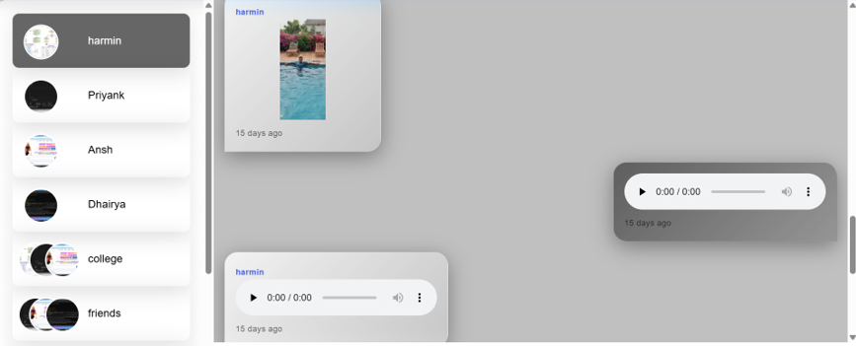
Easly Chat Application
Presented By
Krish Manavadariya (25mca090)
Ayaz Darjada (25mca005)
Internal Guide : Mubina Malik

Slide 2
Topics
Project Profile
Introduction
System Features & Key Technologies
System Study
System Architecture & Workflow
System Analysis
Data Dictionary
Screen Layout
System Testing
Future Enhancement

Slide 3
Project Profile
Project Name: Easly - Chat App
Type of Application: Web Application
Project Description: A web-based real-time messaging application that enables users to chat with friends, manage friend requests, create group chats and view online status for easy and instant communication.
Team Size: 2
Front End: React.js, Tailwind CSS, Material UI (MUI), Redux Toolkit, RTK Query
Back End: Node.js, MongoDB
Development Tools used: VS Code, Postman, MongoDB Compass

Slide 4
Introduction
  Easly Chat is a real-time messaging web application that enables users to chat with friends, manage friend requests, create group chats and view online status for easy and instant communication.
  It integrates user registration with OTP verification, secure login with protected routes, friend management, one-to-one and group chat, and unread message counts.
  Messages are delivered instantly through Socket.io without refreshing the page, and the responsive interface works on both desktop and mobile devices, making communication simple and efficient.

Slide 5
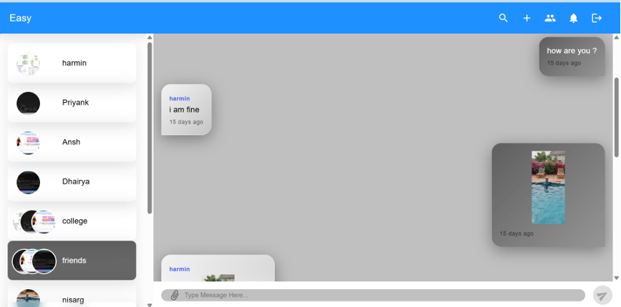
System Features
  User Authentication: Registration with OTP verification, secure login and protected routes.
  Friend Management: Send and accept friend requests and view the friend list.
  Real-Time Chat: One-to-one and group messaging with Socket.io, chat history and unread count.
  Groups & Profile: Create groups, manage members and update your profile picture.

Slide 6
Key Technologies
  Frontend: React.js, Tailwind CSS, Material UI (MUI), Redux Toolkit, RTK Query
  Backend: Node.js for server-side logic and REST APIs
  Database: MongoDB for users, chats, messages and requests
  Real-Time: Socket.io for instant message delivery and online status
  Tools: VS Code, Postman, MongoDB Compass

Slide 7
Introduction to Tools
  React.js: JavaScript library for building user interfaces with a component-based architecture. Its virtual DOM updates only the parts of the page that change, keeping the app fast and responsive.
  Tailwind CSS: Utility-first CSS framework that provides classes to design the UI exactly as required, without pre-designed components like Bootstrap.
  Node.js: JavaScript runtime built on Chrome’s V8 engine. It runs JavaScript on the server, handles HTTP requests and connects with the database.
  MongoDB: Flexible, scalable NoSQL document database that stores data as JSON-like documents and supports create, read, update and delete operations.

Slide 8
System Study
Existing System
Traditional communication methods often do not provide real-time message delivery, and users must refresh the application to see new messages. Support for instant online/offline status is limited, group communication and member management are difficult, and there is no efficient way to track unread (pending) messages. Basic messaging systems also lack friend management such as sending and accepting friend requests.
Proposed System
Easly Chat provides user registration and secure login with protected routes, friend requests (send, accept, view friend list), real-time one-to-one chat using Socket.io with conversation history and unread message count, and group chat to create groups, add members and delete groups. Online/offline status and live updates work without any page refresh.

Slide 9
System Study
Scope of the Proposed System
A real-time digital communication platform offering instant one-to-one and group messaging, friend request and contact management, online/offline user status tracking and unread message notifications, delivered as a scalable and responsive web application for personal and collaborative communication.
Aim and Objective
To provide fast and reliable real-time communication with secure authentication and friend management, support one-to-one and group conversations, display online status and unread message counts, and deliver a simple, responsive and user-friendly messaging experience that improves collaboration.

Slide 10
System Study
  Operational Feasibility
  The system provides a simple and user-friendly interface for real-time communication.
  Users can send and receive messages instantly without refreshing the page, in one-to-one chats and group conversations.
  Users can manage friends by sending and accepting friend requests.
  Online/offline status and unread message counts are shown in real time, improving the overall user experience.

Slide 11
System Study
  Technical Feasibility
  The system is developed using modern web technologies such as React.js, Node.js, MongoDB, Socket.io, Redux Toolkit and Tailwind CSS.
  It supports both desktop and mobile devices through a responsive user interface.
  Real-time communication is achieved using Socket.io, ensuring instant message delivery.
  Secure user authentication and protected routes ensure that only authorized users can access the application.

Slide 12
System Study
  Economic Feasibility
  The application is developed using open-source technologies, which reduces development costs.
  The system reduces communication delays by enabling instant messaging.
  The scalable architecture allows future enhancements without significant additional cost.

Slide 13
System Architecture & Workflow
  User Interface: React.js web interface styled with Tailwind CSS and Material UI.
  Registration & Login: OTP-verified registration and secure login with protected routes.
  State Management: Redux Toolkit and RTK Query manage application state and API calls.
  Friend Management: Users search people, send friend requests and accept them.
  Real-Time Chat: Socket.io delivers one-to-one and group messages instantly, with online status and unread counts.
  Backend Processing: Node.js server handles user requests and application logic.
  Database Management: MongoDB stores users, chats, messages, requests and OTPs.

Slide 14
System Requirement Specification
  Authentication Module: Registration, login with email and password, protected routes, secure logout.
  Friend Management Module: Send and accept friend requests, view friend list, manage connections.
  Personal Chat Module: Real-time one-to-one messaging, chat history, unread count, online/offline status.
  Group Module: Create groups, add or remove members, view members, delete group.
  Real-Time Notification Module: Online/offline status, unread notifications, instant updates through Socket.io.
  User Profile Module: View and update profile information and profile picture.

Slide 15
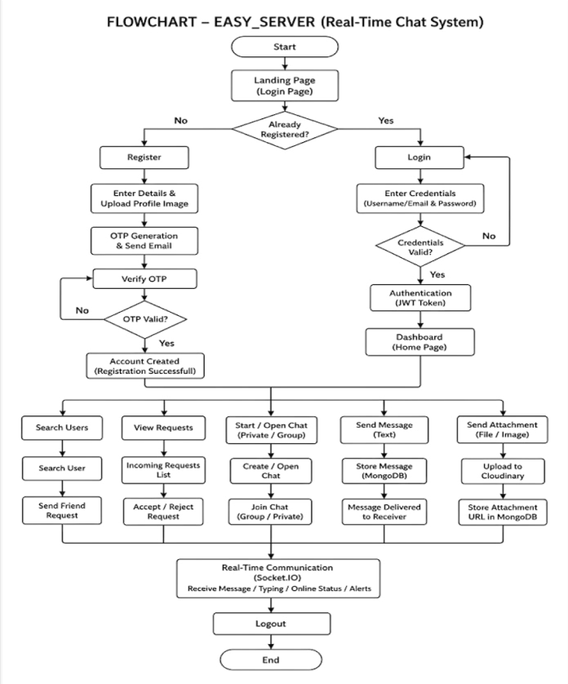
System Analysis
System Flowchart

Slide 16
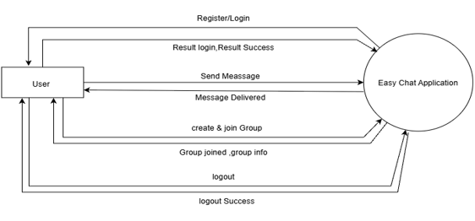
System Analysis
Context Level DFD

Slide 17
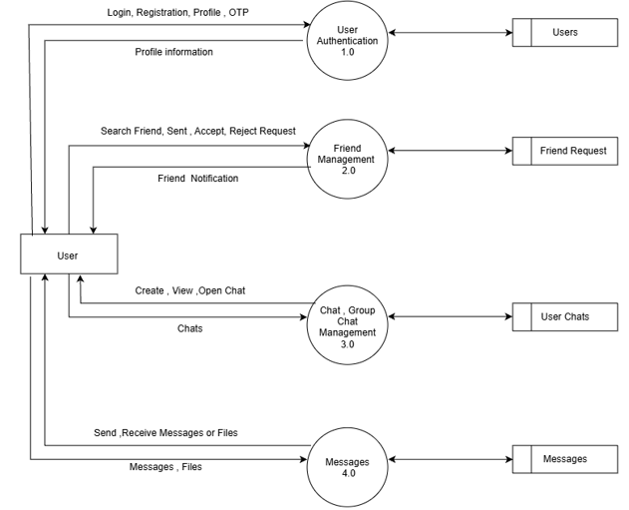
System Analysis
First Level DFD

Slide 18
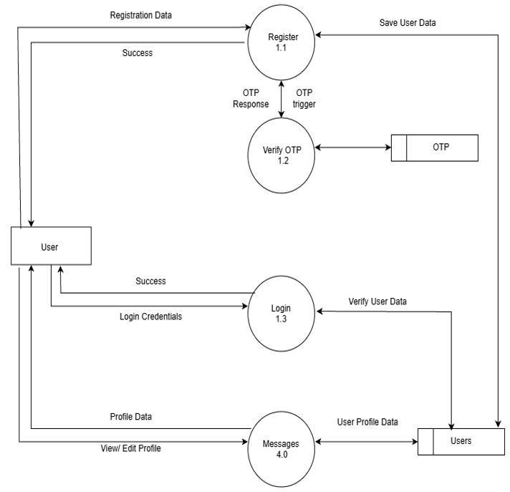
System Analysis
Second Level DFD
Process 1.0: User Authentication

Slide 19
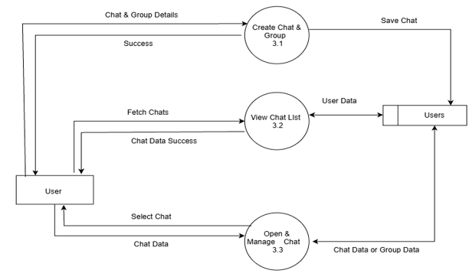
System Analysis
Second Level DFD
Process 3.0: Chat and Group Management

Slide 20
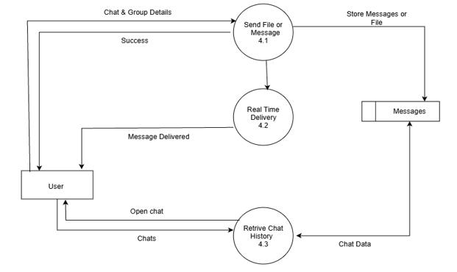
System Analysis
Second Level DFD
Process 4.0: Messages

Slide 21
Data Dictionary
User Table:
Column | Type | Constraint | Enum
Name | String | Required | -
userverified | Boolean | Optional | Default: false
username | String | Required | -
Email | String | Required,Unique | -
password | String | Required | select: false
avatar.public_id | String | Required | -
avatar.url | Boolean | Required | -
bio | String | Required | -

Slide 22
Data Dictionary
Chat Table:
Message Table:
Column | Type | Constraint | Enum
Name | Sting | Required | -
groupchat | Boolean | Optional | Default: false
creator | ObjectId | Optional | Ref: "Users"
member | Array of ObjectId | Optional | Ref: "Users"
timestamps | Auto-generated | Required | CreatedAt, UpdatedAt
Column | Type | Constraint | Enum
content | String | Optional | -
attachments.public_id | String | Required | -
attachments.url | String | Required | -
sender | ObjectId | Required | Ref: "Users"
chat | ObjectId | Required | Ref: "Users"
timestamps | Auto-generated | Required | CreatedAt, UpdatedAt

Slide 23
Data Dictionary
OTP Table:
Request Table:
Column | Type | Constraint | Enum
email | String | Required | -
category | String | Required | Enum: ["register", "forget-password"]
Otp | Number | - | Enum: tokenStatus
timestamps | Auto-generated | Required | CreatedAt, UpdatedAt
Column | Type | Constraint | Enum
status | String | Optional | Enum: ["pending", "accepted", "rejected"], Default: "pending"
sender | ObjectId | Required | Ref: "Users"
chat | ObjectId | Optional | Ref: "Users"
receiver | ObjectId | Required | Ref: "Users"
timestamps | Auto-generated | Required | CreatedAt, UpdatedAt

Slide 24
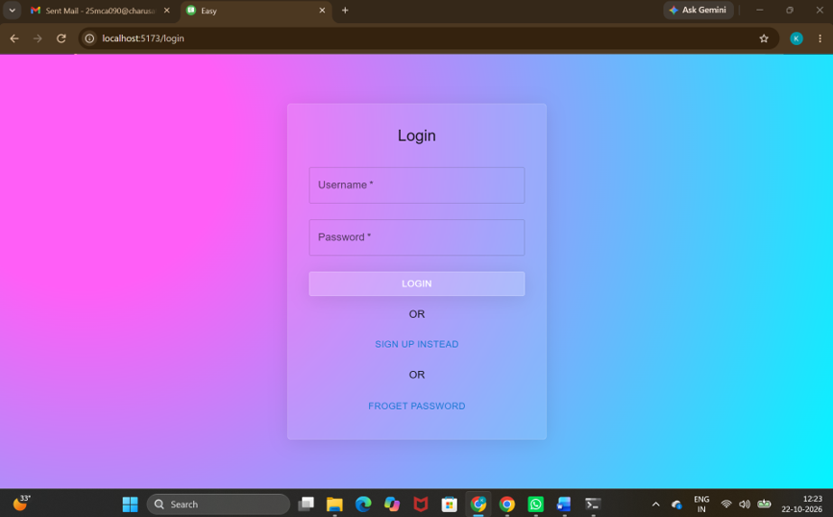
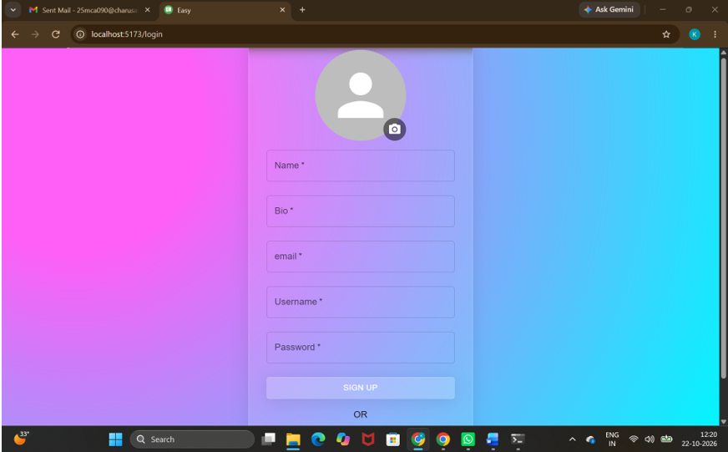
Screen Layout: Login and Signup

Slide 25
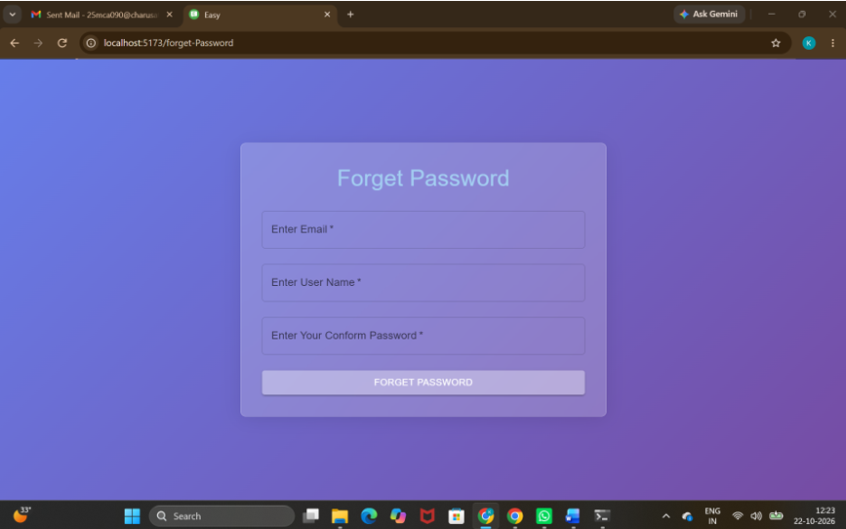
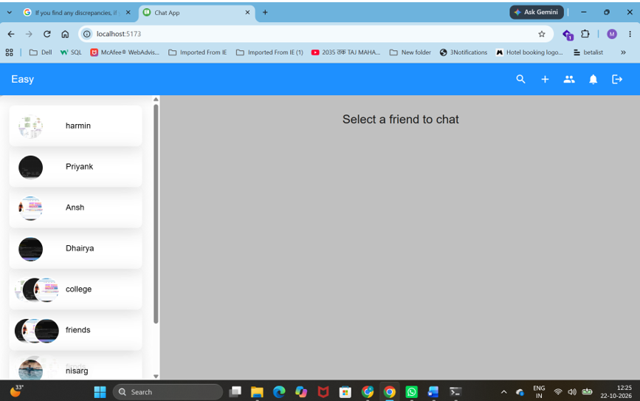
Screen Layout: Forget Password and Dashboard

Slide 26
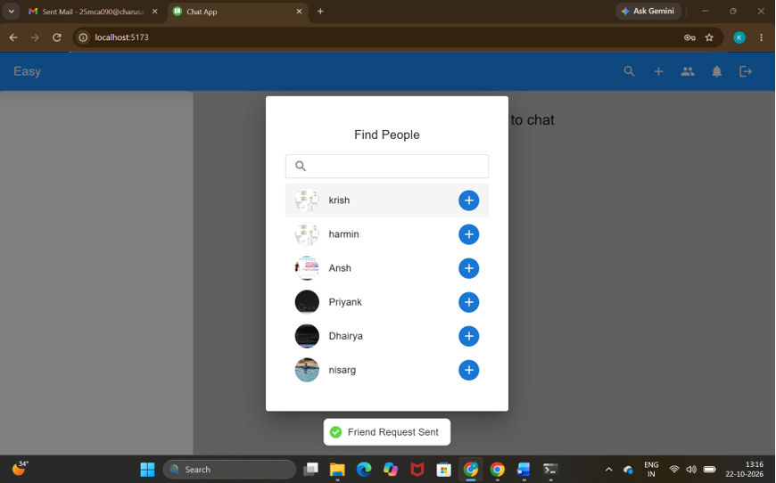
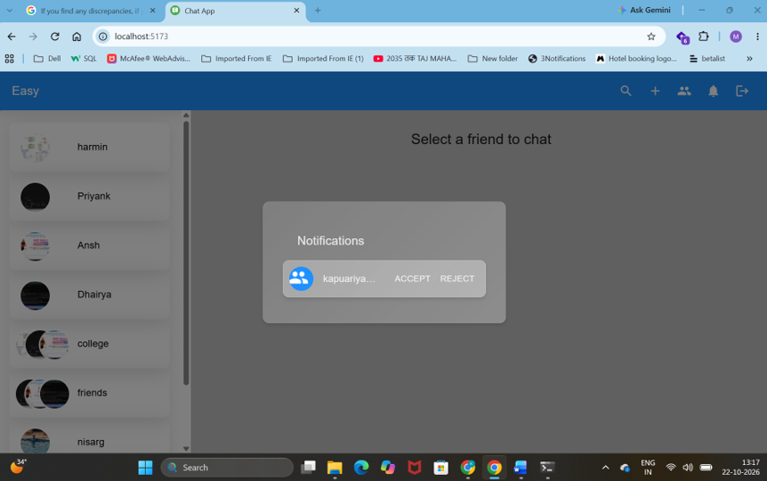
Screen Layout: Find People and Friend Requests

Slide 27
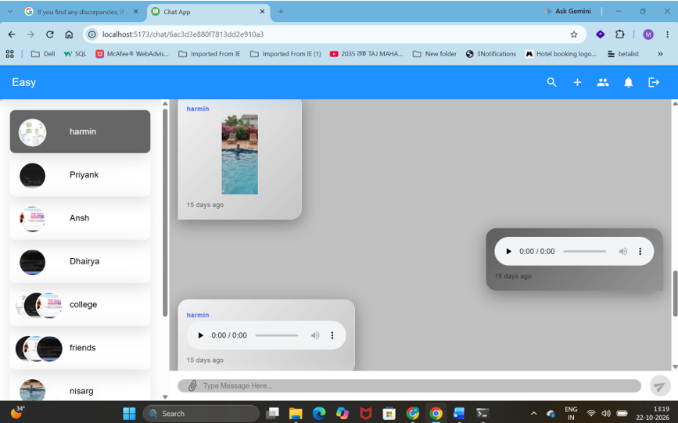
Screen Layout: Friend Chat

Slide 28
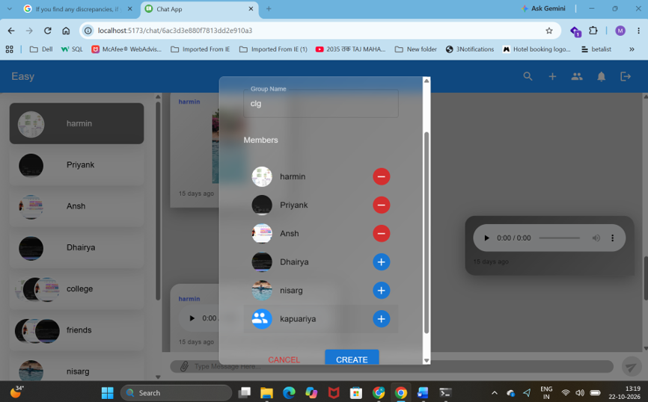
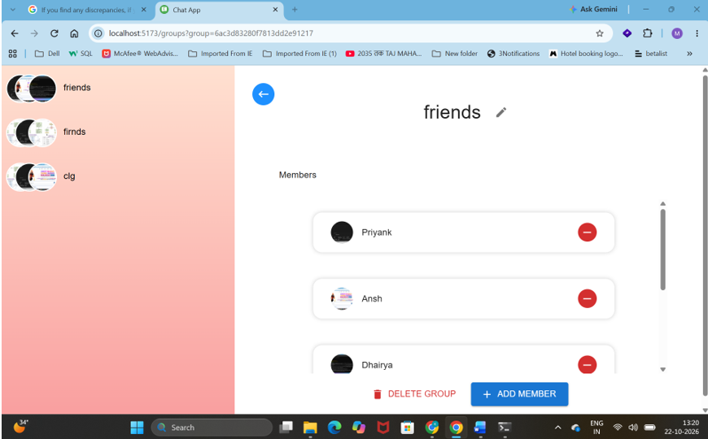
Screen Layout: Group Creation and Group Page

Slide 29

System Testing
  Testing Strategy: Black Box Testing of all modules.
  Total Test Cases: 31
  Passed: 22 test cases (71%)
  Failed: 9 test cases (29%)

Slide 30
System Testing
Black Box Testing:
Sr. No. | Test Case | Input | Expected Output | Actual Output | Status
1 | Registration | Valid Name, Username, Email and Password | User Registered Successfully | User Registered Successfully | Pass
2 | Registration | Invalid Email | Registration Failed | Invalid Email Address | Pass
3 | Registration | Existing Email | Registration Failed | Email Already Exists | Pass
4 | Registration | Empty Required Fields | Validation Error | Required Fields Missing | Pass
5 | Registration | Existing Username | Registration Failed | User Registered Successfully | Fail
6 | OTP Verification | Valid OTP | Account Verified Successfully | Account Verified Successfully | Pass
7 | OTP Verification | Invalid OTP | Verification Failed | Invalid OTP | Pass
8 | OTP Verification | Expired OTP | Verification Failed | Account Verified Successfully | Fail

Slide 31
System Testing
Black Box Testing (continued):
Sr. No. | Test Case | Input | Expected Output | Actual Output | Status
9 | Login | Valid Email and Password | Login Successful | Login Successful | Pass
10 | Login | Invalid Password | Login Failed | Incorrect Password | Pass
11 | Login | Unregistered Email | Login Failed | User Not Found | Pass
12 | Login | Empty Email and Password | Validation Error | Required Fields Missing | Pass
13 | Login | Unverified Account | Login Failed | Login Successful | Fail
14 | Forgot Password | Registered Email | OTP Sent Successfully | OTP Sent Successfully | Pass
15 | Forgot Password | Unregistered Email | OTP Not Sent | User Not Found | Pass
16 | Reset Password | Valid OTP and New Password | Password Reset Successfully | Password Reset Successfully | Pass

Slide 32
System Testing
Black Box Testing (continued):
Sr. No. | Test Case | Input | Expected Output | Actual Output | Status
17 | Reset Password | Invalid OTP | Password Reset Failed | Invalid OTP | Pass
18 | Reset Password | Empty New Password | Validation Error | Password Reset Successfully | Fail
19 | Update Profile | Valid Name, Bio and Avatar | Profile Updated Successfully | Profile Updated Successfully | Pass
20 | Update Profile | Invalid Avatar File | Profile Update Failed | Profile Updated Successfully | Fail
21 | Send Friend Request | Valid User | Friend Request Sent | Friend Request Sent Successfully | Pass
22 | Send Friend Request | Non-existing User | Request Failed | User Not Found | Pass
23 | Send Friend Request | Already Sent Request | Request Failed | Friend Request Sent Successfully | Fail
24 | Accept Friend Request | Pending Friend Request | Friend Added Successfully | Friend Added Successfully | Pass

Slide 33
System Testing
Black Box Testing (continued):
Sr. No. | Test Case | Input | Expected Output | Actual Output | Status
25 | Reject Friend Request | Pending Friend Request | Request Rejected | Request Rejected Successfully | Pass
26 | Search User | Valid Username | Matching Users Displayed | Matching Users Displayed | Pass
27 | Search User | Non-existing Username | No Matching Users Found | Matching Users Displayed | Fail
28 | One-to-One Chat | Abuse | Message not Delivered | Your message contains inappropriate content. | Fail
29 | Send Image | Valid Image File | Image Sent Successfully | Image Sent Successfully | Pass
30 | Send Image | Invalid Image File | Image Upload Failed | Image Uploaded Successfully | Fail
31 | One-to-One Chat | hi | Message delivered successfully | Message delivered | Pass

Slide 34

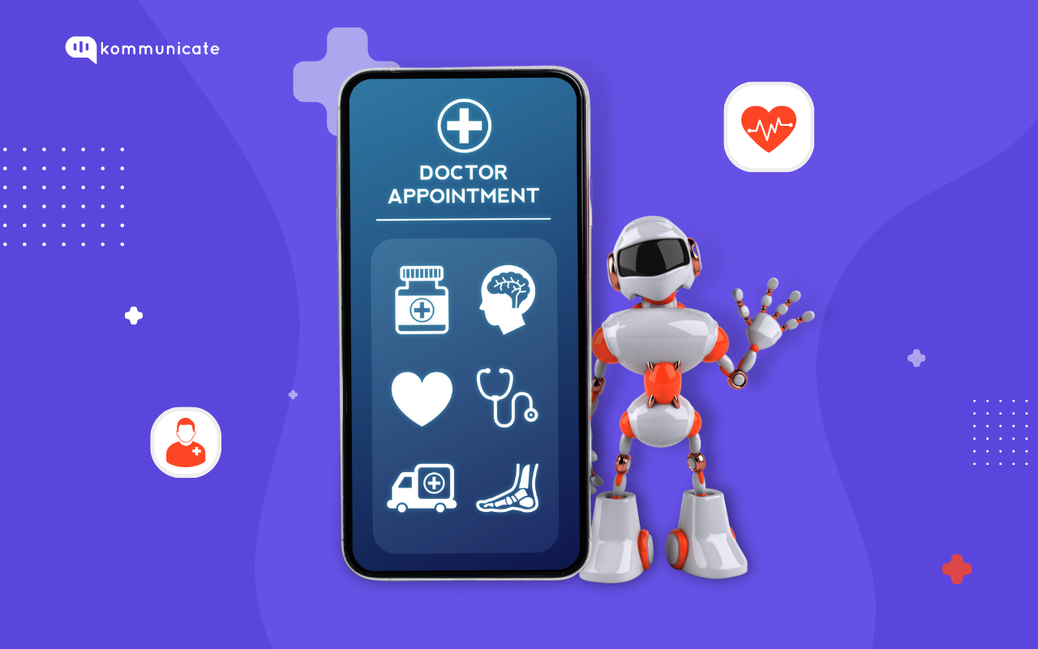
Future Enhancement
  Video and Voice Calling: Calling between two friends.
  Privacy Settings: Detailed privacy options such as blocking users and controlling profile visibility.
  Message Actions: Enable message editing, deletion and reply functionality.
  Custom Themes: Customizable themes, including dark mode and chat personalization.
  Pin and Archive: Allow users to pin important chats and archive conversations.

Slide 35
Bibliography / References
  MongoDB: https://www.mongodb.com/
  Lucide Icons: https://lucide.dev/
  Tailwind CSS: https://tailwindcss.com/
  YouTube: https://www.youtube.com/

Slide 36
Thank You

