Slide 1

DREAM’s
SAHAAYAK
Prawin Subrajith S
Krish Mehta
Karthik Krishna J P

Slide 2

WHAT
IS SAHAAYAK?
SAHAAYAK is an initiative to connect the employers to the really needy.

Slide 3
Social Cause
The pandemic situation has caused a lot of chaos and has resulted in many people loosing their jobs.
75.3 Lakh people have lost their jobs due to covid!
The main cause of creating the SAHAAYAK application is to help India fight UNEMPLOYMENT.

Slide 4
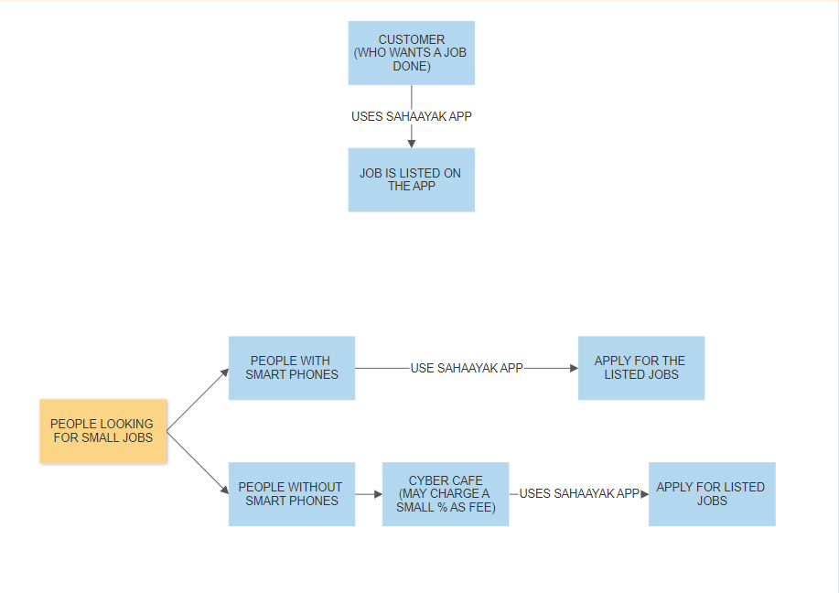
MECHANISM OF THE APPLICATION

Slide 5
SAHAAYAK
NON-PROFITABLE
PROFITABLE

Slide 6
ADVANTAGES
Larger target audience.
Fight against Unemployment.
Increase in GDP.

Slide 7
Thank You

