Slide 1
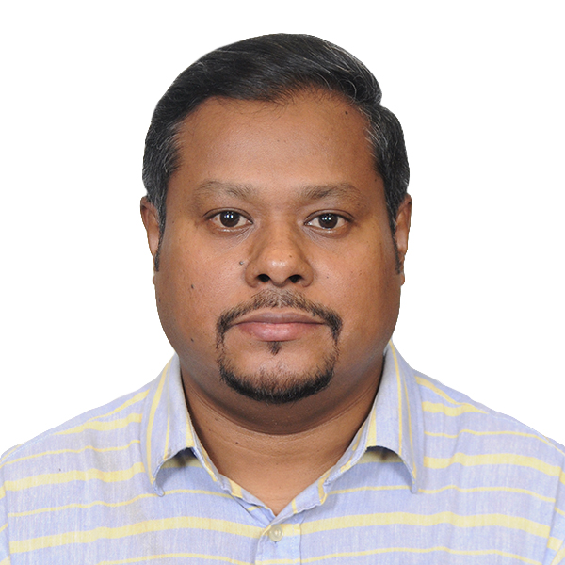
Krishnendu Bhowmick
Java Solution Architect
+91 9038158320 krish.Bhowmick@gmail.com
PROFILE
CURRENT ASSIGNMENT
Visionary and result-driven technology expert with 17+ years of experience in Web application development and support for a wide variety of projects and environments. Experience in planning, designing & implementing various enterprise applications and solutions to enhance capabilities of an organization with focus on agility, ROI, scalability & long-term sustenance.
Strong orientation towards technology, innovation, leadership, teamwork, adaptability to change and developed through a rich global work experience, working with teams of diverse nationalities and ethnicities.
Migrating from a monolithic architecture to microservices is a strategic shift aimed at improving scalability, flexibility, and maintainability. Here’s a high-level summary of the process:
Migration of the existing PDS 1.0 application to new PDS 2.0 application to work with newer tech stack . PDS 1.0 serve all types of rail transit, from high-speed trains to regional networks and metro systems. Our integrated series of components, manufactured using advanced technologies, are designed to meet our customers’ needs for safety, energy efficiency and reliability. This existing application is built on C++ which is now migrated into spring boot and microservices along with kafka as a message broker.
CORE COMPETENCIES
Enterprise grade solution blueprinting and reference architecture definition.
Critical Situation Management
Defining implementation of a road map.
High-level, low-level modelling.
Leading and mentoring high performance team across geographies.
Enterprise web application architecture design and implementation with more than 10+ years of experience.
Executive stakeholder communication.
CERTIFICATIONS
TECHNICAL COMPETENCIES
Capgemini L1 Certified architect, Capgemini AWS Certified Cloud Practitioner
Certified Safe® Agilist - SA 5
MongoDB SI Associate Certification, Mongo DB
Google Professional Cloud Architect
Connected Manager, Capgemini / Harvard
Microservices Architecture: Understanding service deployment, discovery, load balancing, and fault tolerance.
RESTful Services & APIs: Expertise in statelessness, cache ability, and layered system architecture.
Cloud Computing: Familiarity with AWS, Azure, Google Cloud, and DevOps Practices: Experience with CI/CD pipelines, Jenkins, Git, .
Communication & Collaboration: Ability to convey complex ideas to stakeholders and work seamlessly with development teams.
Core Java Knowledge: Mastery of Java EE, JVM performance tuning, and Java development tools.
AI Readiness
Well aware of AI technologies as GEN AI, Agentic AI, MDC
Hands on expertise in Git Hub Copilot .
High level understanding in Lang chain
Understanding in AI/ML pipelines.
Understanding of RAG

Slide 2
Krishnendu Bhowmick
Java Solution Architect
+91 9038158320 krish.Bhowmick@gmail.com
Delivery and Market Growth (Recent)
Topology Data Caching & Performance Optimization ( Wabtec )
Proactively identified scalability and performance challenges caused by repeated topology-service API calls and architected an event-driven Topology Data Caching Extension for PDS 2.0, providing local in-memory access to frequently used topology datasets with automated cache synchronization and invalidation via Event Bus integration.
Business Value: Reduced topology data retrieval effort from 600 to 400 hours/month, delivering 120 hours/month net productivity gain, improving operational efficiency by ~20%, and generating $20K+ annualized business value through enhanced application responsiveness and reduced service dependency.
2. Distributed Event De-duplication & Data Integrity Improvement ( Wabtec )
Designed and implemented a JDBC-based Message De-duplication Framework to detect and eliminate duplicate events across distributed messaging ecosystems, preventing redundant downstream processing and improving accuracy of operational KPI reporting.
Business Value: Eliminated approximately 12K-15K duplicate messages per month, reducing service-level message redundancy by 7-10%, improving data quality, lowering processing overhead, and increasing platform reliability across event-driven workflows.
3. AI-Powered Incident RCA & Automated Remediation ( Caterpillar )
Spearheaded an Agentic AI workflow using GitHub Copilot MDC, integrating ServiceNow and GitHub to automate incident-context gathering, code-change correlation, RCA generation, remediation planning, and automated PR creation, significantly streamlining incident management.
Business Value: Accelerated root-cause analysis and issue resolution, reduced manual investigation effort, shortened incident turnaround time, and enabled faster, more reliable production deployments through AI-driven engineering automation.
PERSONAL DETAIL
9038158320
krish.bhowmick@gmail.com
Kolkata, WB
Married
EXPERIENCES
Crimson Logic
Infosys
Tata Consultancy Services
Price Water House Coopers
Cognizant
Capgemini ( Present )
VISA AVAILABILITY
H1B VALIDITY TILL 2027

Slide 3
Krishnendu Bhowmick
H1B VALID( 2027)
Java Solution Architect
+91 9038158320 krish.Bhowmick@gmail.com
Thought Leadership( Recent )
Identified recurring integration challenges across domains and championed the design of a reusable Kafka Routing Framework, shifting the organization from bespoke routing solutions to a configuration-driven, self-service model. Architected a flexible rule engine enabling dynamic message routing without code changes, fostering platform reusability, operational agility, and long-term scalability. Business Impact: Achieved zero-deployment onboarding for new domains, significantly reduced time-to-market, lowered support costs, and established a strategic foundation for enterprise-scale event-driven integrations.
Recognized the operational and reporting risks posed by duplicate events in a large-scale event-driven ecosystem and championed the design and implementation of a configurable Message De-duplication Framework leveraging persistent JDBC storage for cross-service duplicate detection. Transformed duplicate handling from isolated service-level fixes into a scalable, reusable platform capability, driving greater consistency, observability, and governance across integrations. Business Impact: Significantly reduced duplicate message processing, improved KPI data integrity, optimized infrastructure utilization, and strengthened the resilience of enterprise messaging workflows.
Reduced technical debt by establishing a reusable caching capability that replaced repetitive service-specific integrations, while lowering operational overhead through improved performance, reduced downstream service load, and automated cache synchronization.
Recognized the transformative potential of Generative AI and proactively drove its adoption across engineering teams through targeted training, best-practice frameworks, and hands-on coaching. Enabled developers to integrate AI into daily development, incident management, documentation, and automation workflows, creating a multiplier effect on productivity, delivery speed, and business value realization while fostering a culture of continuous innovation.
INTERSET AREAS
SPORTS
TECHNOLOGY
TRAVEL
MUSIC
LANGUAGE KNOWN
ENGLISH
BENGALI
HINDI

