Slide 1
Let’s Start !!

Slide 2
Micro services – The Challenges and how to handle
Centralized Service Registration and Discovery - EUREKA
Single point of routing / Hiding service division / Integrating response – API GATEWAY ZULL
Single point of Authentication – SPRING SECURITY within ZULL
Service Resilience and Fault Tolerance, Dashboard – HYSTRIX CIRCUIT BREAKER
Service level Load balancing , Scale up and Scale down – RIBBON
Externalized and Centralized Configuration ( Config server / Local / Github )
Service choreography
Distributed Logging and Tracing - SLEUTH / ZIPKIN
Abstraction of intra service call - FEIGN
Role based Access Control – OAUTH 2 / SPRING SECURITY
Service chaining patters
Deployment – DOCKER
Our Approach : To know and understand the above topics and implement at low scale to create a suggested Microservice architecture.
Microservce architecture patterns – A guide
https://dzone.com/articles/design-patterns-for-microservices

Slide 3
Why EUREKA
Centralized Service Registration and Discovery - EUREKA
EUERKA is required to register the service who are subjected to be discocvered at run time by other service through internal intra service calls and in an dynamic fashion. In a typical micro service architecture, multiple instances of same service are running across multiple systems and different nodes. New nodes are added , exiting nodes ae removed in real time . Hence it is impossible for a service to connect to a different service with a static IP address and Port nomenclature .
Instead if we register each service instance with Eureka with some given service name , Eureka internally handle the service discovery for you.
The server where all services are registered is called EUREKA server and the registered services are called EUREKA clients.
EUREKA is one of the most important feature ti consider when you want to implement a micro service architecture.

Slide 4
Problem Description : Create services and register them in Eureka server so that, each service can refer to other service via eureka server service registration using dynamic discovery.
Target Architecture After Implementation of Eureka Service Discovery
MICROSERVICE 1
Services Registration
EUREKA CLIENT
EUREKA SERVER
SID | URL
ABC | ----
XYZ | ----
MICROSERVICE 2
SERVICE REGISTRY
EUREKA CLIENT
SERVICE DISCOVERY
MICROSERVICE 3
EUREKA CLIENT

Slide 5
Why API Gateway
Single point of routing / Hiding service division / Integrating response – API GATEWAY ZULL
Single point of entry into an micro service eco system.
Single point of Authentication ( Authorization to be handled in service layer )
Single point of API routing using simple routing configuration.
It can fan out a request to multiple services and aggregate the results to send back to the consumer.
Protocol adapter.
Primary Load balancing.
Hiding internal micro service architecture and break up.
Hiding how a response is created ( A response might be achieved 10 internal micro service calls but User should not be bothered about that. Gateway must be the one and only interface which will be available to user.

Slide 6
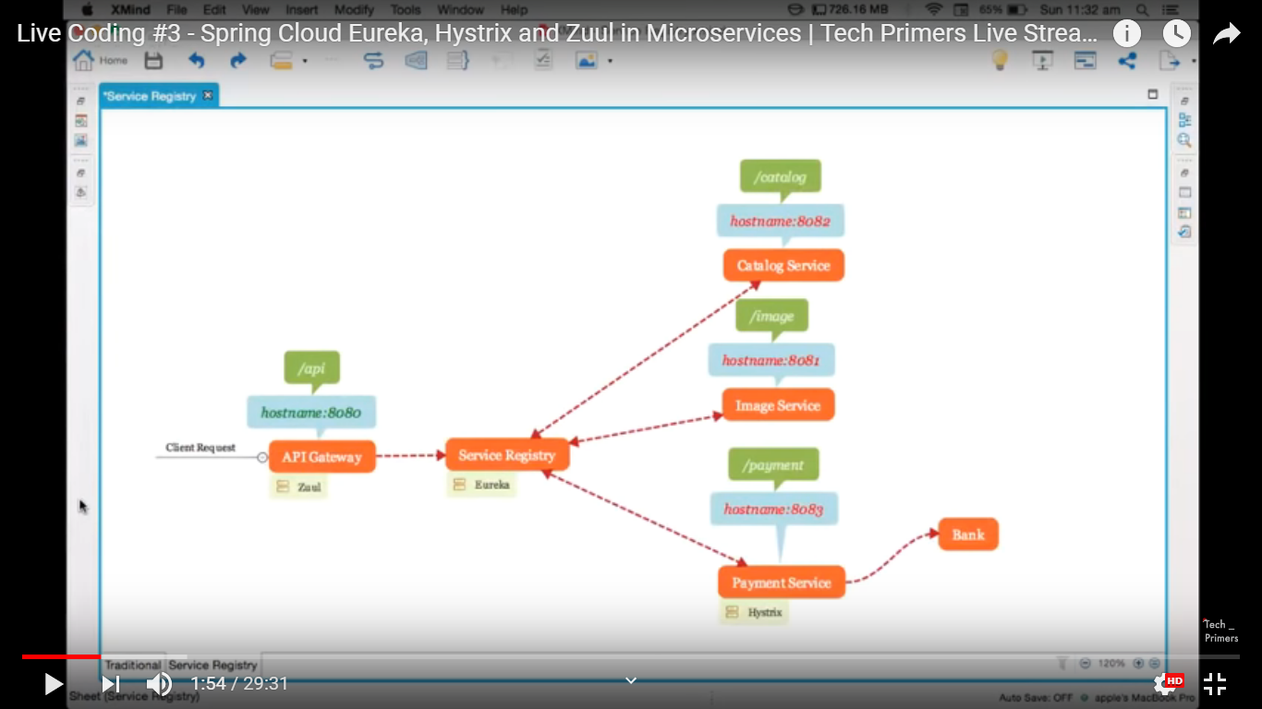
How Zull Filter works
Zull with Eureka

Slide 7

Problem Description : With existing architecture , add an edge server and register with Eureka. Create routing based on simple configuration.
EUREKA SERVER
SID | URL
ABC | ----
XYZ | ----
MICROSERVICE 1
Load Balancer Client
SERVICE REGISTRY
SERVICE DISCOVERY
Routing based on configuration
EUREKA CLIENT
API GATEWAY
ZULL SERVER
MICROSERVICE 2
Routing based on configuration
EUREKA CLIENT
Routing based on configuration
EUREKA CLIENT
ROUTING
ENTRY POINT
MICROSERVICE 3
Target Architecture After Implementation of Eureka Service Discovery + Zull Gateway
PORT : 8080
EUREKA CLIENT

Slide 8
Adding an Centralized Authentication ( No Authorization ) Functionality in Gateway level
Authentication is an important aspect of any application.
In a monolith application its done only once and once authenticated the principal is put into security context so each and every part of the monolith have an access to that.
In Micro services , as the services are discrete the concept of a common security context does not hold good.
Hence we need to authenticate the user in one service , got an token and we are going to use this token in other micro services.
Here we are dealing with authentication only. Authentication or RBAC is a different subject that we will deal later.

Slide 9
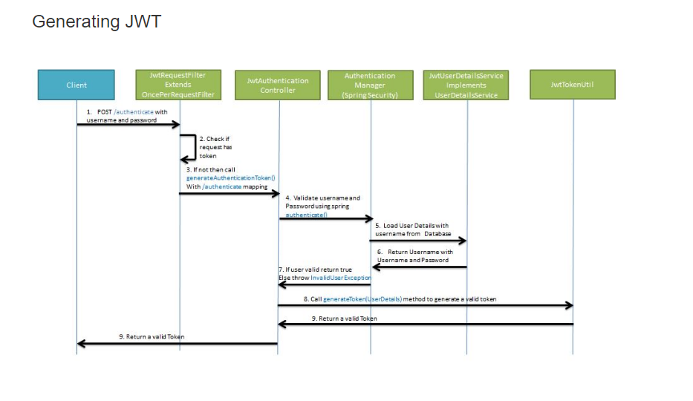
How Centralized Authentication works

Slide 10
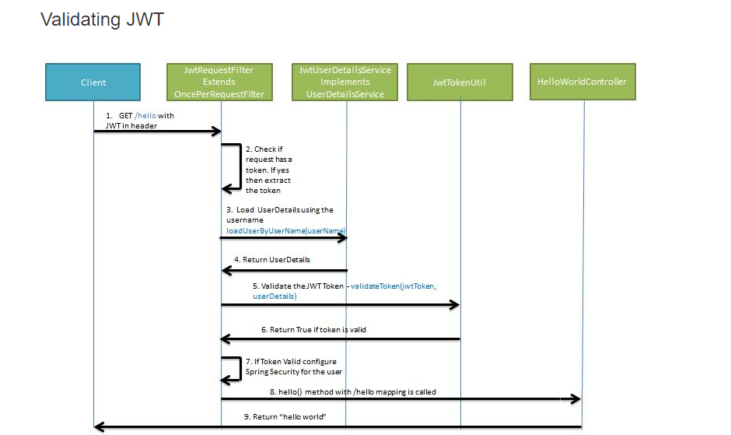
Validating JWT Token in Filter

Slide 11
Overall Flow
Security Flow for Microservice architecture
User provides User Id and password to authentication server.
Authentication authenticate the user against Database/Ldap thisng those.
If authenticated , User details are set to JWT Util to create a JWT Token.
Token sent back to caller.
Caller will wrap it in Head to call successive calls.
A filter is create to intercept the request and get back the token for every service.
Once token is fetched it is sent to JWT Util again to decode and get back the user details again.
Its sent to authentication against Database / Ldap.
If authenticated, User gets access to the service.
If not User is restricted for further usage .
Technologies
JWT Token/ Json Web Token

Slide 12
Problem Description : With existing architecture , add an centralized authentication functionality in edge server level. Every Zull call is now intercepted by a filter.
EUREKA SERVER
SID | URL
ABC | ----
XYZ | ----
MICROSERVICE 1
Load Balancer Client
User Info
SERVICE REGISTRY
SERVICE DISCOVERY
Routing based on configuration
EUREKA CLIENT
API GATEWAY
ZULL SERVER
MICROSERVICE 2
AUTH SERVER
JWT TOKEN
Routing based on configuration
Filter
EUREKA CLIENT
Routing based on configuration
EUREKA CLIENT
ROUTING
ENTRY POINT
MICROSERVICE 3
Target Architecture After Implementation of Eureka Service Discovery + Zull Gateway + Centalized Authentication
PORT : 8080
EUREKA CLIENT

Slide 13
Service Resilience and Fault Tolerance – HYSTRIX CIRCUIT BREAKER
Why HYSTRIX
We know how micros vices collaborates with each other to create the response.
Now if any dependent service is down or taking much time the entire chain could got affected.
Here comes the circuit breaker pattern.
We first need to create dummy response in case a service does not work or slow. This is called a fallback method.
Then we need to tell the system in which scenario , the fallback method needs to called. Once the fallback method gets called we achieve the state of a broken circuit.
This parameters are configuration driven and needs to be applied at method level.
By breaking the circuit we give opportunity to the affected service to come to its normal state. Once its done the circuit will be re connected .
Circuit breaker is very important for micro service resilience .

Slide 14

How hystrix works
How Circuit Breaker works in case of a circuit breaks – Fallback Handling Architecture
Circuit Breaker Implementation here
Service
Client Service
Circuit Breaker
Yes
No
Response Cache
Check in Cache
Default Response

Slide 15
Parameters to be considered
No of request to be considered : 5
No of time outs to be considered : 3
Timeout threshold : 500 ms
Time to Keep the circuit trip : 10 sec
Circuit Breaker Configuration Parameters
Requests
200 ms
100 ms
600 ms
700 ms
100 ms
Not Circuit Breaker Scenario
200 ms
100 ms
600 ms
700 ms
550 ms
Circuit Breaker Scenario
200 ms
600 ms
100 ms
700 ms
550 ms
Circuit Breaker Scenario

Slide 16
Method level Fallback
Service
@HystricCommand
External API 1
3
Method A
Fallback Method A
Client Service
1
2
Resource
@HystricCommand
6
4
External API 2
Method()
5
Method B
Fallback Method B
Service
Target Microservice

Slide 17
Problem Description : Microservice 2 refer Service 3 for some response but service 3 is slow , hence the entire response channel tio user becomes slow. This needs to be handled.
EUREKA SERVER
SID | URL
ABC | ----
XYZ | ----
MICROSERVICE 1
Load Balancer Client
User Info
SERVICE REGISTRY
SERVICE DISCOVERY
Routing based on configuration
EUREKA CLIENT
API GATEWAY
ZULL SERVER
MICROSERVICE 2
AUTH SERVER
JWT TOKEN
Routing based on configuration
Filter
EUREKA CLIENT
Routing based on configuration
EUREKA CLIENT
ROUTING
ENTRY POINT
MICROSERVICE 3
Target Architecture After Implementation of Eureka Service Discovery + Zull Gateway + Centalized Authentication + Hystrix Fallback
PORT : 8080
Fallback
EUREKA CLIENT
Microservice 3 is slow

Slide 18
Why Ribbon
Service level Load balancing , Scale up and Scale down – RIBBON
In computing, load balancing improves the distribution of workloads across multiple computing resources, such as computers, a computer cluster, network links, central processing units, or disk drives. Load balancing aims to optimize resource use, maximize throughput, minimize response time, and avoid overload of any single resource.
When we are using traditional load balancer (server-side load balancer), API caller (client) only knows a single endpoint that is a load balancer and the client doesn't know the list of servers. Load balancer chooses a server from the list.
When we are using client-side load balancer like Ribbon, API caller (client) should know the list of servers and choose one of them from the list. That's why we call it client-side load balancer.
Strategies – Round Robin is default.
Ribbon is a Client side load balancer.

Slide 19
Why Server side traditional Load Balancer is not a good choice ?
Problem with traditional Server side load balancer in Micro service architecture
Server side load balancing is involved in monolithic applications where we have limited number of application instances behind the load load balancer. We deploy our war/ear files into multiple server instances which are basically a pool of server having the same application deployed and we put a load balancer in front of it.
Load balancer has a public IP and DNS. The client makes a request using that public IP/DNS. Load balancer decides to which internal application server request will be forwarded to. It mainly use round robin or sticky session algorithm. We call it server side load balancing.
Mostly server side load balancing is a manual effort and we need to add/remove instances manually to the load balancer to work. So ideally we are loosing the today’s on demand scalability to auto-discover and configure when any new instances will be spinned of.
Another problem is to have a fail-over policy to provide the client a seamless experience. Finally we need a separate server to host the load balancer instance which has the impact on cost and maintenance.

Slide 20
Why Client side load balancer integrate with Eureka to provide solution
Ribbon is integrated with client not server .In case of API gateway it , ,Zull internally using Ribbon for client side load balancing .
Service Instance 1
Provide me all available instance with service id.
EUREKA – ALL INSTANCER ARE REGISTERED UNDER SINGLE SERVICE ID
Service Instance 2
CLIENT REQUIRES ANY AVAILABLE INSTANCE OF SERVICE 1
RIBBON
Please take all available instance
Service Instance 3
Selects any of them upon current strategy
Hence instance acquire process is automated. It does not matter if you add new instances or remove any running instances. Everything happens dynamically. That is something suits with current Micro service requirement.
Service Instance n

Slide 21
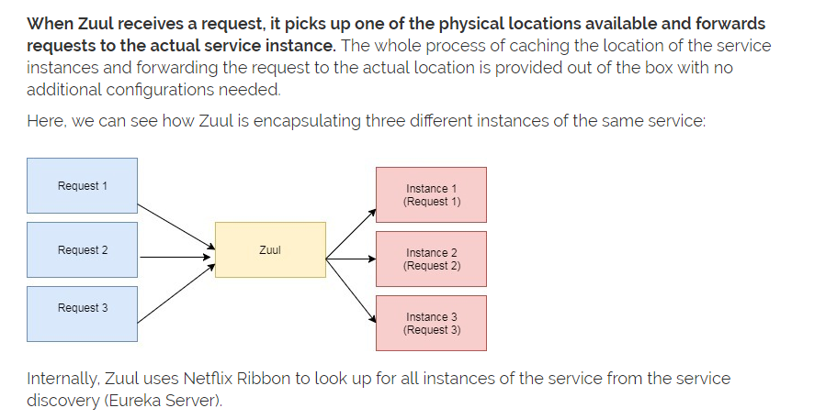
How Ribbon works with Zull API Gateway
https://howtodoinjava.com/spring-cloud/spring-boot-ribbon-eureka/

Slide 22
Problem Description : Multiple instances of Micro service 2 is running. Load balanced need to be configured in Zull Gateway using Ribbon.
PENDING
EUREKA SERVER
SID | URL
ABC | ----
XYZ | ----
MICROSERVICE 1
User Info
SERVICE REGISTRY
SERVICE DISCOVERY
Routing based on configuration
EUREKA CLIENT
API GATEWAY
ZULL SERVER
MICROSERVICE 2
Multiple Instance Running
AUTH SERVER
MICROSERVICE 2
JWT TOKEN
Routing based on configuration
MICROSERVICE 2
Filter
Ribbon
EUREKA CLIENT
Routing based on configuration
EUREKA CLIENT
ROUTING
ENTRY POINT
MICROSERVICE 3
Target Architecture After Implementation of Eureka Service Discovery + Zull Gateway + Centalized Authentication + Hystrix Fallback + Ribbon
PORT : 8080
Fallback
EUREKA CLIENT
Microservice 3 is slow

Slide 23
Externalized and Centralized Configuration ( Local file system / Github , Database etc. )
Why externalized Configuration required
Moving all common configuration from service level to a generic level.
Service specific configuration to be moved to an external location.
Less coupling with configuration with the service.
Configuration can be tweaked any time even not touching the service hence redeployment can be avoided.
If Configurations are versioned in a version control repository like GIT any time one can revert back to any stable configuration ( Commit ID ) when required.
Example of Default Configuration – JPA settings, Eureka client configurations
Example of Service level Configuration - Service level properties
What should not be in any of the config file – PORT ( Should be injected from command layer )

Slide 24
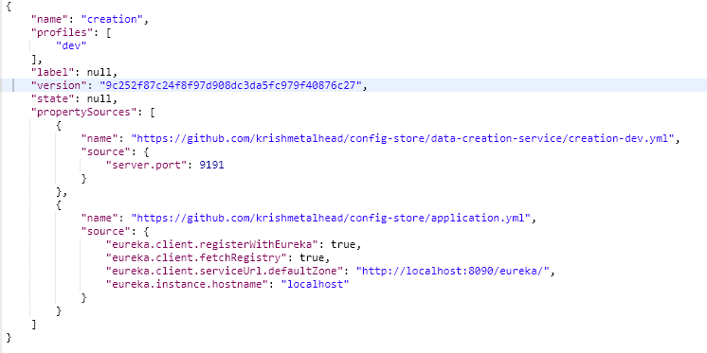
Example of an external configuration fetched via config server
Service specific
Generic

Slide 25



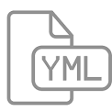
How Externalized Configuration works
Server 1
Cloud / Web
Fetch Configuration
Default Configuration
Config Server
Bootstrap
GIT Config Store
Fetch Configuration
Service 1 Configuration
Server 2
Service 2 Configuration

Slide 26
Problem Description Service 2 will noe fetch its configuration from GIT external Configuration store via config service.
EUREKA SERVER
SID | URL
ABC | ----
XYZ | ----
MICROSERVICE 1
Load Balancer Client
User Info
SERVICE REGISTRY
SERVICE DISCOVERY
Routing based on configuration
EUREKA CLIENT
API GATEWAY
ZULL SERVER
MICROSERVICE 2
Multiple Instance Running
AUTH SERVER
MICROSERVICE 2
JWT TOKEN
Routing based on configuration
MICROSERVICE 2
Filter
Ribbon
EUREKA CLIENT
Routing based on configuration
EUREKA CLIENT
ROUTING
ENTRY POINT
MICROSERVICE 3
Target Architecture After Implementation of Eureka Service Discovery + Zull Gateway + Centalized Authentication + Hystrix Fallback + Ribbon + Config Server + Service Chirography
Fallback
PORT : 8080
Config Server
EUREKA CLIENT
Microservice 3 is slow
Config-Store
Configuration

Slide 27
Why Service choreography ?
Service Choreography
Event driven communication between two micro services.
Add a common message broker so that multiple service can communicate with each other using even driven service choreography.
We will use Apache Active MQ as the mentioned common message broker.
Multiple Channel / Queues will be setup for one business process each.
A service may act as a publisher for one business process and may act as a consumer for other business process.
Example – ORDER CHANNEL / PAYMENT CHANNEL / NOTIFICATION CHANNEL / REEFUND CHANNEL etc.
https://dzone.com/articles/breaking-the-monolithic-database-in-your-microserv

Slide 28
DOUBT ??Cant a single queue used here ?
Service Choreography Example – Ecommerce Example
Producer-Consumer 1
Producer-Consumer 2
Producer-Consumer 3
Producer
Consumer
Producer
Consumer
Producer
Consumer
Catalog Service
Product Servive
Payment Service
Dispatch Service
PRD_SELECTED
PRD_FINALIZED
PYMT_DONE
DSPTCH_BOOKED
PYMT_FAILED
QUEUE3
QUEUE1
QUEUE2
Producer
Compensating Action / Rollback
QUEUE4
REFUND_SERVICE
Producer-Consumer 4
PYMT_FAILED
Consumer

Slide 29

Problem Description Service Cerograph using common message broker pattern ( Event Driven )
Send Mail
Active MQ
EUREKA SERVER
SID | URL
ABC | ----
XYZ | ----
Produces
Consumes
SERVICE REGISTRY
MICROSERVICE 1
NOTIFICATION SERVICE
User Info
SERVICE DISCOVERY
Routing based on configuration
EUREKA CLIENT
API GATEWAY
ZULL SERVER
MICROSERVICE 2
Multiple Instance Running
AUTH SERVER
MICROSERVICE 2
JWT TOKEN
Routing based on configuration
MICROSERVICE 2
Filter
Ribbon
PORT : 8080
Routing based on configuration
EUREKA CLIENT
MICROSERVICE 3
Target Architecture After Implementation of Eureka Service Discovery + Zull Gateway + Centralized Authentication + Hystrix Fallback + Ribbon + Config Server
Fallback
Config Server
EUREKA CLIENT
Microservice 3 is slow
GIT - Config-Store
Configuration

Slide 30
Why distributed tracing
Distributed Logging and Tracing SLEUTH / ZIPKIN
In a monolith all logs are coming under one server log hence tracing is easy.
In micro services architecture each individual services are running in different servers , hence logs are scattered across individual server levels.
Distributed tracing brings all logs across different servers in a centralized platform and group them by Request / Service calls.
Hence it will be easy to debug the logs now.

Slide 31
Distributed Logging Using Sleuth/Zipkin
Microservice1
Microservice2
Microservice3
Microservice4
Sleuth
Sleuth
Sleuth
Sleuth
Logs
Logs
Logs
Logs
Zipkin
Zipkin Log Analyzer

Slide 32
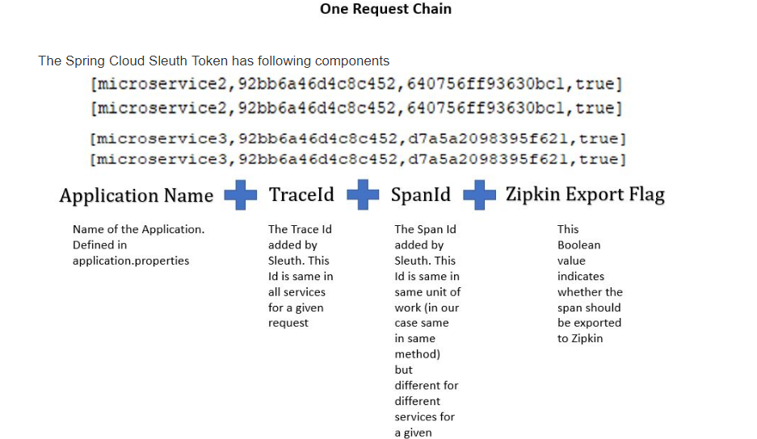
Sleuth Log Message Configuration

Slide 33
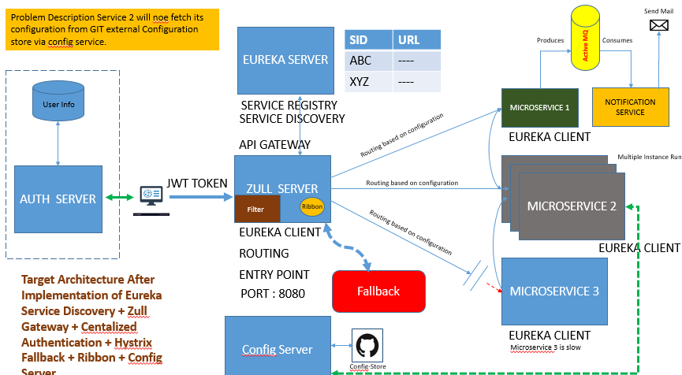
Logs
Zipkin Dashboard
Logs
Zipkin export
Logs
Zipkin
Sleuth and Zipkin added to the existing architecture

Slide 34
Why Feign
Abstraction of intra service call - FEIGN

Slide 35
Why RBAC
Role based Access Control – OAUTH 2 / SPRING SECURITY
Role based access control is essential for every application to restrict the unauthorized users to access a resource.
In monolith this implementation is easy as a common security context exists across the application.
In micro services distributed token needs to be leveraged to achieve the same.
Currently Authentication happens at Zull Gateway level. That will remain same.
We need to add one more authorization level check at service – method level.
For that we need to implement an Auth server , which will connect to database , fetch user , role , permission level details and create access tokens.
At service level we need to use this token and leverage it wiTH method level permission access control or RBAC in short

Slide 36
What is Oauth 2 ?
Oauth 2 – When one service / client / resource access a resource server on behalf of the resource owner , its called an Oauth 2 . Access Token is used in between this communications through out . Token is generated for resource owner upon providing necessary details or credentials. A token consist of all required information includes his role/permission details. An Authentication server acts as the main actor who holds all user related data and create token using this. Auth service has several API end points for create token, check token etc. Spring cloud security and Oauth 2 dependencies are required to create this an Auth server. Every service like google, facebook , git has their own established Auth server which we often use unknowingly.

Slide 37
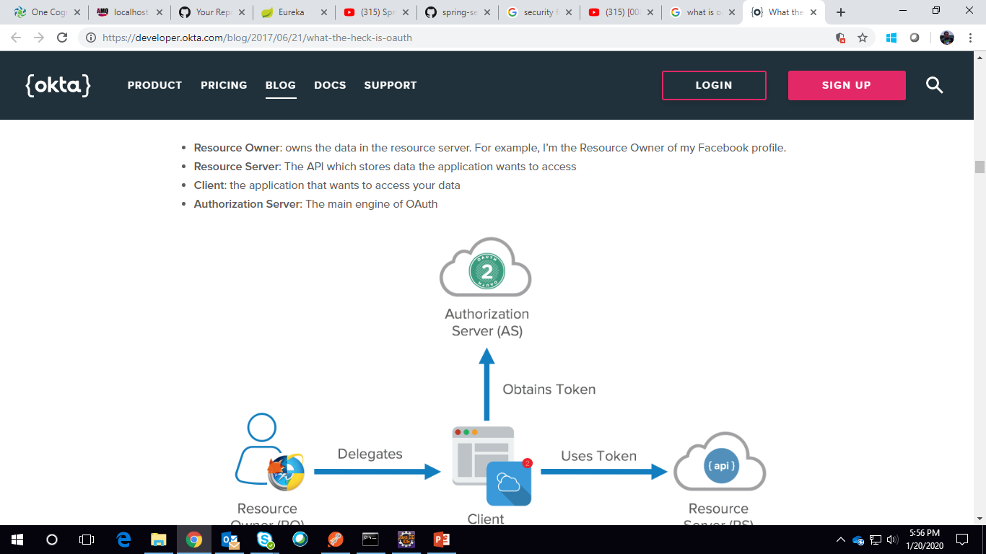
How Oauth 2 works ?

Slide 38
A Typical Oauth2 Flow that involves a client , an AUTHORIZATION server a resource owner and the resource server
provides data to the Client. In our case, the requested emails are unbarred and delivered to the client. The Client requests access to the Resource Server by calling the Authorization Server.
The Authorization Server redirects to allow the user to authenticate, which is usually performed within a browser. This is essentially signing into an authorization server, not the app.
The Authorization Server then validates the user credentials and provides an Access Tokento client, which can be use to call the Resource Server
The Client then sends the Token to the Resource Server
The Resource Server asks the Authorization Server if the token is valid. ( /checkToken API )
The Authorization Server validates the Token, returning relevant information to the Resource Server i.e. time till token expiration, who the token belongs too.
The Resource Server then provides the access to the caller.
Method level RABC gets implemented.

Slide 39
A Typical Oauth2 Flow between API gateway ( called by the resource owner directly ) and the service it tries to call (downstream service – the resource server ) and finally the AUTHORIZATION server.
User provide user name and password to log in into the system. He eventually call the gateway service.
Authentication server gets called and a access token is created and sent back if the user is authenticated.
This token is clubbed into further service call.
The downstream service gets the token.
It calls the Authentication server to get it validated.
It fetched the Role/ Permission / Authorities from the token. ( /checkToken API )
Method level RABC gets implemented.

Slide 40
Lets create the problem description and the solution
Problem
How to communicate the identity of the requestor to the services that handle the request?
Forces
Services often need to verify that a user is authorized to perform an operation
Solution
The API Gateway authenticates the request and passes an access token (e.g. JSON Web Token) that securely identifies the requestor in each request to the services. A service can include the access token in requests it makes to other services. Sensitive header is holds the info about which sensitive information must be blocked. Hence we make it empty to pass everything here.
zuul:
routes:
creation-service:
path: /create/**
serviceId: creation
sensitiveHeaders:

Slide 41
Final architecture

Slide 42
Thank You !!

