Slide 1
On Prem/Cl;oud
Initial Concept
API Gateway
JWT Token
6
Load Balancing
Hide Internal Service Breakups
Reduce Round Trips
Protocol Adapter
Protocol Conversion
Client Side Service Discovery
Server side Service Discovery
Validate Token
Validate Token
Pull/Push
Token
7
8
Token
5
Token Generation
Service 2
4
Validate Token
Token
Validation
Token
Service Registry
Pull/Push
Topic
User
EUREKA SERVER
LOGIN/AUTHENTICATION SERVICE
Service 3
1
2
Validate Token
Token
Token
Authentication
3
Pull/Push
Filter
User Data
In memory/Database via JPA /LDAP etc.
Multiple Instances
Token validation
Ribbon- Client Side Load Balancing

Slide 2
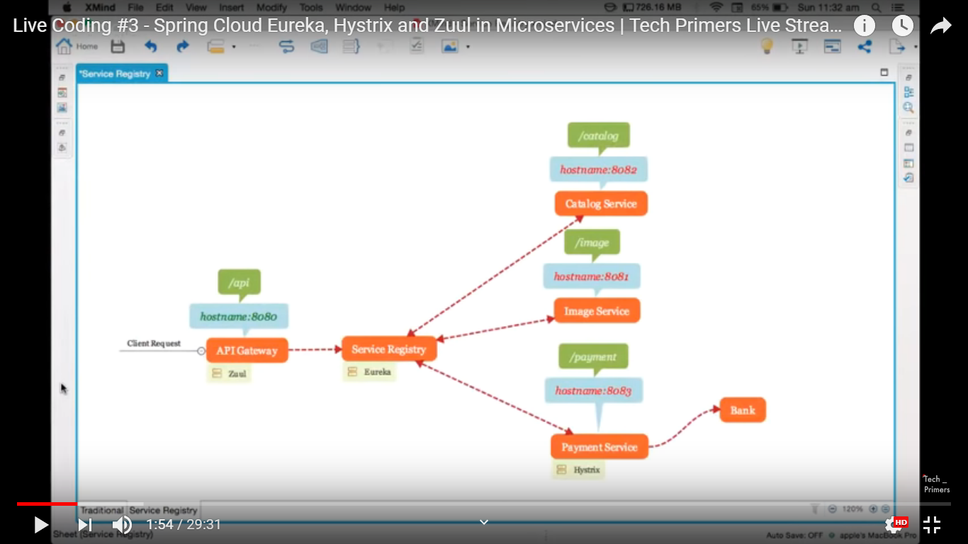
Zull with Eureka

Slide 3

Overall Architecture
PORT : 8090
7 Service registered
Target Architecture
EUREKA SERVER
SID | URL
ABC | ----
XYZ | ----
PORT : 8081
MICROSERVICE 1
MICROSERVICE 4-INSTANCE 1
Load Balancer Client
Load Balanced Service
SERVICE REGISTRY
Load Balancing
SERVICE DISCOVERY
PORT : 8084
Routing based on configuration
EUREKA CLIENT
API GATEWAY
MICROSERVICE 4-INSTANCE 2
PORT : 8082
Load Balanced Service
ZULL SERVER
MICROSERVICE 2
Routing based on configuration
PORT : 8085
MICROSERVICE 4-INSTANCE 3
Load Balanced Service
EUREKA CLIENT
EUREKA CLIENT
Routing based on configuration
ROUTING
PORT : 8083
MICROSERVICE 3
PORT : 8086
ENTRY POINT
PORT : 8080
Hystrix
Circuit Breaker
EUREKA CLIENT
Microservice 4 is a highly demanded service
If MS 2 gets down MS1 sending default response using Hystrix Circuit Breaker

Slide 4
All services are first registered in Eureka server.
Zull acts as single point of entry into the mocroservice ecosystem. All Internal compositions are hidden from the client.
Client hit the service name which is registered in eureka. The Zull server gets called.
Routing on the basis of URL is done in zull.
The intended microservice gets called.
Highly demanded servces can be load balanced ( client side ) with Eureka / Ribbon. Client of this microservices holds the load balancing functionality.
Load balancing algorithm selects any one of the running instances to run.
Microservice can collaborate with other microservice o produce the desired output and return.
In case any of the microservice in this chain malfunction , it is removed from the chain and a default response can be sent instead using Hystrix circuit breaker.
Required Technology
Spring Cloud ( Overall platform )
Netflix Zull ( API Gateway )
Netflix Eureka ( Service Registry and Discovery )
Netflix Ribbon ( Load Balancing – Optional )
Netflix Hystrix ( Circuit Breaker )

Slide 5
Overall Architecture+Security Using JWT
PORT : 8090
7 Service registered
Target Architecture+ Security
EUREKA SERVER
SID | URL
ABC | ----
XYZ | ----
PORT : 8081
MICROSERVICE 1
MICROSERVICE 4-INSTANCE 1
Load Balancer Client
Load Balanced Service
SERVICE REGISTRY
Load Balancing
SERVICE DISCOVERY
PORT : 8084
Routing based on configuration
EUREKA CLIENT
API GATEWAY
MICROSERVICE 4-INSTANCE 2
PORT : 8082
Load Balanced Service
ZULL SERVER
MICROSERVICE 2
JWT
Routing based on configuration
PORT : 8085
MICROSERVICE 4-INSTANCE 3
Load Balanced Service
Uid/PWD
EUREKA CLIENT
EUREKA CLIENT
Generate JWT
Routing based on configuration
ROUTING
JWT
PORT : 8083
MICROSERVICE 3
PORT : 8086
ENTRY POINT
PORT : 8080
Hystrix
Circuit Breaker
AUTH SERVER
Filter
Validate JWT
EUREKA CLIENT
Auth DB
Authentication
Authentication
Microservice 4 is a highly demanded service
If MS 2 gets down MS1 sending default response using Hystrix Circuit Breaker

Slide 6
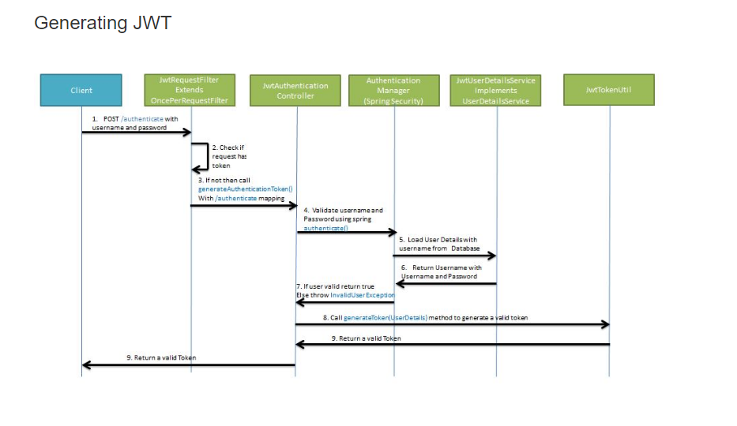

Slide 7
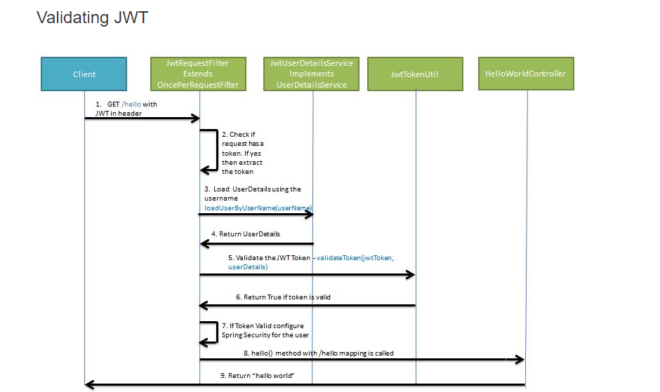

Slide 8
Security Flow for Microservice architecture
User provides User Id and password to authentication server.
Authentication authenticate the user against Database/Ldap thisng those.
If authenticated , User details are set to JWT Util to create a JWT Token.
Token sent back to caller.
Caller will wrap it in Head to call successive calls.
A filter is create to intercept the request and get back the token for every service.
Once token is fetched it is sent to JWT Util again to decode and get back the user details again.
Its sent to authentication against Database / Ldap.
If authenticated, User gets access to the service.
If not User is restricted for further usage .
Technologies
JWT Token/ Json Web Token

Slide 9
Demo Project- Part 1
PORT : 8090
7 Service registered
Target Architecture+ Security Contd.
EUREKA SERVER
SID | URL
ABC | ----
XYZ | ----
PORT : 8081
View User Service
Load Balanced Service
View Service-INSTANCE 1
SERVICE REGISTRY
Load Balancing
SERVICE DISCOVERY
PORT : 8084
Routing based on configuration
EUREKA CLIENT
API GATEWAY
PORT : 8082
Load Balanced Service
View Service-INSTANCE 2
ZULL SERVER
Create Service
JWT
Routing based on configuration
PORT : 8085
Filter
JPA
Uid/PWD
EUREKA CLIENT
Routing based on configuration
EUREKA CLIENT
Generate JWT
JWT
PORT : 8083
JPA
ROUTING
ENTRY POINT
Update Service
PORT : 8080
DB
JPA
AUTH SERVER
Validate JWT
Filter
JPA
EUREKA CLIENT
Auth DB
Authentication
Authentication
Microservice 4 is a highly demanded service
If MS 2 gets down MS1 sending default response using Hystrix Circuit Breaker

Slide 10
Learning Plan– Part 1
Implementation
Pre-requisite : Installation sql, Java 1.8+
Source code reference : https://www.javainuse.com/spring/boot-jwt
S/No | Task | Duration | Status
1 | Creation of Authentication Server and Test | 3 | Done
2 | Creation of Server and client stubs. Registration/ Discovery/Load Balance | 1 | Done
5 | Creation of Table in sql, JPA configuration | 1 | Will be done later
6 | Creation of actual Business services for C, U , V | 2 | Will be done later
7 | Putting filter to incorporate security ( JWT ) | 2 | Done
9 | Add load balancing for View service | 2 | Done

Slide 11
Scope of Demo Project 1
Authentication using JWT
Eureka service registration and dynamic service discovery
API Gateway Service routing Using Zull
Client side Load Balancing using Eureka
Database communication using JPA and MySQL.
Communication via common message broker ( AMQ )

Slide 12
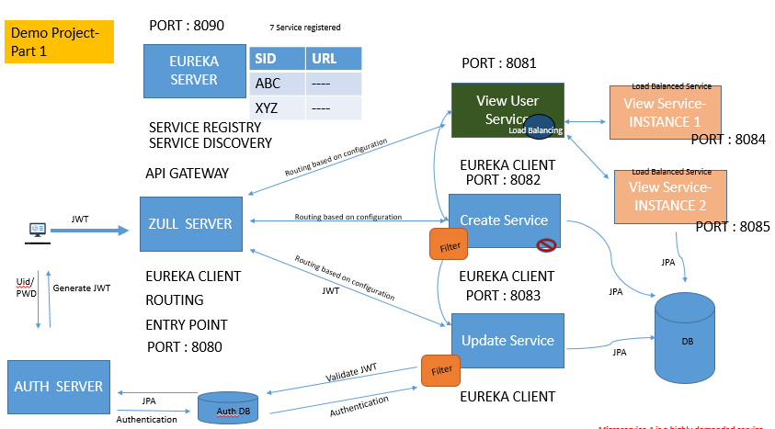

Target Architecture+ Security + Microservice communication viw common msg broker
Active MQ
Created User Data
Poll Message
Notification Service
Demo Project 1 – Service Registration + Dynamic Discovery+ Client side Load Balancing + JWT token based Authentication + Service Choreography via Common message breaker AMQ + JPA + Zull
Send Email Notification

Slide 13
Learning Plan – Part 2
S/No | Task | Detail | Status
1 | Active MQ Integration | Service Choreography via Common message breaker AMQ | Done
2 | Message Push and Pull | Service Choreography via Common message broker AMQ | Done
3 | Hystrix Curcuit Breaker | Fault Tolerance and Resilience | Done
4 | Microservice Slowness | Fault Tolerance and Resilience | Done
5 | Microservice Not Responding | Fault Tolerance and Resilience | Done

Slide 14
Active MQ
Poll Message
Notification Service
Time Out/Circuit Breaker
Load Balancing
Target Architecture+ Security + Microservice communication viw common msg broker + Load Balancing + Timeout
Send Email Notification
Instance 1
Credit Score Service
Instance 2
Credit Score Service
Instance 3
Client side LB + timeout/CB should be done at calling service which is create service here.

Slide 15
No of request to be considered : 5
No of time outs to be considered : 3
Timeout threshold : 500 ms
Time to Keep the circuit trip : 10 sec
How Circuit Breaker works
Requests
200 ms
100 ms
600 ms
700 ms
100 ms
Not Circuit Breaker Scenario
200 ms
100 ms
600 ms
700 ms
550 ms
Circuit Breaker Scenario
200 ms
600 ms
100 ms
700 ms
550 ms
Circuit Breaker Scenario

Slide 16

How Circuit Breaker works in case of a circuit breaks – Fallback Handling Architecture
Circuit Breaker Implementation here
Service
Client Service
Circuit Breaker
Yes
No
Response Cache
Check in Cache
Default Response

Slide 17
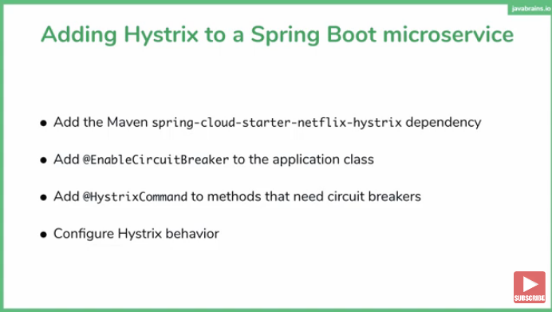
How to enable circuit breaking

Slide 18
Method level Fallback
Service
@HystricCommand
External API 1
3
Method A
Fallback Method A
Client Service
1
2
Resource
@HystricCommand
6
4
External API 2
Method()
5
Method B
Fallback Method B
Service
Target Microservice

Slide 19
Learning Plan – Part 3
S/No | Task | Detail | Status
1 | Distributed Logging | Sleuth | Done
2 | Centralized Log Monitoring | Zipkin | Not started
3 | Non NIO based API Gateway ( Zull ) | Zull setup and integration with Eureka | Done
4 | Centralizing Microservice security in API Gateway ( Single point of Security ) | Decoupling security code from individual micro services and bringing that to API Gateway. | Done
5 | Centralized Authorization |  | Not started
 | Centralized Circuit Breaker | Zull+Hystrix | Not started
6 | Spring Cloud / NIO based API Gateway

Slide 20
Distributed Logging Using Sleuth/Zipkin
Microservice1
Microservice2
Microservice3
Microservice4
Sleuth
Sleuth
Sleuth
Sleuth
Logs
Logs
Logs
Logs
Zipkin
Zipkin Log Analyzer

Slide 21
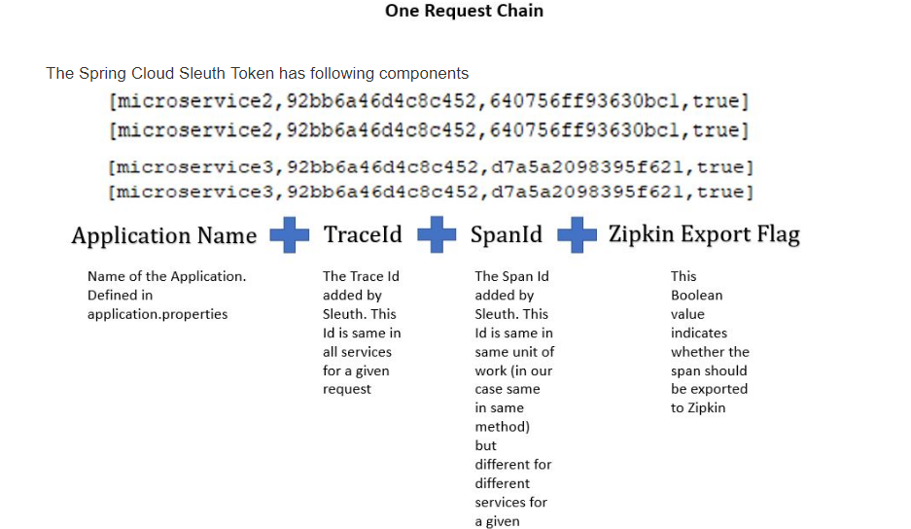
Sleuth Log Message Configuration

Slide 22
Centralized Auth Layer Using Zull API Gateway
PORT : 8090
7 Service registered
Target Architecture+ Centralized Security + API Routing using Zull+ Load balancing using Ribbon.
EUREKA SERVER
SID | URL
ABC | ----
XYZ | ----
PORT : 8081
View User Service
SERVICE REGISTRY
Load Balancing
SERVICE DISCOVERY
Discovery +Routing
EUREKA CLIENT
API GATEWAY
PORT : 8082/83
Round Robin Client Side LB
Instance 1
PORT : 8085
ZULL SERVER
Create Service
Internal Ribbon
Instance 2
Credit Score Service
JWT
Create Service
Discovery +Routing+Load Balancing
Uid/PWD
EUREKA CLIENT
EUREKA CLIENT
Generate JWT
ROUTING
Discovery +Routing
PORT : 8086
ENTRY POINT
PORT : 8084
Active MQ
Notification Service
Centralized Authentication
PORT : 8080
Update Service
AUTH SERVER
JPA
EUREKA CLIENT
Filter
Authentication
Auth DB
PORT : 8087
Microservice 4 is a highly demanded service
If MS 2 gets down MS1 sending default response using Hystrix Circuit Breaker

