Slide 1
Workload-Aware CUDA Decode Attention over an INT8 Paged KV Cache
Krishna Mula · CS 259 · October 28, 2026
Notes:
One question: how do INT8 storage and the way we split work across the GPU interact for decode attention, and can a simple rule pick the right configuration per batch shape?

Slide 2
Decode attention is a memory problem
One decode step, one layer of Qwen3-1.7B, 16K tokens of history, FP16 cache
64 MiB
72 µs
3.8 µs
of K and V read to produce one 128-number output per head
to stream it at the RTX 3090's 936 GB/s peak
for the 134 MFLOP of math at 35.6 FP32 TFLOPS
About 19 times more time moving bytes than doing math. Every design choice follows from that.
Notes:
16 query heads x 16,384 tokens x 128 dims x 2 FLOP x 2 (QK and PV) = 134 MFLOP. Bytes = 16,384 tokens x 4 KiB per token per layer (8 KV heads x 128 dims x 2 bytes x K and V). These are arithmetic, not measurements.

Slide 3
Two levers: fewer bytes, more of the chip
INT8 cache
Split the history
Bytes per token per layer
Batch 1 launches one block per query head
FP16 4,096 B
INT8 2,112 B
Symmetric, one FP32 scale per token and KV head. 52% of the bytes, so up to 1.9x faster if dequantizing is cheap.
16 of 82 SMs busy. Splitting each head's history into chunks gives every SM work, at the cost of a merge.

Slide 4
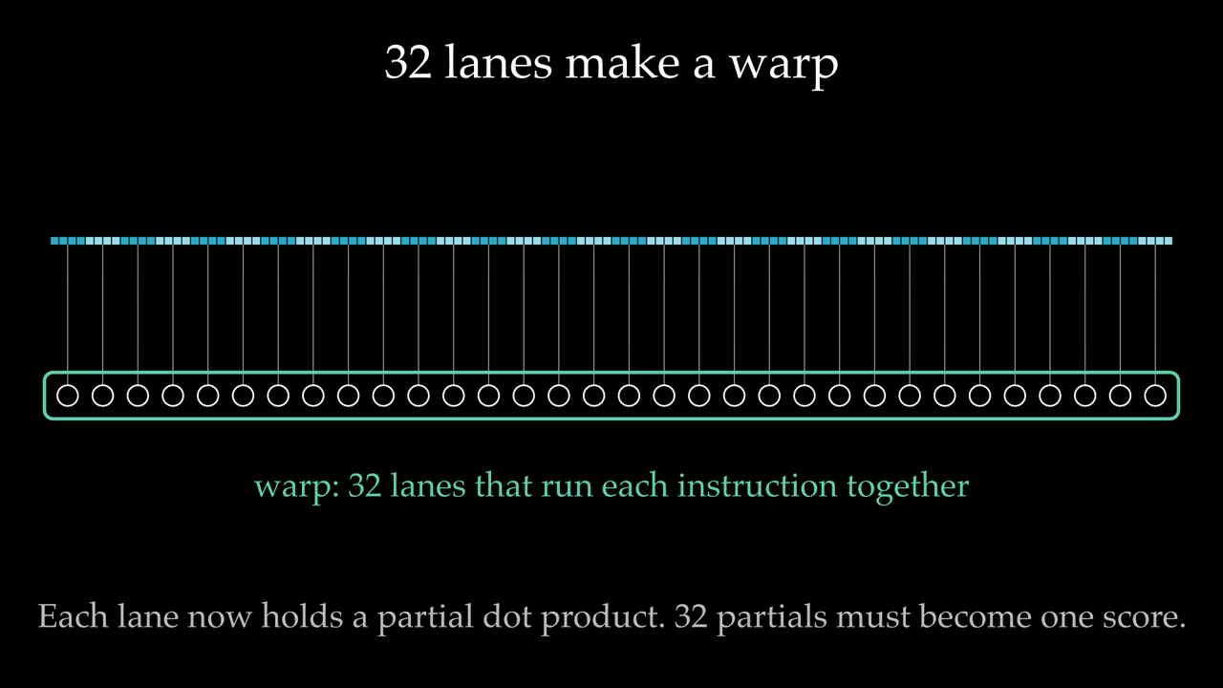
Threads, lanes, and warps
Notes:
A thread is one stream of instructions. On NVIDIA GPUs threads run in groups of 32 called warps, and the 32 lanes of a warp execute the same instruction at the same time. In our kernel, one warp handles one query head, and each lane owns 4 of the 128 numbers in q, K, and V.

Slide 5
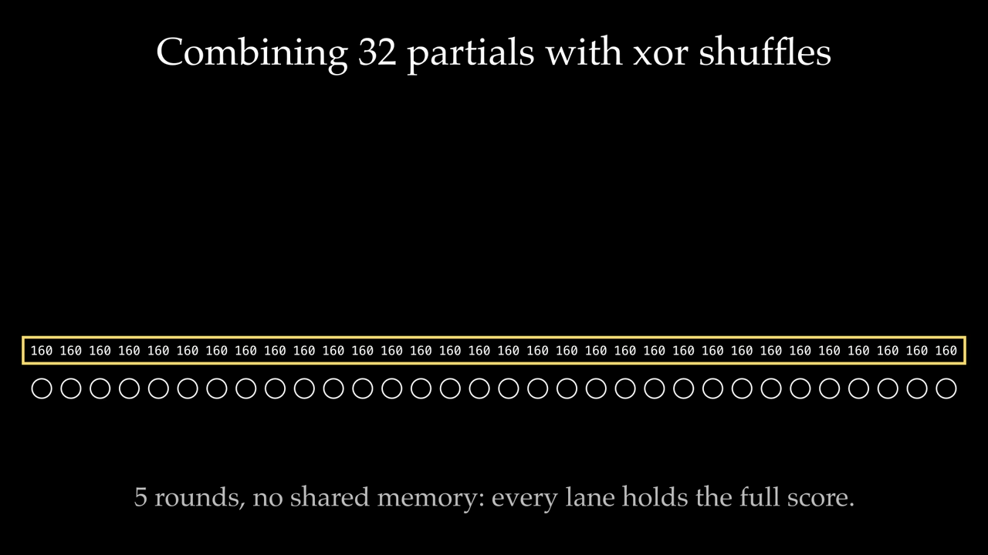
A warp adds 32 numbers in 5 steps
Notes:
__shfl_xor_sync lets a lane read another lane's register directly, without shared memory. In round r, lane i reads from lane i xor d, for d = 16, 8, 4, 2, 1. After 5 rounds every lane has the full sum. This is how each token's score q · k is finished, and it is the warp_reduce warm-up kernel.

Slide 6
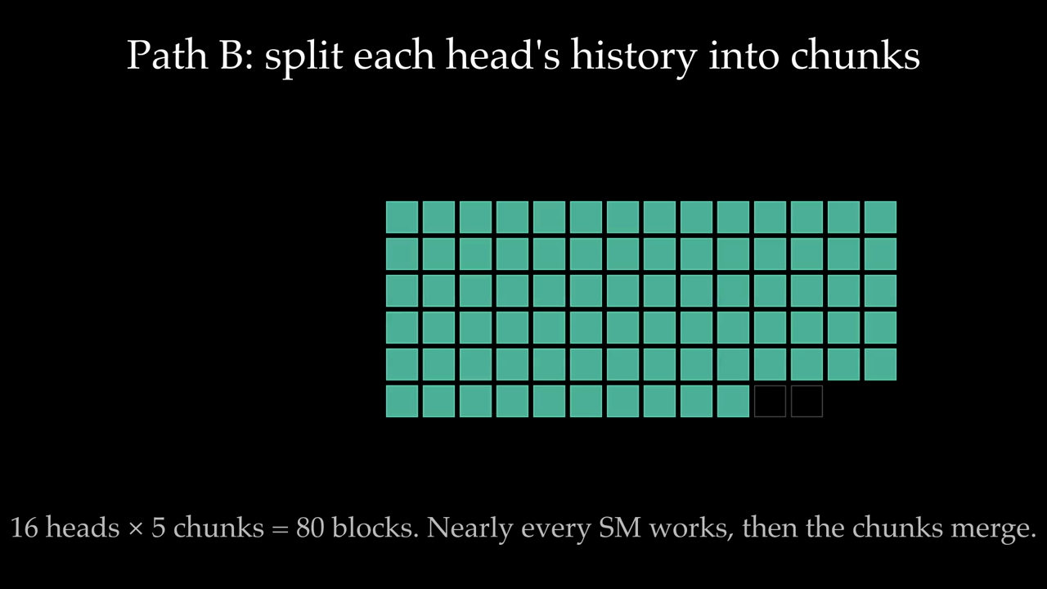
Blocks, the grid, and 82 SMs
Notes:
A block is a group of threads that runs on one streaming multiprocessor (SM). Our blocks are a single warp. The grid is every block in a launch: one per request and query head. At batch 1 that is 16 blocks on a chip with 82 SMs. Splitting the history into chunks multiplies the number of blocks. The real chunk counts are larger, and each SM runs up to 16 of our blocks at once.

Slide 7
One kernel, two paths
decode(q, k_cache, v_cache, k_scale, v_scale, block_table, seq_lens, num_chunks)
Path A
1 chunk
normalize, write output
Path B
N chunks
(m, l, u) per chunk, merged in PyTorch
Grid: (request, query head, chunk). Templated on the cache type, so INT8 and FP16 share one source.
Merge two partial states: m = max(m₁, m₂), l = l₁·e^(m₁−m) + l₂·e^(m₂−m), u likewise, output = u / l
Notes:
Each block runs online softmax over its token range: a running max m, a running sum l, and a running weighted sum of V rows u. Path B blocks stop before normalizing and write (m, l, u). An empty chunk writes m = -inf, l = 0, u = 0, and the merge handles it exactly.

Slide 8
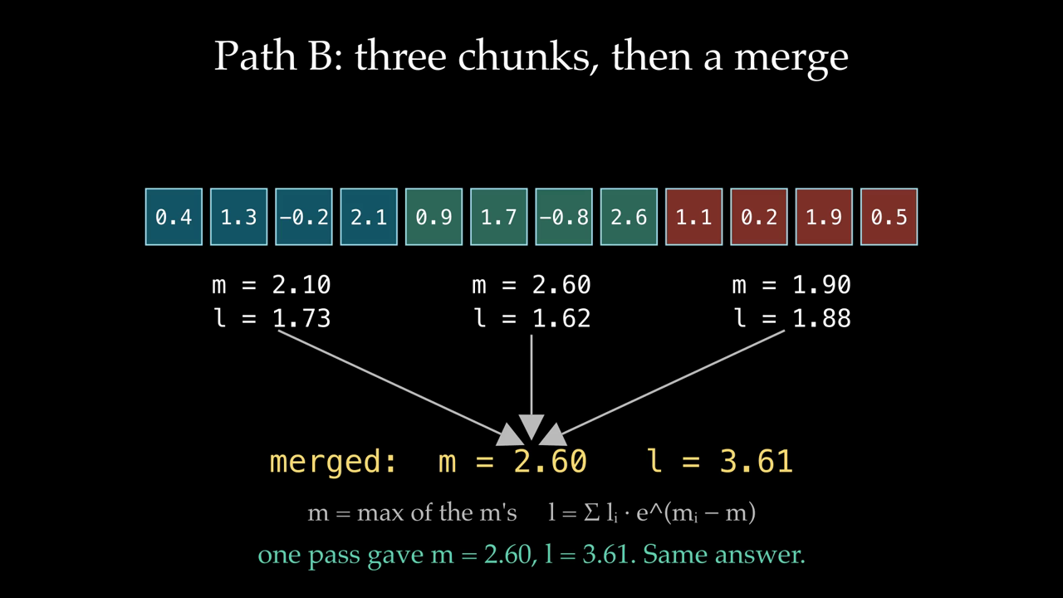
Why chunks can be merged exactly
Notes:
Softmax needs the max and the sum over all scores, but online softmax keeps them as a running state: m, the largest score so far, and l, the sum of e^(z - m). V gets the same running treatment in u. Any split of the history into chunks gives partial states that merge to the exact one-pass answer. That is what makes Path B correct.

Slide 9
What the numbers will be measured on
Item | Choice
GPU | RTX 3090: 82 SMs, 24 GB, 936 GB/s, 6 MB L2 (Vast.ai VM, Nsight counters work)
Model shape | Qwen3-1.7B: 16 query heads, 8 KV heads, head dim 128
Cache | Paged, 16 tokens per page. INT8 with per-token scales, or FP16
Workloads | Batch 1, 4, 16 at contexts 1K, 4K, 16K. Decode only
Baseline | PyTorch SDPA on a pre-gathered contiguous FP16 history
Timing | CUDA events, warmup, repeats, working set larger than L2
Notes:
SDPA is timed on a history that is already contiguous, which excludes the gather. That makes it the harder baseline to beat. Out of scope: prefill, mixed-length batches, FlashInfer, a CUDA merge kernel, and vLLM integration.

Slide 10
Where the project stands
Done
In progress
Next
PyTorch reference and 26 tests
Online softmax and merge in Python
Warp sum and max kernel
GPU check: Nsight works on the 3090
Path A FP16 kernel, one warp per head
Kernel tests against the reference
INT8 through the template
Path B with a PyTorch merge
Benchmarks, Nsight, selector rule
Paper by November 5

Slide 11
Expected results
Predictions from a performance model of the kernel as designed. Not measured yet. The goal is to match or explain each one.
Notes:
The model is scripts/expected_results.py. Each path's time is the larger of two limits: streaming the bytes at 85% of peak bandwidth (the GPU check reached 87%), or the time one warp needs to walk its tokens one at a time. The per-token cost, 0.3 microseconds, is the guess that matters most. Its plausible range is 0.15 to 0.6.

Slide 12
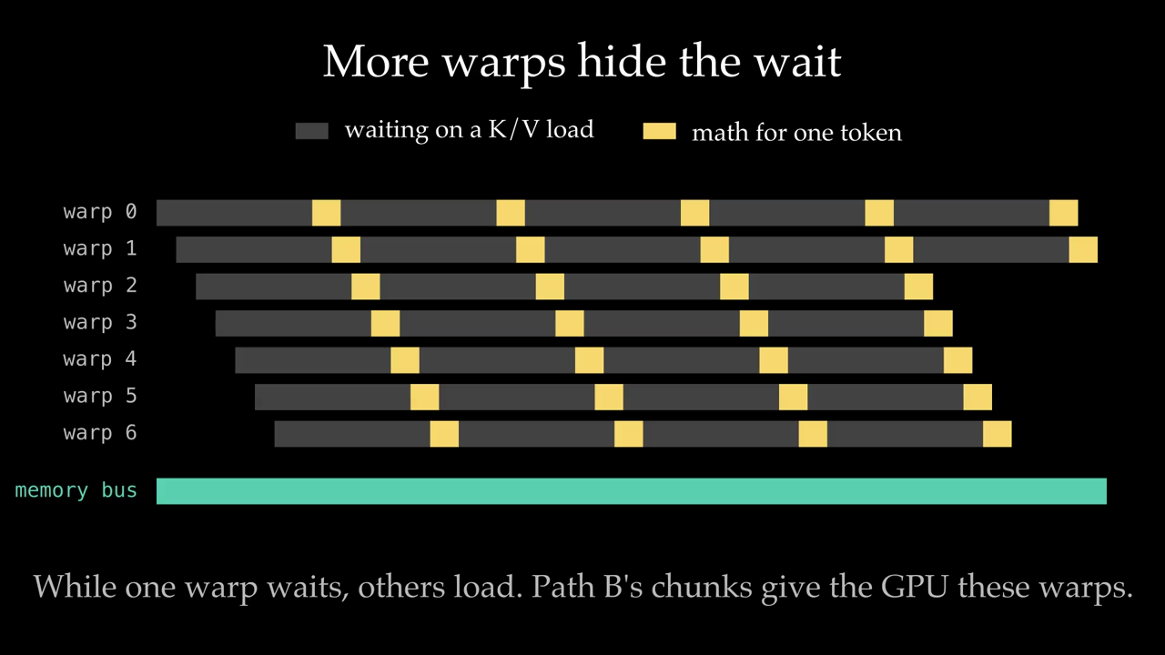
Why Path A should be slow
Notes:
A global memory load takes hundreds of nanoseconds. One warp walking tokens in order spends most of its time waiting, so the memory bus sits mostly idle. With many warps resident, the SM switches to another warp while one waits, which keeps the bus busy. Path B provides those warps. This is the reasoning behind the expected numbers that follow.

Slide 13
Batch 1: splitting is worth 25 to 44x
EXPECTED
Path A 1.2 ms at 4K
One warp walks all 4,096 tokens in order. Its time is per-token latency, about 1% of DRAM bandwidth.
Path B 49 µs, SDPA 34 µs
Chunks fill the chip. At batch 1 the PyTorch merge (about 25 µs) keeps Path B behind SDPA. FP16 and INT8 overlap here.
Notes:
Path A grows linearly with context and does not depend on bandwidth, because one warp can have only a few loads in flight. If the per-token cost is 0.15 us instead of 0.3, Path A halves. The ranking does not change.

Slide 14
At batch 16, 16K: INT8 beats SDPA 1.4x
EXPECTED
Where bytes dominate, INT8 pays off
At batch 16 and 16K: SDPA 1540 µs, Path B FP16 1378 µs, Path B INT8 1084 µs.
Path A is not shown. It stays near 1.2 ms at 4K and 4.9 ms at 16K for every batch size.

Slide 15
INT8 should win 1.0 to 1.3x, not 1.9x
EXPECTED
Shape | Path B FP16 | Path B INT8 | INT8 gain | DRAM % of peak, FP16 / INT8
B1 · 16K | 112 µs | 112 µs | 1.00x | 64% / 33%
B4 · 4K | 112 µs | 97 µs | 1.16x | 64% / 38%
B4 · 16K | 365 µs | 303 µs | 1.21x | 78% / 49%
B16 · 4K | 365 µs | 292 µs | 1.25x | 78% / 51%
B16 · 16K | 1378 µs | 1084 µs | 1.27x | 83% / 55%
Halving the bytes moves the limit from DRAM to latency. With one warp per head, each token still costs a load, five shuffles, and two exponentials, so INT8 Path B hits about 50% of peak bandwidth while FP16 reaches about 80%.
Notes:
This is the prediction most worth testing with Nsight Compute. If INT8 Path B shows about 50% DRAM throughput and high stall-long-scoreboard, the latency explanation holds. The fix for later is more warps per head, so several tokens are in flight at once.

Slide 16
The selector becomes a chunk-count rule
EXPECTED
Batch 1
Batch 4
Batch 16
64 chunks
16 chunks
4 chunks
1,024 warps
1,024 warps
1,024 warps
With a one-warp Path A, splitting is expected to win at every shape in the sweep. The rule picks chunks so that batch × 16 heads × chunks ≈ 1,024 warps, close to the 1,312 the 3090 can keep resident.
Notes:
The original question was A versus B. The model says Path A as written never wins, so the interesting decision is the chunk count. If Path A gets more warps per head later, the A versus B crossover comes back at large batch.

Slide 17
Per-token INT8 is lossy because of K
MEASURED
V quantizes well, about 1% error.
K has outlier channels, up to 66x the median, so one scale per token wastes precision on the rest.
Static K smoothing (QServe) cuts Qwen3 to 1.8% mean, 8% worst. It is future work.
CPU, one 2,048-token text, 16 decode positions. A small sample.

Slide 18
From expected to measured
1
Path A correct
FP16, then INT8 through the template. Zero compute-sanitizer errors.
2
Path B correct
Chunks plus PyTorch merge match the reference, including empty chunks.
3
Measure
Latency at 9 shapes, Nsight on 2 to 4 cases. Check the 0.3 µs per-token guess first.
4
Explain
Every gap between expected and measured gets a cause, backed by a profile.
Notes:
Cut from the class scope, and the paper says so: a CUDA cache-write kernel, FlashInfer, K smoothing, GQA head sharing, mixed-length batches, a CUDA merge kernel, and vLLM integration.

Slide 19
Questions
github.com/krishmula/warpcache

