Slide 1
Website Project IT Club Academia

Slide 2
Hello!
I am Krish Maharjan
Here to give a presentation on the project I concluded.

Slide 3
Design and build a landing page for IT club.

Slide 4
1.
Design
Designing of the website and prototyping

Slide 5
Tech stack used
HTML
CSS
javaScript

Slide 6
Language used
 | HTML | CSS | JavaScript
Percentage(%) | 43 | 53.3 | 3.7

Slide 7
Responsive Layout

Slide 8
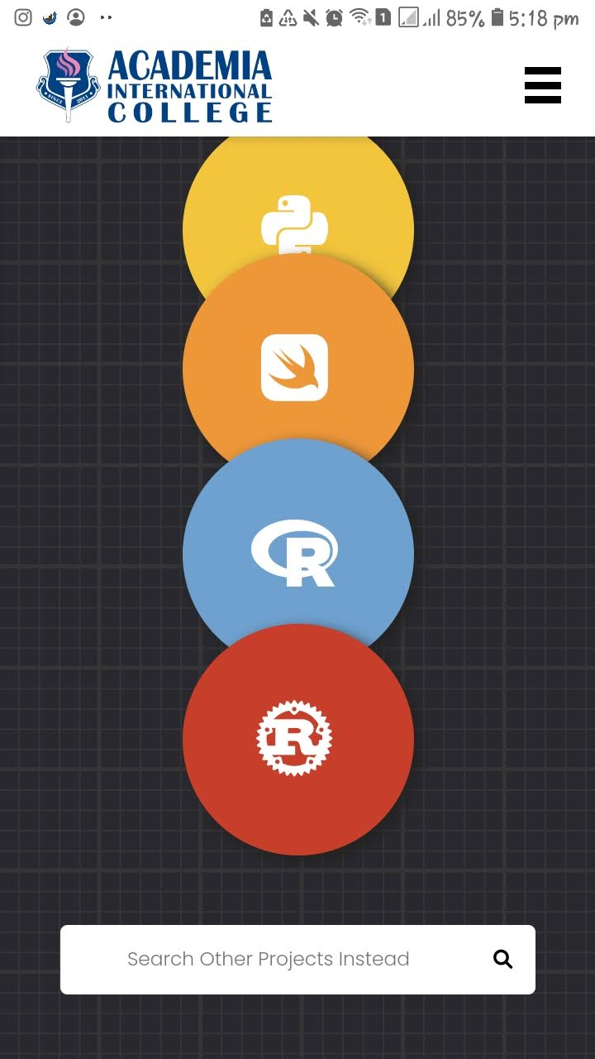
Mobile Responsive
68.1% of all website visits in 2020 came from mobile devices

Slide 9
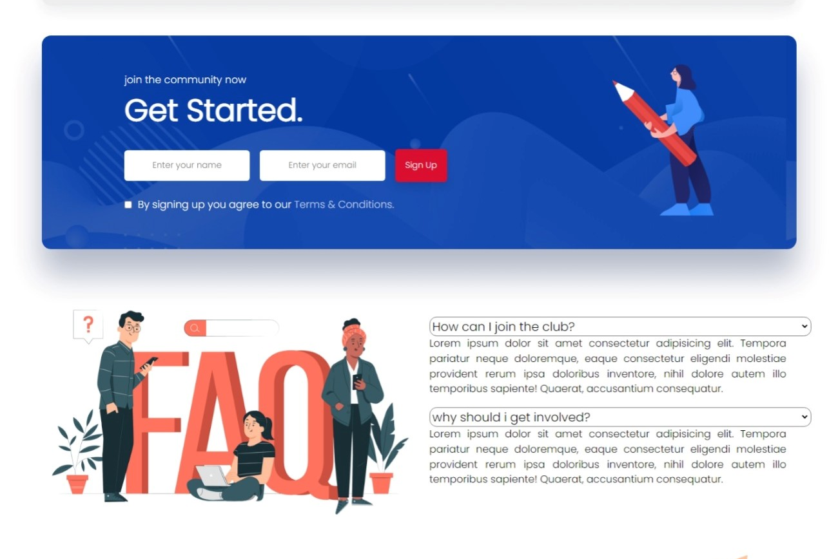
Desktop Responsive
Desktops drove 28.9% of visits

Slide 10
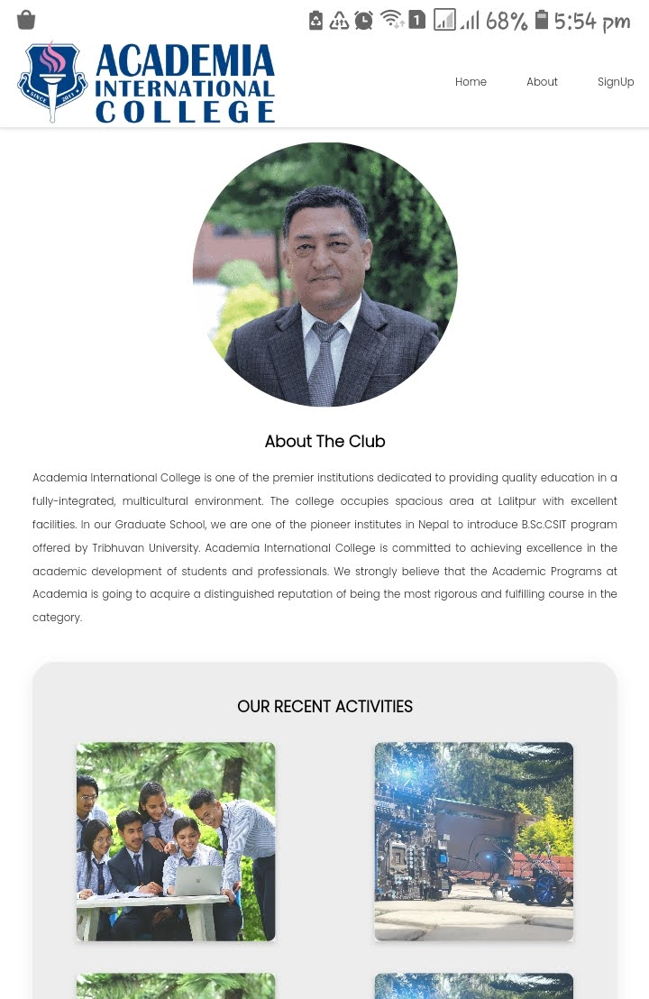
Tablet Responsive
while 3.1% of visitors came from tablets

Slide 11
2.
Semantic HTML
For better defining different sections and layout

Slide 12
3.
Site Demo
Presentation of the website.

Slide 13
Any questions?
You can find me at
Github.com/krishmzn
krishmzn69@gmail.com

