Slide 1


Slide 2


Slide 3
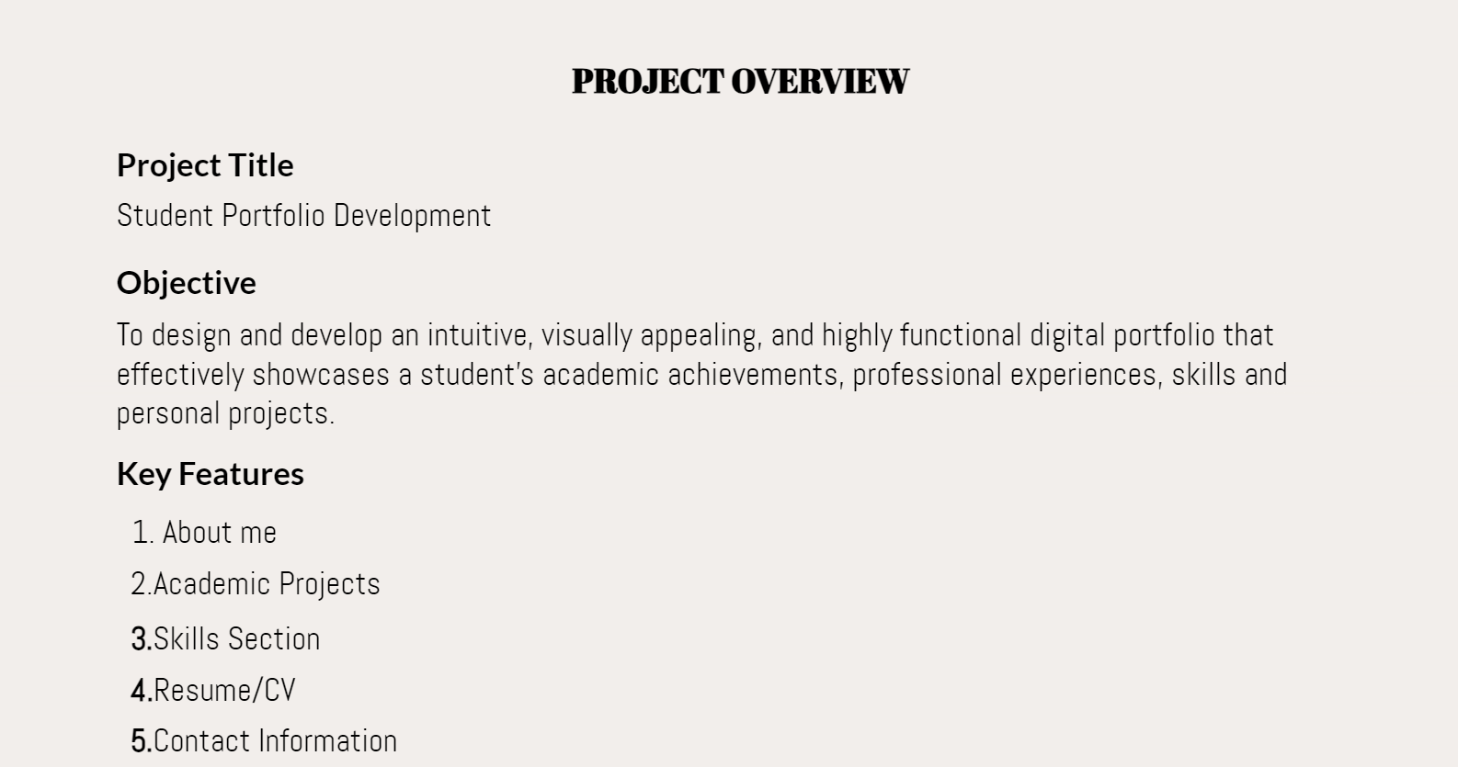

Slide 4
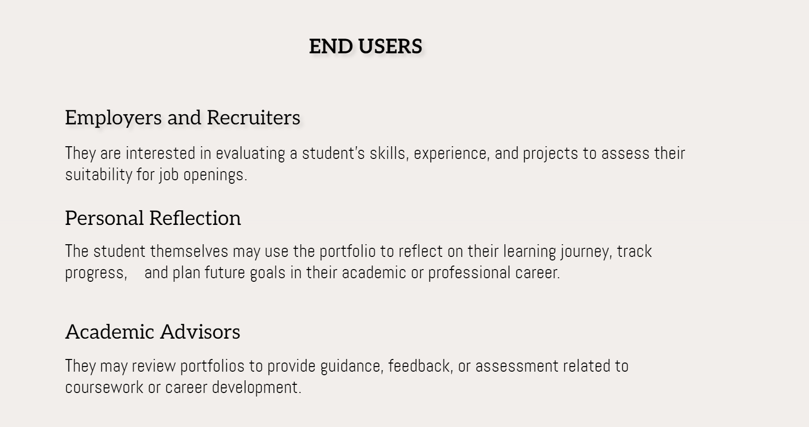

Slide 5
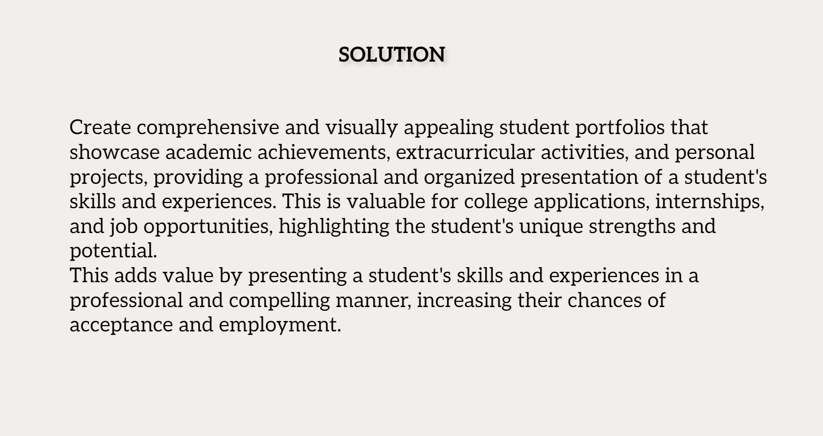

Slide 6
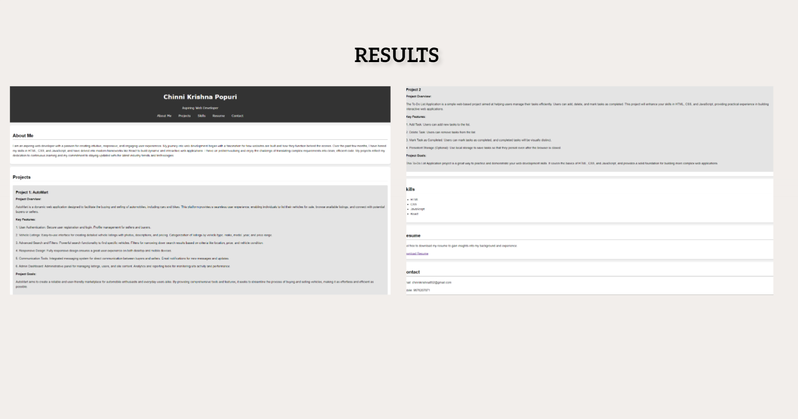
GITHUB https://github.com/krishn00000/Student-portfolio

Slide 7


