Slide 1
Task 1
Ethical Hacking
PortSwigger Lab Solutions : Screenshots
Name : Krishna Vijay Patil

Slide 2
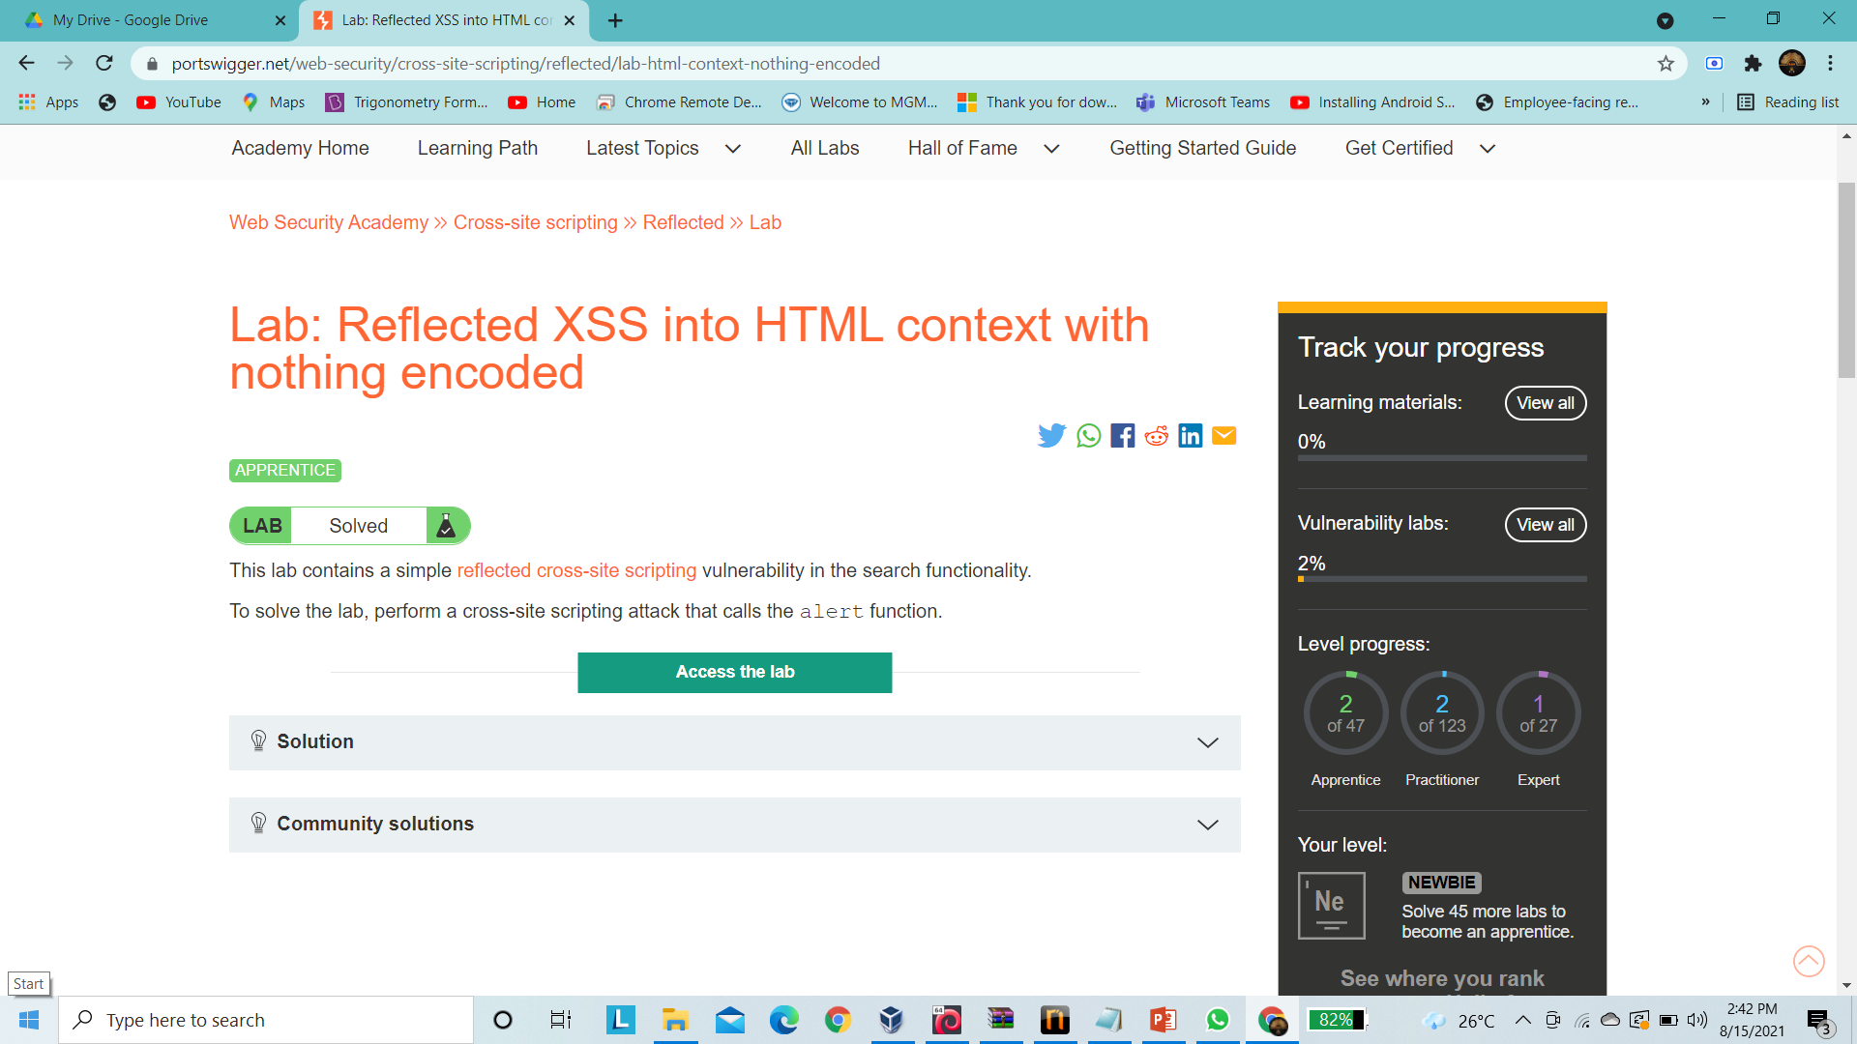

Slide 3
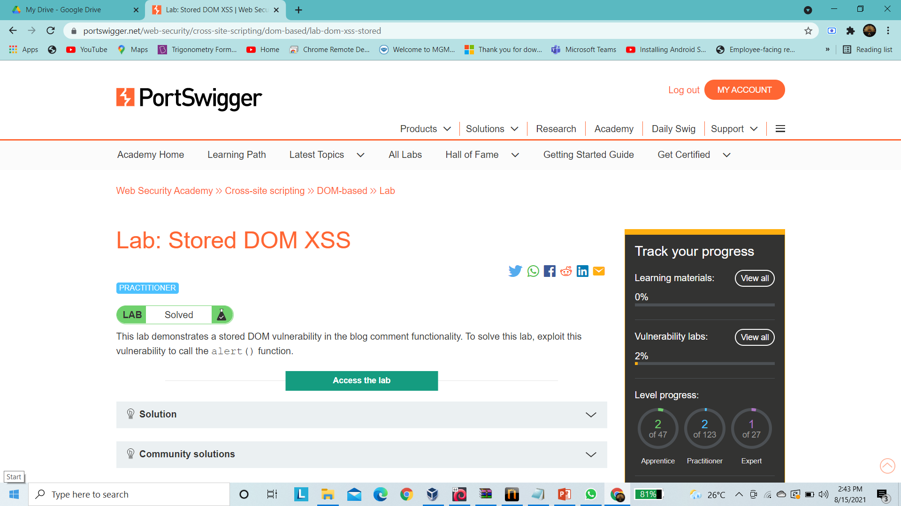

Slide 4
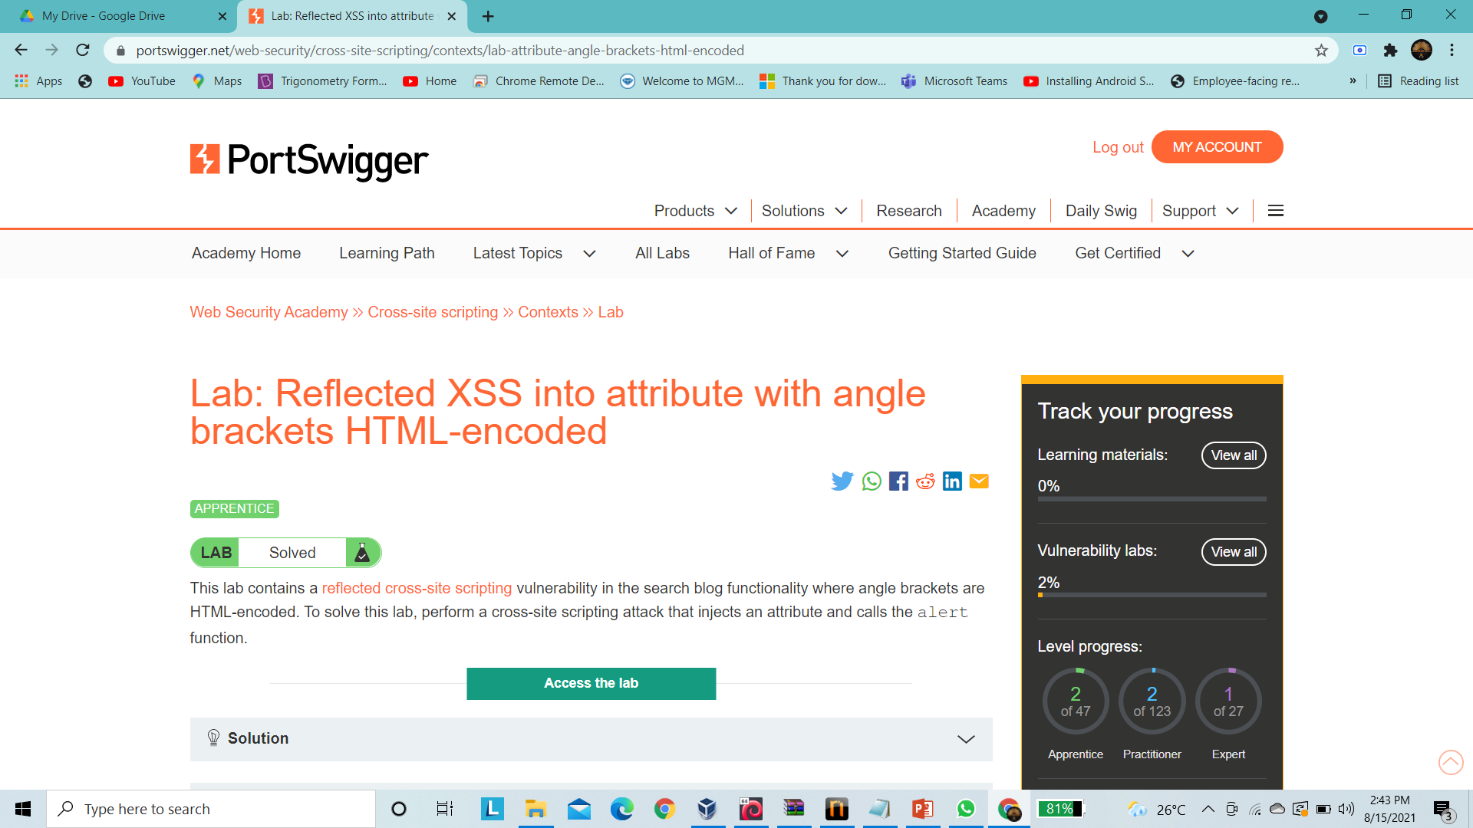

Slide 5
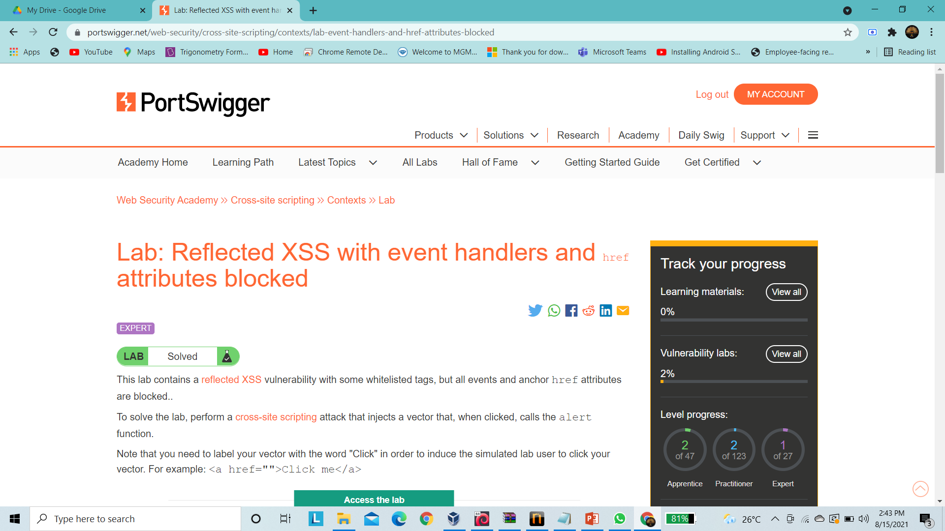

Slide 6
