Slide 1
Task 2
Ethical Hacking
Scanning : https://zero.webappsecurity.com/
Name : Krishna Vijay Patil

Slide 2
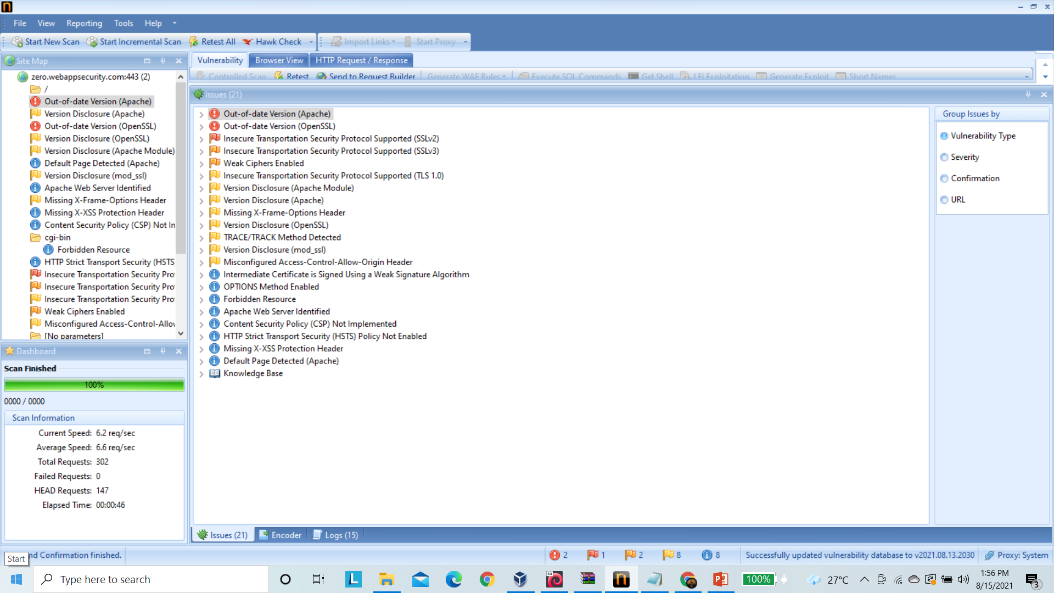
Vulnerabilities found in https://zero.webappsecurity.com/

Slide 3
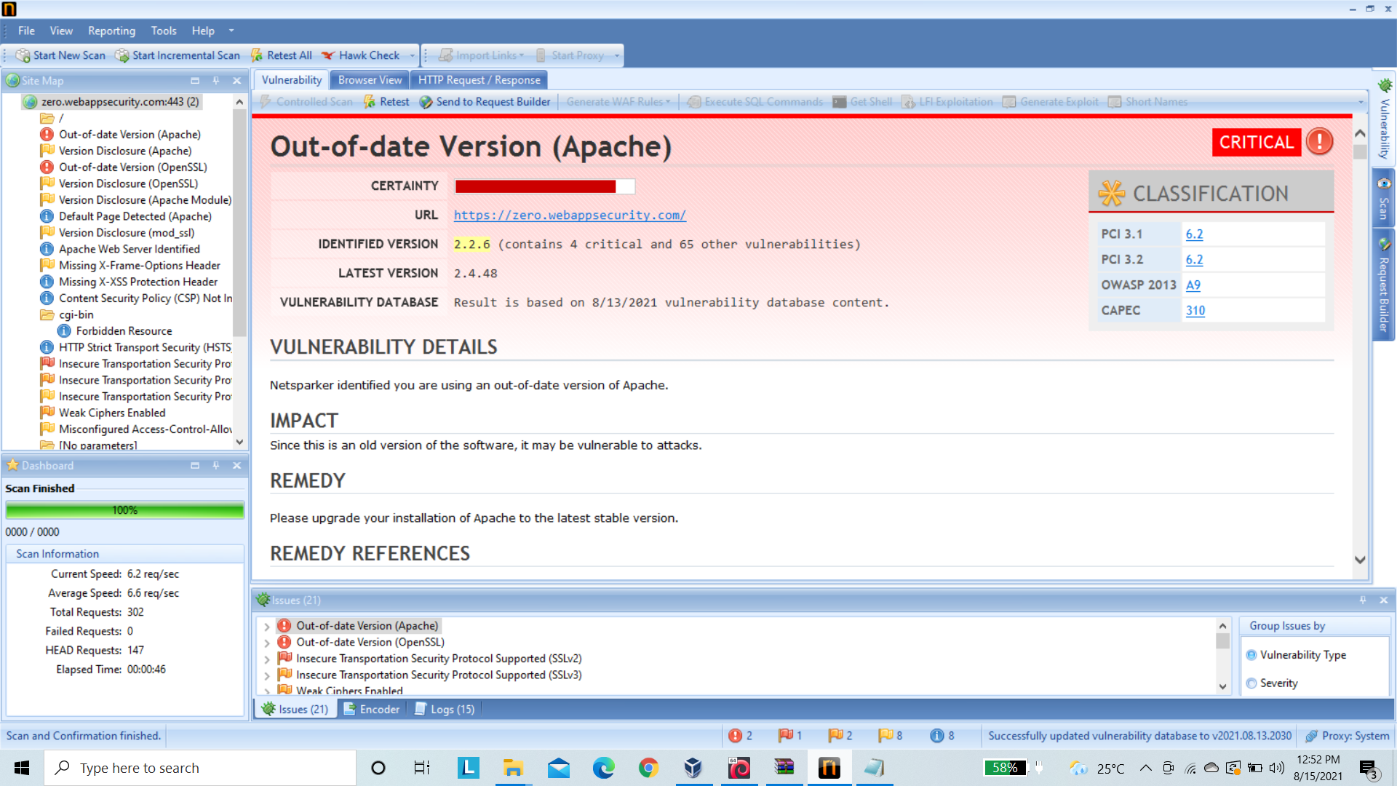
Report From Netsparker

Slide 4
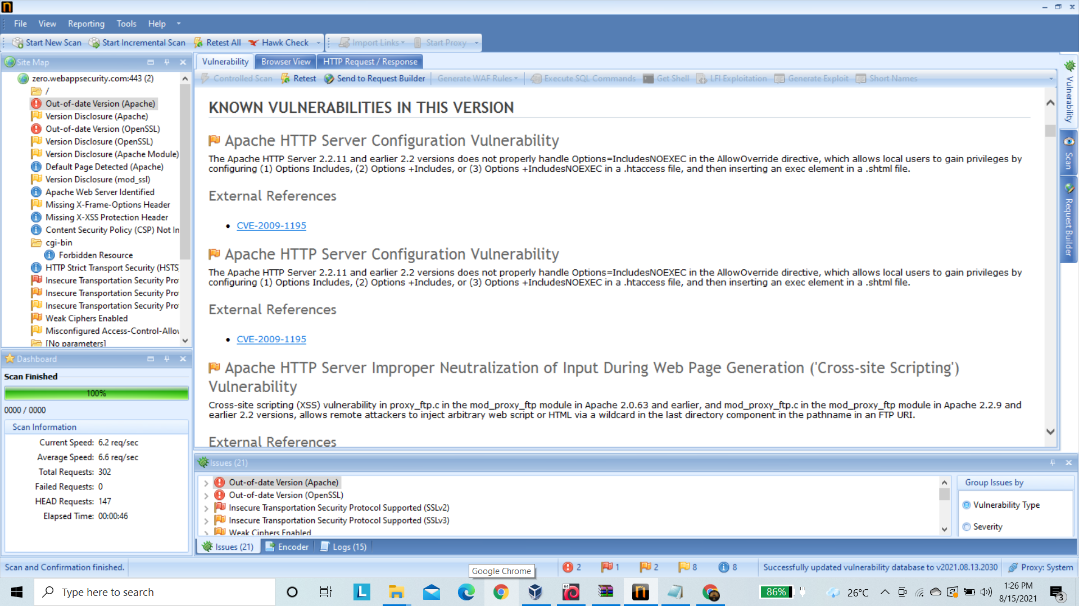
Known Vulnerabilities In Version

Slide 5
Report For Out-Of-Date (Vulnerability)
Title : Found Vulnerability Out-Of-Date Version (Apache) in https://zero.webappsecurity.com/
Domain : https://zero.webappsecurity.com/
Vulnerability : Out Of Date Version (Apache)
Severity : Critical
Testing Environment : Windows 10, Netsparker, wifi
Vulnerability Description : Netsparker identified you are using an out-of-date version of Apache.
-> Netsparker identified a version disclosure (Apache) in the target web server's HTTP response.
-> This information might help an attacker gain a greater understanding of the systems in use and potentially develop further attacks targeted at the specific version of Apache.

Slide 6
Impact : 1) As it is a old version of Apache software, it may be vulnerable to attacks and might harm your users.
2) An attacker might use the disclosed information to harvest specific security vulnerabilities for the version identified.
Remedy : Replace your old version(2.2.6) with latest version.
Please install/upgrade the stable latest version(2.4.48) of Apache.
Known vulnerabilties in this versions :
1) Apache HTTP Server Configuration Vulnerability
2) Apache HTTP Server Resource Management Errors Vulnerability
3) Apache HTTP Server Improper Neutralization of Input During Web Page Generation ('Cross-site Scripting') Vulnerability
4) Apache HTTP Server Cross-Site Request Forgery (CSRF) Vulnerability

Slide 7
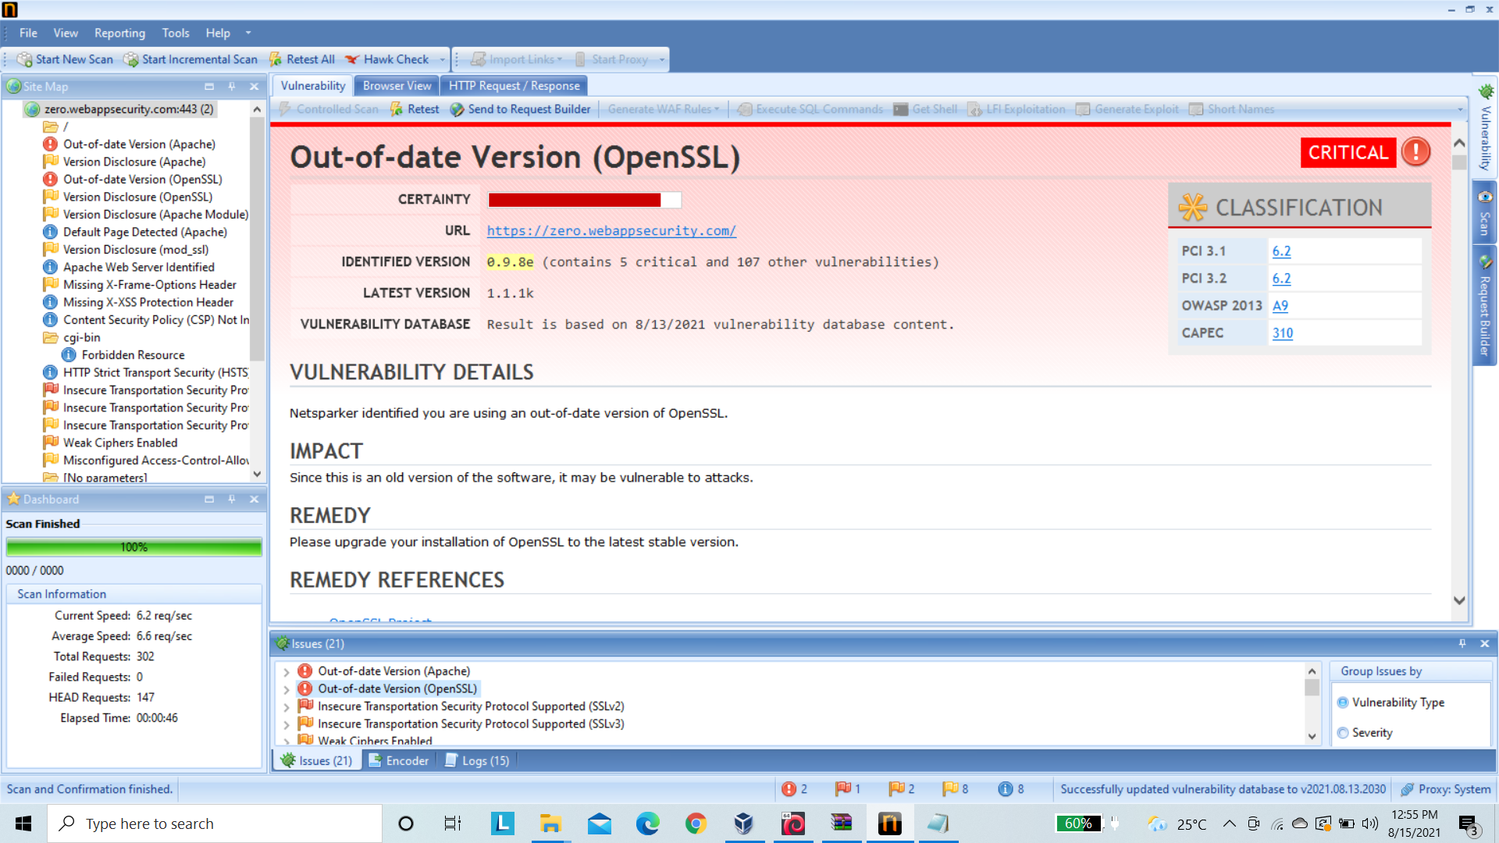
Second Vulnerability : Report From Netsparker

Slide 8
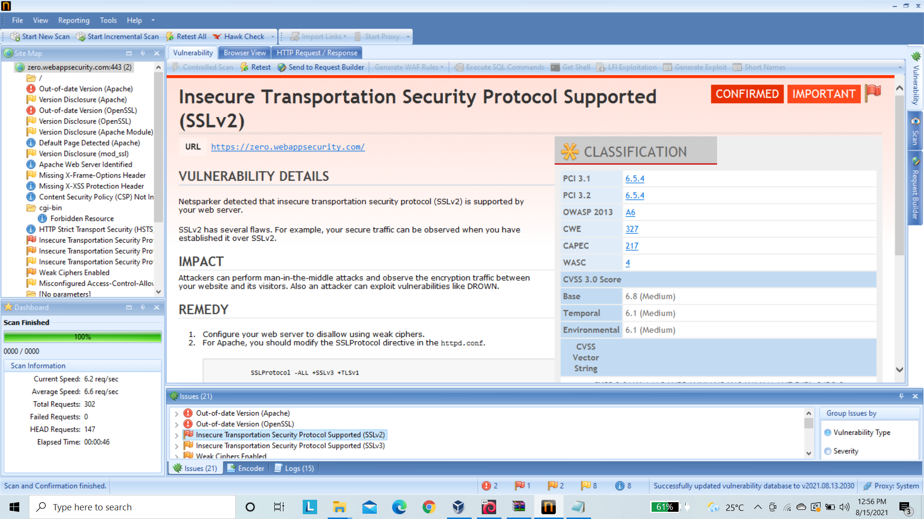
Third Vulnerability : Report From Netsparker

