Slide 1
APPLIED MACHINE LEARNING FOR TEXT ANALYSIS (24ALT3101) AI-POWERED SMART INTERVIEW ASSESSMENT
Team Members:
V. Sai Dhanush — 2420030162 D. Krishna Chaitanya — 2420090077 U. Chaitanya Karthik — 2420090030
Under the Esteemed Guidance of:
Dr . KATANGURI SWANTHANA (CSE)

Slide 2
Contents
Problem Statement
Objectives
Literature Survey
Research Gap
Innovation & Creativity
Novelty
Feasibility
Project Plan
Proposed Architecture/Methodology
Datasets & Technology Stack
References

Slide 3
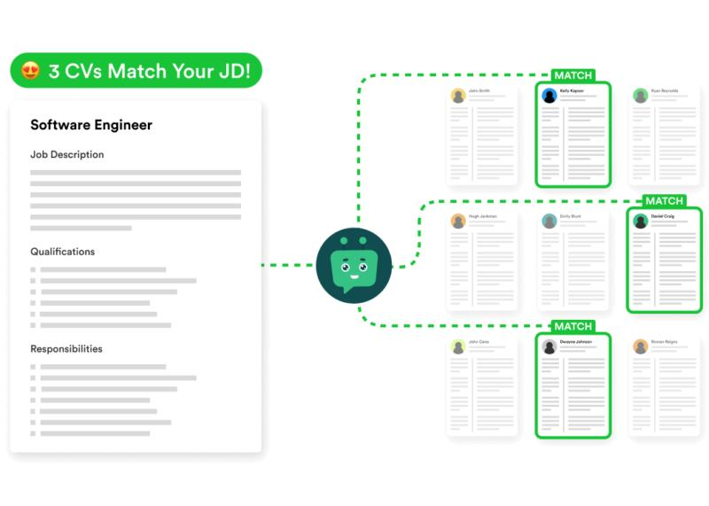
PROBLEM STATEMENT
① Time-Consuming Screening
Manually reviewing large numbers of resumes and matching them with job descriptions is slow and repetitive.
② Keyword-Based Screening
Traditional ATS systems may miss relevant candidates when skills are expressed using different terminology.
③ Limited Interview Insights
Traditional interviews do not provide consistent, measurable analysis of speech, communication and answer quality.
④ Disconnected Skill Assessment
Resume screening, interview evaluation and coding assessment are usually handled as separate stages.
This is consistent with the problems identified in your existing project material.

Slide 4
OBJECTIVES
Intelligent Resume Screening — Match candidate skills with job requirements using semantic analysis.
Adaptive AI Interview — Generate personalized questions based on the role, resume and responses.
Multimodal Assessment — Evaluate answer quality, communication and speech characteristics.
Technical Skill Validation — Assess practical coding ability through role-specific coding tasks.
Unified Decision Support — Combine assessment results into a clear candidate scorecard and feedback report.

Slide 5
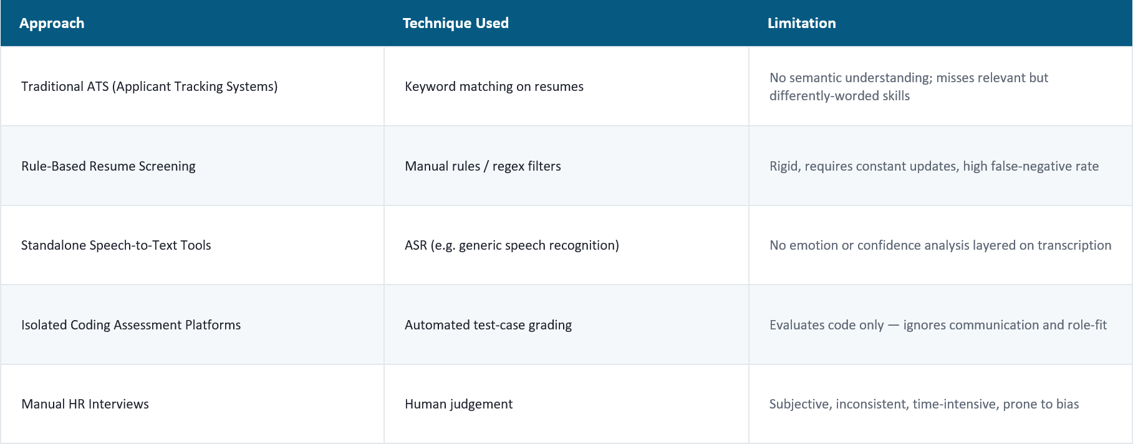
LITERATURE SURVEY

Slide 6




RESEARCH GAP
No Unified Pipeline
Limited Emotion-Aware Evaluation
Existing tools handle resume screening, speech analysis, and coding assessment separately — never as one integrated system.
Very few systems combine transcription with genuine emotional/confidence analysis of candidate speech.
Persistent Human Bias
No Multimodal Scoring
Manual scoring still dominates final decisions, reintroducing the subjectivity automation should remove.
Text, voice, and code are rarely fused into a single explainable candidate score.

Slide 7
INNOVATION & CREATIVITY
01 — AI-Driven Interview
Replaces fixed question lists with an AI-based interviewer.
Generates questions based on the job role and candidate profile.
02 — Semantic Answer Understanding
Evaluates the meaning and relevance of candidate answers.
Goes beyond simple keyword matching.
03 — Multimodal Assessment
Combines text, voice and coding assessment.
Provides a broader view of candidate performance.
04 — Automated Personalized Feedback
Automatically combines assessment results.
Identifies strengths, weaknesses and skill gaps.
Generates personalized improvement suggestions.
Key Idea:
AI does not only assess the candidate — it also helps the candidate improve.

Slide 8
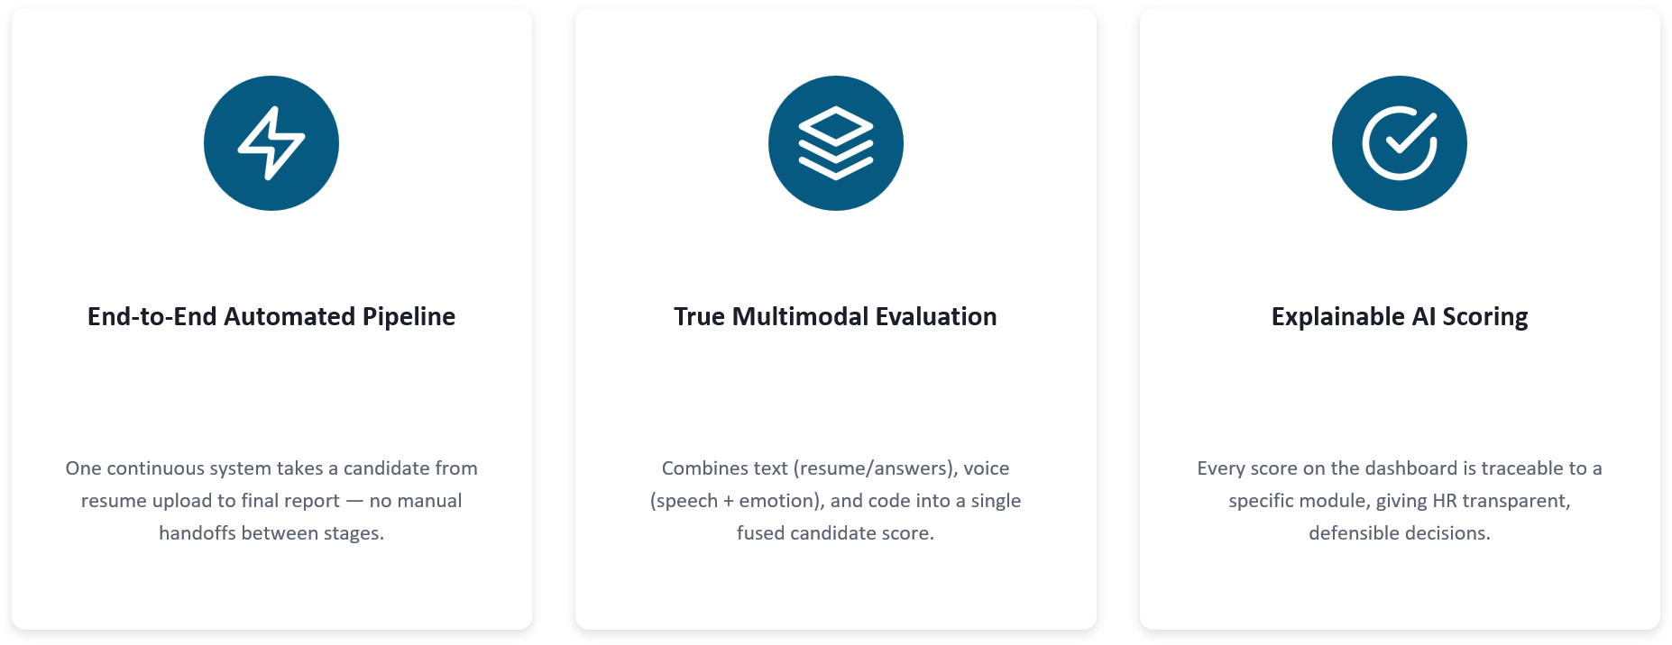
NOVALITY

Slide 9
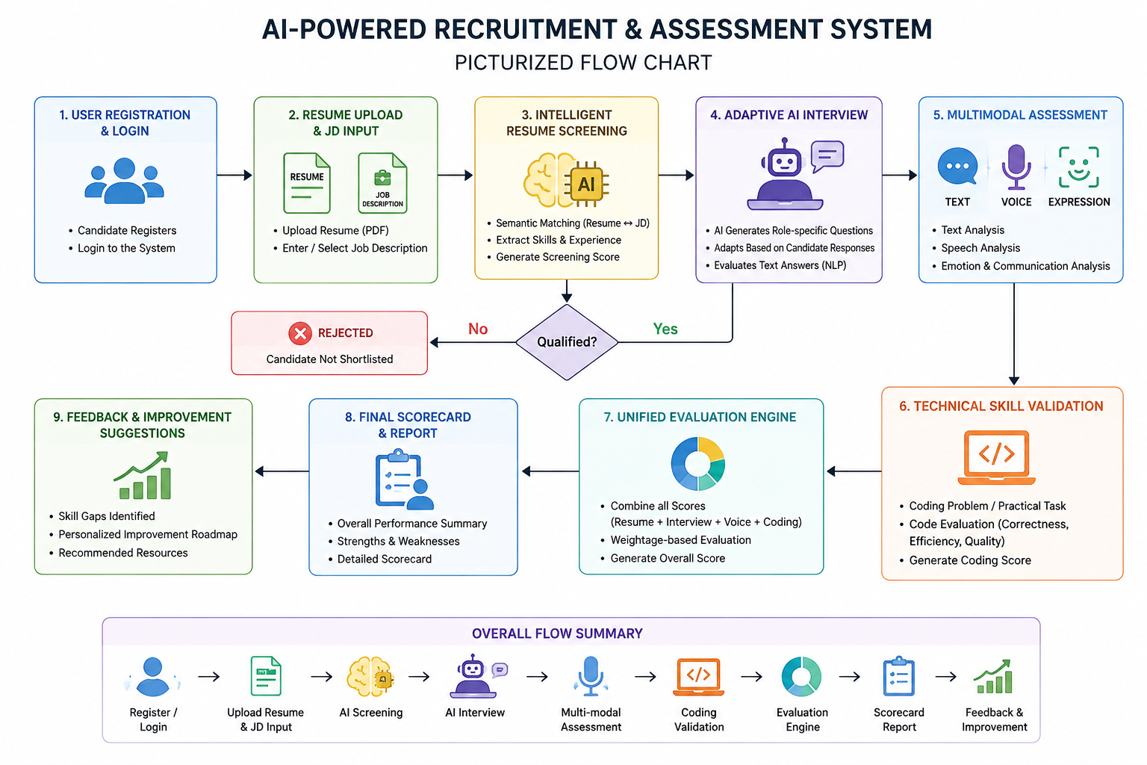
FEASIBILITY ANALYSIS

Slide 10
PROJECT PLAN
PHASE 1
PHASE 2
PHASE 3
PHASE 4
Data & Resume
Speech & Emotion
NLP & Coding
System & Testing
• Resume Parsing
• JD Processing
• Semantic Matching
• Dataset Cleaning
• Whisper Integration
• Speech → Text
• Emotion Analysis
• Audio Processing
• BERT Answer Scoring
• Semantic Matching
• Coding Assessment
• Test-Case Grading
• Dashboard Integration
• Final Report Gen.
• Full Pipeline Testing
• Deployment
MATCHING
VOICE
EVALUATION
DELIVERY
Evaluation Metrics
Resume Matching
Speech-to-Text
Answer Evaluation
Emotion Analysis
Coding Assessment
Similarity / Match Score
Transcription Accuracy
Semantic / Relevance Score
Classification Performance
Test Cases Passed / Accuracy

Slide 11
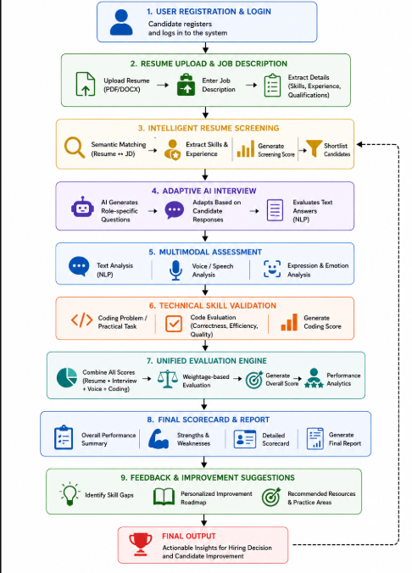
PROPOSED ARCHITECTURE/METHODOLOGY
Workflow:
1.User Registration & Login
2.Resume & Job Description Upload
3.Intelligent Resume Screening
4.Adaptive AI Interview
5.Speech-to-Text & Multimodal Analysis
6.Technical Coding Assessment
7.Final Hiring Recommendation / Improvement Roadmap

Slide 12
Thankyou

