Slide 1
Data Wrangling Final Project
Krishna Chaitanya Piratla

Slide 2
Project
Aim:
To provide a visual comparison of the sentiment trend for news articles related to a search word between any two months
Steps Required:
Get articles related data for the required months
Perform sentiment analysis on these sets of data
Provide a graphical comparison

Slide 3
Project
Tools Used:
Data Source: Used NYTimes API as it seemed to be a popular API among the news publishing houses
R

Slide 4
Project
Challenges faced:
NYTimes API returns only 10 results for each request. (Had to send the API request multiple times to collect sufficient data)
Calling the API multiple times results in an Error 429 (Too Many Requests)
Using the recommended ‘sleep time of 6 seconds’ didn’t help. (Putting a ‘sleep time of 20 seconds’ between each call still resulted in the 429 error sporadically)
Further this increased the execution time up to upwards of 8 minutes for each comparison.
Inconsistent structure of the returned json: output function fails sporadically for certain months.
Full text not returned in the json. Only the abstract and lead paragraph are the relevant attributes for our purpose.

Slide 5
Project
Decisions and Assumptions:
Chose ‘Abstract’ for the sentiment analysis
Assumption: Abstract captures the sentiment of the full article better than just the first paragraph of the article
Had to limit the results to ‘newest 100’ for every month to reduce the frequency of the 429 error.
Assumption: The sentiment trend in a month would be adequately captured by the latest 100 articles in a month

Slide 6
The final implementation...

Slide 7
Some interesting observations...

Slide 8
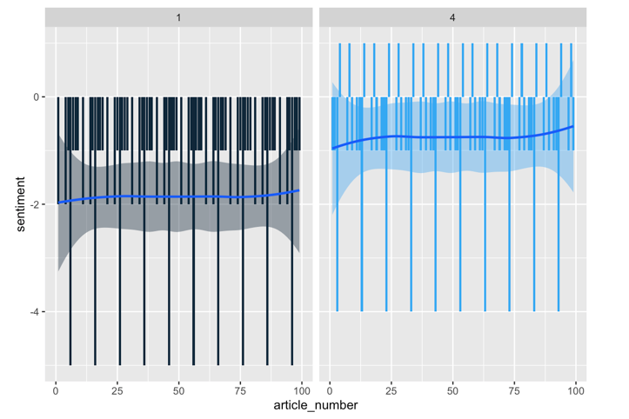
‘Vaccine’ – Jan 2021 vs April 2021

Slide 9
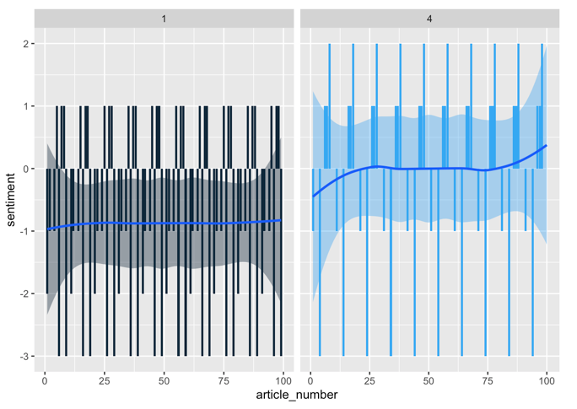
‘Trump’ – Jan 2021 vs April 2021

Slide 10
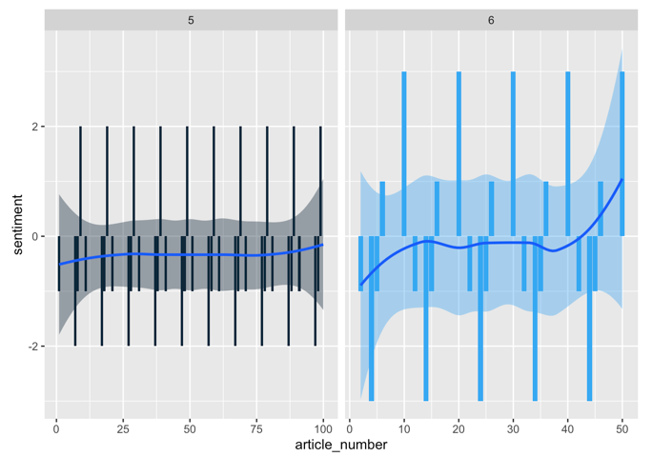
‘Thrones’ (read ‘Game of Thrones’ ☺) – May 2019 vs June 2016

Slide 11
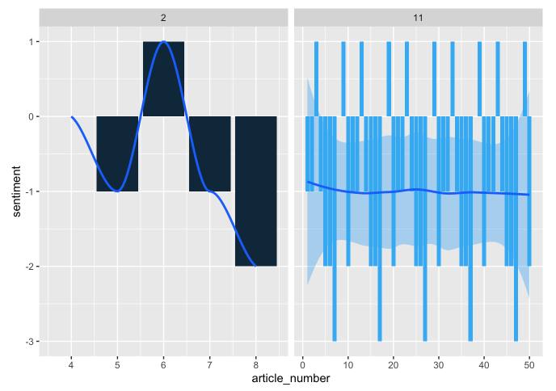
‘Spacey’ (read ‘Kevin Spacey’) – May 2019 vs June 2016

Slide 12
Thank you!

