Slide 1


Gold Price Prediction
RNS INSTITUTE OF TECHNOLOGY
BENGALURU - 98
DEPARTMENT OF INFORMATION SCIENCE & ENGINEERING
Presentation on Internship
KRISHNA DAGA
USN: 1RN17IS047
New Age Solutions Technologies
Internal Guide
Ms. Kavya TC
Asst. Prof, Dept of ISE, RNSIT
External Guide
Mr. Aman Upadhyay
NASTECH

Slide 2
AGENDA
Abstract
About the Company
Introduction
Literature Survey
Requirements
System Design
Implementation
Testing
Conclusion and Future Enhancements
References
Q & A

Slide 3
ABSTRACT
Gold has always occupied a predominant place in country's economies, and among populations.
Owing to its characteristics, it is used as a hedging tool or can act as a safe haven in turmoil conditions.
The aim of this project titled Gold Price Prediction is to explore the relationship of gold price with various explanatory variables that tend to be considered as indicators of financial and geopolitical crises.
On the other hand, the study investigates the possibility of predicting gold price based on these variables.

Slide 4
About the Company
NASTECH is specialized in creating effective solutions through proper analysis, consultation, design and testing.
They are able to successfully address the challenges that stand in our way.
Their goal is to keep their clients on the leading edge of information transfer technologies, adding significant value to their business.
They accomplish this by creating a long-term relationship with each partner by combining creative and cost-effective solutions.

Slide 5
INTRODUCTION
The Goal of this project is to accurately predict the future adjusted closing price of Gold ETF across a given period of time in the future. For this project I have used different Machine Learning Algorithms and ensemble the solution model by combining top three performing models to predict the Adjusted closing price of the GLD ETF using a dataset of past prices system.
The challenge of this project is to accurately predict the future adjusted closing price of Gold ETF across a given period of time in the future. The problem is a regression problem, because the output value which is the adjusted closing price in this project is continuous value. Various studies have been conducted by researchers to forecast gold rates using different machine learning algorithms with varying degrees of success but until recently the ability to build these models has been restricted to academics. Now with libraries like Scikit-learn anyone can build powerful predictive models. For this project I will use different linear, ensemble and boosting machine learning models to predict the adjusted closing price of the SPDR Gold Trust (GLD) ETF using a dataset of past prices from 18/11/2004 to 01/01/2019.

Slide 6
LITERATURE SURVEY
Real time Forecasting [1]: Little is known about the nature of the revisions of gold price data or how these revisions and delays in data availability affect out-of-sample forecast accuracy.
ARIMA Method [2-4]: Forecasts could be made only for immediate future and not for a longer time period. Requires a long time series and it doesn’t guarantee perfect forecasting.
Artificial Neural Network (ANN) [5]: Need a long training time and too many parameters to setup
Genetic Algorithm – BP Neural Network (GABP) [7]: This technique was able to optimizes the connection weights of multilayer feedforward neural network (BP neural network), so as to expand the searching space of the neural network and improve the learning efficiency and precision.
Multiple Linear Regression (MLR) [8]: Accuracy is dependent on other major factors that influence the future gold prices. They use stepwise procedures to solve the problem of multicollinearity by reducing the total number of independent variable and PraisWinsten to solve the problem of correlated error terms

Slide 7
LITERATURE SURVEY
Dynamic Model Averaging (DMA) [9]: To obtain better predictive power, we must allow model evolution and parameter evolution as supported by DMA and DMS with DMS having the better result. Factor-Augmented Vector Autoregressive (FA VAR) [7] Only the result of the first year are accurate to some extent.
Wavelet Neural Network - Artificial Bee Colony (WNN-ABC) [10]: Generalization ability of WNN is too weak to forecast the long-term gold price as macroeconomics indexes that affect the price of gold vary significantly from time to time.
Rolling and Recursive Neural Network [11]: This predictive capacity is relevant in which it can be used as one of the alternatives to technical analysis and conventional time series forecast such as ARIMA.
Particle Swarm Optimization (PSO) [12]: Able to cope with the fluctuations of gold price time series and yields good prediction accuracy

Slide 8
LITERATURE SURVEY
Empirical Mode Decomposition (EMD) [13]: Able to deal with non-linear and nonstationary data. Performs better than the more mature traditional wavelet transform (WT) methods Ensemble models [31] Give better accuracy than various neural network approaches. Comparison of 17 forecast method [32] Only 9 out of 17 are able to provide a forecast which outperforms random walk Exponential smoothing (ETS) performs the best with ARIMA and trend and seasonal components (TBATS) next in line.

Slide 9
Hardware Requirements
Hardware : Processor Intel dual core and above
Operating System : Windows 7, Windows 8, Windows 10
Internet Connection : Existing telephone lines, Data card or Any Wireless Network
Browser: Google chrome latest version, IExplorer 10;
Performance: The turn-around time of the project will be medium

Slide 10
Software Requirements
OS: Windows 7 with SP1; Recommended: Windows 10
CPU: Intel or AMD processor with 64-bit support; Recommended: 2.8 GHz or faster processor
GPU: nVidia GeForce GTX 1050 or equivalent; Recommended: nVidia GeForce GTX 1660 or Quadro T1000
Disk Storage: 4 GB of free disk space
Monitor Resolution: 1280x800; Recommended: 1920x1080
Internet: Internet connection required for software activation

Slide 11
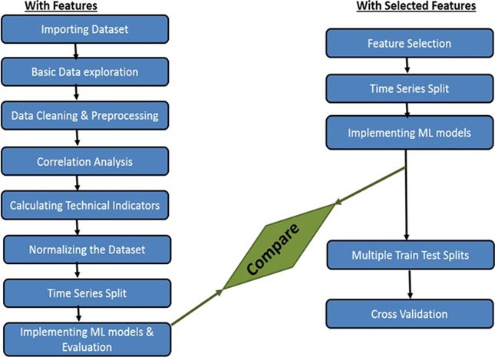
System Design
An architecture diagram describes what you're building, how stakeholders interact with it, and where constraints lie.
Architecture diagram for the given project is shown below:

Slide 12
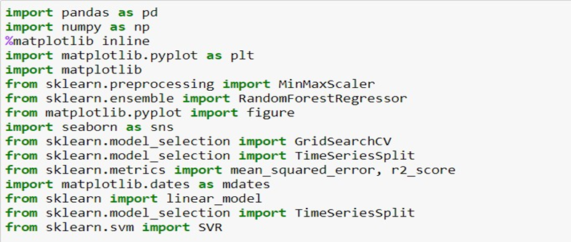
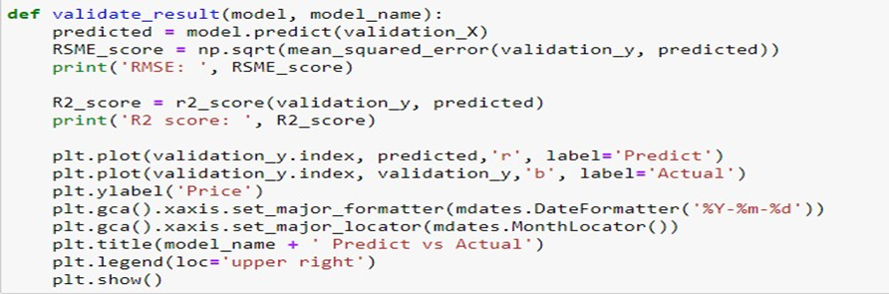
Implementation / Coding
Importing Libraries
Result Validation

Slide 13
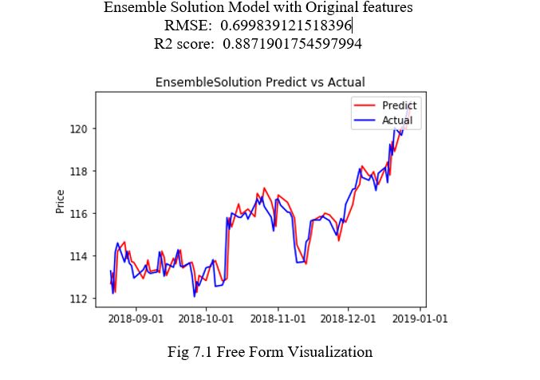
CONCLUSIONS
Free Form Visualization
In order to conclude my report, I would choose an ensemble model with original feature visualization. As I was very satisfied by seeing how close I have predicted the price with the actual price and it has the lowest Root Mean Square error of 0.699.

Slide 14
Future Enhancements
There are still many technical indicators and feature variables that we have not included in our project, maybe there are some other indicators that we haven’t explored that would perform better.
There are lots of Machine Learning algorithms that we haven’t tried and maybe neural networks or LSTM would perform better than our solution.
And last but not least we have used data of around 14 years if we would increase the data, the performance of our solution models may be improved.

Slide 15
REFERENCES
[1] Pierdzioch, C., M. Risse, and S. Rohloff, On the eficiency of the gold market : Results of a real-time forecasting apprroach. International Review of Financial Analysis, 2014. 32: p. 95-108.
[2] Khan, M.M.A., Forecasting of Gold Prices (Box Jenkins Approach). International Journal of Emerging Technology and Advanced Engineering, 2013. 3(3): p. 662-670.
[3] G, D.M., G. Nambiar, and R. M, Forecasting Price And Analysing Factors Influencing The Price Of Gold Using Arima Model And Multiple Regression Analysis International Journal of Research in Management, Economics and Commerce, 2012. 2(11): p. 548-563.
[4] Abdullah, M.L., ARIMA Model for Gold Bullion Coin Selling Prices Forecasting International Journal of Advances in Applied Sciences 2012. 1(4): p. 153- 158.
[5] Mombeini, H. and A. Yazdani-Chamzini, Modeling Gold Price via Artificial Neural Network Journal of Economics, Business and Management, 2015. 3(7): p. 699-703.
[6] Hussein, S.F.M., M.B.N. Shah, M.R.A. Jalal, and S.S. Abdullah, Gold price prediction using radial basis function neural network, in 4th International Conference on Modeling, Simulation and Applied Optimization (ICMSAO). 2011: Kuala Lumpur.
[7] Liu, C., Price Forecast for Gold Futures Based on GA-BP Neural Network, in International Conferenceon Management and Service Science. 2009: Wuhan. p. 1-4.
[8] Ismail, Z., A. Yahya, and A. Shabri, Forecasting Gold Prices Using Multiple Linear Regression Method. American Journal of Applied Sciences, 2009. 6(8): p. 1509-1514.
[9] Aye, G., R. Gupta, S. Hammoudeh, and W.J. Kim, Forecasting the Price of Gold Using Dynamic Model Averaging. International Review of Financial Analysis, 2015.
[10] Li, B., Research on WNN Modeling for Gold Price Forecasting Based on Improved Artificial Bee Colony Algorithm. Computational Intelligence and Neuroscience, 2014. 2014.
[11] Parisi, A., F. Parisi, and D. Díaz, Forecasting gold price changes: Rolling and recursive neural network models. Journal of Multinational Financial Management, 2008. 18(5): p. 477-487.
[12] Hadavandi, E., A. Ghanbari, and S. AbbasianNaghneh, Developing a Time Series Model Based On Particle Swarm Optimization for Gold Price Forecasting, in 2010 Third International Conference on Business Intelligence and Financial Engineering. 2010, IEEE CONFERENCE PUBLICATIONS. p. 337-340.
[13] Jian-hui, Y. and D. Wei, Prediction of Gold Price Based on WT-SVR and EMD-SVR Model, in International Conference on Computational Intelligence and Security (CIS). 2012: Guangzhou.

Slide 16
Question and Answer

Slide 17
THANK YOU

